Slide 1
CS 372 Lecture #21
Reliable data transfer with TCP
  network congestion
    causes
    costs
    control
Note: Many of the lecture slides are based on presentations that accompany
Computer Networking: A Top Down Approach, 6th edition,
by Jim Kurose & Keith Ross, Addison-Wesley, 2013.

Slide 2
Network Congestion
As utilization approaches maximum, delay increases
  Excessive traffic is called congestion
Cause: end systems are sending too much data too fast for network/routers to handle
  Why do we blame the routers?
Costs: delayed/dropped packets (buffer overflow at routers)
  long delays from queuing in router buffers
    causing queues to fill up … which causes incoming packets to be dropped
  dropped packets
    everything used for those packets … wasted
  slow ACKs cause unnecessary retransmission
    waste of resources … and retransmission compounds the problem
  eventual congestion collapse
Affected by, but different from flow control
On top-10 list of important networking research topics

Slide 3
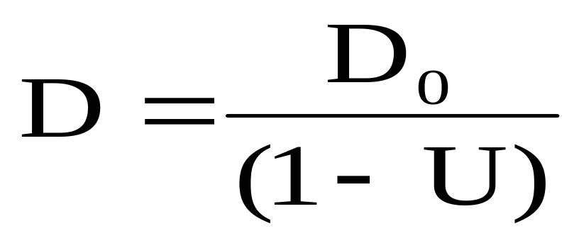
Relationship: delay ↔ utilization
D is the effective delay
  Also called expected delay
U is the network utilization
  range is [0 … 1]
D₀ is the delay when the network has no other traffic (throughput is at its maximum )
  i.e., the delay when U is zero.

Slide 4
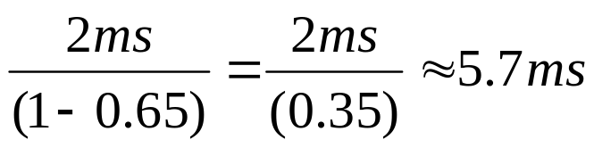
Relationship: delay ↔ utilization
Example: Suppose that “no-traffic delay” D₀ is 2 ms, and the network is used at 65% of capacity. (utilization U = 0.65)
The effective delay is approximately
When utilization is 0 (no traffic), D = D₀.
When utilization is 1 (100% of capacity), congestion collapse is guaranteed.

Slide 5
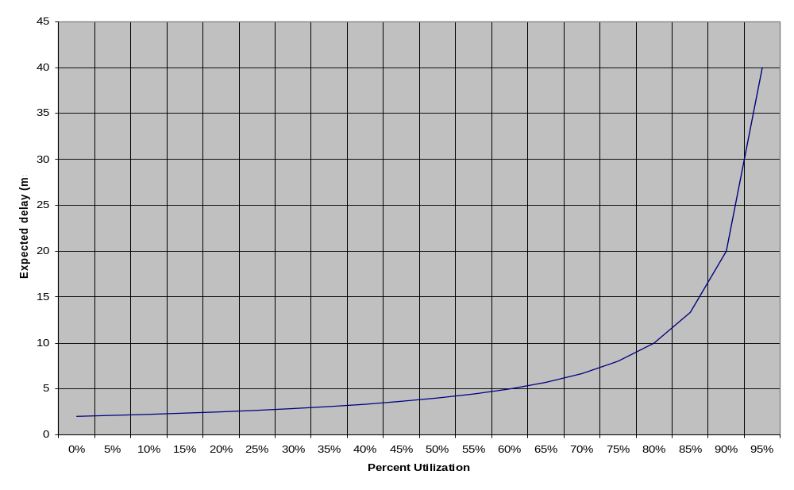
Graphing the problem
Plot the effective delay for network utilization between 0% and 95%.
Where is the "knee" in the graph?
Note: Let D₀ = 2. The graph will look the same for any constant D₀ > 0.
Performance degrades rapidly as utilization exceeds 85%

Slide 6
Congestion Control
Goals:
  Optimize utilization
  Handle causes of network congestion
    Retransmission handles only the symptoms
  Detect congestion
  Avoid congestion (when possible)
  React to congestion (when necessary)

Slide 7
Optimizing utilization
Smarter timeouts
Better sliding-window size management
More efficient acknowledgements
Others?
  Discussion topic

Slide 8
Smarter timeouts:
TCP Round Trip Time (RTT) and Timeout
TCP count-down timer
RTT:
  can only be estimated
  varies from one packet to another
Timer too short:
  premature timeout
  unnecessary retransmissions
Timer too long:
  slow reaction to segment loss
“just right” timer can improve efficiency
Estimating the RTT:
SampleRTT: measured time from end of segment transmission until receipt of ACK
  ignore retransmissions
  can use handshake timing (plus)
  however, SampleRTT can vary widely
To get “smoother” estimated RTT:
  average several recent measurements, not just current SampleRTT

Slide 9

TCP Round Trip Time and Timeout
EstimatedRTT_{n} = (1- α)*EstimatedRTT_{n-1} + α*SampleRTT
Exponential Weighted Moving Average (EWMA)
influence of past sample decreases exponentially fast
typical value: α = 0.125
Start EstimtedRTT at first SampleRTT

Slide 10
TCP Round Trip Time and Timeout
Setting the timeout
Best to add a “safety margin” to EstimtedRTT
  large variation in EstimatedRTT -> larger safety margin
see how much SampleRTT deviates from EstimatedRTT:
DevRTT_{n} = (1-β)*DevRTT_{n-1} + β*(SampleRTT-EstimatedRTT)
(typically, β = 0.25)
Then set timeout interval:
TimeoutInterval = EstimatedRTT + 4*DevRTT

Slide 11
Summary Lecture #21
Definitions
  utilization
  congestion, congestion collapse
  effective delay
Setting timeouts
  SampleRTT, EstimatedRTT, DevRTT

