Slide 1
CS 372 Lecture #26
The Internet Protocol
  IP datagram format
  IP addressing
Note: Many of the lecture slides are based on presentations that accompany
Computer Networking: A Top Down Approach, 6th edition,
by Jim Kurose & Keith Ross, Addison-Wesley, 2013.

Slide 2
The Internet Protocol (IP)
IP is the internet’s network layer protocol
  alternatives: few, obscure
IP accepts TCP / UDP segments, destination address
  Encapsulates segment, source address, destination address, other info … into datagram
  Provides “best-effort”, host-to-host delivery

Slide 3
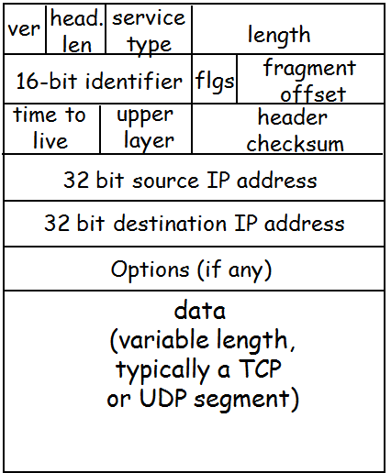
IP datagram header
VER - version of IP (currently 4)
HEAD. LEN - header length (number of 32-bit “lines”)
SERVICE TYPE - sender's preference for low latency, high reliability
LENGTH - total bytes in datagram (including header)
IDENT, FLAGS, FRAG OFFSET - used with fragmentation (later)
TTL - time to live
  decremented in each router
  datagram discarded when TTL = 0
UPPER LAYER - type of protocol carried in datagram
  e.g., TCP, UDP
HEADER CHECKSUM - 1s-complement of sum
SOURCE IP ADDRESS - IP address of original source
DESTINATION IP ADDRESS - IP address of ultimate destination
OPTIONS – added in multiples of 32 bits (padded if necessary)
  e.g., record route, timestamp
  If no options, HEAD LEN = 5
DATA – TCP or UDP segment (includes segment header)
Datagram overhead
At least:
20 bytes of TCP/UDP
20 bytes of IP
= 40 bytes for every packet

Slide 4
Datagram forwarding
IP header contains all information needed to deliver datagram to destination computer
  Destination address
  Source address
  Identifier (session, sequence)
  Other delivery information
Each router examines header of each datagram and forwards datagram along path to destination

Slide 5
Internet addresses
A key aspect of a virtual network is a single, uniform address format
  Address format must be independent of any particular hardware address format
    Can't use hardware addresses because different technologies have different address formats
    Can't use addresses that are local to a network because multiple networks might use the same addresses internally

Slide 6
IP addressing (version 4)
In IPv4, each host is assigned a 32-bit number, called the IP address or Internet address
  Unique across entire Internet
  Number of unique IP addresses possible:
    2³² = 4,294,967,296
    some are reserved
IP version 6 (later)

Slide 7
IP address notation
  Common form is “dotted decimal”
  e.g.: 128.253.40.28
  range is [0.0.0.0 … 255.255.255.255]
    each “component” range is [0 … 255]
IP address is just a 32-bit number
  It’s the same internally, regardless of its external representation
  Dotted-decimal is only for convenience
  In hexadecimal form, the range is [00000000 … FFFFFFFF]
    divides naturally into 4 bytes (1 byte = 2 hex digits)
    e.g.: 128.253.40.28 (D-D) = 80 FD 28 1C (hex)
    each group represents one byte [00 … FF]
  In binary form, the range is [00000000000000000000000000000000 … 11111111111111111111111111111111]
    e.g.: 128.253.40.28 (D-D) = 10000000 11111101 00101000 00011100 (binary)
  In ordinary decimal form, the range is [0 … 4294967295]
    e.g.: 128.253.40.28 (D-D) = 2164074524 (decimal)

Slide 8
IP address hierarchy
Every ISP network in the internet is assigned network address that is unique within the internet
  includes indicator for number of bits used for network identification
  may be divided into sub-nets
  e.g., 128.193.35.0 / 24
Every host in a specific network is assigned a host number that is unique within that network
  e.g., 0.0.0.123
Host's IP address is the combination of the network address and host address
  e.g., 128.193.35.123 / 24
Address format enables efficient routing
  longest prefix matching

Slide 9
IP address assignment
ISP network addresses are unique
  assigned by ICANN:
    Internet Corporation for Assigned Names and Numbers
Host addresses may be duplicated on different networks
  assigned by network (admin or DHCP)
The combination of network address and host number is unique in the entire internet
  assignment of ISP network addresses must be coordinated globally
  assignment of sub-nets and host numbers can be managed locally

Slide 10
Summary Lecture #26
IP datagram
  format
  contents
IP addresses
  formats, conversions
    e.g., dotted-decimal to binary
  network address, host number

