Slide 1
CS 372 Lecture #1
Preliminaries

Slide 2
Networking is complicated
Enormous body of knowledge
Years of training
Specialization in
  Hardware
  Algorithms
  Applications
  Administration
  Protocols
  Encryption
  Security
  Wireless
  Etc.

Slide 3
Why is networking so complex?
Variety of hardware
Variety of software
Variety of protocols / standards
Terminology can be confusing
  Acronyms
  Industry re-defines or changes terminology from academia
  New terms invented continuously
Wireless / mobility issues add even more complexity

Slide 4
Why is networking so complex?
There are many standards that have to be able to communicate with each other
Outside the most isolated local-area network, every communication must include information about which standards are being used.

Slide 5
Handling the complexity
Concentrate on abstractions / concepts to unravel complexity
Use a few example technologies to illustrate the concepts
Use some hands-on lab experience to reinforce the concepts.

Slide 6
Networks and the Internet
Network: system for connecting computers using a single transmission technology
Internet: set of networks connected by routers that are configured to communicate among a variety of network transmission technologies
  A network of networks

Slide 7



















The Internet
PC
Millions of connected computing devices:
  hosts = end systems
  running network apps
mobile network
server
wireless
laptop
global ISP
smartphone
home
network
Communication links:
  fiber, copper, radio, satellite
  transmission rate = bandwidth
regional ISP
wireless
links
wired
links
Packet switches: forward packets (chunks of data)
  routers and switches
router
institutional
network

Slide 8
Networks and the Internet
We will analyze networks and the Internet in terms of
  Transmission technologies
    Data transmission - media, data encoding
    Packet transmission - data exchange over a network
  Communication protocols – reliable transmission
  Internetworking - universal service over a network of networks
  Internet applications - programs that use the Internet

Slide 9
In the real world …
Networks are an important part of everyday activities
  Business
  Home
  Government
  Education
Globally, the Internet is growing exponentially
  Started out as a research project with a few dozen university sites
    Support came from military
  Today, billions of computers and millions of networks world-wide

Slide 10
Growth of the internet
Ethernet made local networking possible
  Ethernet is a networking standard
  Several other standards exist
TCP/IP protocol made internetworking possible
  Transmission Control Protocol / Internet Protocol

Slide 11
Growth of the internet
Fundamental changes from centralized to distributed computing
Incorporated features for reliability, robustness, and scalability
  Multiple links
  Distributed routing / messaging
Exponential growth

Slide 12
Counting Internet Hosts
Aug 1981 213
…
Feb 1986 2,308
…
Jan 1991 376,000
…
Sep 2000 360,985,492
…
Sep 2006 ~1,093,000,000 16.7 %
Sep 2008 ~1,572,000,000 23.5 %
Sep 2010 1,966,514,816 28.7 %
Sep 2012 2,405,510,175 34.3 %
Source: Internet World Stats
Percent of Earth’s population

Slide 13
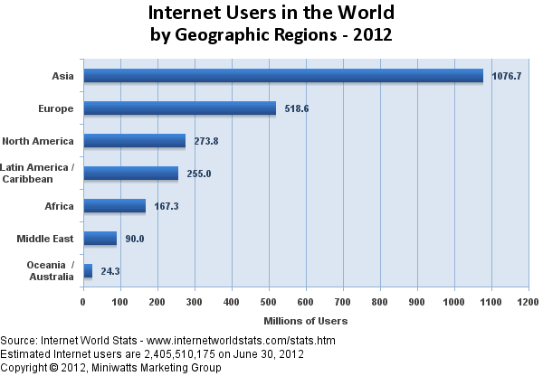

Slide 14
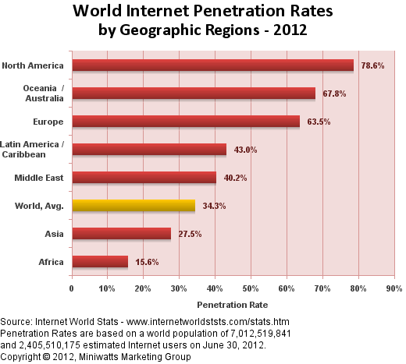

Slide 15
Economic impact
Phenomenal industry growth around:
  Computer hardware / software
  Networking hardware / software
  Network management / security
Companies must integrate planning, implementation, management and upgrades
Job creation

Slide 16
Network standards
Research started in 1967 to develop an Interface Message Processor (IMP)
Group started a repository for comments by other researchers … Request for Comments (RFC) - 1969
  http://www.rfc-editor.org grew from this. It is the place to find all of the latest adopted standards for networking.
  First “open-source” community
Internet Engineering Task Force (IETF)
  http://www.ietf.org
  Non-profit organization, produces technical documents that influence the way people design, use, and manage the Internet.

Slide 17
Preliminaries: Metrics (measurements)
Speed (distance/time) is measured in electronic units:
  K = 10³, M = 10⁶, G = 10⁹, etc.
  E.G., network speed of 8 Mbps means 8,000,000 bits per second
Size in bits, Bytes is measured in binary units
  Commonly used: K = 2¹⁰, M = 2²⁰, G = 2³⁰, etc.
  In this course, use: Ki = 2¹⁰, Mi = 2²⁰, Gi = 2³⁰
  E.G., disk size of 200 GiB means
  200 x 2³⁰ Bytes = 214,748,364,800 Bytes
  = 1,717,986,918,400 bits
Bytes and bits (abbreviations)
  Use lower-case b for bits
  Use upper-case B for Bytes
  Example: 1 Mib = 128 KiB

Slide 18
Etymology
Common variable names in RFC
  foo
  bar
  foobar
http://www.faqs.org/rfcs/rfc3092.html

Slide 19
Summary Lecture #1
Definitions:
  network, internet
Networking complexity
Growth of the Internet
  Economic impacts
RFC and IETF (networking standards)
Metrics (speed and size)

