Slide 1
CS 372 Lecture #36
MAC addresses
Address Resolution Protocol (ARP)
Note: Many of the lecture slides are based on presentations that accompany
Computer Networking: A Top Down Approach, 6th edition,
by Jim Kurose & Keith Ross, Addison-Wesley, 2013.

Slide 2
MAC Addresses
IP address is a virtual address:
  network-layer address
  gets datagram to destination IP subnet
MAC (Media Access Control) address is a physical address:
  function: get frame from one interface to another physically-connected interface (same network)
  NOTE: Every communication at the physical layer is sent to a MAC address!
MAC address allocation administered by IEEE
  manufacturer buys portion of MAC address space
    assures uniqueness
  48 bit MAC address (for most LANs)
    burned in NIC ROM by manufacturer
MAC addresses are portable
  can move LAN card from one LAN to another
  not true for IP address

Slide 3

MAC Addresses
Each NIC (adapter) on LAN has unique MAC address
1A-2F-BB-76-09-AD
Broadcast MAC address:
FF-FF-FF-FF-FF-FF
LAN
(wired or
wireless)
= NIC
71-65-F7-2B-08-53
58-23-D7-FA-20-B0
0C-C4-11-6F-E3-98

Slide 4
MAC Addresses
Given:
A knows B’s MAC address
A wants to send a frame to B
A encapsulates B’s MAC into the frame
A sends the frame into the medium
All nodes’ NICs check the frame
  Is this for me?
Only B accepts the frame
  All other nodes discard the frame
Node A
137.196.7.78
1A-2F-BB-76-09-AD
137.196.7.23
137.196.7.14
LAN
71-65-F7-2B-08-53
58-23-D7-FA-20-B0
0C-C4-11-6F-E3-98
137.196.7.88
Node B

Slide 5
ARP: Address Resolution Protocol
Given:
A knows B’s IP address
A does not know B’s MAC address
A wants to send a frame to B
ARP
Each IP node (host, router) on LAN has ARP table
ARP table: maps IP, MAC address for some LAN nodes
< IP address; MAC address; TTL>
  remove mapping after TTL (typically 20 min)
A looks up B’s MAC address in its ARP table
A encapsulates B’s MAC into the frame
A sends the frame into the medium
Only B accepts the frame
Node A
137.196.7.78
1A-2F-BB-76-09-AD
137.196.7.23
137.196.7.14
LAN
71-65-F7-2B-08-53
58-23-D7-FA-20-B0
0C-C4-11-6F-E3-98
137.196.7.88
Node B

Slide 6
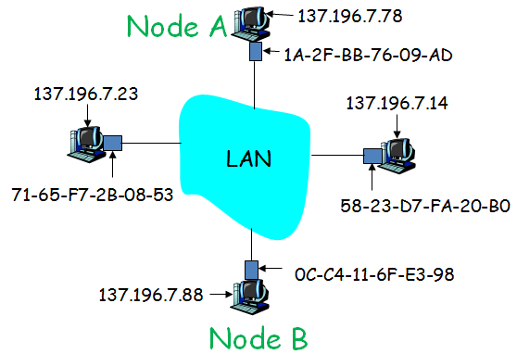
ARP: Case 1—Same LAN
Given:
A knows B’s IP address
B’s MAC address is not in A’s ARP table
A wants to send a frame to B
A caches IP-to-MAC address pair in its ARP table until information times out (TTL)
ARP is plug-and-play
  nodes create their ARP tables without intervention from network administrator
A broadcasts ARP query packet, containing B's IP address
  broadcast MAC address is FF-FF-FF-FF-FF-FF
  all machines on LAN receive ARP query
B receives ARP packet, replies to A with B's MAC address
A sends frame to B since it now knows its MAC address

Slide 7



ARP: Case 2—routing to another LAN
Given:
A knows B’s IP address
B is in a separate LAN, so MAC address is not in A’s ARP table
A wants to send a frame to B
A knows that B belongs to a different subnet by checking B’s IP address (222.222.222.222)
A also knows IP address of router R (111.111.111.110)
If necessary, A uses ARP to get R’s MAC address (E6-E9-00-17-BB-4B)
A creates frame with R's MAC address as destination
  frame contains A-to-B IP datagram
A’s NIC sends frame and R’s NIC receives it
R removes IP datagram from Ethernet frame, sees its destination is B
R uses ARP to get B’s MAC address (49-BD-D2-C7-56-2A)
R creates frame containing A-to-B IP datagram and sends it to B
B
A
= NIC
R
111.111.111.111
222.222.222.222
74-29-9C-E8-FF-55
49-BD-D2-C7-56-2A
222.222.222.220
1A-23-F9-CD-06-9B
111.111.111.112
111.111.111.110
222.222.222.221
CC-49-DE-D0-AB-7D
E6-E9-00-17-BB-4B
88-B2-2F-54-1A-0F

Slide 8
Summary Lecture #36
MAC addresses
  MAC broadcast
Address Resolution Protocol (ARP)
ARP scenarios
  creating/using ARP internal LAN tables
  routing to external IP address
Discussion question: Why can’t we just use IP addresses?

