Slide 1
CS 372 Lecture #30
IP Datagram Fragmentation
  Maximum Transmission Unit (MTU)
  Datagram re-assembly
Note: Many of the lecture slides are based on presentations that accompany
Computer Networking: A Top Down Approach, 6th edition,
by Jim Kurose & Keith Ross, Addison-Wesley, 2013.

Slide 2
Encapsulation across multiple hops
Whenever a datagram transits a physical network, it is encapsulated in a frame appropriate to that network.
  Hardware frame encapsulation/un-encapsulation at the link layer
  Hardware frame formats may differ
Each router in the path from the source to the destination:
  Un-encapsulates incoming datagram from frame (link layer)
  Processes datagram - determines next hop (network layer)
  Re-encapsulates datagram in outgoing frame (link layer)
Datagram itself is (almost!) unchanged
  may be fragmented

Slide 3
MTU
Every hardware technology specification includes the definition of the maximum size of the frame data area
  maximum transmission unit (MTU)
Any datagram encapsulated in a hardware frame must be smaller than the MTU for that hardware
Internet has variety of network technologies with different MTUs
  Source doesn’t know path MTU
    smallest MTU for complete route to destination
  Easy for source to limit IP datagram size to local MTU
    link layer must pass local MTU up to transport layer for TCP segments
  A downstream network might have smaller MTU than local network

Slide 4
Choosing datagram size
IP datagrams can be much larger than hardware MTUs
  IP TOTAL LENGTH: maximum is 65,535 bytes (including header)
Typical hardware frames:
  Ethernet: 1500 bytes
  Token ring: 2048 or 4096 bytes
One technique - limit datagram size to smallest MTU of any known network
  Problem: impedes use of newer technologies
IPv4 uses fragmentation

Slide 5
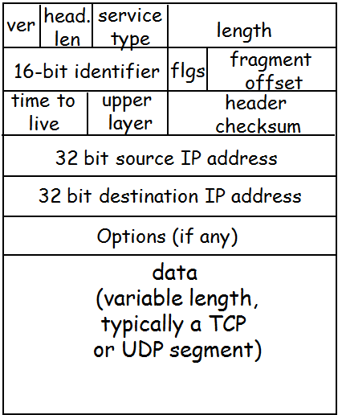
Fragmentation
IP datagram format
Router detects inbound datagram that is larger than the outbound network MTU
  Splits datagram into fragments
  Each fragment is smaller than the MTU of the outbound network
Each fragment is an independent datagram
  Includes all header fields
  All fragments have the IDENTIFIER of the original datagram
  3-bit FLAGS field indicates if datagram is a fragment
  13-bit FRAGMENT OFFSET gives order of fragment in original datagram

Slide 6
IP Fragmentation and Reassembly
length
=4000
ID
=x
fragflag
=0
offset
=0
Example
4000-byte datagram
MTU = 1500 bytes
One large datagram becomes
several smaller datagrams
length
=1500
ID
=x
fragflag
=1
offset
=0
1480 bytes in
data field
length
=1500
ID
=x
fragflag
=1
offset
=185
offset in
8-byte blocks
= 1480/8
length
=1060
ID
=x
morefrag
=0
offset
=370
  fragflag: 0 = not a fragment, 1 = is a fragment
  dontfrag: 0 = OK to fragment, 1 = do not fragment
  morefrag: 0 = last fragment, 1 = more fragments

Slide 7
Re-assembly
Reconstruction of original datagram is called re-assembly
  performed by protocol stack at final destination
IDENTIFICATION field in each fragment matches original datagram
  fragments from different datagrams can arrive out of order and still be sorted out
FLAGS field bit identifies fragment containing end of data from original datagram
FRAGMENT OFFSET specifies re-assembly order
  counted in 8-byte blocks

Slide 8
Re-assembly
Once a datagram is fragmented, it stays fragmented until it reaches destination.
The final destination performs the reassembly.
  Reassembly is not done along the way, even if an outbound network has a larger MTU.
Two advantages to having the final destination do the reassembly:
  It reduces the amount of information needed by routers.
  It allows routers to change dynamically.
  It avoids re-fragmenting

Slide 9
Fragment loss
IP does not guarantee datagram delivery, so fragments may be lost.
Destination
  Sets timer with first fragment
  If timer expires before all fragments arrive
    one or more fragments assumed lost
    Destination drops entire original datagram
    Source is assumed to retransmit entire original datagram
Reasons for the all-or-nothing behavior:
  There’s no mechanism for a receiver to tell a sender which fragments arrived.
  The sender does not know about any fragmentation that happened along the way.
  Even if the sender could retransmit a single fragment, it might take a different route and be fragmented differently.

Slide 10
Fragmenting a fragment
Fragment may encounter subsequent network with even smaller MTU
Router fragments the fragment to fit local MTU
Resulting (sub)fragments look just like original datagrams (except for size and offsets)
No need to reassemble hierarchically
IP does not distinguish among "original" fragmentation and subsequent fragmentations
Re-assembly is entirely the responsibility of the protocol on the destination host

Slide 11
Summary Lecture #30
Definitions:
  MTU
    local MTU, network MTU, path MTU
fragmentation, fragments, sub-fragments
re-assembly

