Slide 1
CS 372 Lecture #3 (Part 2)
Overview of Networking:
Network core
  circuit switching
    frequency-division multiplexing
    time-division multiplexing
  packet switching
    statistical multiplexing
Utilization
Note: Many of the lecture slides are based on presentations that accompany
Computer Networking: A Top Down Approach, 6th edition,
by Jim Kurose & Keith Ross, Addison-Wesley, 2013.

Slide 2

The network core: Packet Switching
Statistical multiplexing
100 Mbps
Ethernet
A
C
statistical multiplexing
1.5 Mbps
B
queue of packets
waiting for output
link
D
E

Slide 3
The network core: Packet Switching
Statistical multiplexing
Sequence of A & B packets does not have fixed pattern
Transmission medium is shared on demand.
  if a host is idle, its bandwidth is available to others.
Compare:
  in TDM, each host gets same slot (periodically)
  in FDM, each host gets same bandwidth (continuously)
  with either TDM or FDM
    a limited number of hosts get exclusive use of one slot or one channel
    if a host is idle, its bandwidth is wasted.

Slide 4
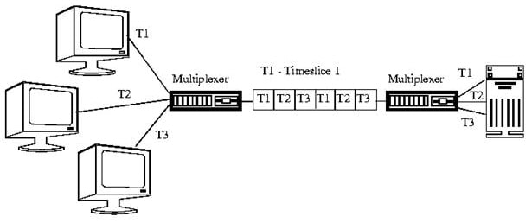
The network core: Packet Switching
Statistical multiplexing
(HELPER SLIDE ONLY)
What is Statistical Multiplexing?
Statistical Multiplexing is a multiplexing technique that allows information from a number of channels to be combined for transmission over a single channel.
How Statistical Multiplexing Works?
Statistical multiplexing dynamically allocates bandwidth to each channel on an as-needed basis. This is in contrast to time-division multiplexing (TDM) techniques, in which quiet devices use up a portion of the multiplexed data stream, filling it with empty packets. Statistical multiplexing allocates bandwidth only to channels that are currently transmitting. It packages the data from the active channels into packets and dynamically feeds them into the output channel, usually on a FIFO (first in, first out) basis, but it’s also able to allocate extra bandwidth to specific input channels.
Statistical multiplexing devices usually support other features, such as the following:
Store-and-forward error detection and correction capability:
  Identifies which channel sent each packet of data and corrects errors that occur
Data compression:
  Increases the amount of data that can be sent per packet
Notes:
https://networkencyclopedia.com/statistical-multiplexing/

Slide 5
The network core:
Circuit switching versus Packet switching
A
Circuit switching
TDM for 2 circuits (FDM is similar)
A reserves 1 circuit
B reserves 1 circuit, but has no packets to send
2 Mbps
B
Utilization = only 50% = 1 Mb/s
A
Packet switching
Statistical multiplexing for 2 hosts
A uses full link since B has no packets to send
2 Mbps
B
Utilization = 100% = 2 Mb/s
Note: Packet switching has some additional overhead

Slide 6
The network core:
Circuit switching versus Packet switching
Utilization (average % of bandwidth used)
Circuit switching transmits at a constant rate.
Packet switching allows more users to use network! (better utilization)
Suppose each user is active 10% of time
circuit-switching:
  with 10 users, each gets 0.1 Mbps when active
packet-switching:
  with 35 users, probability that more than 10 are active is less than .0004.
  performance is nearly the same as 10 users with circuit-switching
N users
1 Mbps link
Discussion question: how did we get value 0.0004?

Slide 7
The network core:
Circuit switching versus Packet switching
Sometimes all (or most) users want to be active
Packet switching is fine for data that is not time-critical
  However …
    Excessive congestion causes:
      packet delay and loss
      "jitter"
    packet construction creates additional overhead
    protocols needed for reliable data transfer, congestion control
    bandwidth guarantees are needed for audio/video apps
Q: How to provide circuit-like behavior (constant rate or appearance of constant rate)?
  still a research problem

Slide 8
Summary Lecture #3
Definitions:
  network core
  circuit-switching, packet-switching
  multiplexing
  utilization
Network core
  composition (interconnected routers)
  functions
FDM, TDM
Statistical multiplexing

