Slide 1
CS 372 Lecture #10
The Application Layer:
  Example application
    Hypertext Transfer Protocol (HTTP)
Note: Many of the lecture slides are based on presentations that accompany
Computer Networking: A Top Down Approach, 6th edition,
by Jim Kurose & Keith Ross, Addison-Wesley, 2013.

Slide 2
Web and HTTP (RFC 2616)
Web page consists of a base HTML-file which includes several referenced objects
  Object can be HTML file, JPEG image, Java applet, audio file,…
Each object is addressable by a Uniform Resource Locator (URL)
Example URL:
www.someschool.edu/someDept/pic.gif
host name
path name in host directory structure

Slide 3

HTTP overview
Web’s application layer protocol
client/server model
  client: browser that requests, receives, “displays” Web objects
  server: Web server sends objects in response to requests
HTTP request
PC running
Explorer
HTTP response
HTTP request
Server
running
Apache Web
server
HTTP response
Mac running
Navigator

Slide 4
HTTP overview (continued)
Uses TCP:
client initiates TCP connection (creates socket) to server, port 80
server accepts TCP connection from client
HTTP messages (application-layer protocol messages) exchanged between browser (HTTP client) and Web server (HTTP server)
TCP connection closed
HTTP is “stateless”
server maintains no information about past client requests
aside
Protocols that maintain “state” are complex!
past history (state) must be maintained
if server/client crashes, their views of “state” may be inconsistent, must be reconciled

Slide 5
HTTP connections
Nonpersistent HTTP
At most one object is sent over a TCP connection.
downloading multiple objects requires multiple connections
Persistent HTTP
Multiple objects can be sent over single TCP connection between client and server.

Slide 6
Non-persistent HTTP
Suppose user enters URL www.someSchool.edu/someDepartment/home.index
(contains text,
references to 10
jpeg images)
1a. HTTP client initiates TCP connection to HTTP server (process) on port 80 at www.someSchool.edu
1b. HTTP server at host www.someSchool.edu waiting for TCP connection at port 80. “accepts” connection, notifying client
2. HTTP client sends HTTP request message (containing URL) into TCP connection socket. Message indicates that client wants object someDepartment/home.index
3. HTTP server receives request message, forms response message containing requested object, and sends message into its socket, and closes connection.
time

Slide 7
Non-persistent HTTP (cont.)
4. HTTP client receives response message containing html file, displays html. Parsing html file, finds 10 referenced jpeg objects
time
5. Steps 1-4 repeated for each of 10 jpeg objects

Slide 8
Non-Persistent HTTP: Response time
Definition of RTT(round-trip time): time for a small packet to travel from client to server and back.
Response time:
one RTT to initiate TCP connection
one RTT for HTTP request and first few bytes of HTTP response to return
file transmission time
initiate TCP
connection
RTT
request
file
RTT
time to
transmit
file
file
received
time
time
total = 2RTT+transmit time
(non-persistent HTTP)

Slide 9
Persistent HTTP
Nonpersistent HTTP issues:
requires 2 RTTs per object
operating system overhead for each TCP connection
browsers often open parallel TCP connections to fetch referenced objects
Persistent HTTP
server leaves connection open after sending response
subsequent HTTP messages between same client/server sent over open connection
client sends requests as soon as it encounters a referenced object
as little as one RTT for all the referenced objects

Slide 10
HTTP request message
two types of HTTP messages: request, response
HTTP request message:
  ASCII (human-readable format)
carriage return character
request line
(GET, POST,
HEAD commands)
line-feed character
GET /index.html HTTP/1.1\r\n
Host: www-net.cs.umass.edu\r\n
User-Agent: Firefox/3.6.10\r\n
Accept: text/html,application/xhtml+xml\r\n
Accept-Language: en-us,en;q=0.5\r\n
Accept-Encoding: gzip,deflate\r\n
Accept-Charset: ISO-8859-1,utf-8;q=0.7\r\n
Keep-Alive: 115\r\n
Connection: keep-alive\r\n
\r\n
header
lines
Extra carriage return,
line feed at start
of line indicates
end of header lines
Your web browser is an application that includes and implements the client side of HTTP.

Slide 11
HTTP request message: general format
method
sp
URL
sp
version
cr
request
line
lf
header field name
value
cr
lf
~
~
header
lines
~
~
header field name
value
cr
lf
cr
lf
~
entity body (data)
~
body
~
~
sp = space cr/lf = carriage-return/line feed (Enter key)

Slide 12
Uploading form input
Web page often includes form input
URL method:
uses GET method
input is uploaded in URL field of request line
Example:
POST method:
input is uploaded to server in entity body
www.somesite.com/animalsearch?monkeys&banana

Slide 13
HTTP response message
status line
protocol
status code
status phrase
HTTP/1.1 200 OK\r\n
Date: Sun, 24 Mar 2013 20:09:20 GMT\r\n
Server: Apache/2.0.52 (CentOS)\r\n
Last-Modified: Tue, 19 Mar 2013 17:00:02 GMT\r\n
ETag: "17dc6-a5c-bf716880"\r\n
Accept-Ranges: bytes\r\n
Content-Length: 2652\r\n
Keep-Alive: timeout=10, max=100\r\n
Connection: Keep-Alive\r\n
Content-Type: text/html; charset=ISO-8859-1\r\n
\r\n
data data data data data ...
Header lines
Extra cr/lf
data, e.g.,
requested
HTML file

Slide 14
HTTP response status codes
In first line of server-to-client response message.
A few sample codes:
200 OK
  request succeeded, requested object later in this message
301 Moved Permanently
  requested object moved, new location specified later in this message (Location)
400 Bad Request
  request message not understood by server
404 Not Found
  requested document not found on this server
505 HTTP Version Not Supported

Slide 15
Try out HTTP (client side) for yourself
1. Telnet to your favorite Web server:
telnet web.engr.oregonstate.edu 80
Opens TCP connection to port 80
(default HTTP server port) at web.engr.oregonstate.edu
Anything you type will be sent to port 80 at web.engr.oregonstate.edu
and the connection will close (default behavior).
2. Type in a GET HTTP request:
By typing this in (hit carriage
return twice), you send
this minimal (but complete)
GET request to HTTP server
GET /~paulson/ HTTP/1.1
Host: engr.oregonstate.edu
3. Look at response message sent by HTTP server
(or use Wireshark to look at captured HTTP request/response)

Slide 16
Summary Lecture #10
Definitions
  URL
  RTT
  response time
HTTP
  Non-persistent, persistent
  Request, response
  Form input

Slide 17
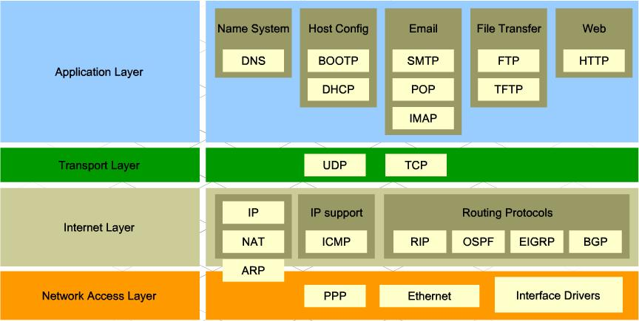
Summary
Application-Layer Protocols
http://walkwidnetwork.blogspot.com/2013/04/application-layer-internet-protocol.html

