Slide 1
CS 372 Lecture #13
The Application Layer:
  Domain Name Services (dns)
Note: Many of the lecture slides are based on presentations that accompany
Computer Networking: A Top Down Approach, 6th edition,
by Jim Kurose & Keith Ross, Addison-Wesley, 2013.

Slide 2
Addresses in an internet
Every host that is connected to any network has a unique hardware address
  12 hexadecimal digits, assigned by the manufacturer of the network interface device
    e.g., 90e612a73d
  used at the physical layer
  not practical for internet addressing
IANA assigns internet protocol (IP) network addresses to service providers, etc., to be managed hierarchically
  e.g., 128.192.0.0 (IP version 4)
Service providers assign IP addresses to individual subscribers, and bind these IP addresses to subscriber hardware addresses.
  e.g., 128.192.35.172 (IPv4 dotted-decimal notation)
Much more later about IP addressing (IPv4 and IPv6)

Slide 3
The need for naming
All applications use IP addresses through the TCP/IP protocol software
Numeric addresses are easy for computers to manage
… but difficult for humans to remember:
  e.g., 128.192.35.172 (dotted-decimal)
  binary form is 10000000110000000010001110101100
The computer needs binary addresses
Humans "need" mnemonics
Domain Name System (DNS) provides translation between symbolic names and IP addresses

Slide 4
Structure of DNS names
Each name consists of a sequence of alphanumeric components separated by periods
Examples:
  comcast.com
  www.oregonstate.edu
  www.cnn.com
  classes.engr.oregonstate.edu
Note: There is not a correspondence between the DNS name’s individual components and the fields of an IP address in dotted-decimal notation

Slide 5
Structure of DNS names
Names are hierarchical, with most significant component on the right
  Top-Level Domain (TLD)
Second from right is the domain name within the TLD
  Approved by a global authority

Slide 6
Structure of DNS names
Other names may be added by the organization that owns the name
  hierarchical structure
Left-most component is computer name
NOTE: www does not necessarily imply web services.
  It’s just a computer name in a domain.

Slide 7
Structure of DNS names
Organizations apply for names in a TLD. E.G.:
  oregonstate.edu
  mozilla.com
Organizations determine own internal structure. E.G.:
  eecs.oregonstate.edu
  classes.eecs.oregonstate.edu
  www.mozilla.com
  en-US.www.mozilla.com

Slide 8
IP/DNS authority
IP addresses and “root zone” TLDs coordinated by IANA (Internet Assigned Numbers Authority)
  http://www.iana.org
Information database (whois), dispute resolution, etc., managed by InterNIC (Internet Network Information Center)
  http://www.internic.net
High-level management of Internet names and addresses handled by ICANN (Internet Corporation for Assigned Names and Numbers)
  http://www.icann.org
.com TLD managed by Network Solutions
  http://www.networksolutions.com
.edu TLD managed by Educause
  http://www.educause.edu

Slide 9
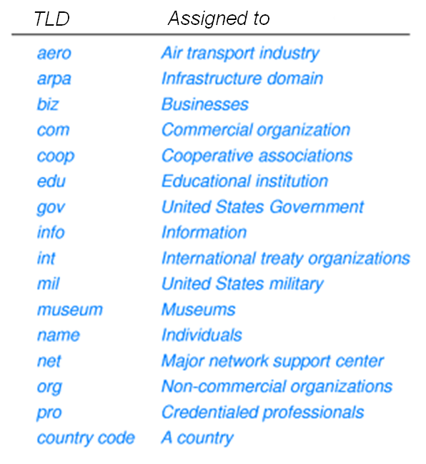
“Traditional” top-level domains (TLD)

Slide 10
New gTLD (generic TLD)
In 2012, ICANN started taking applications for new TLD names.
  Application fee: US$185,000.00
    Additional fees may apply
  Approval process: 9 – 20 months
  1,930 applications submitted
    mostly company names (e.g., .canon, .progressive, …)
    … and professions (e.g., .attorney, .doctor, …)
These should be showing up soon.

Slide 11
Geographic structure
http://www.iana.org/domains/root/db#
TLDs are USA-centric
Geographic TLDs (ccTLD)
are used for organizations
in other countries.
Examples:
Note: some countries sell their ccTLDs
  e.g., www.verisign.tv
    .tv was once owned by Tuvalu
TLD | Country
.uk | United Kingdom
.cn | China
.in | India
.jp | Japan
.pg | Papua New Guinea
.cl | Chile
.ke | Kenya

Slide 12
Geographic structure
Countries define their own internal hierarchy:
.ac.jp and .edu.au are used for academic organizations in Japan and Australia, respectively
DNS domains are logical concepts and need not correspond to physical location of organizations
  E.G., chinatoday.com is hosted partly in Beijing, partly in San Francisco

Slide 13
DNS: Domain Name System
distributed database: implemented in hierarchy of many name servers
application-layer protocol: running at host, routers, & name servers to resolve names (address/name translation)
DNS services
hostname to IP address translation
Web server aliasing
  Canonical, alias names
mail server aliasing
load distribution
Discussion question: Lookups would be faster if there were one massive central database instead of having to search a hierarchical distributed database. Why not centralize DNS?

Slide 14
DNS: a distributed, hierarchical database
Root DNS Servers
…
…
com DNS servers
org DNS servers
edu DNS servers
yahoo.com
DNS servers
pbs.org
DNS servers
poly.edu
DNS servers
umass.edu
DNS servers
amazon.com
DNS servers
Example: Client wants IP for www.amazon.com
1st approximation:
  client queries root server to find .com DNS server
  client queries .com DNS server to get amazon.com DNS server
  client queries amazon.com DNS server to get IP address for www.amazon.com

Slide 15

DNS: root name servers
Contacted by local name server that can not resolve name
Root name server:
  gets mapping from authoritative name server if name mapping not known, and returns mapping to local name server
c. Cogent, Herndon, VA (5 other sites)
d. U Maryland College Park, MD
h. ARL Aberdeen, MD
j. Verisign, Dulles VA (69 other sites )
k. RIPE London (17 other sites)
i. Netnod, Stockholm (37 other sites)
e. NASA Mt View, CA
f. Internet Software C.
Palo Alto, CA (and 48 other sites)
m. WIDE Tokyo
(5 other sites)
13 root name “servers” worldwide
a. Verisign, Los Angeles CA
(5 other sites)
b. USC-ISI Marina del Rey, CA
l. ICANN Los Angeles, CA
(41 other sites)
g. US DoD Columbus, OH (5 other sites)

Slide 16
DNS records
DNS: distributed database storing resource records (RR)
RR format: (name, value, type, ttl)
type=A
  name is hostname
  value is IP address
type=CNAME
  name is alias name for some “canonical” (the real) name
  www.ibm.com is really
  servereast.backup2.ibm.com
  value is canonical name
type=NS
  name is domain (e.g., foo.com)
  value is hostname of authoritative name server for this domain
type=MX
  value is name of mailserver associated with name
ttl=<seconds to remain in cache>

Slide 17
DNS protocol, messages
query and reply messages, both with same message format
2 bytes
2 bytes
message header
identification: 16 bit # for query, reply to query uses same #
flags:
  query or reply
  recursion desired
  recursion available
  reply is authoritative
identification
flags
# questions
# answer RRs
# authority RRs
# additional RRs
questions (variable # of questions)
answers (variable # of RRs)
NOTE: All multi-byte numeric values must be in big-endian order (network order).
authority (variable # of RRs)
Discussion question: Why does DNS use UDP instead of (reliable) TCP?
additional info (variable # of RRs)

Slide 18
Domain name ⇔ IP address
Lookup, Reverse lookup
http://remote.12dt.com/rns/
http://www.dnsstuff.com/
… and many others

Slide 19
Summary Lecture #13
Definitions
  IP address
  Domain name
  TLD
DNS
  Structure
  Management
  Lookups
  Protocol, messages
This concludes our coverage of the Application Layer
  Next: the Transport Layer

