Slide 1
Virtual Backdrop
HCL/CprE 575
Nichole Dugan
Edward Jezisek
Brian Schulte

Slide 2
The Team
Nichole Dugan
Edward Jezisek
Brian Schulte

Slide 3

The Pitch
Virtual Backdrop
What if any photo could be your driver’s license photo?
Have to go to a station to get your driver’s license photo
Have to have a backdrop in order to get federal standards

Slide 4
Target Audience
Eligible driver’s license and ID holders in the state of Iowa
18 to 70 years old
Renewing or updating
Younger generations (18-30)
Thrive in a culture of mobile development
Tend to choose self-service over in person interactions
Residents who prefer to avoid the DMV

Slide 5
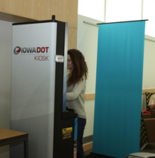
Why this is needed
Customers complain about their license photos
Allows for flexibility and customer choice
Kiosks in Iowa could take up less space if they didn’t have to use a backdrop

Slide 6
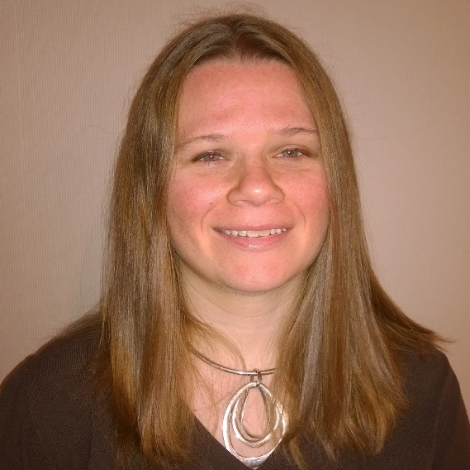
Previous Attempts
Current algorithms have some flaws
Vendor current solution has problems with including subject’s hair in the background
Other algorithms don’t appear to remove the whole background
Other algorithm deals with video
Most deal with color matching
Nichole Dugan

Slide 7
Related work
MorphoTrust USA
Patent for virtual backdrop
Jeong-In Park and Jin-Tak Choi, Koren University
Algorithm using a Code Book
Splits image into sections
Microsoft Research Video Algorithm
Tries to identify foreground and background
Uses color matching to try to determine if a pixel is in the foreground or background

Slide 8
Opportunities
OpenCV and background identification
OpenCV has a good framework for identifying backgrounds
Using video may improve the quality of detecting the background
Team’s experience can help us solve this problem

Slide 9
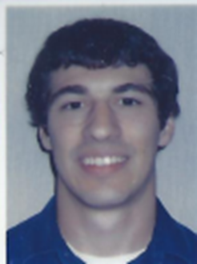

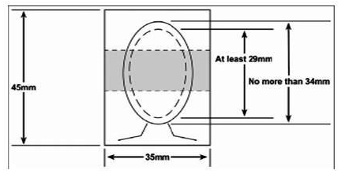
Project Phases
Phase I
Allow users to capture video and upload photos
Phase II
Remove and replace background
Phase III
Integrate virtual backdrop into an Android application
Phase IV
Add ICAO requirement checks
Brian Schulte

Slide 10
Project Concept
C++
OpenCV
v3.1.0
Android application
Version Control
GitHub

Slide 11
Testing
Each of our team members will test the application locally
Will test with already uploaded photos also
Will test on different backgrounds
Photos will be evaluated based on how well the background is removed

Slide 12
Definition of Success
Code removes background image and places a blue background on the photo
Hair is not blended into the background
Application is deployable on android devices meeting application requirements
Stretch Goal
Output photo meets ICAO standards

Slide 13
Questions?
Please submit questions to us via BlackBoard
Nichole Dugan
Edward Jezisek
Brian Schulte
Notes:
This concludes our project presentation. If you have questions, you may contact any of us via black board.

