Slide 1
AES Cipher

Slide 2
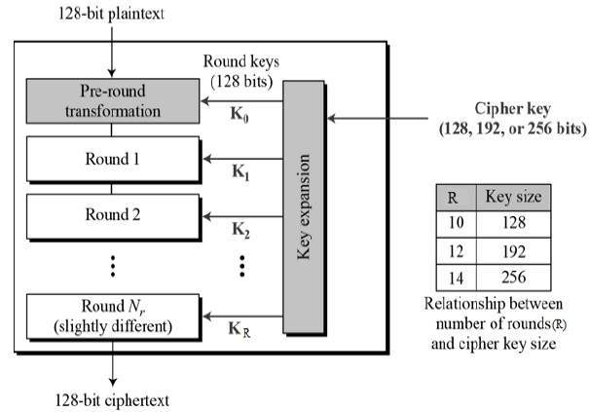
Breakdown 1/2
K₀ through K_{R} are round keys
Key sizes vary, but 128 bit is most common
Encrypts 128 bit blocks, but only performs transformations on the 16 bytes of the the block
Notes:
Rhine Dall’s key schedule algorithm
Larger key sizes are useless
Encrypts 128 bit blocks of plaintext at a time

Slide 3
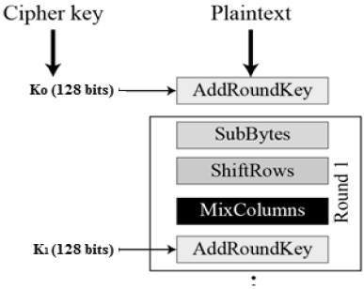
Breakdown 2/2
AddRoundKey
SubBytes
ShiftRows
MixColumns
Repeat 1. through 3. x10 – 14
SubBytes
ShiftRows
AddRoundKey
Notes:
128 bit round keys k0 - k(of)n are produced by the key schedule algorithm
The substitution algorithm in SubBytes performs an operation that randomizes the bytes which produces confusion
The ShiftRows and MixColumns permute the bytes and together produce diffusion
Repeat x # of times based on the key size
Exit with…

Slide 4
AES: What it is
Symmetric key cipher
A federal standard for encrypting government documents beginning in 2002
Superseded DES (1977), which is known to have vulnerabilities
No none way to crack an AES cipher
Notes:
NIST provided the standard for AES
DES vulnerability: such as its key size being too small at 56 bits
There’s no none way to crack an AES cipher as long as it’s key is safe and it well implemented

Slide 5
Ciphertext Stealing vs. Padding
AES enciphers a block of plaintext at a time
As a block cipher has a mode of operation
Ciphertext stealing
Padding
Which is better?
Notes:
Book mention ciphertext stealing and padding as two ways to make a plaintext work with the cipher
For ciphertext stealing you encrypt the second to last block, xor it with the last block, and encrypt it again and use it as your new last block
With padding you just add on new bits to fit to the next block
AES enciphers 128 bits, and using it repeatedly is how blocks are enciphered. I could only imagine that ciphertext stealing would be used when there were harsh constraints on the ciphertexts length.

