Slide 1

Predicting Accident Severity From Road and Lighting Conditions
Ethan Feldman
September 2020

Slide 2
Our research
Background and Use Case
Data
Exploratory Analysis
Models
Conclusion
Future Work

Slide 3
Background
Increasing number of accidents
Want to predict occurrence and severity
How is SEVERITY impacted by:
ROAD CONDTIONS
LIGHTING CONDITIONS

Slide 4
SEVERITY
Low Severity
Only property damage
No injuries to passengers or pedestrians
High Severity
Injury to passengers or pedestrians
Possible property damage

Slide 5
Use case
Seattle Department of Transportation
Seattle first responders
Driver education and awareness

Slide 6
Data
From the City of Seattle
https://s3.us.cloud-object-storage.appdomain.cloud/cf-courses-data/CognitiveClass/DP0701EN/version-2/Metadata.pdf
Includes a wide array of variables and descriptions of accidents
Dates back to 2014

Slide 7
Data
Identified our TARGET variable as SEVERITY
Identified our FEATURE SET as
Road Conditions
Wet, mud, snow, ice, etc.
Light Conditions
Day, Dusk, Dawn, Night without or Night with lights
Removed unclear accidents (missing, unknown, other)

Slide 8
Data
Aware of a potential BIAS in the target data, severity
Low severity vastly outweights high severity
Want a model that predicts based on features, not on frequency of severity only
High: 136,485
Low: 58,188

Slide 9
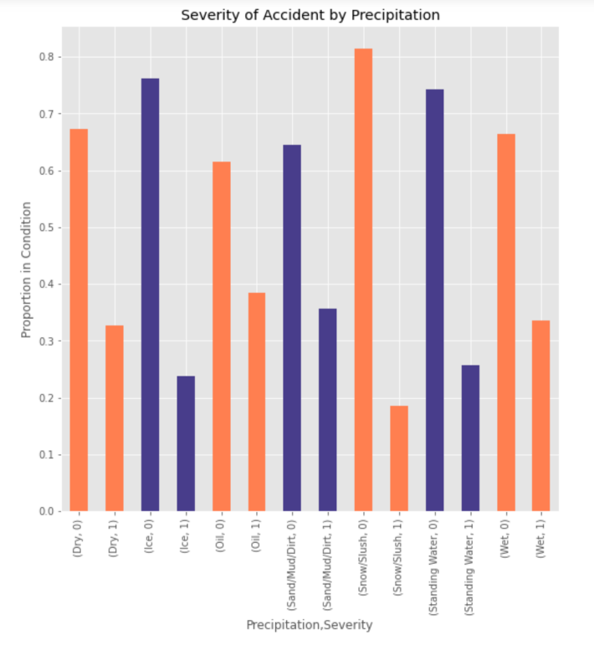
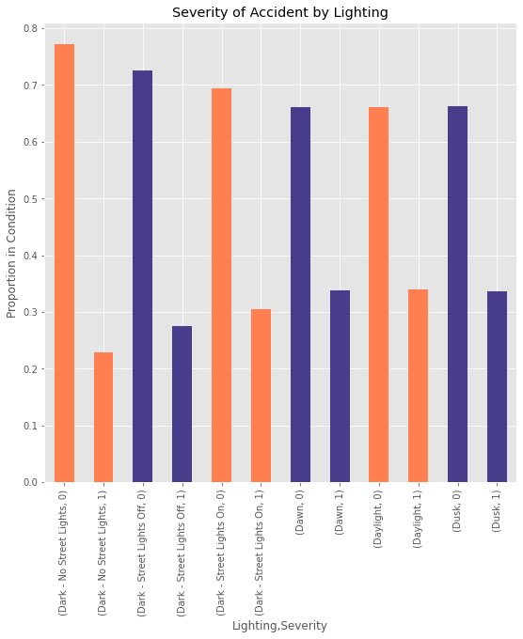
Exploration

Slide 10
Models
Logistic Regression
Decision Tree Classifier
Random Forest Classifier
k-Nearest Neighbor Classifier

Slide 11
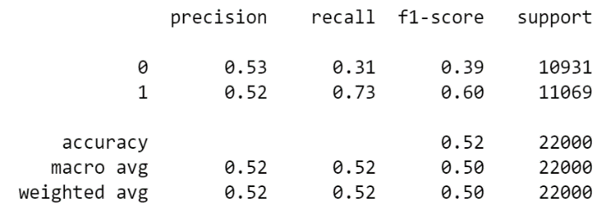
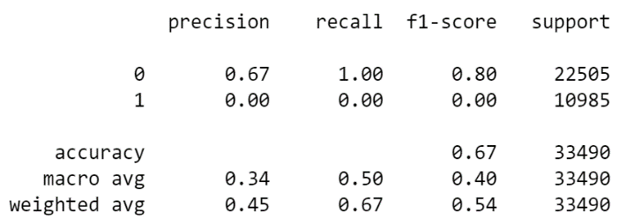
Models
Logistic Regression
Down Sampled
Original

Slide 12
Models
Decision Tree
Accuracy of 67.4%
Random Forest
Accuracy of 67.19%
k-Nearest Neighbor
Best accuracy with k=2
Accuracy of 67.46%

Slide 13
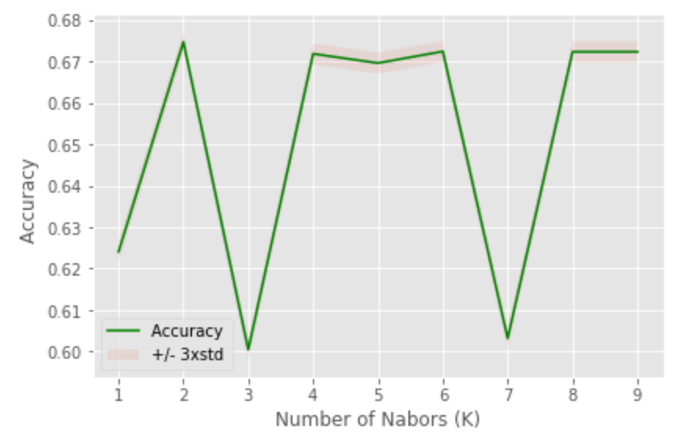
How to pick k

Slide 14
Conclusions
Many options for models
Our best choice appears to be:
k Nearest Neighbor (k=2)
Decision Tree Classifier

Slide 15
Future
Repeat with data set that provides more breakdown of severity
Repeat based on locations
No explanation of how or why
If location included, can study:
Signs
Speed Limits
Lanes

