Slide 1
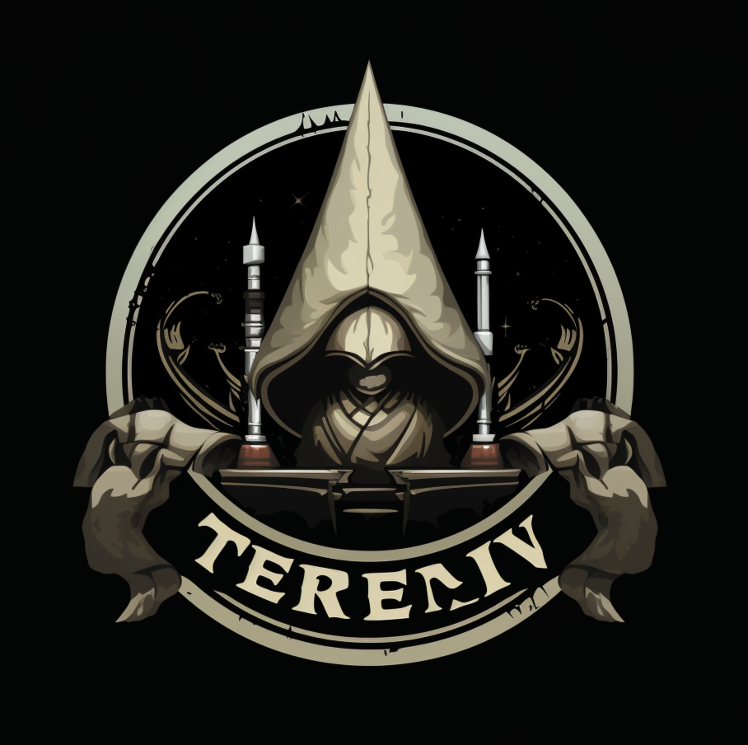
New Hire Indoc
Operative Smallberries
Training Development Lead
Logistics Division
CONFIDENTIAL

Slide 2
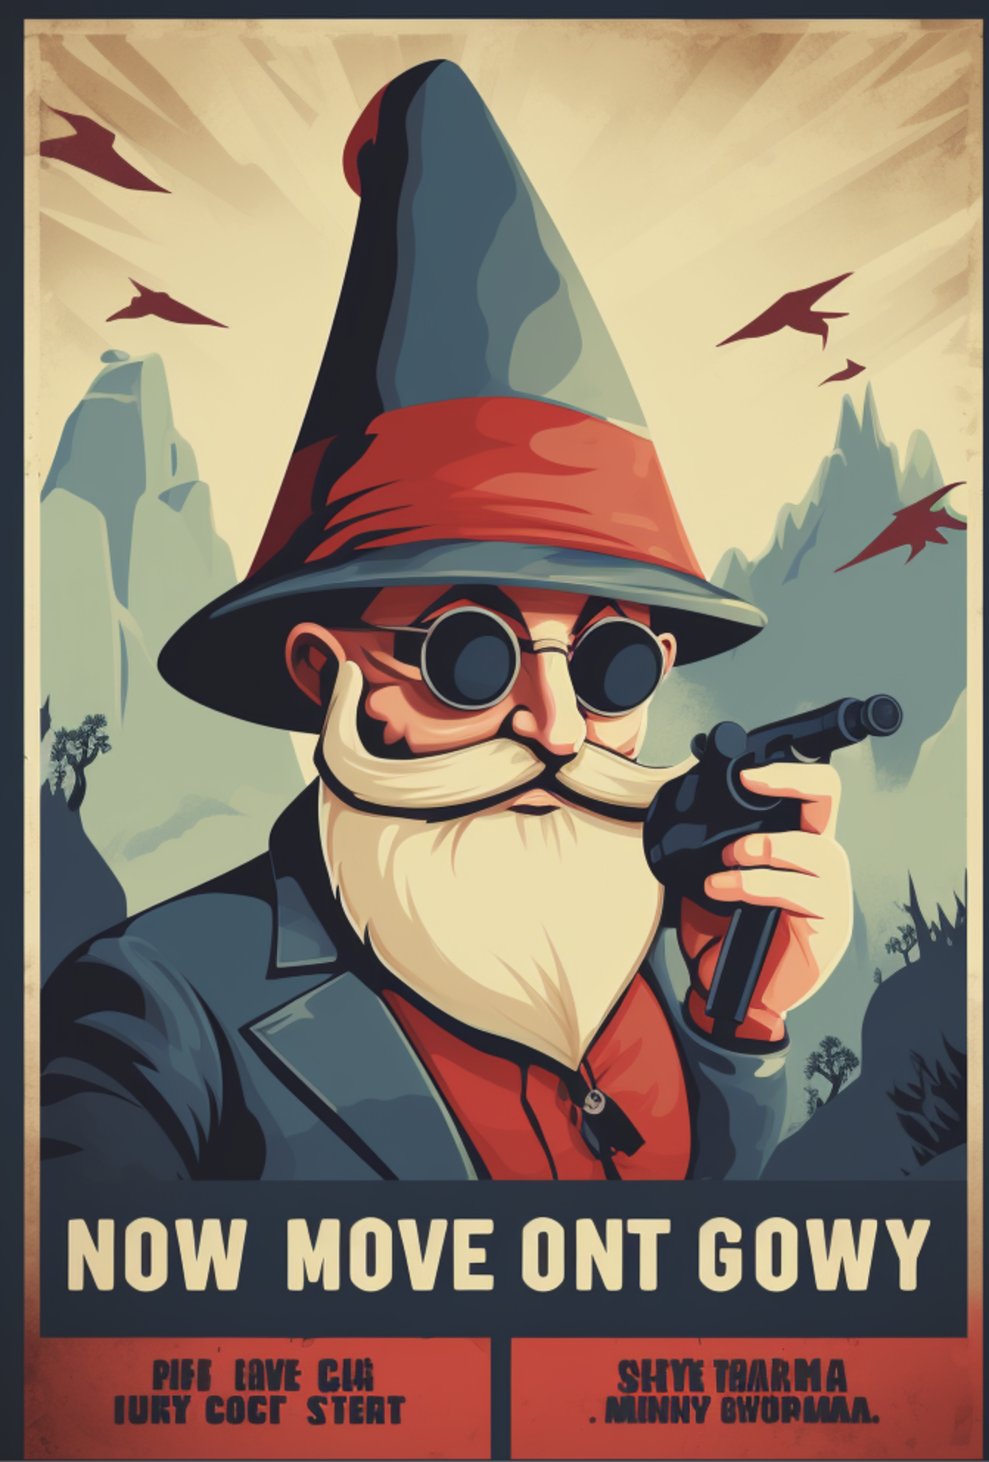
Don’t Be A Nosy Gnome & Keep Your Desk Clean
CONFIDENTIAL

Slide 3
Trust Organizational Hierarchy
Nils - Informants - general populace who report to the Trust
Halfs - Those looking to apply to either 1s or 2s.
1 - Trust Handler - well know around any neighborhood. Located in close proximity to any House Sivis guilds and police stations in Zilargo.
2 - Trust Spy - Standard Foot Soldier.
3 - Trust Operative - More senior agents.
4 - Trust Director - Leaders inside a division.
5 - Trusted - Head of a division
6 – The Protector
CONFIDENTIAL

Slide 4
The Five “I”s
Counter-Intelligence (CI) – Identify & Neutralize opposing spies
External Intelligence (XI) - Focus on foreign political & economic information.
Internal Intelligence (I Squared) - Internal to Zilargo. Keep the peace,
Military Intelligence (MI) - Capabilities of other nations
Corporate Intelligence (Corp) - Capabilities of other Noble Houses
CONFIDENTIAL

Slide 5
The Five “D”s
Surveillance Division (Ears) - Passive & Active data collection
Analysis Division (Guts) - Make sense of it all.
Logistics Division (Heart) - Support activities for other divisions.
Technical Division (Brains) - Researches new advances in spycraft & communications.
Operations Division (Ass) - We take the shit out.
CONFIDENTIAL

