Slide 1
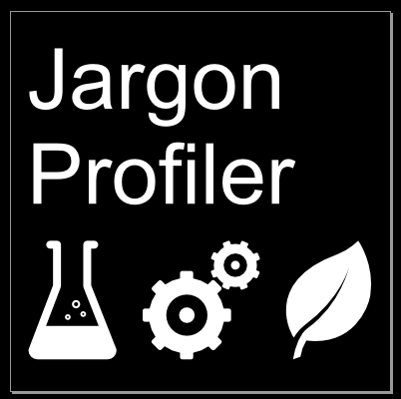
The Problem:
When communicating with non-experts, technical language or jargon creates barriers for understanding.
As an expert, it can be a challenge to identify if you have successfully removed jargon from a document.
The Solution:

Slide 2
What does the Jargon Profiler do?
Takes text
(US English)
Excludes:
pronouns, abbreviations, numbers, words shorter than three letters
Reports the % of word not classed as jargon
,
Novel aspects:
Munroe approach to characterising common language (top 1000 words)
Alternative definitions of jargon
User can provide an exclusion list of key words
it provides multiple outputs:
multiple metrics based on different definitions of jargon
a highlighted version of the text identifying jargon
a word cloud distinguishing jargon from common words.

Slide 3
Applications:
Writers or communicators can use it as a self-check.
Can be used by funding bodies, journal editors to assess appropriateness of “lay” abstracts.
Used to rate online training content.
Compliment to traditional grammar checkers, common exercise on writing course.
Extensions:
Add other classifications of jargon
Different representations of output
Transcribe a sound file and analyse the jargon content of that.

Slide 4
Demo

Slide 5
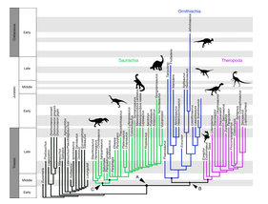
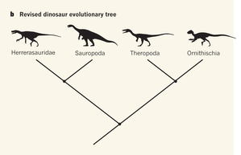

Case study: A new dinosaur family tree
Munroe Score
Primary paper: A new hypothesis of dinosaur relationships and early dinosaur evolution
Baron et al, Nature doi:10.1038/nature21700
News & Views: Palaeontology: Dividing the dinosaurs
Kevin Padian, Nature doi:10.1038/543494a
Editor's summary
Nature
A 130-Year-Old Fact About Dinosaurs Might Be Wrong
Ed Yong, The Atlantic
55.1
59.4
61.4
Technical Abstracts
67.5
Newspaper articles

