Slide 1
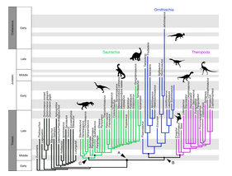
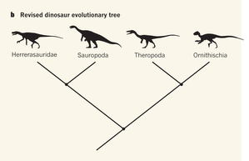
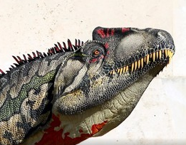
Case study: A new dinosaur family tree
Munroe Score
Primary paper: A new hypothesis of dinosaur relationships and early dinosaur evolution
Baron et al, Nature doi:10.1038/nature21700
News & Views: Palaeontology: Dividing the dinosaurs
Kevin Padian, Nature doi:10.1038/543494a
Editor's summary
Nature
A 130-Year-Old Fact About Dinosaurs Might Be Wrong
Ed Yong, The Atlantic
55.1
59.4
61.4
Technical Abstracts
67.5
Newspaper articles

