Slide 1
‘Commit’ment to Travel: Trends of Flight Excursions from the US
Eric hagee, iqbal sandhu,
khrystyne vaughan & cheng zeng

Slide 2
To Travel or Not to Travel?
Purpose: Analyze U.S. citizens travel trends to international regions for the last ~20 years (1996 -2017).
Data Analysis Questions/Rationale:
How has travel numbers changed over time?
“Have people been traveling more or less as time goes on?”
What's the most popular and the least favorable travel destination according to the travel trends in the past ~20 years?
“Where do people tend to go when leaving the US?”

Slide 3
To Travel or Not to Travel? (cont’d)
What may make people travel over a certain period of time?
“Are people traveling from a perspective of desire or relief?’
How the change of economy affects people's purchasing power on traveling overseas?
“What might affect where a person goes and when?”
Answered most of our questions, but this led to more which needs more information

Slide 4
Questions and Data

Slide 5
Questions and Data
Our focused questions require:
Time analysis to correlate travel against time of year.
Destination frequency rates.
Economic analysis over travel rates.
Popularity ratios over destinations.
Popularity ratio against economic analysis.
Data Sources:
Travel Departures: https://travel.trade.gov/research/monthly/departures/
Unemployment Rates (BLS Data Finder): https://beta.bls.gov/dataQuery/find?fq=survey:[ln]&s=popularity:D
Median Income in U.S. (FRED Economic Data): https://fred.stlouisfed.org/series/MEHOINUSA672N

Slide 6
Data Cleanup & Exploration

Slide 7
Data Cleanup & Exploration
Describe the exploration and cleanup process
Discuss insights you had while exploring the data that you didn't anticipate
Discuss any problems that arose after exploring the data, and how you resolved them
Present and discuss interesting figures developed during exploration, ideally with the help of Jupyter Notebook

Slide 8
Data Analysis

Slide 9
Data Analysis
Evaluate the data sources and determine what alterations are needed to provide answers for our focused questions
Extract answers from data sources through plot manipulations
Re-evaluate data sources to find alternative hypotheses
Notes:
Is the data suitable to answer initial questions
Challenge ourselves to see if the data contradicts any preconceived outcomes
What further questions has this analysis generated

Slide 10
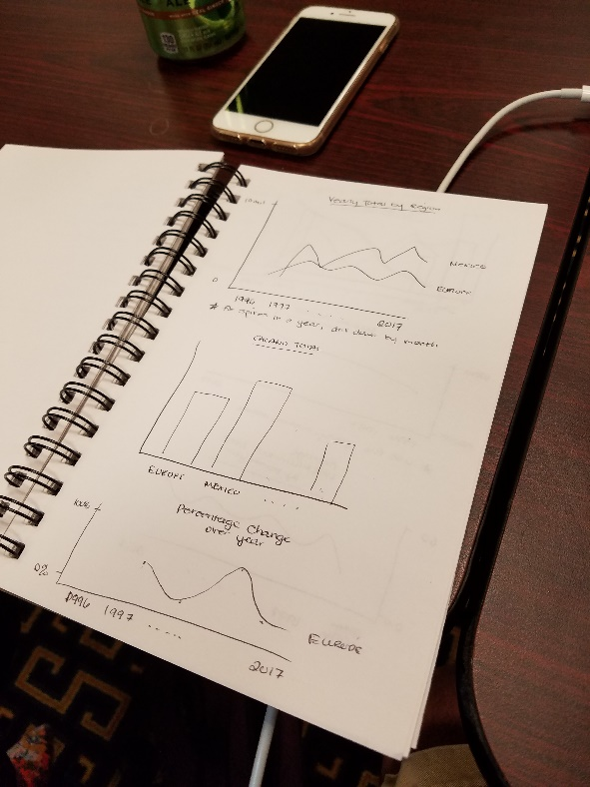
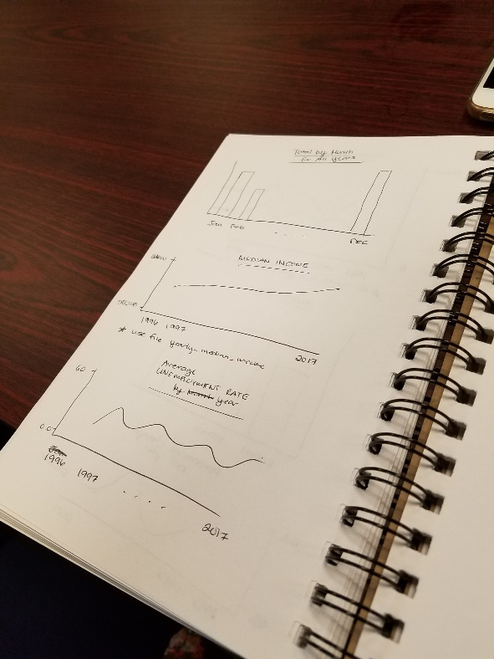
Data Analysis (cont’d)
What charts can we use to show our findings

Slide 11
Discussion

Slide 12
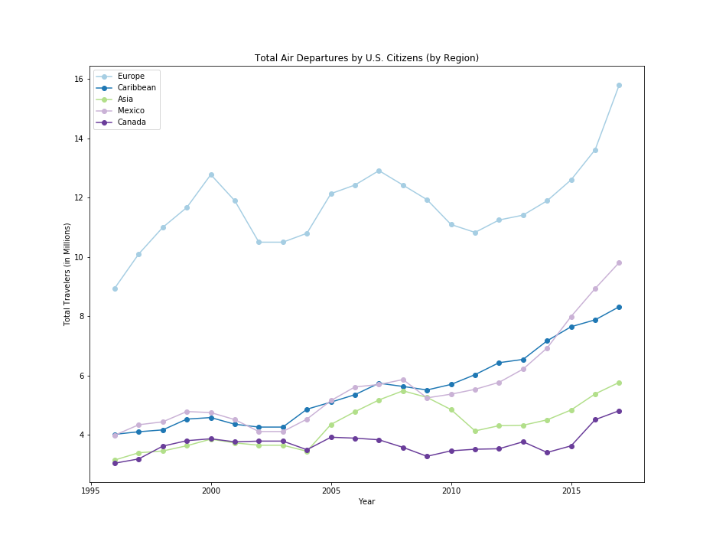
How has travel numbers changed over time?
Travel has nearly doubled since 1996, however some regions have shown more of a change than others.
Notes:
The Middle East and Central America have shown an upward trend over time, while South America and Oceania have lagged behind other areas in growth.

Slide 13
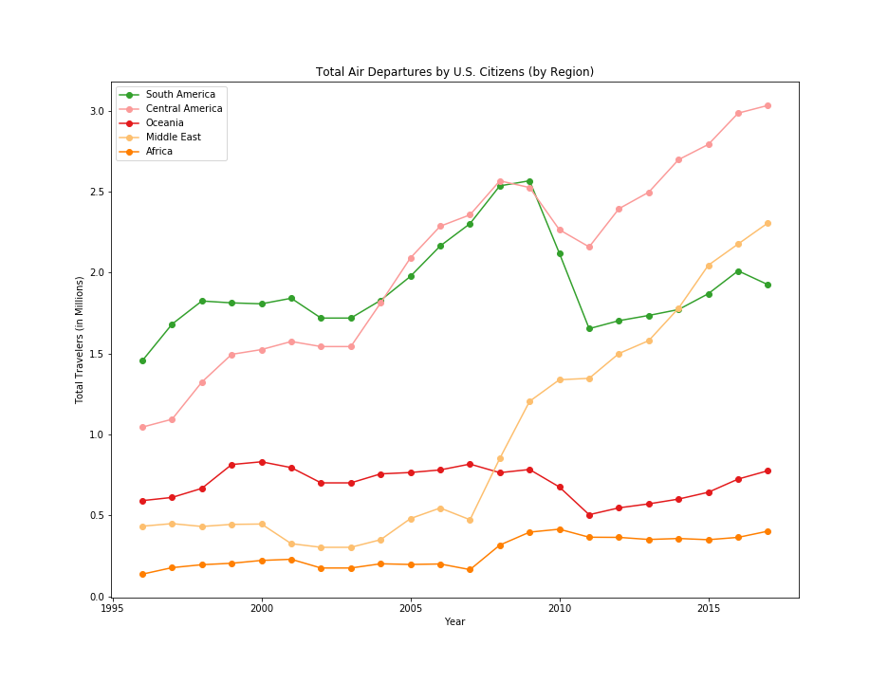
How has travel numbers changed over time? (cont’d)
The Middle East and Central America have shown an upward trend over time, while South America and Oceania have lagged behind other areas in growth.

Slide 14
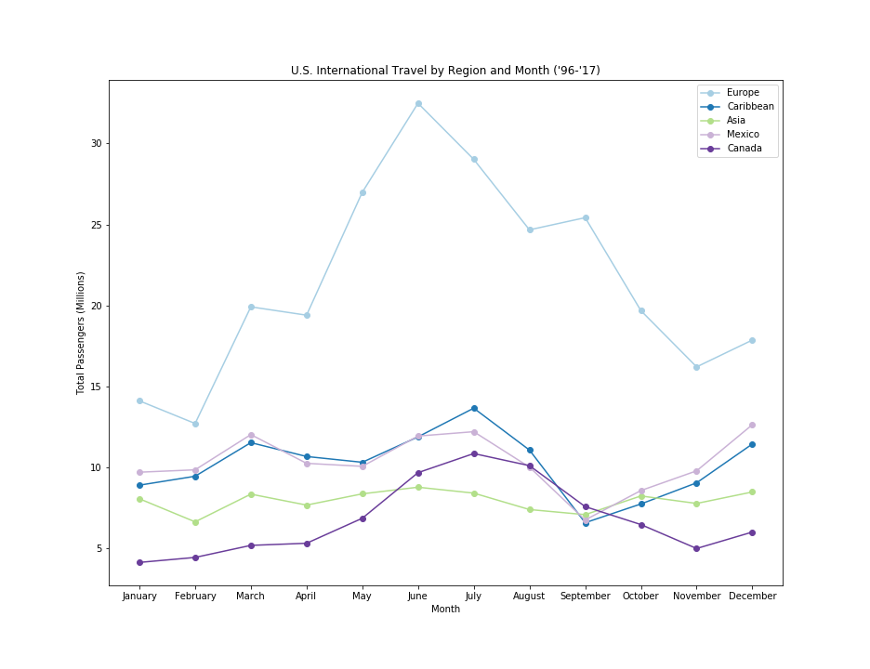
What may make people travel during certain periods of time?
Spikes throughout the year align with readily available opportunities for segments of the population.
Notes:
Travel patterns reveal themselves in monthly charts. There are spikes for travel in March potentially due to carnival/spring break. The summer months are the busiest, likely due to the pleasant weather and kids being out of school. September shows a downwards trend for the Carribean and Mexican regions, likely owing to the hurricane season. December has a noticeable spike as well, most likely because of the holidays and time from work.

Slide 15
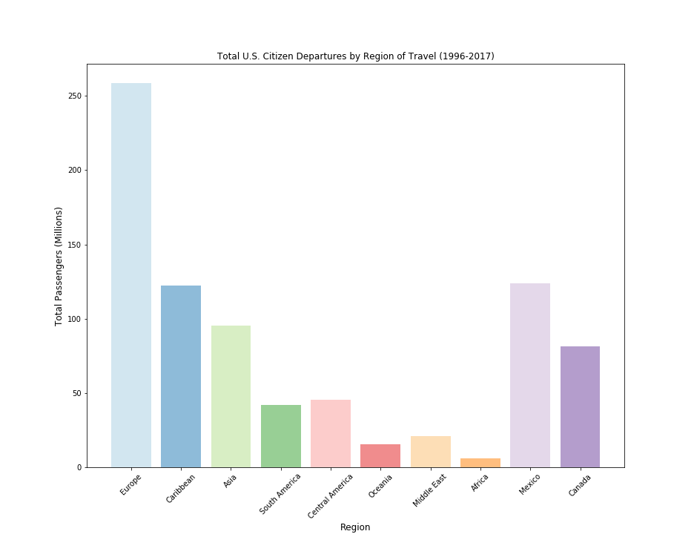
What's the most and least popular destination in the past ~20 years?
Europe is by far the most popular. Mexico and the Caribbean alternate between second and third place fairly often. The least traveled to region appears to be Africa.

Slide 16
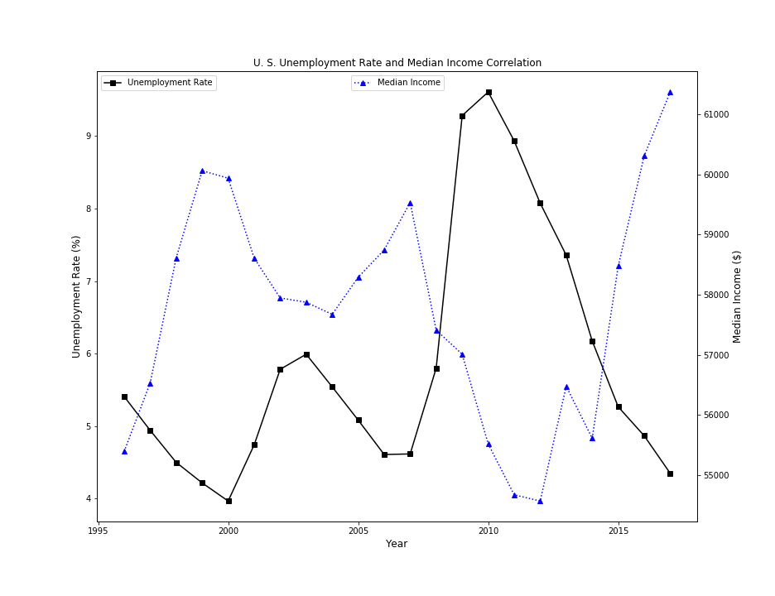
How the change of economy affects people's purchasing power on traveling overseas?
The unemployment rate to the median income are inversely related

Slide 17
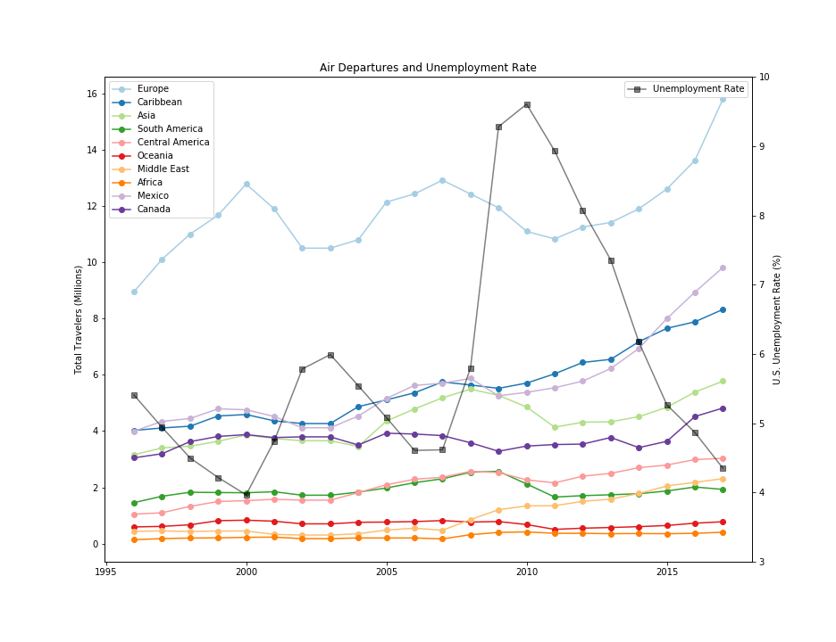
How the change of economy affects people's purchasing power on traveling overseas?
The amount of outbound visitors appears to be inversely linked to the unemployment rate.
Median income seems to be reflected in overall travel. However, travel is affected more when distance is further than closer.
Notes:
Median and Travel are related. Travel to closer destinations increases or stays the same as unemployment goes up.

Slide 18
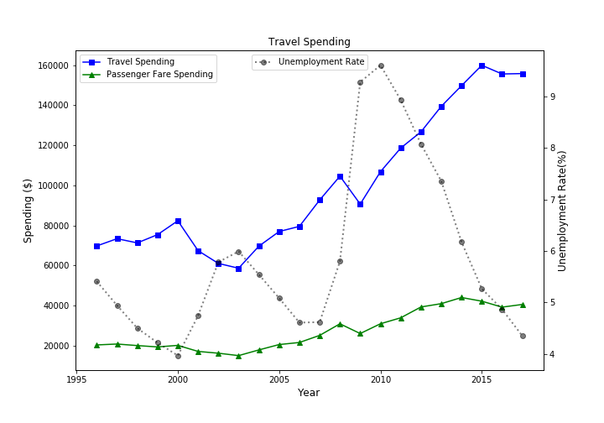
How the change of economy affects people's purchasing power on traveling overseas? (cont’d)
Travel spending has made an upward trajectory overall, suffering only slight setbacks after 9/11 and the recession in 2008.

Slide 19
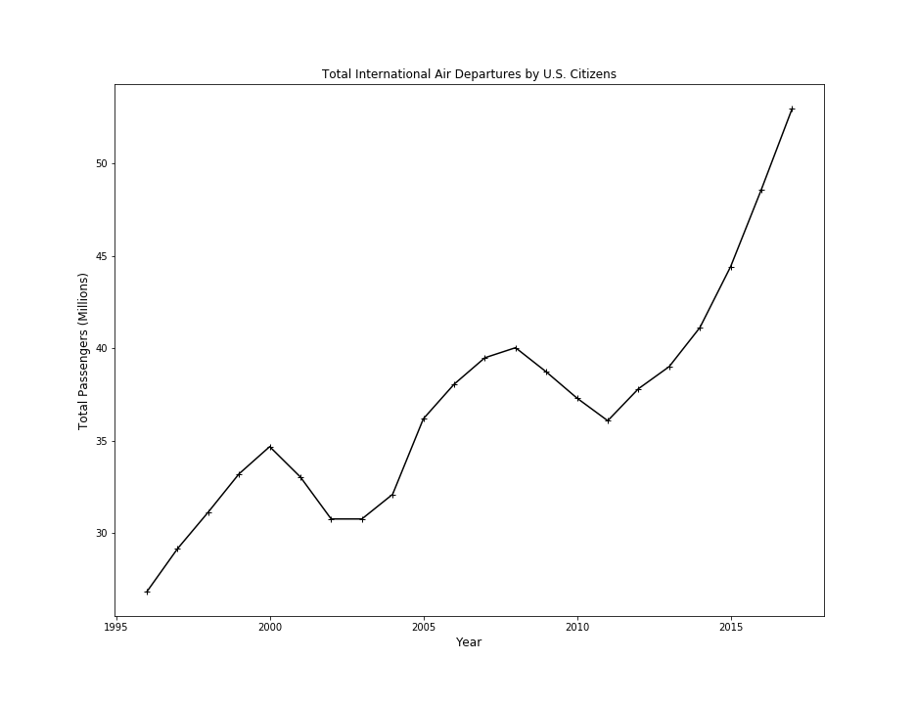
What is the change on travel numbers during a major historical event/ natural disaster/ political crisis?
It is difficult to describe the impact of a major historical event on the data that we have. We can not conclusively say that events such as 9/11 have impacted the travel data, while at the same time discounting the recession and it’s impact on travel tourism and the economy.

Slide 20
Post Mortem

Slide 21
Post Mortem
Challenges:
Finding data for time span to correlate against
Additional Question(s):
Analysis of departure zone vs. economic/political situations of the time.

Slide 22
Questions?

