Slide 1
‘Commit’ment to Travel: Trends of Flight Excursions from the US
Eric hagee, iqbal sandhu,
khrystyne vaughan & cheng zeng

Slide 2
To Travel or Not to Travel?
Define the core message or hypothesis of your project.
Purpose: Analyze U.S. citizens travel trends to international regions for the last ~20 years (1996 -2017).
Describe the questions you asked, and why you asked them.
Describe whether you were able to answer these questions to your satisfaction, and briefly summarize your findings.

Slide 3
Questions and Data
Elaborate on the questions you asked, describing what kinds of data you needed to answer them, and where you found it

Slide 4
Data Cleanup & Exploration
Describe the exploration and cleanup process
Discuss insights you had while exploring the data that you didn't anticipate
Discuss any problems that arose after exploring the data, and how you resolved them
Present and discuss interesting figures developed during exploration, ideally with the help of Jupyter Notebook

Slide 5
Data Analysis
Discuss the steps you took to analyze the data and answer each question you asked in your proposal
Present and discuss interesting figures developed during analysis, ideally with the help of Jupyter Notebook

Slide 6
Data Analysis and Discussion

Slide 7
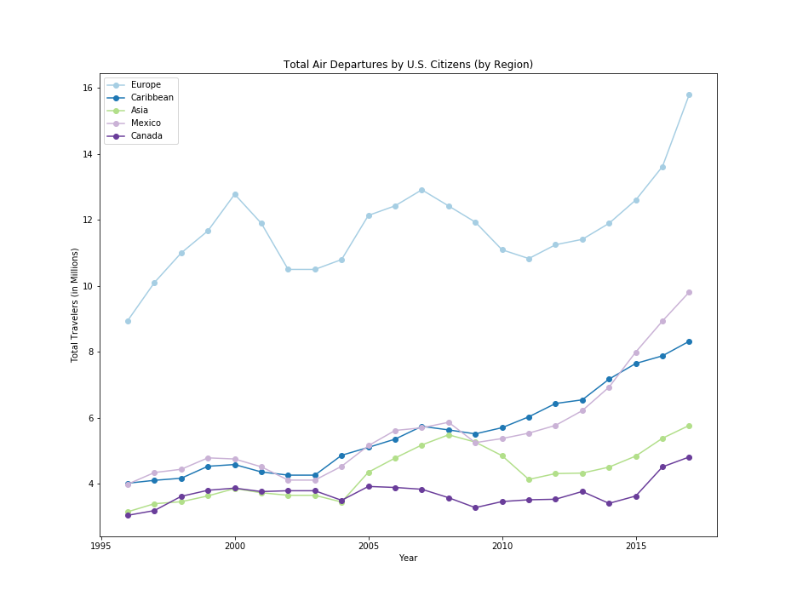
How has travel numbers changed over time?
Travel has nearly doubled since 1996, however some regions have shown more of a change than others.
Notes:
The Middle East and Central America have shown an upward trend over time, while South America and Oceania have lagged behind other areas in growth.

Slide 8
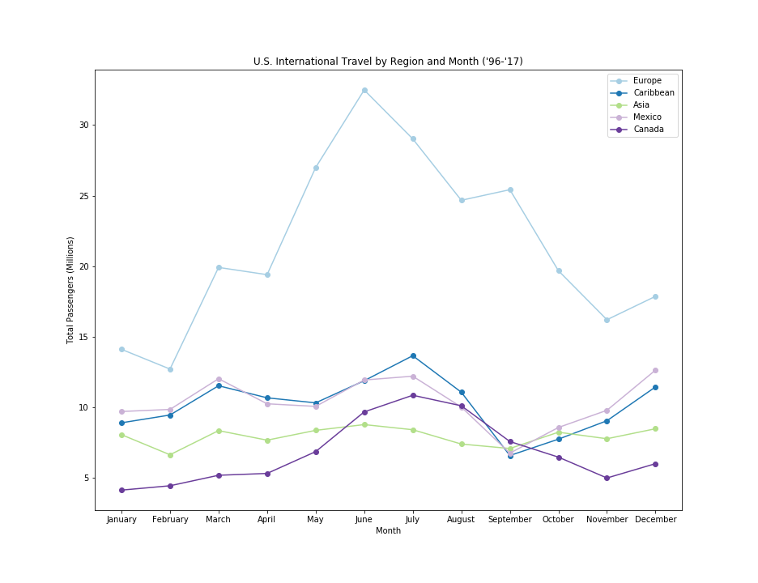
What may make people travel during certain periods of time?
Notes:
Travel patterns reveal themselves in monthly charts. There are spikes for travel in March potentially due to carnival/spring break. The summer months are the busiest, likely due to the pleasant weather and kids being out of school. September shows a downwards trend for the Carribean and Mexican regions, likely owing to the hurricane season. December has a noticeable spike as well, most likely because of the holidays and time from work.

Slide 9
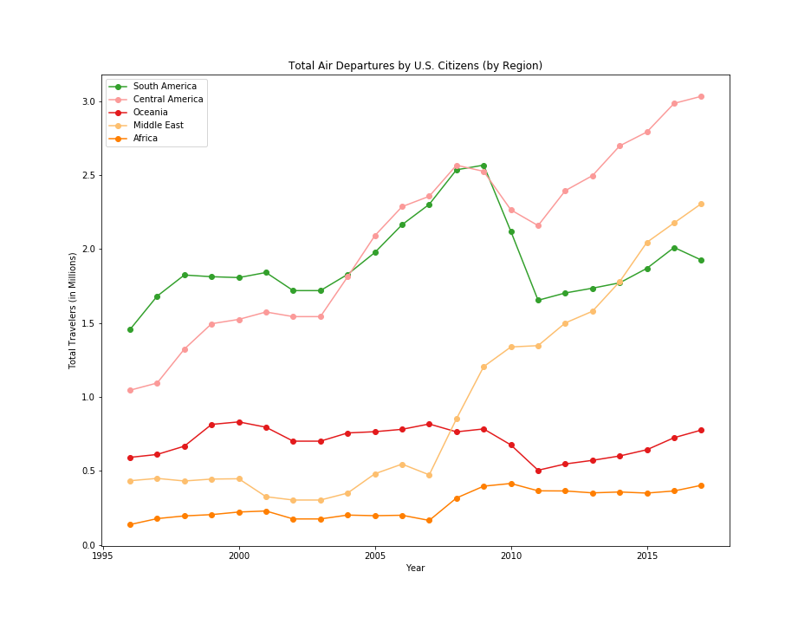
What's the most popular and the least favorable travel destination according to the travel trends in the past ~20 years?
Europe is by far the most popular. Mexico and the Caribbean alternate between second and third place fairly often.
The least traveled to region appears to be Africa.

Slide 10
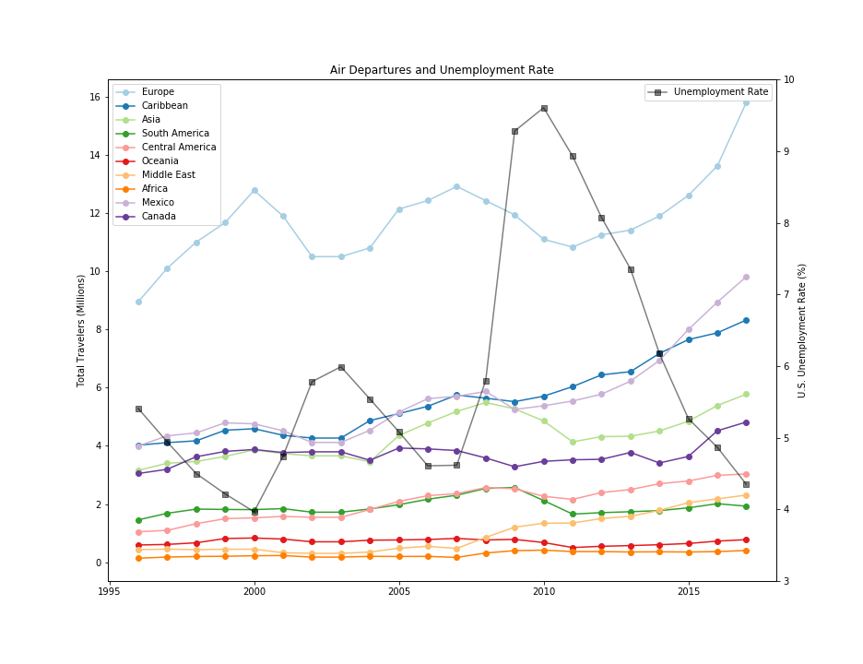
How the change of economy affect people's purchasing power on traveling overseas?
The amount of outbound visitors appears to be inversely linked to the unemployment rate. Travel spending has made an upward trajectory overall, suffering only slight setbacks after 9/11 and the recession in 2008.

Slide 11
What is the change on travel numbers during a major historical event/ natural disaster/ political crisis?
It is difficult to describe the impact of a major historical event on the data that we have. We can not conclusively say that events such as 9/11 have impacted the travel data, while at the same time discounting the recession and it’s impact on travel tourism and the economy.

Slide 12
Post Mortem

Slide 13
Post Mortem
Discuss any difficulties that arose, and how you dealt with them
Discuss any additional questions that came up, but which you didn't have time to answer: What would you research next, if you had two more weeks?

Slide 14
Questions?

