Slide 1
resstock_amy2012_release_1_upgrade=4_8
File created on: 4/17/26 11:14:34 AM MDT

Slide 2
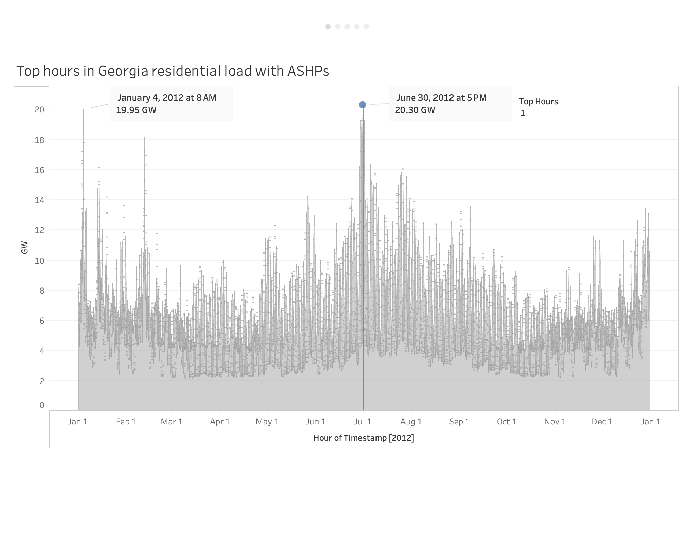

Slide 3
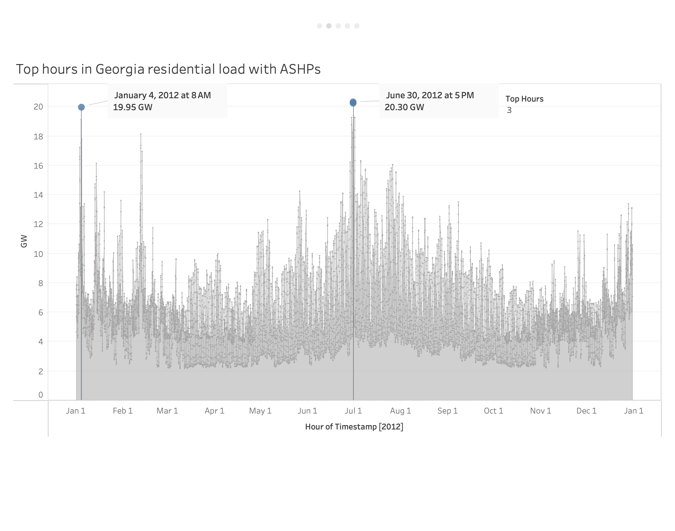

Slide 4
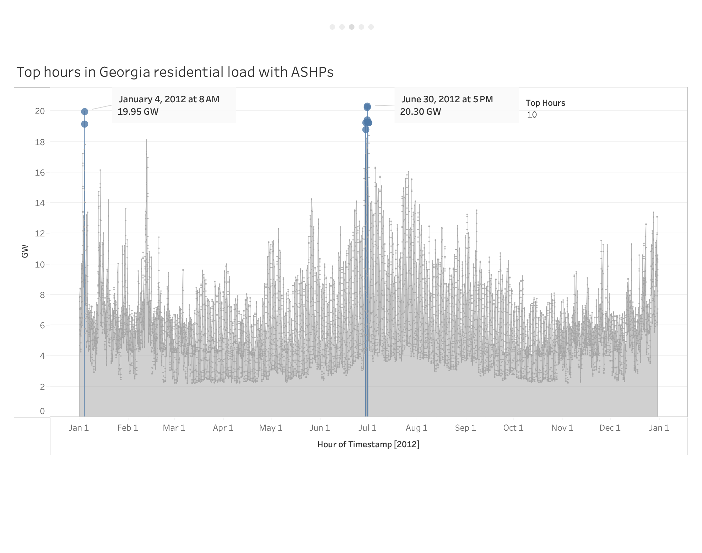

Slide 5
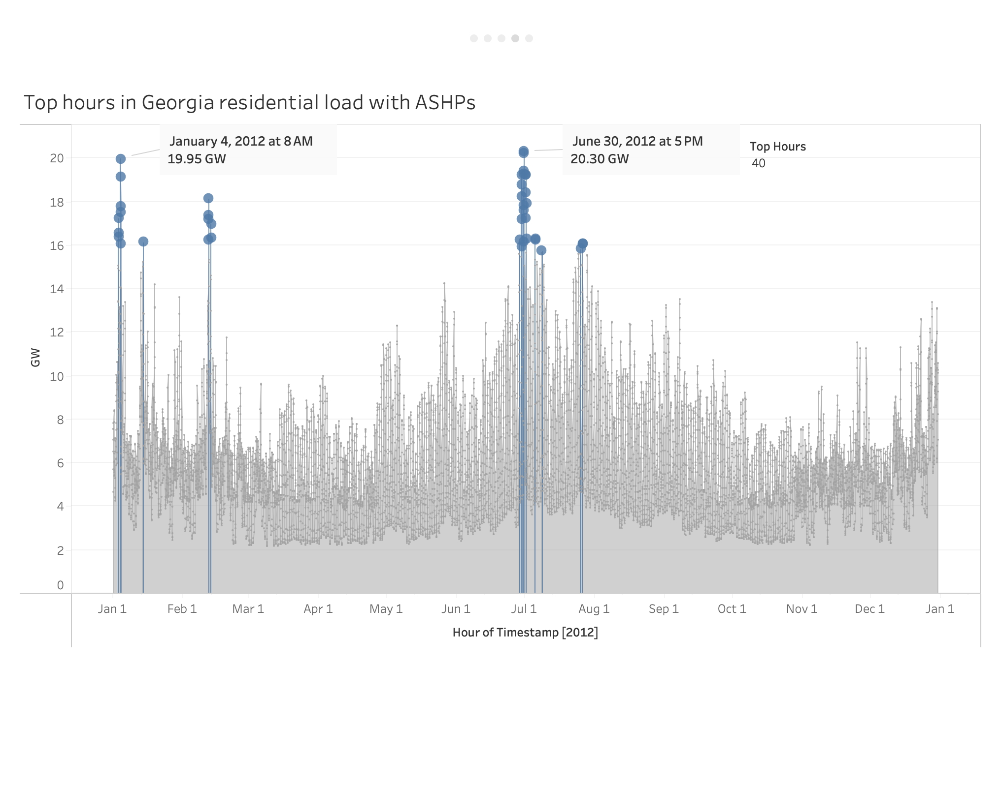

Slide 6
