Slide 1
Project Pretention by team 6
Hybrid vs. Other Fuel Types
A Used Car Sales Analysis for Discount Motors
Growing hybrid and electric vehicle sales ahead of the UK's 2030 transition
Prepared for: Marketing Team, Discount Motors
Prepared by: Team 6
Date: July 2026

Slide 2
Business Background & Goals
The UK will require all new cars sold to be zero-emission from 2030.
This will reshape buyer expectations well before then, petrol and diesel vehicles are likely to lose value faster, while buyers increasingly weigh a car's future value and running cost.
2030
UK ban on new petrol/diesel car sales
Discount Motors sold zero electric vehicles in the last six months, so hybrids are currently the only electrified option in its sales data.
0
Electric vehicles sold in the last six months
Goal: grow hybrid & EV sales next year
Discount Motors | Hybrid vs. Other Fuel Types
2

Slide 3
Project Objectives
“How do hybrid car sales differ from other fuel types (petrol, diesel, etc.) over the last six months?”
1
Increase hybrid sales now
2
Prepare customers for EVs
Identify what currently differentiates hybrid buyers from petrol and diesel buyers, and use that to make hybrids more appealing despite their higher price.
Since no electric vehicles were sold in this period, hybrid sales data serves as the closest available proxy for electrified-vehicle buyer behavior ahead of 2030.
Discount Motors | Hybrid vs. Other Fuel Types
3

Slide 4
Our Approach
How we addressed the business question
1
Validated & cleaned the data
Checked all 9 columns of 6,738 vehicle sales for missing values, duplicates, incorrect types, and invalid entries. Removed 39 duplicate records and corrected invalid engine-size entries, leaving 6,699 clean records.
2
Explored the data visually
Built single-variable and multi-variable visualizations in Power BI to understand the shape of the data and how fuel types compare.
3
Compared hybrid to other fuel types
Measured price, mileage, road tax, MPG, and engine size for Hybrid, Petrol, Diesel, and Other to isolate what makes hybrid different.
4
Defined a KPI to monitor
Translated the comparison into a single trackable metric — the Hybrid Sales Mix Rate — that management can monitor going forward.
Discount Motors | Hybrid vs. Other Fuel Types
4

Slide 5
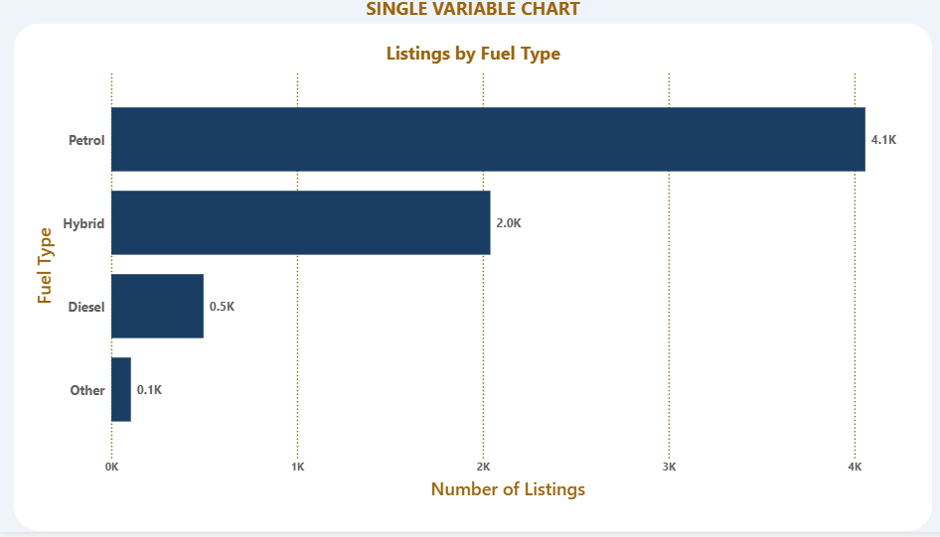
Finding: Fuel Type Distribution
30%
of all sales are already Hybrid
Petrol leads with 4,058 sales, followed by Hybrid at 2,040 (≈30%), then Diesel (496) and Other (105). Hybrid is already a substantial, established part of the business — not a niche category to build from zero.
Discount Motors | Hybrid vs. Other Fuel Types
5

Slide 6
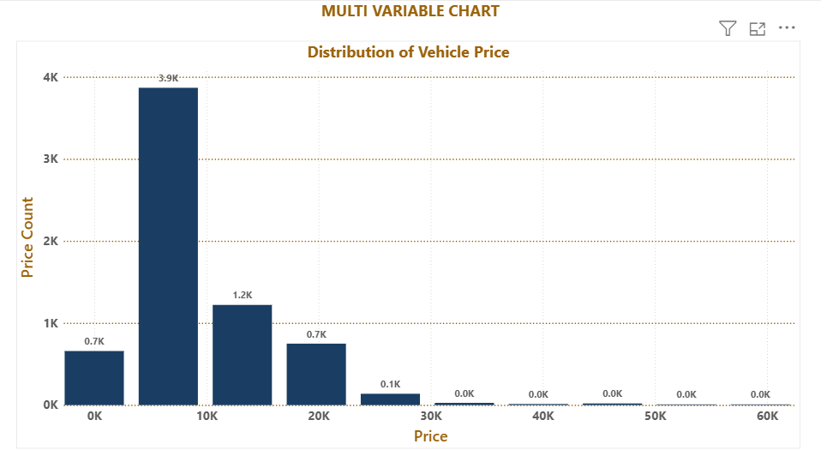
Finding: Price Distribution
£8K–£15K
is where most vehicle prices cluster
Prices range from £850 to £59,995, with a long tail toward the top end. Most of the market sits in the budget-to-mid-range band — important context for how a hybrid price premium will land with the average buyer.
Discount Motors | Hybrid vs. Other Fuel Types
6

Slide 7
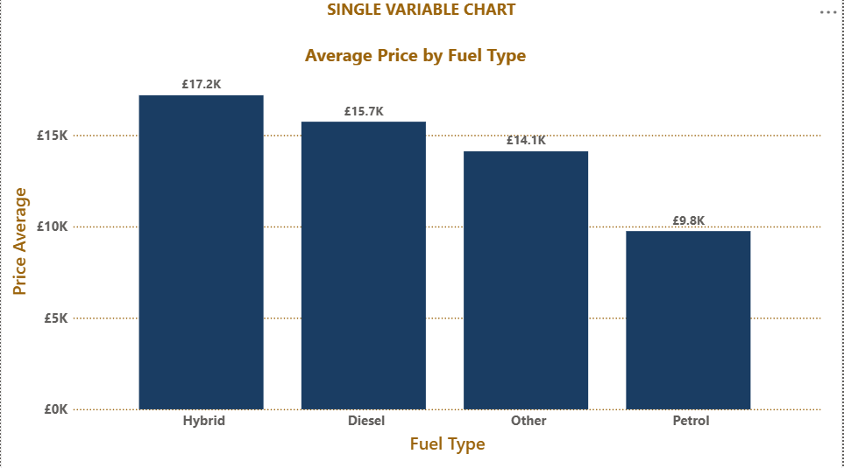
Finding: Average Price by Fuel Type
£17,188
average Hybrid price vs. £9,755 Petrol
Hybrids carry the highest average price and are almost exclusively automatic (99%+). Hybrid buyers pay a real premium up front, bundled with automatic transmission — hybrid should be marketed as a premium purchase, not compared to entry-level manual petrol cars on price alone.
Discount Motors | Hybrid vs. Other Fuel Types
7

Slide 8
Key Findings Summary
Metric | Hybrid | Petrol | Diesel
Average price | £17,188 | £9,755 | £15,740
Average mileage | 24,415 | 19,977 | 41,661
Average annual tax | £60 | £105 | £149
Average MPG | 75.3 | 58.1 | 52.0
Average engine size | 1.8L | 1.2L | 2.1L
Takeaways
Hybrids cost more upfront but save £45–£89/year in road tax
Hybrids are the most fuel-efficient fuel type by a wide margin
Hybrid mileage sits between Petrol and Diesel i.e it is a mixed commuter/family profile
Hybrid is already ~30% of sales
Discount Motors | Hybrid vs. Other Fuel Types
8

Slide 9
Business Metric to Monitor
Hybrid Sales Mix Rate
Formula
(Number of Hybrid Vehicles Sold ÷ Total Vehicles Sold) × 100
30.5%
Why it matters
A single, trackable number that reflects progress on both business goals at once: growth means more hybrid sales today, and a larger hybrid base is the group most receptive to a future EV purchase.
current value
2,040 Hybrid sales ÷ 6,699 total sales × 100
How the business should use it
Recalculate monthly or quarterly as new sales come in
Track alongside average tax saving per hybrid sold (£45/year vs. Petrol)
Review in the same reporting cycle as overall sales performance
Target: 40% within 12 months
Discount Motors | Hybrid vs. Other Fuel Types
9

Slide 10
Recommendations
1
Lead with total cost of ownership
Market hybrids on running-cost savings (£45–£89/yr tax, 20–30% better MPG), not sticker price — this closes the gap the price premium creates.
2
Position hybrid as the premium trim
Since hybrids are almost universally automatic, pair hybrid offers with automatic-transmission financing rather than comparing to manual base models.
3
Use hybrid owners as a warm EV audience
Nearly 30% of customers already accepted a cost trade-off similar to EVs — target them first for EV test drives and campaigns.
4
Track the KPI every reporting cycle
Review Hybrid Sales Mix Rate alongside overall sales performance, with a stated target, so hybrid growth stays visible and accountable.
Hybrids already have real traction and a defensible cost story — the natural bridge to grow EV sales ahead of 2030.
Discount Motors | Hybrid vs. Other Fuel Types
10

