Slide 1
Install Jenkins on CentOS 7
Step 1: Update your CentOS 7 system
sudo yum install epel-release
sudo yum update
Step 2: Install Java
sudo yum install java-1.8.0-openjdk
sudo yum install java-1.8.0-openjdk-devel
Java -version
set two environment variables: "JAVA_HOME" and "JRE_HOME"
sudo cp /etc/profile /etc/profile_backup
echo 'export JAVA_HOME=/usr/lib/jvm/jre-1.8.0-openjdk' | sudo tee -a /etc/profile
echo 'export JRE_HOME=/usr/lib/jvm/jre' | sudo tee -a /etc/profile
source /etc/profile
Verify environment variables
echo $JAVA_HOME
echo $JRE_HOME

Slide 2

Step 3: Install Jenkins
cd ~
sudo wget -O /etc/yum.repos.d/jenkins.repo https://pkg.jenkins.io/redhat-stable/jenkins.repo
sudo rpm --import https://pkg.jenkins.io/redhat-stable/jenkins.io.key
yum install jenkins
Start the Jenkins service and set it to run at boot time:
Service Jenkins start
Launch Jenkins, go to browser
http://<IP Address>:<Port Number> -→ Default port number is 8080
Change PORT NUMBER or HOME Directory
File : /etc/sysconfig/jenkins

Slide 3
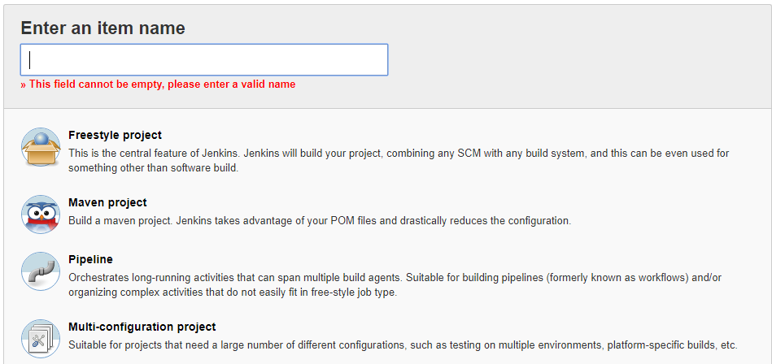
Project Types

Slide 4
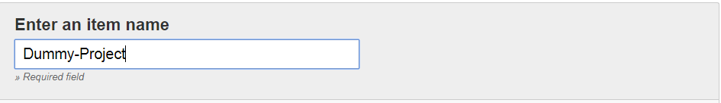
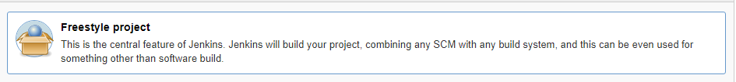
Creating Project
Give the Project Name
Select the project type
Click on OK
For Free style project , we can observe six sections

Slide 5
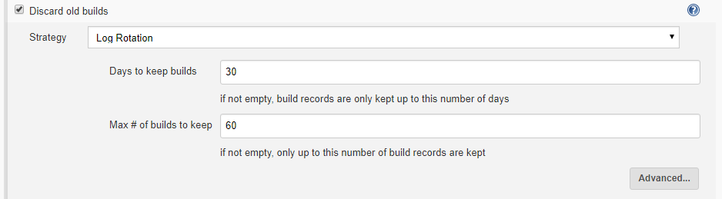
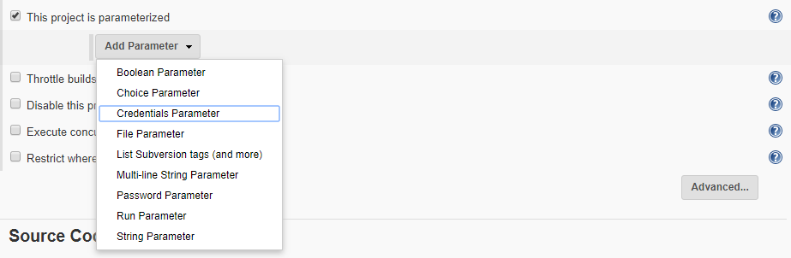
Important options of General
Passing input to the Job using parameterized options

Slide 6
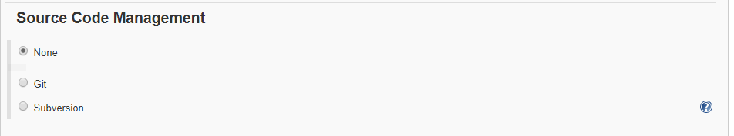
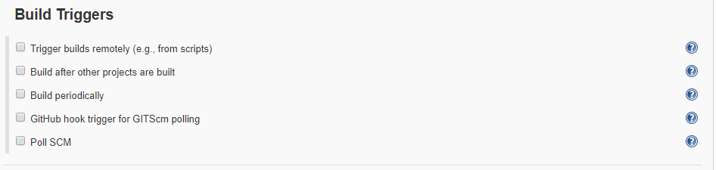
Source Code Management
Build Triggers

Slide 7
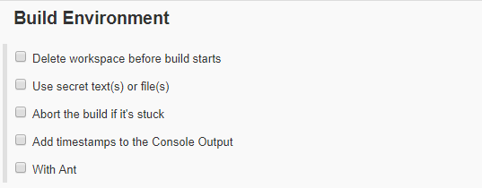
Trigger Builds Remotely : Job can be triggered from scripts
Build after other projects are Build: Current job will become down stream for the job which you mentioned here
Build periodically : Based on the schedule job will be triggered (same cron job setup)
GITHUB trigger for GITSCM Polling : when ever code pushed to SCM , job will be triggered
Poll SCM : Based on the schedule job will be triggered but code commit should be happened in the SCM other wise job will not be triggered
Build Environment
Delete workspace before build start: It will clean the job workspace before build starts
Abort build if it’s stuck: Job will be aborted it it is stuck after completion of timeout time which we mentioned in the timeout option
Add timestamps to the Console Output: Date and time will be added to the out put of job , which we can observe in the console output

Slide 8
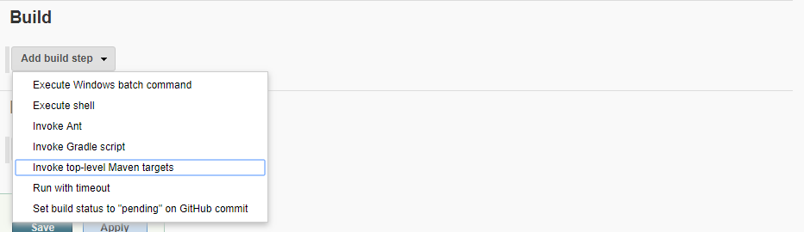
Build
Execute Windows batch command: Window batch command can be executed
Execute Shell: Shell command can be executed
Invoke top-level Maven targets : Invoke Maven Build phases
Run with timeout : Job execution time can be passed

Slide 9
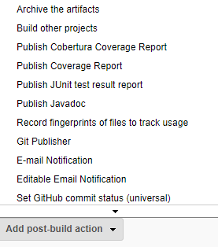
Post Build Actions:
Archive the artifacts: Artifacts location can be passed where we want to store
Build other projects: Current job will become upstream for the job which we passed here
Publish Junit test result report : Junit results can be captured (**/target/surefire-reports/*.xml)
Email Notification : Email can be send if the job fails
Editable Email Nofication : Email can be send for different actions (ex : success or failure)

Slide 10
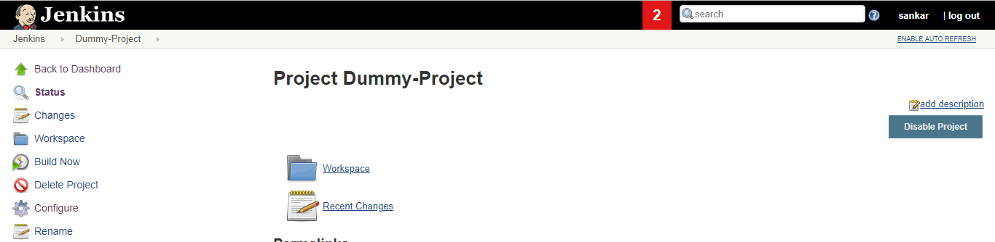

Job Information
Build Job: click on Build Now
Job Output : Go to builds history , open Console output

Slide 11
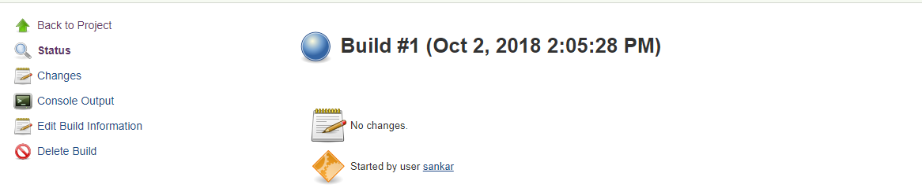
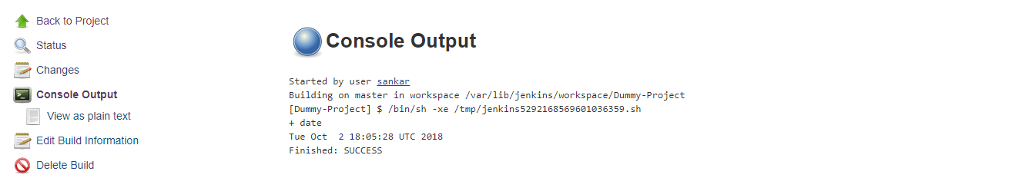
Console Output : Click on Console output to see the job log information
Delete Build : Click on Delete Build to delete the Build

Slide 12
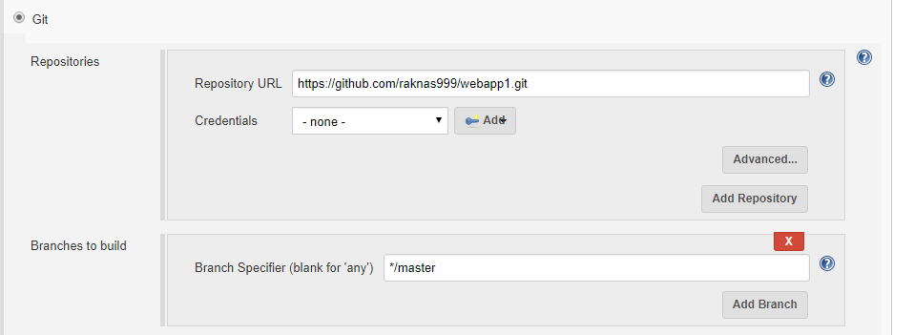
GIT Integration :
Repositories : Under Repository we need to specify the GIT Repository path so that jenkins will pull the code from that repository
Credintials : If the repository is public then credentials are optional , if it is private repository we need to pass credentials , credentials can be stored using Add button
Branches to build: The branch where the code should be picked
Note : Git plugin will be installed when we opt suggested plugins at the time of Jenkins setup , otherwise install GIT plugin and use it

Slide 13
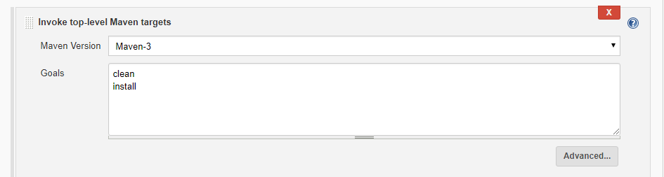
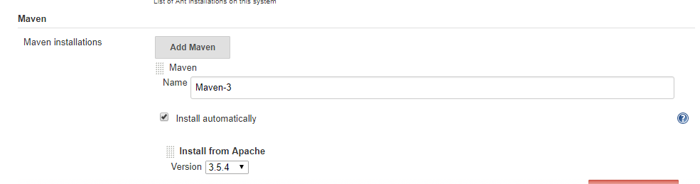
Maven Integration :
If the project style is free style
Maven Integration steps :
1. Click on Manage Jenkins
2. Click on Global Tool Configuration
3. Go to Maven section then click on Add Maven

Slide 14
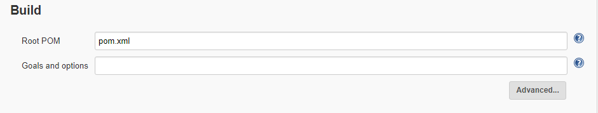
1. Give the Name of Maven (user choice)
2. Check the option Install Automatically
3. Choose the required version of Maven
Using Maven in the Job
1. Choose Invoke Top Level Maven Target in the Build section
2. Choose the Maven Version
3. Specify the Maven Goals
If the project style is Maven Project
Root POM : It is default, no need to change this one
Goals and Options : Here we need to mention Maven Goals

Slide 15
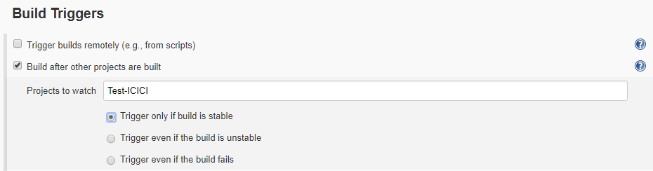
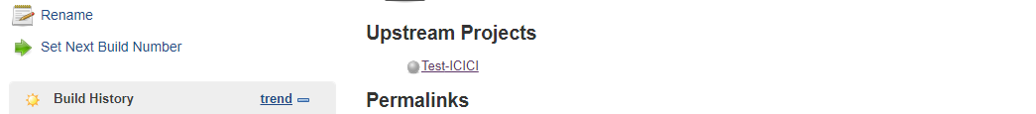
Down Stream and Upstream Jobs :
Upstream Job Configuration :
1. Go to Job configuration
2. Go to Build Triggers section
3. Choose the option Build after other Projects are build
a. Projects to watch : Give the Name of the Upstream Project
b. Options are used to triggering the job based on upstream job staus
After Saving the project we can observer Upstream project details

Slide 16
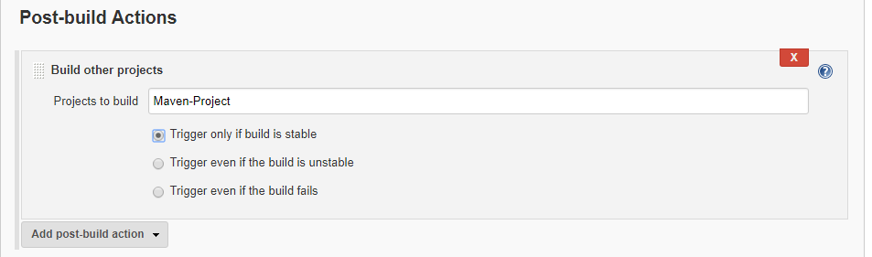
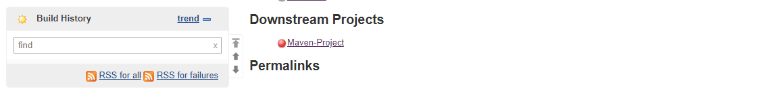
Down Stream Job Configuration :
1. Go to Job configuration
2. Go to Post Build Actions section
3. Choose the option Projects to build
a. Projects to Build : Give the Name of the Upstream Project
b. Options are used to triggering the job based on upstream job staus
After Saving the project we can observer Down stream project details

Slide 17

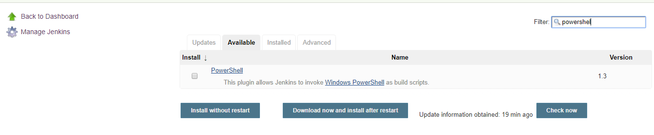
Plugins :
Go to Manage Jenkins then click on Manage Plugins
Install Plugin : Click on Available tab and search for plugin
Click on Download now and install after restart or install without restart

Slide 18
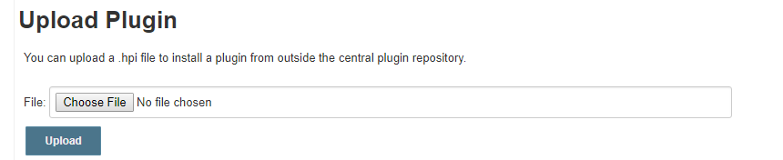
Custom Plugins : To install custom plugins (.hpi file) select advanced tab
Choose the file and upload
Sample Plugins
Install Below Plugins:
1. Static Analysis Collector
2. Checkstyle
3. FindBugs
4. PMD
5. Cobertura

Slide 19
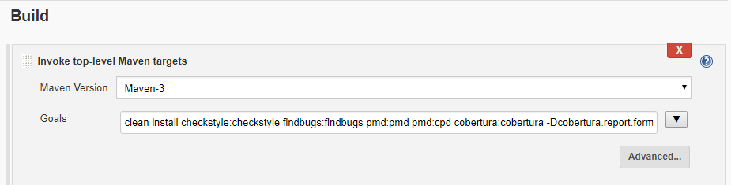
Plugins usage : in the build step provide the plugin along with the goal
clean install checkstyle:checkstyle findbugs:findbugs pmd:pmd pmd:cpd cobertura:cobertura -Dcobertura.report.format=xml

Slide 20
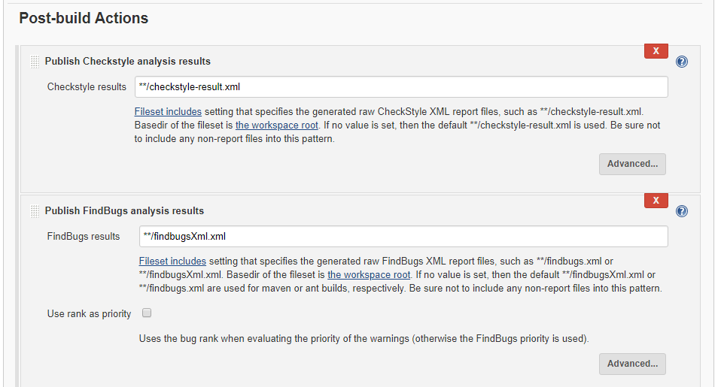
Capture the plugin output in the Post Build Actions
Checkstyle results : **/checkstyle-result.xml
FindBugs results : **/findbugsXml.xml

Slide 21
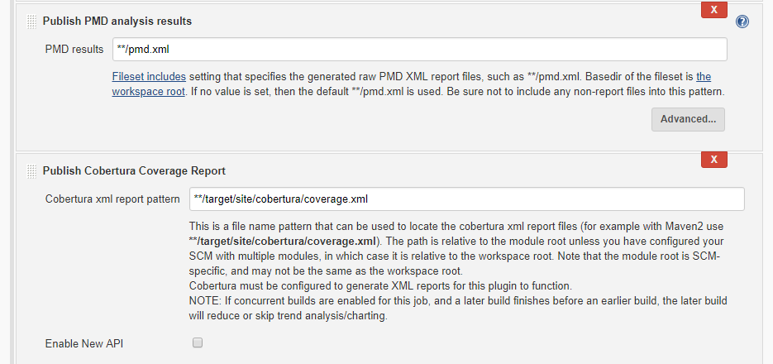
PMD results : **/pmd.xml
Cobertura XML report pattern : **/target/site/cobertura/coverage.xml

Slide 22

Changing Port Number:
Go to the path : /etc/sysconfig
Open the config file : jenkins
Change the port number to the variable JENKINS_PORT (by default it will be 8080)
After changing the port number save the file (:wq)
Restart jenkins (service jenkins restart)
Open browser and type ipaddress:9090 , now jenkins will run with new port number

Slide 23
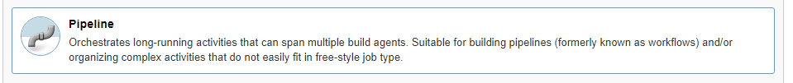
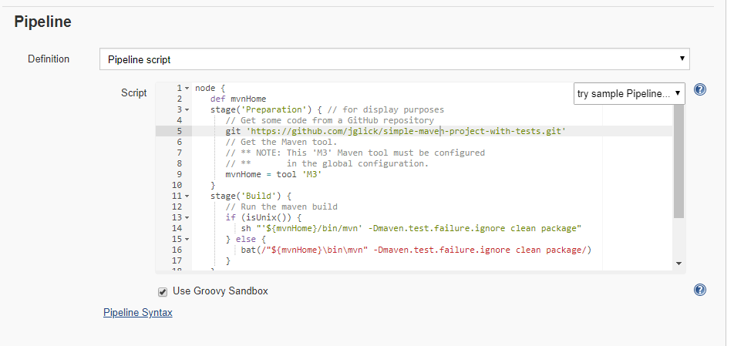
Pipeline Job:

Slide 24
Sample Code:
node {
def mvnHome
stage('Preparation') { // for display purposes
// Get some code from a GitHub repository
git 'https://github.com/jglick/simple-maven-project-with-tests.git'
// Get the Maven tool.
// ** NOTE: This 'M3' Maven tool must be configured
// ** in the global configuration.
mvnHome = tool 'M3' }
stage('Build') { // Run the maven build
if (isUnix()) {
sh "'${mvnHome}/bin/mvn' -Dmaven.test.failure.ignore clean package"
} else {
bat(/"${mvnHome}\bin\mvn" -Dmaven.test.failure.ignore clean package/)
}
}
stage('Results') { junit '**/target/surefire-reports/TEST-*.xml' archive 'target/*.jar' }
}

Slide 25
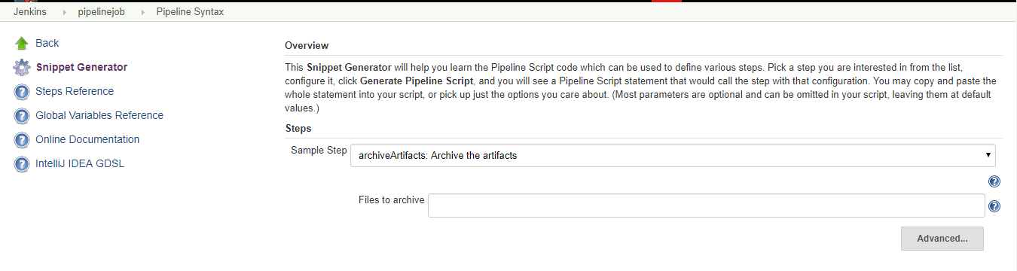
Pipeline Code Generator:
Click on Pipeline syntax
Multiple options are available in sample step, choose as per the requirement

Slide 26
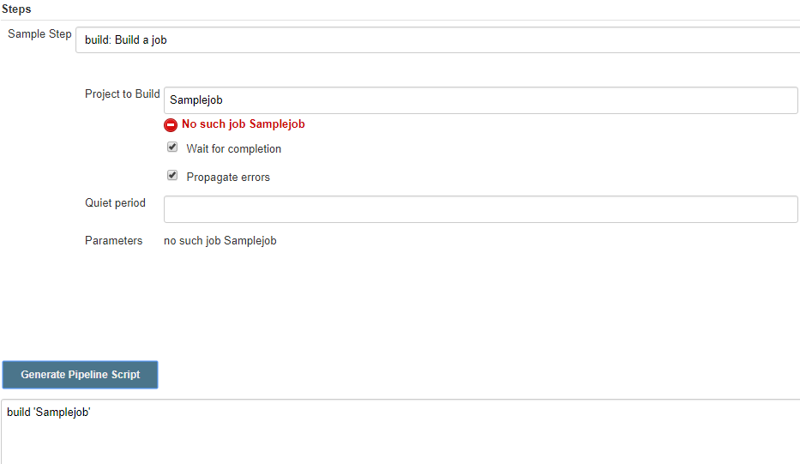
Creating Project thru snippet generator

Slide 27
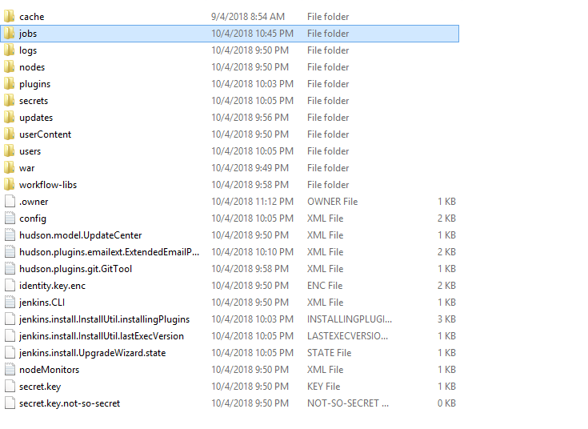
Jenkins directory content

Slide 28
Docker Container as Slave
Create a machine and install docker on it
Enabling the docker TCP API
1. Change startup options
The default ‘OPTIONS’ in /etc/init.d/docker is:
OPTIONS="${OPTIONS:-${other_args}}"
Change it to :
OPTIONS="${OPTIONS:-${other_args}} -H tcp://0.0.0.0:2375 -H unix:///var/run/docker.sock"
2. sudo service docker restart
3. Test API
curl http://<ip_address>:2375/version

Slide 29
Create docker image
You can pull a ready-made jenkins slave using docker pull command!
docker pull evarga/jenkins-slave
Login to the machine and perform below actions
docker run -i -t image-name /bin/bash
Perform below actions
apt-get update
apt-get install git
Come out from the machine
exit
Take the container ID
docker ps -a
Create an image on top of the container
docker commit <container-id> docker-slave-image

Slide 30
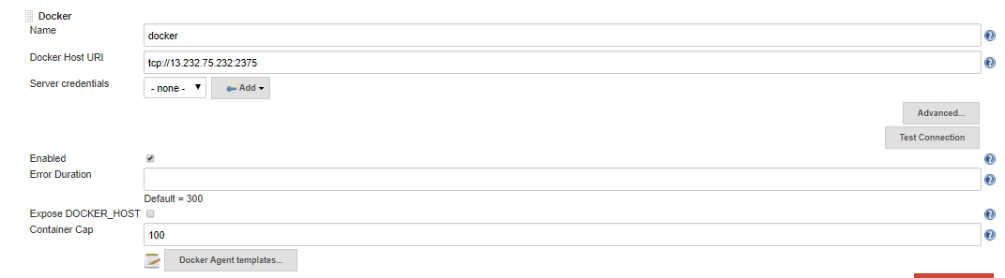
Jenkins Configuration
Install docker plugin
Go to Manage Jenkins → Configure system -→ Cloud → Add new cloud(select Docker)
Test the connection, it should show API version
Host URL : Docker machine IP (if it is aws machine then take public ip)
Click on Docker Agent templates

Slide 31
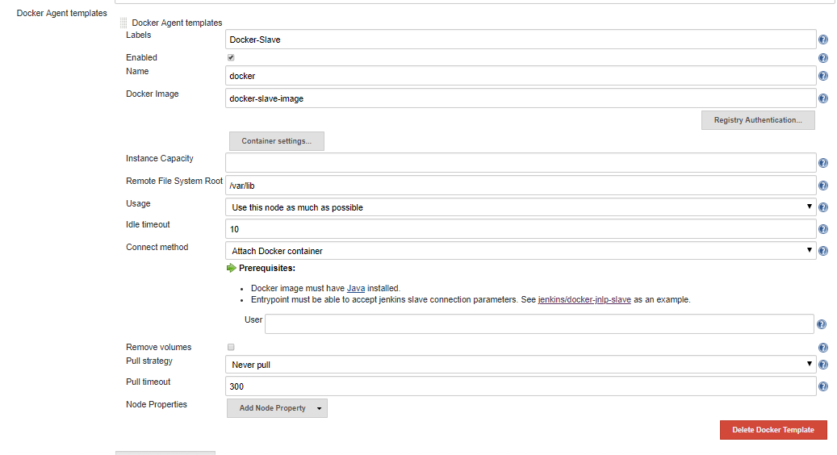

Slide 32
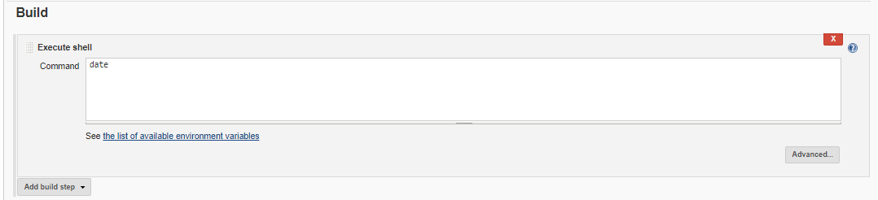
Docker Image : Newly create image on top of the container
Labels : To identify Docker slave name in Jenkins during job creation
Remote File System Root : Jenkins home directory on the container
Job Setup

Slide 33
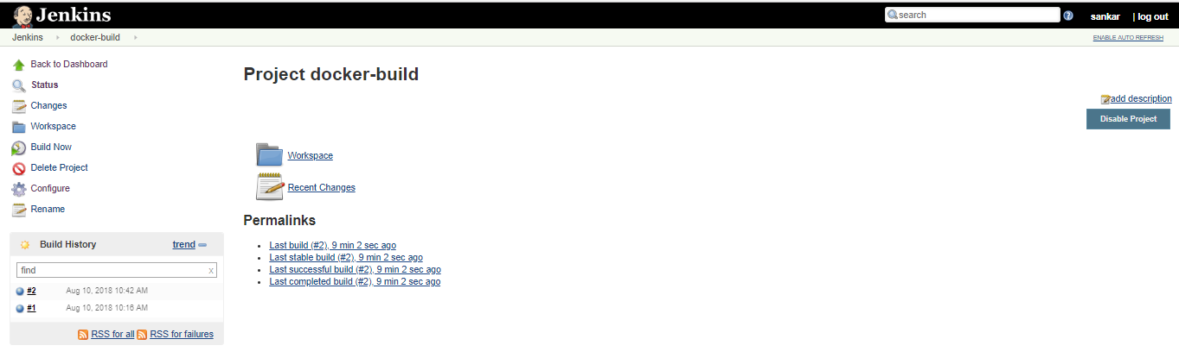
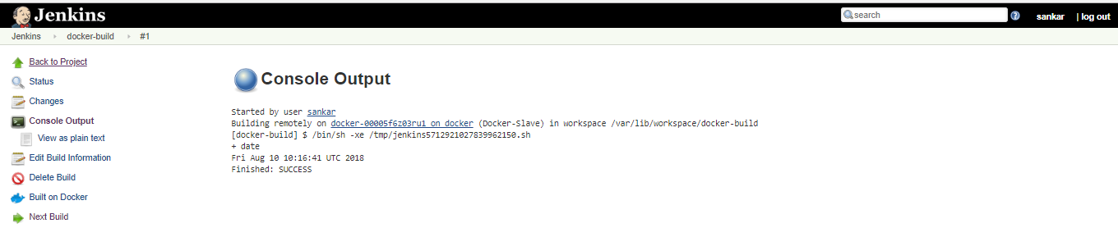

Slide 34
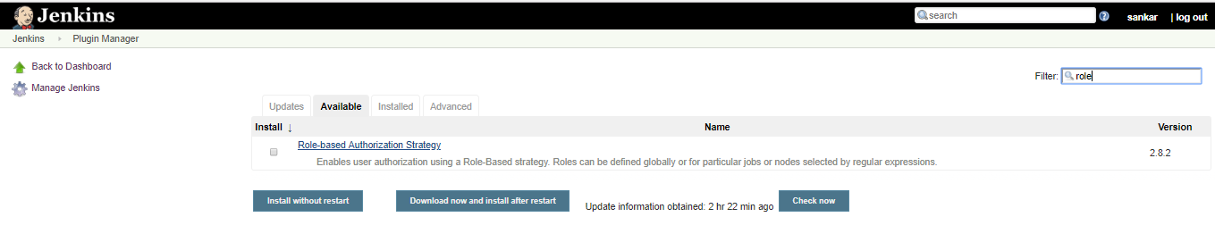
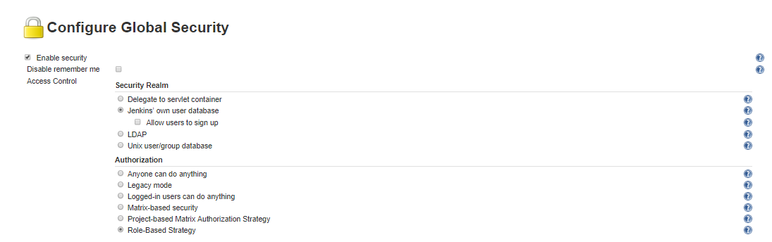
Role Based Strategy Plugin
Install the plugin
Enable Role Based Strategy Plugin

Slide 35
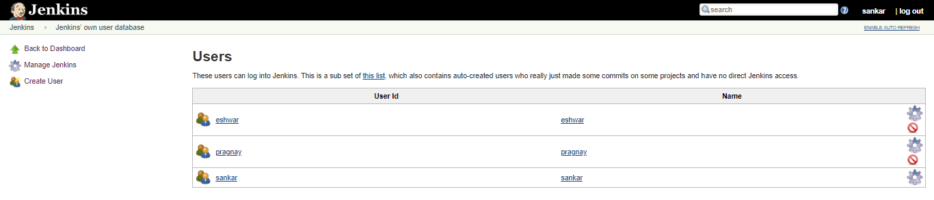
Create Two Users
Go to Manage and Assign Roles
Note :This option will come only after enabling Role based strategy plugin in the global security

Slide 36
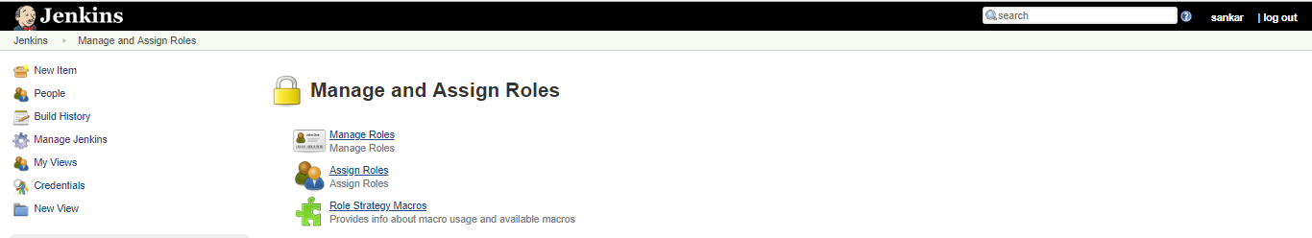
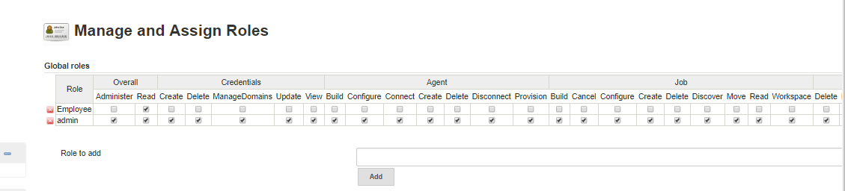
Click on Manage Roles
Create Employee Global Role and assign overall read permission

Slide 37
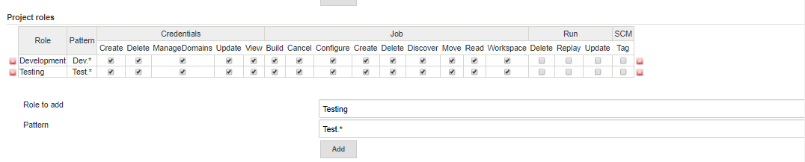
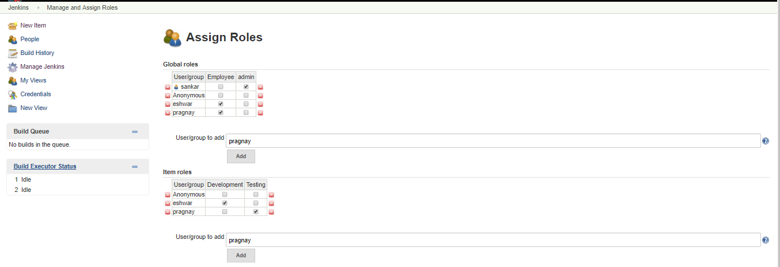
Create Development and Testing Project Roles
Assign the users to Global and Project roles

Slide 38
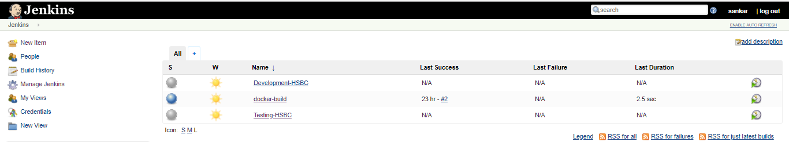
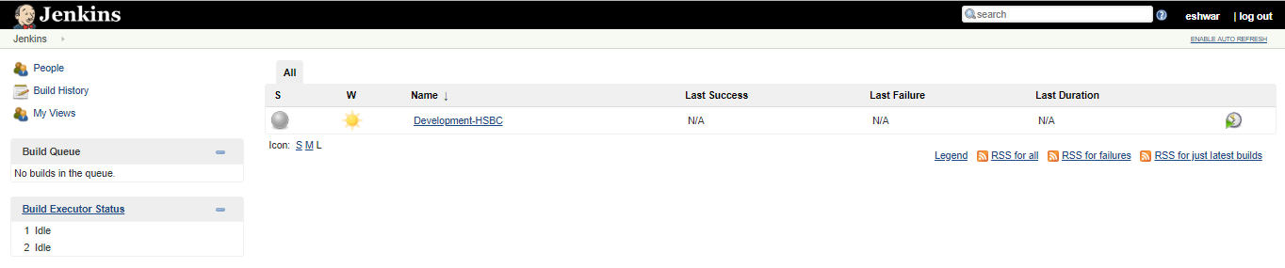
Create Development and Testing projects
Login with user Eshwar , only Development project is visible

Slide 39
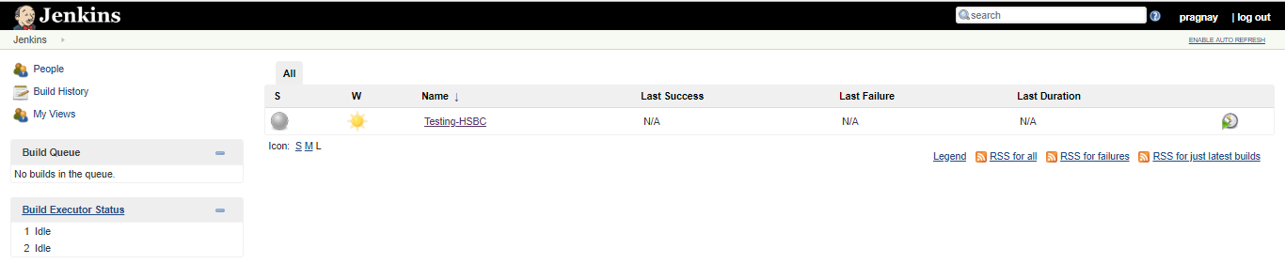
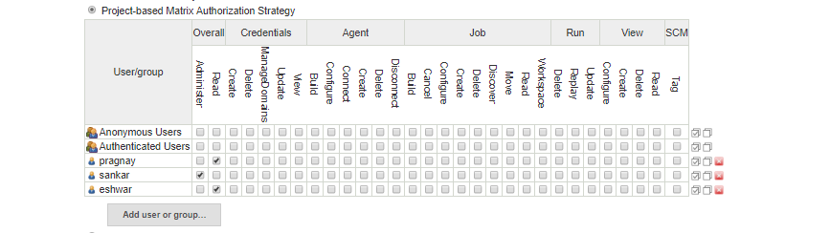
Login with user Pragnay , only Testing project is visible
Project based Matrix Authorization Strategy Plugin
Add the users and assign overall read permission

Slide 40
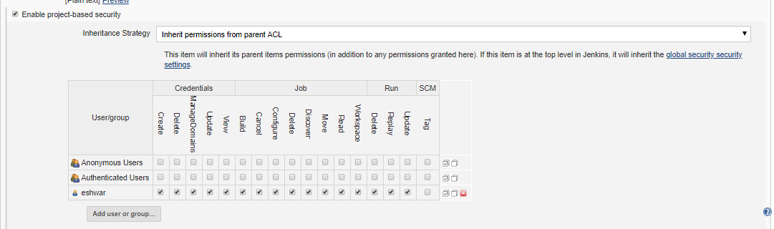
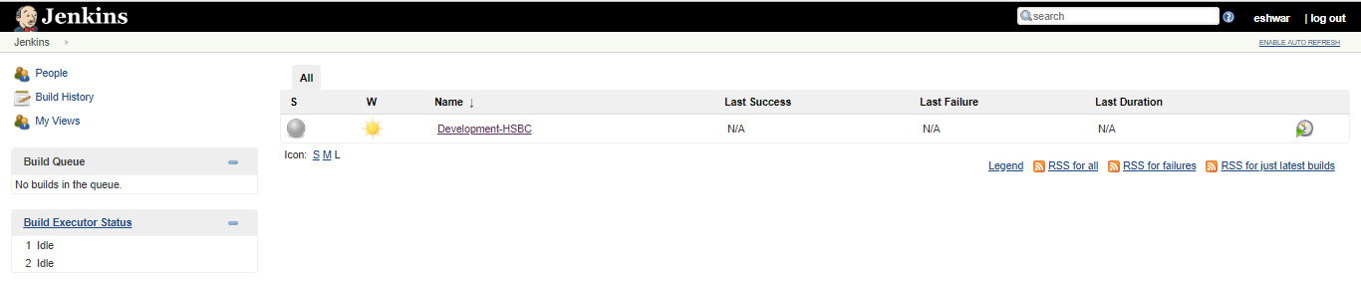
Go to project configuration and add the user and assign required permissions
Log in and verify the user

Slide 41
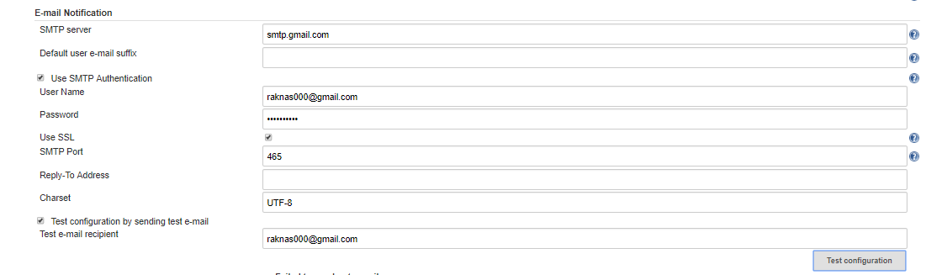

EMAIL Notification
Note : Mailer plugin version 1.20 is working one
Allow secure access if test failed : https://myaccount.google.com/u/1/lesssecureapps?pageId=none

Slide 42

Update JAVA_OPTOINS in /etc/sysconfig/Jenkins file to allow smtp
Test again , it will succed
Modify the Build data, we should receive mail once the job fails

Slide 43


Sent mail
Only for failure jobs mail will be send not for successful jobs

Slide 44


For successful/unsuccessful jobs update Extended Email Notification step
Go to post build actions of the project and select Editable Email Notification

Slide 45


Add trigger under Advanced settings, select success

Slide 46

Linux machine as Slave
Create slave machine
Install Java on the Slave server
sudo yum install java-1.8.0-openjdk
sudo yum install java-1.8.0-openjdk-devel
Setup JAVA_HOME and JRE_HOME
Add the below variables in /etc/profile
export JAVA_HOME=/usr/lib/jvm/jre-1.8.0-openjdk
export JRE_HOME=/usr/lib/jvm/java-1.8.0-openjdk/jre
Source profile
Add administrative service user to the Slave server
useradd jenkins -U -s /bin/bash
Passwd jenkins
Modifying /etc/sudoers:

Slide 47


On the Jenkins machine
Switch to Jenkins user and create SSH key
usermod -s /bin/bash jenkins
Place the public key into the slave machine’s authorized_keys file
ssh-copy-id jenkins@192.168.0.9
Create slave node

Slide 48

In above Diagram :Name : Name that uniquely identifies an agent within this Jenkins installation. Description : Optional ,description for this agent. # of executors : The maximum number of concurrent builds that Jenkins may perform on this agent. Remote root directory : An agent needs to have a directory dedicated to Jenkins. Specify the path to this directory on the agent. It is best to use an absolute path, such as /var/jenkins or c:\jenkins. This should be a path local to the agent machine. There is no need for this path to be visible from the master.

Slide 49

Launch method : It Controls how Jenkins starts this agent. Launch agent via Java Web Start : Allows an agent to be launched using Java Web Start. In this case, a JNLP file must be opened on the agent machine, which will establish a TCP connection to the Jenkins master. This means that the agent need not be reachable from the master,the agent just needs to be able to reach the master. By default, the JNLP agent will launch a GUI, but it’s also possible to run a JNLP agent without a GUI, e.g. as a Window service. Launch agent via execution of command on the master : Starts an agent by having Jenkins execute a command from the master. Use this when the master is capable of remotely executing a process on another machine, e.g. via SSH or RSH. Launch slave agents via SSH: Starts a slave by sending commands over a secure SSH connection. The slave needs to be reachable from the master, and master will have to supply an account that can log in on the target machine. No root privileges are required.
Run the job, it will run on slave node

Slide 50


Windows machine as Slave
Configure Global Security
Create slave machine

Slide 51


Click on Launch
Slave-agent will be downloaded

Slide 52


Launch the downloaded agent
Run the job on windows-slave

Slide 53


Slave High-Avialability
If slave goes down, the jobs which are running on the slave will not be trigger until slave is back.
To handle this situation create slave group and run the jobs , if one slave goes down other slave will be available
to execute the jobs
Step1 :
create more than one node with same label name
Step 2:
create the job and route it to the label group then execute the job.

Slide 54



Workspace is created In one of the slave node
Other slave not having any workspace
Step 3 : Stop one of the slave node and re run the job

Slide 55


Job executed on the other slave which is active
Job details can be found on the second slave which is active

Slide 56


Dynamic Slave Creation
Install Amazon Ec2 plugin

Slide 57


Create IAM user with EC2 full access
Add the aws key and secret key of the user which created in AWS
Add the ssh private key

Slide 58

Configure the cloud

Slide 59



Slide 60

Click on Advance and provide the following details then save it

Slide 61


Job will launch automatically slave machine
The newly created machine attached to the job
Once the slave is up and running , job will be executed on the slave
After the job completion with in 15 to 20mins, slave will be terminated

Slide 62


Jenkins CLI
Download the Jenkins-cli.jar and copy it into Jenkins Machine

Slide 63

Change Build Number
Install Next Build Number Plugin
Click on set Next Build Number

Slide 64



Slide 65
Script Console
Groovy script which will update the admin email address for jenkins.
import jenkins.model.*
def jenkinsLocationConfiguration = JenkinsLocationConfiguration.get()
jenkinsLocationConfiguration.setAdminAddress("sankar <raknas000@gmail.com>")
jenkinsLocationConfiguration.save()
Groovy Script Examples: https://github.com/cloudbees/jenkins-scripts
Webhook
https://IP:8080/github-webhook/

Slide 66


GIT HUB Update : Go to the repository settings, click on Webhooks and add webhook
JenkinsUpdate : Go to the job which was configured for that particular repository , click on build triggers then enable hook

Slide 67

Auto Merging of GIT Hub branches
Name of repository : User choice name

Slide 68


Slide 69
Ignore unit test cases
-Dmaven.test.skip=true
Download plugins
http://updates.jenkins-ci.org/download/plugins
Error : No Valid Crumb(script console)
import jenkins.model.Jenkins
def instance = Jenkins.instance
instance.setCrumbIssuer(null)

Slide 70

Shared Libraries:
Jenkins Shared library is the concept of having a common pipeline code in the version control system that can be used by any number of pipelines just by referencing it. In fact, multiple teams can use the same library for their pipelines.
vars: This directory holds all the global shared library code that can be called from a pipeline. It has all the library files with a .groovy extension
src: It is a regular java source directory. It is added to the classpath during every script compilation. Here you can add custom groovy code to extend you shared library code
resources: All the non-groovy files required for your ur pipelines can be managed in this folder

Slide 71
Create a file named gitCheckout.groovy under vars folder.
Here is our Git Checkout shared library code
def call(Map stageParams) {
checkout([
$class: 'GitSCM',
branches: [[name: stageParams.branch ]],
userRemoteConfigs: [[ url: stageParams.url ]]
])
}
def call(Map stageParams) – A simple call function which accepts a Map as an argument. From the pipeline stage, we will pass multiple arguments which get passed as a map to the shared library.
stageParams.branch – its the branch parameter which comes from the pipeline stage and we use stageParams to access that variable in the shared library.
Commit the changes and push it to your repository.

Slide 72

Add Github Shared Library Repo to Jenkins
Step 1: Go to Manage Jenkins –> Configure System
Step 2: Find the Global Pipeline Libraries section and add your repo details and configurations as shown below.

Slide 73
Use Checkout Library in Declarative Pipeline
We always call the library using the filename under vars. In this case, gitCheckout is the filename created under vars. Here is how we call gitCheckout library from the pipeline or Jenkinsfile
we are passing branch and url parameter to the Checkout function. Here is the full declarative pipeline code
@Library('jenkins-library@master') _
pipeline {
agent any
stages {
stage('Git Checkout') {
steps {
gitCheckout(
branch: "master",
url: "https://github.com/raknas999/hello-world-servlet.git"
)
}
}
}
}

Slide 74


Slide 75

Console-Output:

