Slide 1
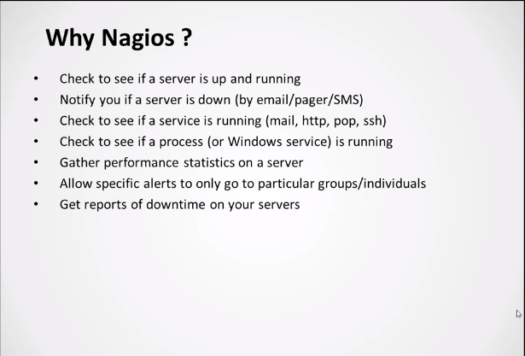

Slide 2
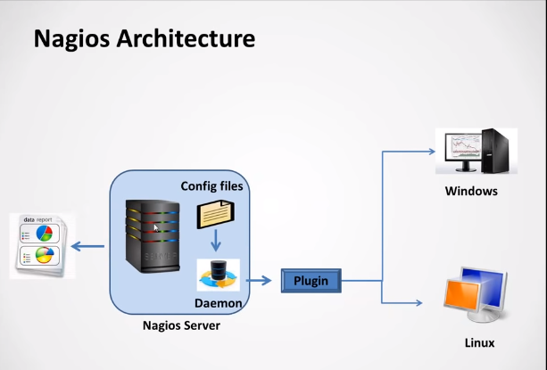
Config Files : where we are configure the details of servers
Deamon : it will reads the details of the config files and runs the respective plugin to get the details of the servers in a interval of time

Slide 3
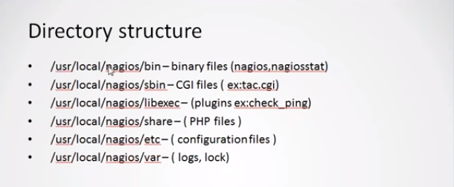

Slide 4
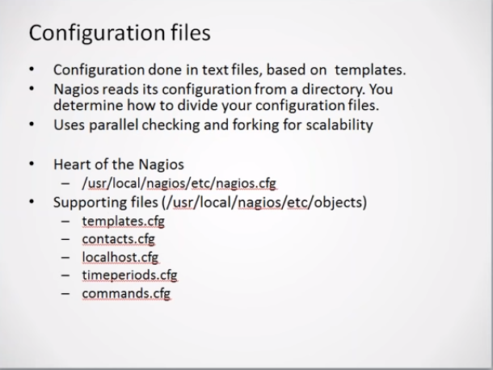

Slide 5
Nagios Setup: https://linuxize.com/post/how-to-install-and-configure-nagios-on-ubuntu-18-04/
Package 'libapache2-mod-php7.2' has no installation candidate:
sudo add-apt-repository ppa:ondrej/php
Adding node to Nagios: https://tecadmin.net/monitor-remote-linux-host-using-nagios/

Slide 6
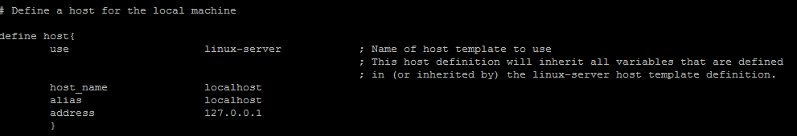
Path of the config files : /usr/local/nagios/etc
Nagios.cfg : main file which consists all the properties of nagios server
Resource.cfg : You can define $USERx$ macros in this file, which can in turn be used in command definitions in your host config file(s). $USERx$ macros are useful for storing sensitive information such as usernames, passwords,
etc. They are also handy for specifying the path to plugins and event handlers
Path of the config files : /usr/local/nagios/etc/objects
Localhost.cfg : host file for monitoring the machine, it consist host definition and service definition
Use : template name (template info can be found in templates.cfg)
Host_name : name of the server
Alias : duplicate name
Addresss : ipaddress of the server

Slide 7
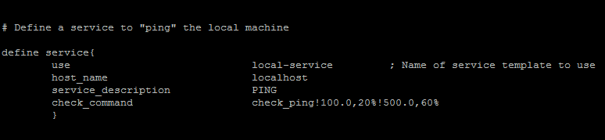
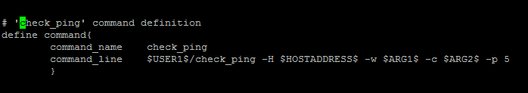
Use : template name
Host_name : name of the server
Service_description : name
Check_command : command details (command details can be found in command.cfg)
commands.cfg : commands information
Command_name : command name
Command_line : execute the command on the server
($USER1 is macro name and check_ping is plugin name)

Slide 8
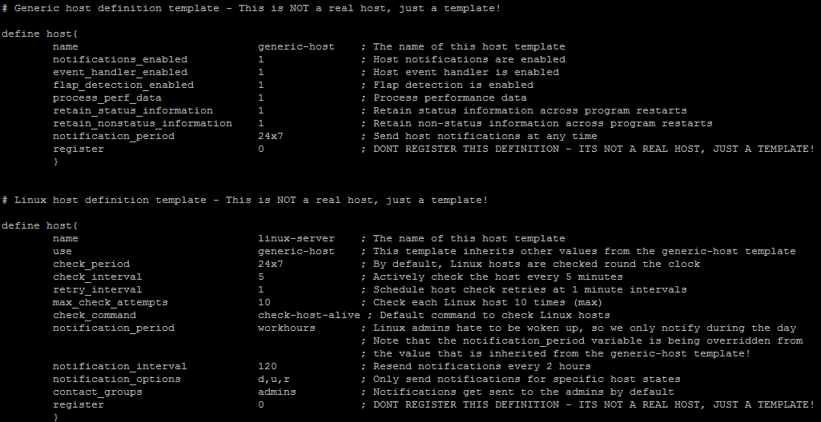
templates.cfg : reusable properties

Slide 9
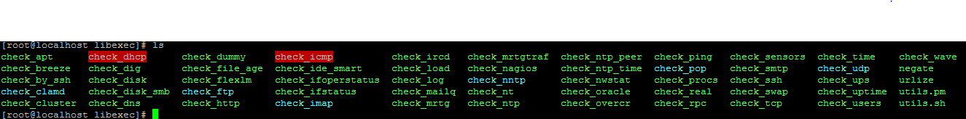
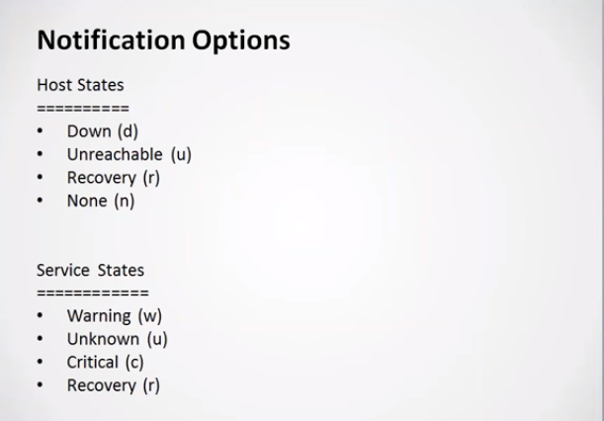
Plugins path :/usr/local/nagios/libexec
To check plugin’s details : ./plugin name --help

Slide 10
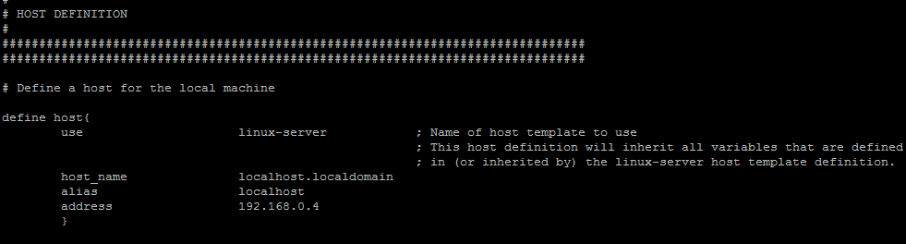
Adding Host
Use : template name
Host_name : hostname of the machine
Alias : alias name for future reference
Address : IP address of the machine
Note : interval time in the templates will be 5 minutes , so to node will be checked every
5 minutes , if we want it can be changed.

Slide 11
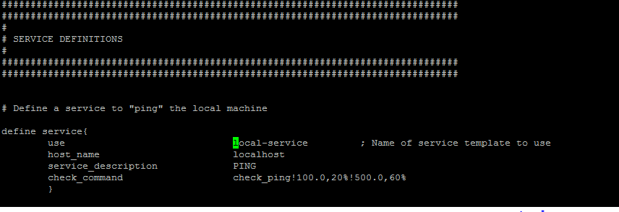
Adding Services
Use : template name
Host_name : hostname or alias name of the machine
Service_description : details of the service
Check_command : command to be executed on the machine(command info can be found
commands.cfg file)
Note : interval time in the templates will be 5 minutes , so to services will be checked every
5 minutes , if we want it can be changed.

Slide 12
Write a Custom Nagios Check Plugin
Exit Codes : To identify the status of a monitored service, Nagios runs a check plugin on it. Nagios can tell what the status of the service is by reading the exit code of the check.
0 - Service is OK.
1 - Service has a WARNING.
2 - Service is in a CRITICAL status.
3 - Service status is UNKNOWN.
Example : Let's consider I have the Nagios server configured to alert only on critical status, so I want an alert if I have too many services on a Warning status.

Slide 13
check_warnings.sh (place this file in /usr/local/nagios/libexec/)
#!/bin/bash
countWarnings=$(/usr/local/nagios/bin/nagiostats | grep "Ok/Warn/Unk/Crit:" | sed 's/[[:space:]]//g' | cut -d"/" -f5)
if (($countWarnings<=5)); then
echo "OK - $countWarnings services in Warning state"
exit 0
elif ((6<=$countWarnings && $countWarnings<=30)); then
# This case makes no sense because it only adds one warning.
# It is just to make an example on all possible exits.
echo "WARNING - $countWarnings services in Warning state"
exit 1
elif ((30<=$countWarnings)); then
echo "CRITICAL - $countWarnings services in Warning state"
exit 2
else
echo "UNKNOWN - $countWarnings"
exit 3
fi

Slide 14
Allow the execution of the script
sudo chmod +x /usr/local/nagios/libexec/check_warnings.sh
Set a New Checking Command and Service
Define a command in the commands.cfg file. This file location depends on the configuration you've done, in my case it is in /usr/local/nagios/etc/objects/commands.cfg.
# Custom plugins commands...
define command{
command_name check_warnings
command_line $USER1$/check_warnings.sh
}
Remember that the $USER1$ variable, is a local Nagios variable set in the resource.cfg file, in my case pointing to /usr/local/nagios/libexec.

Slide 15
Set a Service
Edit the /usr/local/nagios/etc/objects/localhost.cfg file and add the following block:
# Example - Check current warnings...
define service{
use local-service
host_name localhost
service_description Nagios Server Warnings
check_command check_warnings
}
Always remember, prior to reloading Nagios, check that there are no errors in the configuration. You do this with nagios -v command as root:
sudo /usr/local/nagios/bin/nagios -v /usr/local/nagios/etc/nagios.cfg
reload the service
Service nagios restart

Slide 16
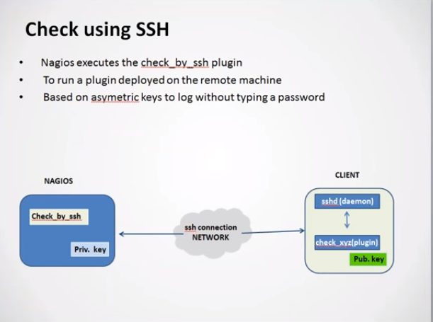
Running plugin’s on Remote machine
NPRE Client should be installed on the remote machine to run the plugins
If the servers are huge then installing agent on all the machines will be time takes so we can use check_by_ssh plugin to connect the remote machines and run the plugin

Slide 17
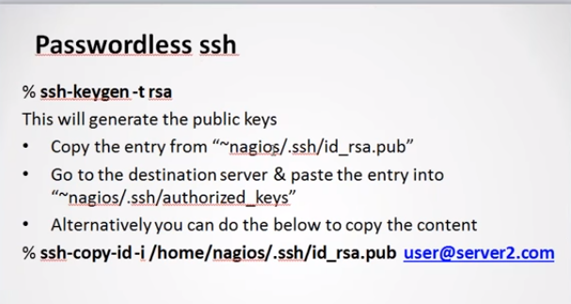
How to run the plugins on the remote machine
Once after connecting the remote machine using plugin check_by_ssh then we need to run the plugin’s on the machine
But the plugins are present in the nagios server not on the remote machine
So we need to create a directory on the nagios server and place all the plugins then
Mount the directory to the remote machines then run the plugin on the remote.
To connect Remote Machine

Slide 18
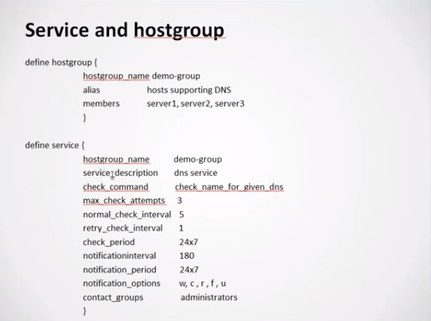
Create Hostgroup :
if we want to run a check on n no of machines instead of defining
The service for all the machines we can create group and call that group in the service

Slide 19
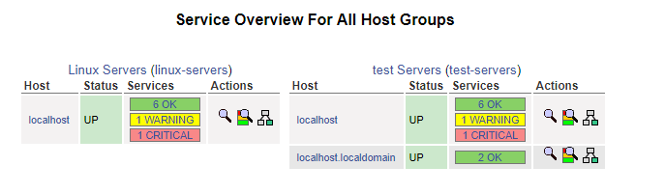
Create Hostgroup :
edit the file /usr/local/nagios/etc/objects/localhost.cfg and add the host group
# Define an optional hostgroup for Linux machines
define hostgroup{
hostgroup_name test-servers ; The name of the hostgroup
alias test Servers ; Long name of the group
members localhost,localhost.localdomain ; Comma separated list of hosts that belong to this group
}
Restart the nagios service

Slide 20
Adding Remote host :
The NRPE (Nagios Remote Plugin Executor) plugin allows you to monitor any remote Linux/Unix services or network devices
Step 1: Update server
Apt-get update
Step 2: Install Nagios NRPE plugin
sudo apt-get install nagios-nrpe-server nagios-plugins
Step 3: Configure NRPE
After successfully installing NRPE service, Edit nrpe configuration file /etc/nagios/nrpe.cfg in your favorite editor and add your nagios service ip in allowed hosts.
vim /etc/nagios/nrpe.cfg
allowed_hosts=127.0.0.1, 192.168.1.100
Where 192.168.1.100 is your Nagios server ip address.
Step 4: Restart
sudo /etc/init.d/nagios-nrpe-server restart

Slide 21
Step 6: Verify Connectivity from Nagios
Now run the below command from Nagios server to make sure your nagios is able to connect nrpe client on remote Linux system. Here 192.168.1.11 is your remote Linux system ip.
/usr/local/nagios/libexec/check_nrpe -H 192.168.1.11
Output : NRPE v2.15
Note : if check_nrpe is missing, install the plugin and check
Install plugin : sudo apt-get install nagios-nrpe-plugin
/usr/lib/nagios/plugins/ (plug in will be installed in this path, move to
Corresponding plug in path and check)
Adding Remote Linux Host to Nagios Monitoring Server
Step 1 :To add a remote host you need to create a two new files “hosts.cfg” and “services.cfg” under “/usr/local/nagios/etc/” location.
[root@tecmint]# cd /usr/local/nagios/etc/
[root@tecmint]# touch hosts.cfg
[root@tecmint]# touch services.cfg

Slide 22
Step 2 : Now add these two files to main Nagios configuration file. Open nagios.cfg file with any editor.
[root@tecmint]# vi /usr/local/nagios/etc/nagios.cfg
# You can specify individual object config files as shown below:
cfg_file=/usr/local/nagios/etc/hosts.cfg
cfg_file=/usr/local/nagios/etc/services.cfg
Step 3 : Now open hosts.cfg file and add the default host template name and define remote hosts as shown below. Make sure to replace host_name, alias and address with your remote host server details.
[root@tecmint]# vi /usr/local/nagios/etc/hosts.cfg

Slide 23
## Default Linux Host Template ##
define host{
name linux-box ; Name of this template
use generic-host ; Inherit default values
check_period 24x7
check_interval 5
retry_interval 1
max_check_attempts 10
check_command check-host-alive
notification_period 24x7
notification_interval 30
notification_options d,r
contact_groups admins
register 0 ; DONT REGISTER THIS - ITS A TEMPLATE
}
## Default
define host{
use linux-box ; Inherit default values from a template
host_name tecmint ; The name we're giving to this server
alias Ubuntu ; A longer name for the server
address 5.175.142.66 ; IP address of Remote Linux host
}

Slide 24
Step 4 : Next open services.cfg file and add the following services to be monitored.
[root@tecmint]# vi /usr/local/nagios/etc/services.cfg

Slide 25
define service{
use generic-service
host_name tecmint
service_description CPU Load
check_command check_nrpe!check_load
}
define service{
use generic-service
host_name tecmint
service_description Total Processes
check_command check_nrpe!check_total_procs
}
define service{
use generic-service
host_name tecmint
service_description Current Users
check_command check_nrpe!check_users
}
define service{
use generic-service
host_name tecmint
service_description SSH Monitoring
check_command check_nrpe!check_ssh
}
define service{
use generic-service
host_name tecmint
service_description FTP Monitoring
check_command check_nrpe!check_ftp
}

Slide 26
Step 5 : Now NRPE command definition needs to be created in commands.cfg file.
[root@tecmint]# vi /usr/local/nagios/etc/objects/commands.cfg
Add the following NRPE command definition at the bottom of the file
###############################################################################
# NRPE CHECK COMMAND
#
# Command to use NRPE to check remote host systems
###############################################################################
define command{
command_name check_nrpe
command_line $USER1$/check_nrpe -H $HOSTADDRESS$ -c $ARG1$
}

Slide 27
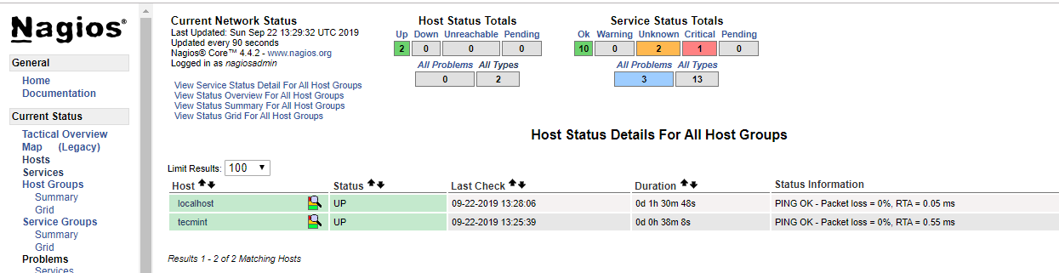
Step 6 : Finally, verify Nagios Configuration files for any errors.
[root@tecmint]# /usr/local/nagios/bin/nagios -v /usr/local/nagios/etc/nagios.cfg
Step 7: Restart Nagios
[root@tecmint]# service nagios restart
Refresh Nagios server, we can observer host is added

Slide 28
Configure Postfix to Use Gmail SMTP on Ubuntu
Step-1 : sudo apt-get install postfix mailutils libsasl2-2 ca-certificates libsasl2-modules
If you do not have postfix installed before, postfix configuration wizard will ask you some questions. Just select your server as Internet Site and for FQDN use something like mail.example.com (user choice)
Step-2: vim /etc/postfix/main.cf (add the below lines, relayhost will be exist already remove the property or update)
relayhost = [smtp.gmail.com]:587
smtp_sasl_auth_enable = yes
smtp_sasl_password_maps = hash:/etc/postfix/sasl_passwd
smtp_sasl_security_options = noanonymous
smtp_tls_CAfile = /etc/ssl/certs/ca-certificates.crt
smtp_use_tls = yes
You might have noticed that we haven’t specified our Gmail username and password in above lines. They will go into a different file. Open/Create
Step-3: vim /etc/postfix/sasl_passwd
[smtp.gmail.com]:587 username@gmail.com:password

Slide 29
Step-4 : Fix permission and update postfix config to use sasl_passwd file:
sudo chmod 400 /etc/postfix/sasl_passwd
sudo postmap /etc/postfix/sasl_passwd
Step-5 : Finally, reload postfix config for changes to take effect:
sudo /etc/init.d/postfix reload
Testing:
Check if mails are sent via Gmail SMTP server
echo "Test mail from postfix" | mail -s "Test Postfix" you@example.com
Troubleshooting:
If you still haven’t received any mail, check the mail error log.
sudo tail /var/log/mail.log
If the mail log is empty or doesn’t exist, try parsing the syslog. This will return the last 50 entries for postfix.
sudo tail -f -n 50 /var/log/syslog | grep postfix
If the syslog is empty and you still haven’t received any test email, it’s possible that the test email was rejected by the recipient server. You should check to see if anything has bounced back to your mail folder.
sudo less /var/mail/$(whoami)

Slide 30
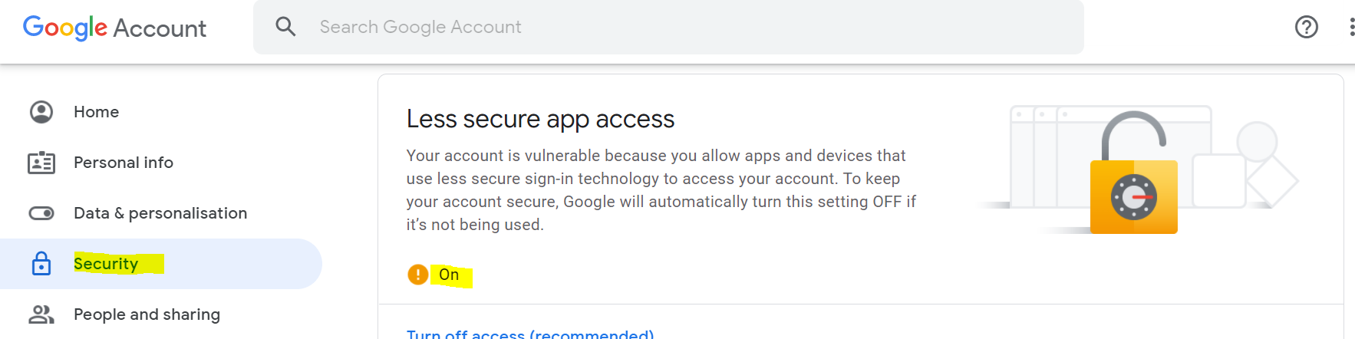
Error: “SASL authentication failed; server smtp.gmail.com”
You need to unlock the captcha by visiting this page https://www.google.com/accounts/DisplayUnlockCaptcha
You can run test again after unlocking captcha.
Still blocking on the less secure app access

Slide 31
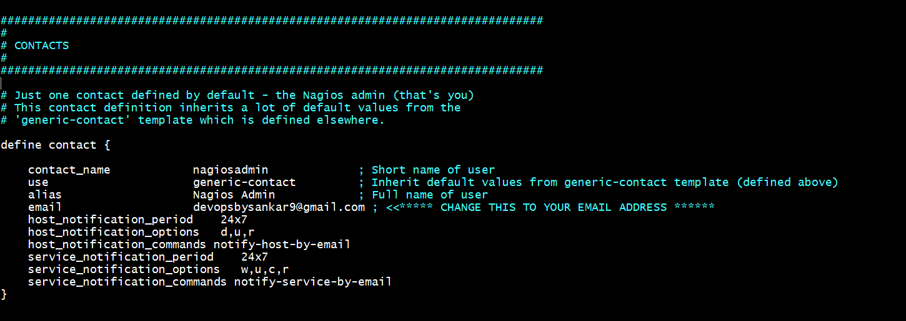
EMAIL Configuration:
Contacts.cfg
define contact{
contact_name nagiosadmin ;Short name of user
use generic-contact ;Inherit default values from generic-contact template (defined above)
alias Full name of user
email <your email goes here>
host_notification_period 24x7
host_notification_options d,u,r
host_notification_commands notify-host-by-email
}

Slide 32
commands.cfg
# 'notify-host-by-email' command definition
define command{
command_name notify-host-by-email
command_line /usr/bin/printf "%b" "***** Nagios *****\n\nNotification Type: $NOTIFICATIONTYPE$\nHost: $HOSTNAME$\nState: $HOSTSTATE$\nAddress: $HOSTADDRESS$\nInfo: $HOSTOUTPUT$\n\nDate/Time: $LONGDATETIME$\n" | /usr/bin/mailx -s "** $NOTIFICATIONTYPE$ Host Alert: $HOSTNAME$ is $HOSTSTATE$ **" $CONTACTEMAIL$
}
# 'notify-service-by-email' command definition
define command{
command_name notify-service-by-email
command_line /usr/bin/printf "%b" "***** Nagios *****\n\nNotification Type: $NOTIFICATIONTYPE$\n\nService: $SERVICEDESC$\nHost: $HOSTALIAS$\nAddress: $HOSTADDRESS$\nState: $SERVICESTATE$\n\nDate/Time: $LONGDATETIME$\n\nAdditional Info:\n\n$SERVICEOUTPUT$\n" | /usr/bin/mailx -s "** $NOTIFICATIONTYPE$ Service Alert: $HOSTALIAS$/$SERVICEDESC$ is $SERVICESTATE$ **" $CONTACTEMAIL$
}

Slide 33
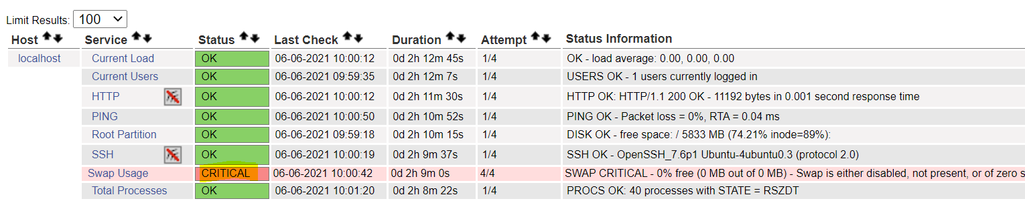
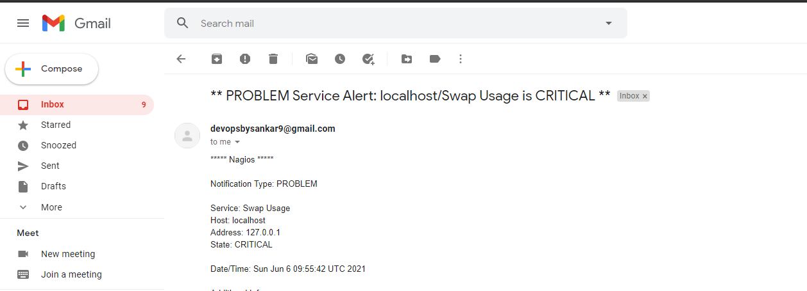
Nagios server Alert :

Slide 34
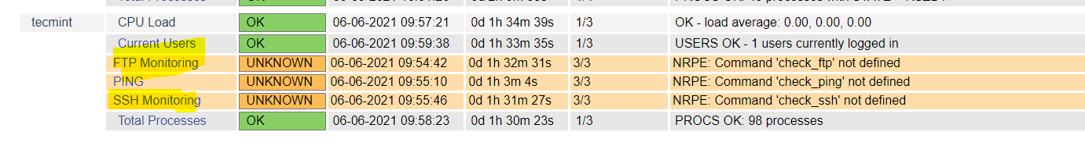
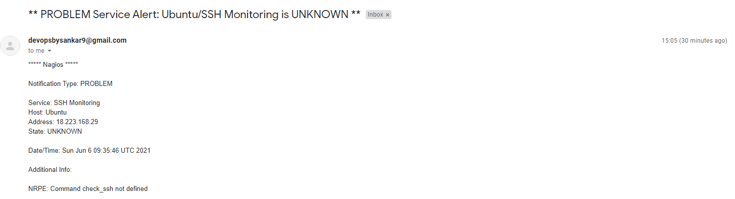
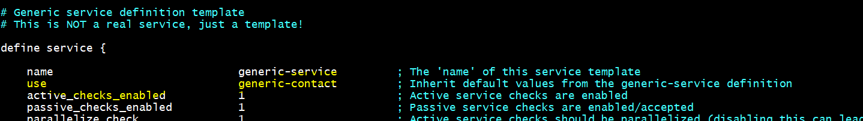
Remote Server Alert :
Add generic-contact in service template(use)

