Slide 1
Nexus Installation (username : admin , password : admin123)
Step 1 : Install Java
sudo yum install java-1.8.0-openjdk -y (java-8)
Step 2 : Create a directory app and switch into the directory
sudo mkdir /app && cd /app
Step 3 : Download nexus 2.11.2
wget www.sonatype.org/downloads/nexus-2.11.2-03-bundle.tar.gz
Step 4 : Untar the downloaded file
sudo tar –xvf nexus-2.11.2-03-bundle.tar.gz
Rename the untared file to nexus.
sudo mv nexus-2.11.2-03 nexus
Step 5 : As a good security practice, it is not advised to run nexus service with any sudo user. So create a new user named nexus.
sudo adduser nexus
Step 6 : Change the ownership of nexus files to nexus user.
sudo chown -R nexus:nexus /app/nexus
sudo chown -R nexus:nexus /app/sonatype-work
chmod -R 775 /app/nexus chmod -R 775 /app/sonatype-work
Step 7 : Running Nexus As A Service
sudo ln -s /app/nexus/bin/nexus /etc/init.d/nexus
Step 8 : Manage Nexus Service(with nexus user)
sudo service nexus start
Step 9 : Access the nexus dashboard,
https : ipaddress:8081/nexus

Slide 2
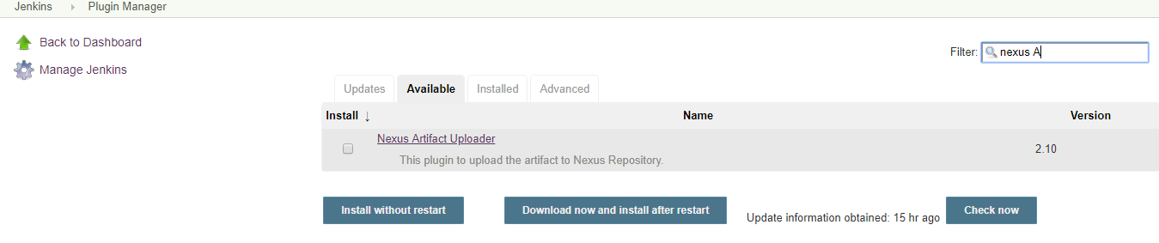
Sonatype Nexus Plugin Upload
Go to manage jenkins-→ Manage plugins
Install the Plugins :
Nexus Artifact Uploader
Nexus Platform

Slide 3
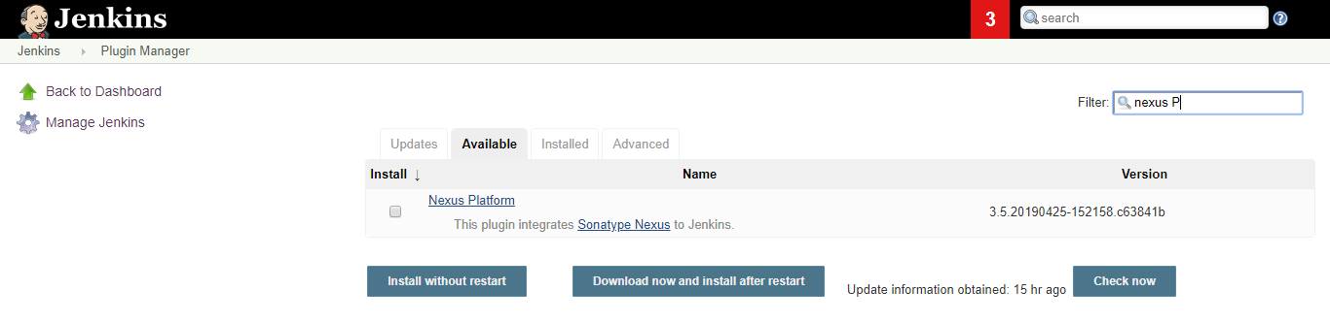
Upload nexus plugin

Slide 4
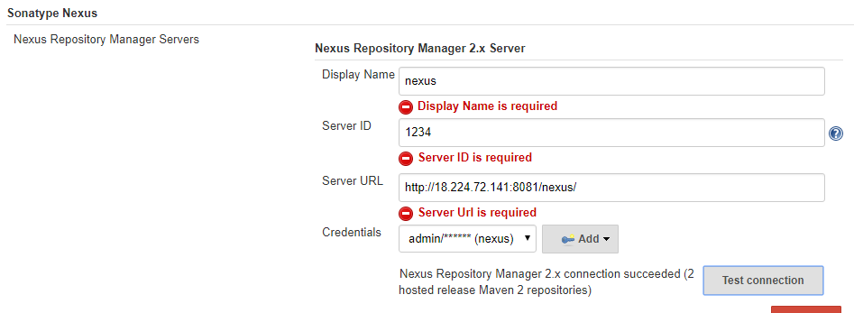
Sonatype Nexus Configuration
Manage Jenkins -→ Congiure System
Display Name : User choice
Server ID : User choice
Server URL : sonatype nexus server URL
Credentials : Sonatype nexus credentials (admin, admin123)

Slide 5
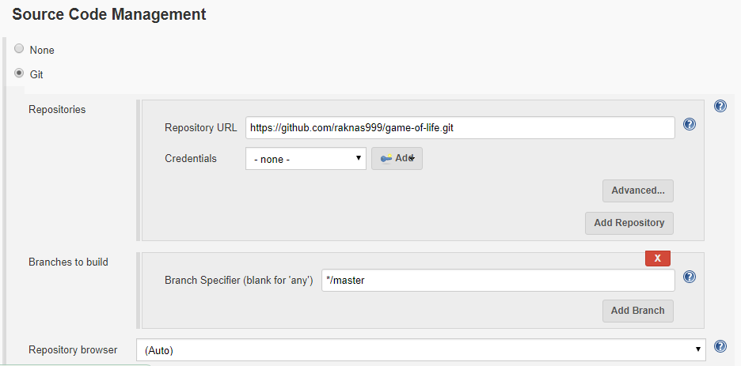
Upload artifact to nexus thru Jenkins
Create Free style job
Configure SCM : https://github.com/raknas999/game-of-life.git

Slide 6
Project POM.XML settings
Add the below code end of the POM (before </project>
<distributionManagement>
<repository>
<id>releases</id>
<name>Releases</name>
<url>http://18.224.72.141:8081/nexus/content/repositories/releases</url>
</repository>
<snapshotRepository>
<id>snapshots</id>
<name>Snapshots</name>
<url>http://18.224.72.141:8081/nexus/content/repositories/snapshots</url>
</snapshotRepository>
</distributionManagement>

Slide 7
Maven Configuration (install maven : yum install maven)
Add the below code in the config file : /usr/local/maven/conf/settings.xml in between <server> … </server> tag
<server>
<id>releases</id>
<username>admin</username>
<password>admin123</password>
</server>
<server>
<id>snapshots</id>
<username>admin</username>
<password>admin123</password>
</server>

Slide 8
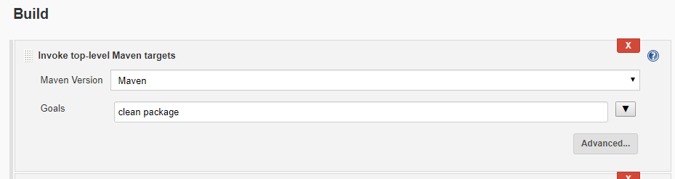
Build Steps
Maven goal

Slide 9
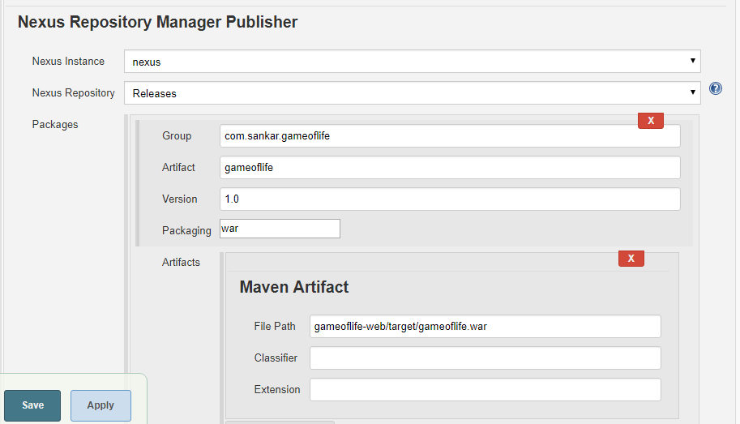
Nexus repository publisher
Group & artifact : check in the pom file for group id and artifact
File path : war file path in the workspace

Slide 10
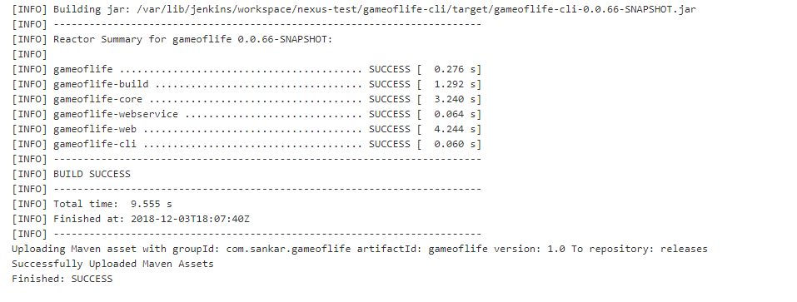
Build the job
We can observer the artifact uploaded message, go to nexus and verify

Slide 11
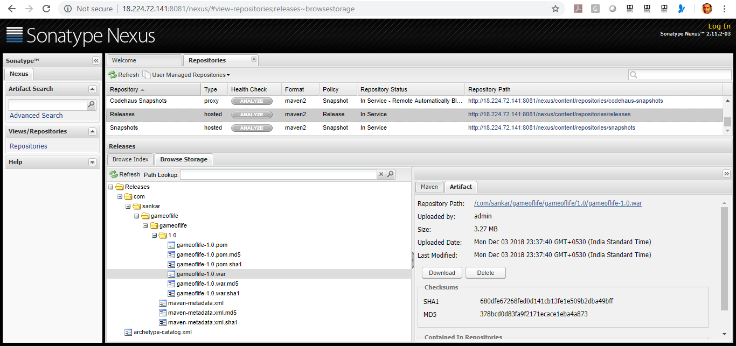
We can observer the artifact added under release folder

