Slide 1
Shell scripting :sequence of commands to a text file and tell the shell to execute the text file instead of entering the commands
Sample script:
#!/bin/bash
"Hello, World!"
"Knowledge is power."
Shebang: it is nothing but the absolute path to the Bash interpreter (#!/bin/bash).
Give execute permission to script (chmod +x script name)
Execute (./script name)
Comments:
Single line comment: # Vivek Gite - 30/Aug/2009
Multi line comment:
echo "Adding new users to LDAP Server..."
<<COMMENT1 Master LDAP server : dir1.nixcraft.net.in Add user to master and it will get sync to backup server too Profile and active directory hooks are below
COMMENT1

Slide 2
Debug script:
bash -x script-name
or
#!/bin/bash
### Turn on debug mode ###
set -x # Run shell commands
"Hello $(LOGNAME)"
"Today is $(date)"
"Users currently on the machine, and their processes:" ### Turn OFF debug mode ###
set +x
Variables
variables are used to store data and configuration options
System Variables
Created and maintained by Linux bash shell itself. This type of variable (with the exception of auto_resume and histchars) is defined in CAPITAL LETTERS
set or env or printenv

Slide 3
User Defined Variables
Created and maintained by user. This type of variable defined may use any valid variable name
varName=someValue
Display The Variable Value
echo "$varName“ or echo "${varName}"
Examples
myhome="/home/v/vivek"
Echo "$myhome"
input="/home/sales/data.txt"
Echo "Input file $input"
NOW=$(date)
echo $NOW
Rules for Naming variable name
Do not put spaces on either side of the equal sign when assigning value to variable (ex : no= 10)
Define a NULL variable as follows
vech= vech=""

Slide 4
Arrays : These variables are called scalar variables. Shellsupports a different type of variable called an arrayvariable. This can hold multiple values at the same time. Arrays provide a method of grouping a set of variables
array_name[index]=value
NAME[0]="Zara"
NAME[1]="Qadir"
NAME[2]="Mahnaz"
NAME[3]="Ayan"
NAME[4]="Daisy"
Display Array Item:
echo "First Index: ${NAME[0]}"
echo "Second Index: ${NAME[1]}"
Display all the items:
echo "First Method: ${NAME[*]}"
echo "Second Method: ${NAME[@]}"

Slide 5
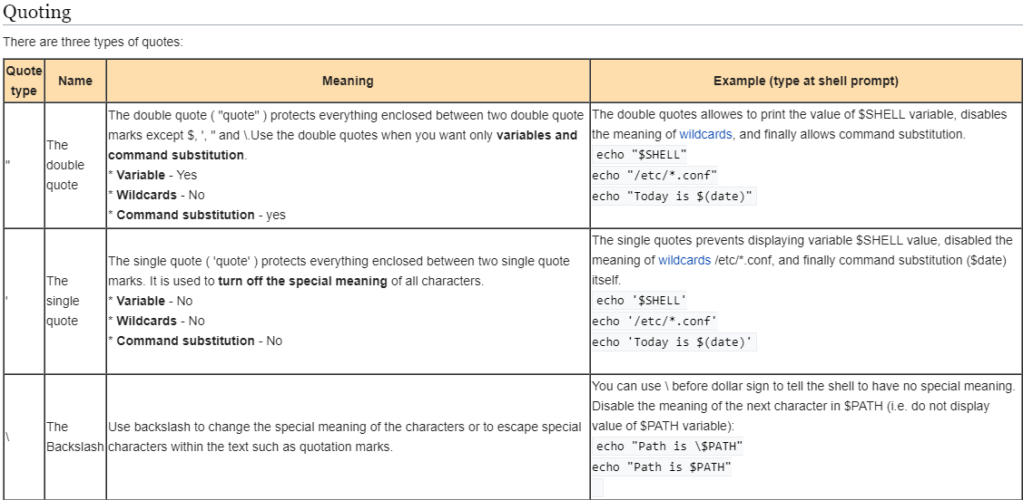

Slide 6
Export Variables
The export builtin automatically exports to the environment of child processes
vech=Bus, echo $vech(value will be displayed, bash, echo $vech (empty value will be displayed)
backup="/nas10/mysql"
"Backup dir $backup"
bash
"Backup dir $backup"
Unset : to delete the variables during program execution. It can remove both functions and shell variables
vech=Bus
$vech
unset vech
$vech
Read Command
You can accept input from the keyboard and assign an input value to a user defined shell variable
read -p "Prompt" variable1 variable2 variableN
-p "Prompt" : Display prompt to user without a newline.

Slide 7
$IFS : Internal Field seperator
nameservers="ns1.nixcraft.net ns2.nixcraft.net ns3.nixcraft.net"
read -r ns1 ns2 ns3 <<< "$nameservers"
change the IFS separator value
pwd="gitevivek:x:1002:1002::/home/gitevivek:/bin/sh"
IFS=:
Read -r login password uid gid info home shell <<< "$pwd"
Perform arithmetic operations
$((expression))
expr EXPRESSION
echo "12+5" | bc

Slide 8
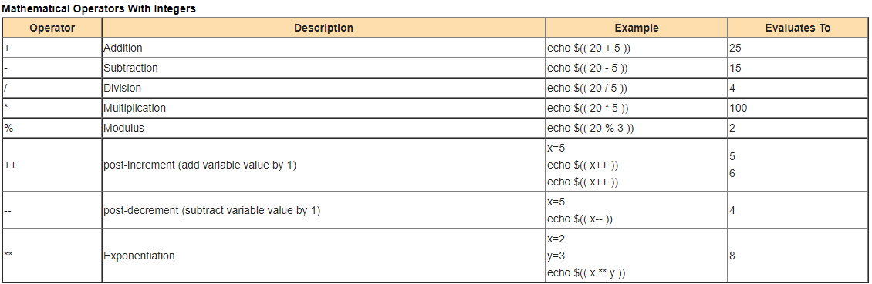
Create an integer variable
#!/bin/bash
# set x,y and z to an integer data type
declare -i x=10
declare -i y=10
declare -i z=0
z=$(( x + y ))
echo "$x + $y = $z"

Slide 9
Create the constants variable
You can create the constants variables using the readonly command
readonly var readonly varName=value
Path name expansion
Examples
I like {tom,jerry}
echo file{1,2,3}.txt
echo file{1..5}.txt
Sample outputs: To remove files called hello.sh, hello.py, hello.pl, and hello.c, enter
rm -v hello.{sh,py,pl,c}
setup environment variables
Add the settings to ~/.bashrc:
# Set vim as default text editor
EDITOR=vim
# Oracle database specific
ORACLE_HOME=/usr/lib/oracle/xe/app/oracle/product/10.2.0/server

Slide 10
Setting system wide shell options
By default /etc/profile file act as a system-wide profile file for the Bash shell.
You can force setting using this file for all user. However, it is recommended that you use /etc/profile.d file under CentOS / Fedora / Redhat Enterprise Linux. For all other distribution edit /etc/profile file.
Task: Setting up a JAVA_HOME and PATH settings for all user.Create /etc/profile.d/java.sh file, enter:
#!/bin/bash
JAVA_HOME=/opt/jdk1.5.0_12
PATH=$PATH:$JAVA_HOME/bin
chmod +x /etc/profile.d/java.sh
Test command
test condition
test condition && true-command || false-command
Examples:
test 5 -eq 5 && echo Yes || echo No
test -f /etc/resolv.conf && echo "File /etc/resolv.conf found." || echo "File /etc/resolv.conf not found."

Slide 11
If structures to execute code based on a condition
if condition
then
command1
command2 ...
commandN
fi
if test -f /file/exists
then
command1
command2 ... commandN
fi
Example:
read -p "Enter a password" pass
if test "$pass" == "jerry" then
"Password verified."
fi

Slide 12
If..else..fi
if command
then
command executed successfully execute all commands up to
else statement or to fi if there is no else statement
else
command failed so
execute all commands up to fi
fi
Example:
##!/bin/bash
read -p "Enter a password" pass
if "$pass" = "jerry" then
"Password verified."
else
echo "Access denied."
fi

Slide 13
Nested ifs
if condition
then
if condition
then
.....
..
do this
else
....
.. do this
fi
else
...
.....
do this
fi

Slide 14
Example
#!/bin/bash
read -p "Enter a number : " n
if [ $n -gt 0 ]; then
echo "$n is a positive."
elif [ $n -lt 0 ] then
echo "$n is a negative."
elif [ $n -eq 0 ] then
echo "$n is zero number."
else
"Oops! $n is not a number."
fi
Exit Status
Every Linux command executed by the shell script or user, has an exit status
0 exit status means the command was successful without any errors.
A non-zero (1-255 values) exit status means command was failure.
echo $?
date # run date command
echo $? # print exit status

Slide 15
Example
#!/bin/bash
# set var
PASSWD_FILE=/etc/passwd
# get user name
Read -p "Enter a user name : " username
# try to locate username in in /etc/passwd grep "^$username" $PASSWD_FILE > /dev/null
# store exit status of grep
# if found grep will return 0 exit stauts
# if not found, grep will return a nonzero exit stauts status=$?
If test $status -eq 0 then
"User '$username' found in $PASSWD_FILE file."
else
"User '$username' not found in $PASSWD_FILE file."
fi

Slide 16
Logical AND
First_command && Second_command
rm /tmp/filename && echo "File deleted."
command2 is executed if, and only if, command1 returns an exit status of zero (true). In other words, run command1 and if it is successfull, then run command2.
Logical OR
First_command || Second_command
command2 is executed if, and only if, command1 returns a non-zero exit status. In other words, run command1 successfully or run command2.
cat /etc/shadow 2>/dev/null || echo "Failed to open file"
Logical Not !
Logical not (!) is boolean operator, which is used to test whether expression is true or not. For example, if file not exists, then display an error on screen. Logical not (!) is boolean operator, which is used to test whether expression is true or not. For example, if file not exists, then display an error on screen.
[ ! expression ]
if [ ! condition ] then
command1 command2
fi
[ ! -d /backup ] && mkdir /backup

Slide 17
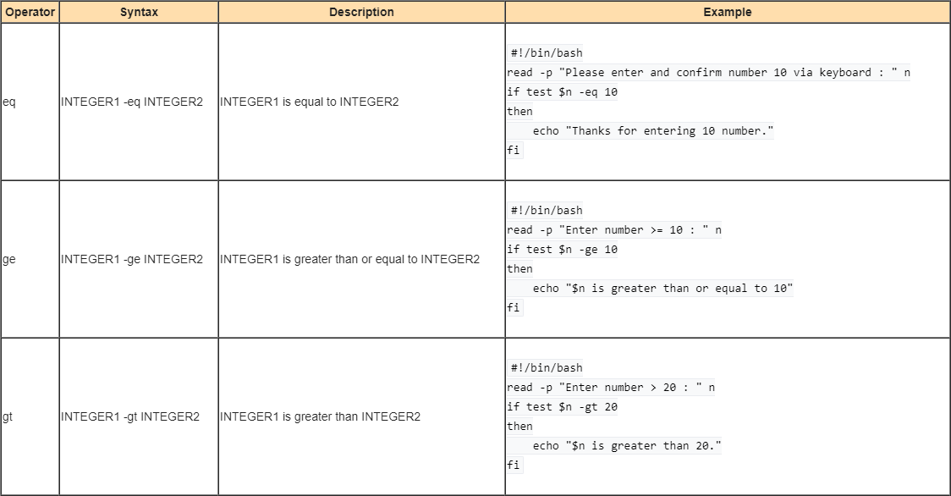
Numeric comparison

Slide 18
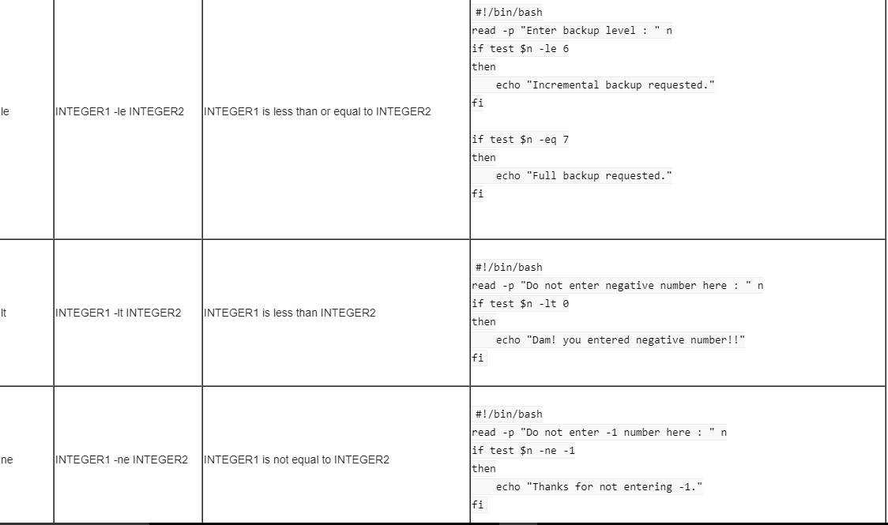

Slide 19
String comparison
STRING1 = STRING2
Example
The length of STRING is zero
#!/bin/bash
-s -p "Enter your password " pass
if test "$pass" = "tom"
then
echo "You are allowed to login!"
fi
#!/bin/bash
-s -p "Enter your password " pass
if test -z $pass
then
echo "No password was entered!!! Cannot verify an empty password!!!"
exit 1
fi
If test "$pass" != "tom"
then
echo "Wrong password!"
fi
#!/bin/bash
-s -p "Enter your password " pass
if test "$pass" != "tom"
then
echo “Wrong password"
fi

Slide 20
File attributes comparisons
-b file Checks if file is a block special file; if yes, then the condition becomes true. [ -b $file ] is false.
-c file Checks if file is a character special file; if yes, then the condition becomes true. [ -c $file ] is false.
-d file Checks if file is a directory; if yes, then the condition becomes true. [ -d $file ] is not true.
-f file Checks if file is an ordinary file as opposed to a directory or special file; if yes, then the condition becomes true. [ -f $file ] is true.
-g file Checks if file has its set group ID (SGID) bit set; if yes, then the condition becomes true. [ -g $file ] is false.
-k file Checks if file has its sticky bit set; if yes, then the condition becomes true. [ -k $file ] is false.
-p file Checks if file is a named pipe; if yes, then the condition becomes true. [ -p $file ] is false.
-t file Checks if file descriptor is open and associated with a terminal; if yes, then the condition becomes true. [ -t $file ] is false.
-u file Checks if file has its Set User ID (SUID) bit set; if yes, then the condition becomes true. [ -u $file ] is false.
-r file Checks if file is readable; if yes, then the condition becomes true. [ -r $file ] is true.
-w file Checks if file is writable; if yes, then the condition becomes true. [ -w $file ] is true.
-x file Checks if file is executable; if yes, then the condition becomes true. [ -x $file ] is true.
-s file Checks if file has size greater than 0; if yes, then condition becomes true. [ -s $file ] is true.
-e file Checks if file exists; is true even if file is a directory but exists. [ -e $file ] is true

Slide 21
Command-Line Arguments
The Unix shell is used to run commands, and it allows users to pass run time arguments to these commands.
All command line parameters or arguments can be accessed via $1, $2, $3,..., $9.
$* holds all command line parameters or arguments.
$# holds the number of positional parameters.
$? holds the return value set by the previously executed command.
$$ holds the process number of the shell (current shell).
$0 hold the script name.
$@ holds all command line parameters or arguments.
Exit command
The exit statement is used to exit from the shell script with a status of N.
Use the exit statement to indicate successful or unsuccessful shell script termination.
The value of N can be used by other commands or shell scripts to take their own action.
If N is omitted, the exit status is that of the last command executed.
Use the exit statement to terminate shell script upon an error.
If N is set to 0 means normal shell exit. Create a shell script called exitcmd.sh:
#!/bin/bash
Echo "This is a test." # Terminate our shell script with success message
exit 0

Slide 22
The case statement
#!/bin/bash
# if no command line arg given
# set rental to Unknown
if [ -z $1 ]
then
rental="*** Unknown vehicle ***"
elif [ -n $1 ]
then
# otherwise make first arg as a rental
rental=$1
fi
# use case statement to make decision for rental
case $rental in
"car") echo "For $rental rental is Rs.20 per k/m.";;
"van") echo "For $rental rental is Rs.10 per k/m.";;
"jeep") echo "For $rental rental is Rs.5 per k/m.";;
"bicycle") echo "For $rental rental 20 paisa per k/m.";;
"enfield") echo "For $rental rental Rs.3 per k/m.";;
"thunderbird") echo "For $rental rental Rs.5 per k/m.";;
*) echo "Sorry, I can not get a $rental rental for you!";;
esac
case $variable-name in pattern1)
command1
...
....
commandN
;;
pattern2)
command1
...
....
commandN
;;
patternN)
command1
...
....
commandN
;;
*)
esac

Slide 23
For loop
for var in item1 item2 ... itemN
do
command1
command2
....
...
commandN
done
#!/bin/bash
for i in 1 2 3 4 5
do
echo "Welcome $i times."
done
for command in data pwd df
do
Echo "*** The output of $command command >"
#run command
$command
done

Slide 24
#!/bin/bash
echo "Printing file names in /tmp directory:"
for f in $(ls /tmp/*)
do
$f
done
Nested for loop
#!/bin/bash
# A shell script to print each number five times.
for (( i = 1; i <= 5; i++ )) ### Outer for loop ###
do
for (( j = 1 ; j <= 5; j++ )) ### Inner for loop ### do
echo -n "$i "
done
echo "" #### print the new line ###
done

Slide 25
The while loop
while [ condition ]
do
command1
command2
..
....
commandN
done
#!/bin/bash
# set n to 1
n=1
# continue until $n equals 5
while [ $n -le 5 ] do
echo "Welcome $n times."
n=$(( n+1 )) # increments $n
done

Slide 26
#!/bin/bash
file=/etc/passwd
# set field delimiter to :
# read all 7 fields into 7 vars
while IFS=: read -r user enpass uid gid desc home shell
do # only display if UID >= 500
[ $uid -ge 500 ] && echo "User $user ($uid) assigned \"$home\" home directory with $shell shell."
done < "$file"
Until loop
until [ condition ]
do
command1
command2
...
....
commandN
done
#!/bin/bash
i=1
until [ $i -gt 6 ]
do
echo "Welcome $i times."
i=$(( i+1 ))
done

Slide 27
Break statement
#!/bin/bash
match=$1 # fileName
found=0 # set to 1 if file found in the for loop
# show usage
[ $# -eq 0 ] && { echo "Usage: $0 fileName"; exit 1; }
# Try to find file in /etc
for f in /etc/*
do
if [ $f == "$match" ]
then
echo "$match file found!"
found=1 # file found
break # break the for looop
fi
done
# noop file not found
[ $found -ne 1 ] && echo "$match file not found in /etc directory"

Slide 28
Continue statement
The continue statement is used to resume the next iteration of the enclosing FOR, WHILE or UNTIL loop.
#!/bin/sh
NUMS="1 2 3 4 5 6 7"
for NUM in $NUMS
do Q=`expr $NUM % 2`
if [ $Q -eq 0 ]
then
echo "Number is an even number!!"
continue
fi
echo "Found odd number"
done

Slide 29
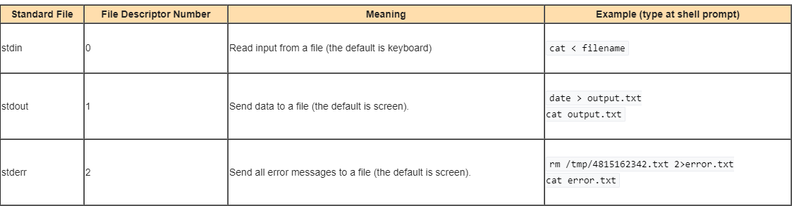
Input and Output
Standard input
sort < /etc/resolv.conf
Standard output
command > output.file.name
Standard error
command 2> errors.txt

Slide 30
/dev/null discards unwanted output
#!/bin/bash
# set var
PASSWD_FILE=/etc/passwd
# get user name
Read -p "Enter a user name : " username
# try to locate username in in /etc/passwd
#
grep "^$username" $PASSWD_FILE > /dev/null
# store exit status of grep
# if found grep will return 0 exit stauts
# if not found, grep will return a nonzero exit stauts
status=$?
If test $status -eq 0
then
echo "User '$username' found in $PASSWD_FILE file."
else
echo "User '$username' not found in $PASSWD_FILE file."
fi

Slide 31
Redirection of both input and output
command-name >cmd.log 2>&1
@hourly /scripts/backup/nas.backup >/dev/null 2>&1
Shell function
To avoid large and complicated scripts use functions.
You divide large scripts into a small chunks/entities called functions.
Functions makes shell script modular and easy to use.
Function avoids repetitive code. For example, is_root_user() function can be reused by various shell scripts to determine whether logged on user is root or not.
Function performs a specific task. For example, add or delete a user account.
Writing the hello() function
hello() {
'Hello world!' ; }
Invoking the hello() function
hello

Slide 32
Pass Parameters to function
# Define your function here
Hello () {
echo "Hello World $1 $2"
}
# Invoke your function
Hello Zara Ali
Function with return value:
#!/bin/sh
# Define your function here
Hello () {
echo "Hello World $1 $2"
return 10
}
# Invoke your function
Hello Zara Ali
# Capture value returnd by last command
ret=$?
echo "Return value is $ret"

Slide 33
Nested Functions
#!/bin/sh
# Calling one function from another
number_one () {
echo "This is the first function speaking..."
number_two
}
number_two () {
echo "This is now the second function speaking..."
}
# Calling function one.
number_one

Slide 34
#!/bin/bash
# Write a script that will count the number of files in each of your subdirectories.
# echo "Enter the path of directory"
read dirpath
START=$dirpath
# change your directory to command line if passed
# otherwise use home directory
[ $# -eq 1 ] && START=$1 || :
if [ ! -d $START ]
then
echo "$START not a directory!"
exit 1
fi
# use find command to get all subdirs name in DIRS variable
DIRS=$(find "$START" -type d)
# loop thought each dir to get the number of files in each of subdir
for d in $DIRS
do
[ "$d" != "." -a "$d" != ".." ] && echo "$d dirctory has $(ls $d | wc -l) files" || :
done

Slide 35
No of Vowels in a string
#!/bin/bash
clear
Echo “enter a string”
read str
len=$(expr length $str)
count=0
while [ $len -gt 0 ]
do
ch=$(echo $str | cut -c $len)
case $ch in
[aeiouAEIOU] )
count=$(($count + 1))
echo $ch
;;
esac
len=$(( $len - 1 ))
done
echo $count
Or
grep -o [aeiouAEIOU] file | wc -l

Slide 36
Execute shell scripts on Remote Machine
ssh user@remotemachine 'bash -s' < local_script.sh
Install SSHPASS
Download latest epel-release rpm from
wget https://dl.fedoraproject.org/pub/epel/6/x86_64/epel-release-6-8.noarch.rpm
Install epel-release rpm:
# rpm –ivh
Install sshpass rpm package:
# yum install sshpass
Sample HTML webpages
https://www.free-css.com/free-css-templates/page241/big-city

