Slide 1
SonarQube Installation:
Hardware Requirements
The SonarQube server requires at least 2GB of RAM to run efficiently and 1GB of free RAM for the OS.
The amount of disk space you need will depend on how much code you analyze with SonarQube. As an example, SonarCloud the public instance of SonarQube, has more than 30 millions lines of code under analysis with 4 years of history. SonarCloud is currently running on a Amazon EC2 m4.large instance, using about 10 Gb of drive space. It handles 800+ projects having roughly 3M open issues. SonarCloud is running on PostgreSQL 9.5 and it is using about 15Gb of drive space.
SonarQube must be installed on hard drives that have excellent read & write performance. Most importantly, the "data" folder houses the Elasticsearch indices on which a huge amount of I/O will be done when the server is up and running. Great read & write hard drive performance will therefore have a great impact on the overall SonarQube server performance.

Slide 2
Install Java
Step 1: Update your CentOS 7 system
sudo amazon-linux-extras install epel
sudo yum update
Step 2: Install Java
sudo yum install java-1.8.0-openjdk
sudo yum install java-1.8.0-openjdk-devel
Java -version
set two environment variables: "JAVA_HOME" and "JRE_HOME"
sudo cp /etc/profile /etc/profile_backup
echo 'export JAVA_HOME=/usr/lib/jvm/jre-1.8.0-openjdk' | sudo tee -a /etc/profile
echo 'export JRE_HOME=/usr/lib/jvm/jre' | sudo tee -a /etc/profile
source /etc/profile
Verify environment variables
echo $JAVA_HOME
echo $JRE_HOME

Slide 3
Step 1 : Download and Install SonarQube
wget http://downloads.sourceforge.net/project/sonar-pkg/rpm/sonar.repo
sudo mv sonar.repo /etc/yum.repos.d/sonar.repo
sudo yum install sonar
Step 2 : Start the SonarQube
sudo service sonar start
Step 3 : Launch the SonarQube
http://<ipaddress>:9000

Slide 4
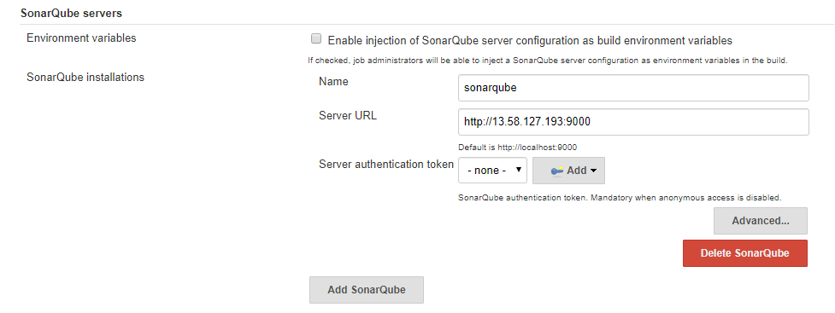
SonarQube Integration with Jenkins
Install the Plugin : SonarQube Scanner for Jenkins
Add the sonarqube details in the configuration

Slide 5
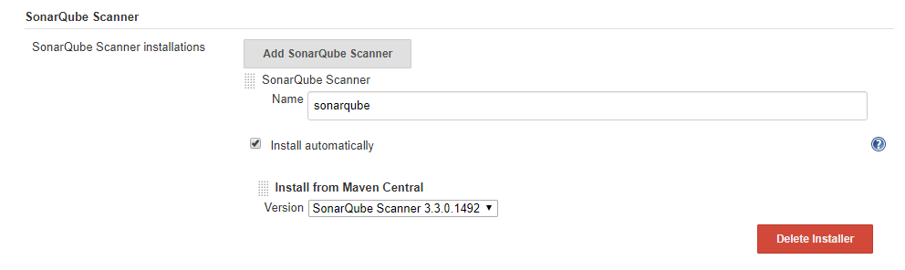
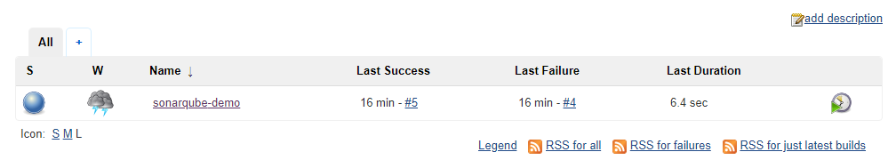
Add sonarqube scanner under Global Tool Configuration
Creat Free style job with following details

Slide 6
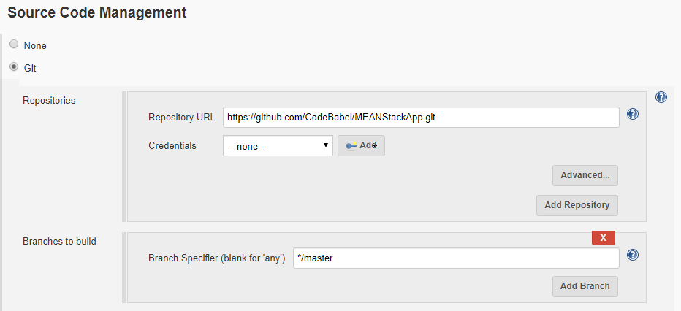
SCM Details : https://github.com/CodeBabel/MEANStackApp.git

Slide 7
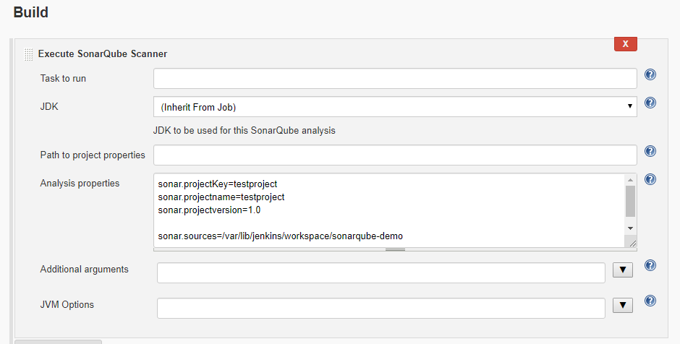
Sonar Scanner Details :
sonar.projectKey=testproject
sonar.projectname=testproject
sonar.projectversion=1.0
sonar.sources=/var/lib/jenkins/workspace/sonarqube-demo
sonar.java.binaries=/var/lib/jenkins/workspace/sonarqube-demo/target/classes/

Slide 8
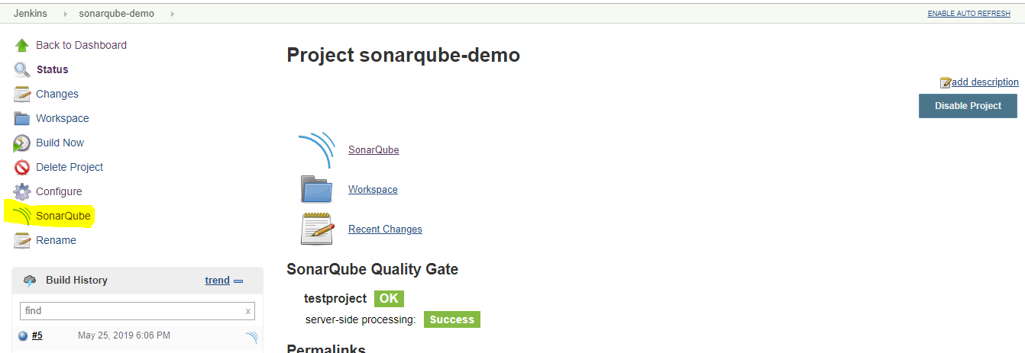
Build the Job
To check the code quality details click on SonarQube link, it will route the sonarqube dash
board

Slide 9
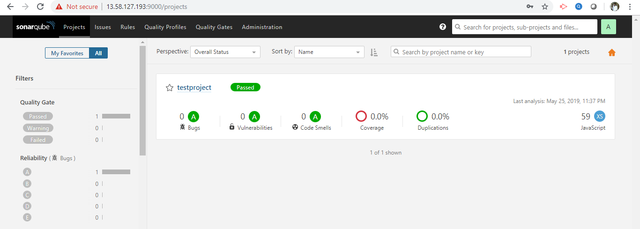
We can observer project details, for more details click on the project
Username : admin
Password : admin

Slide 10
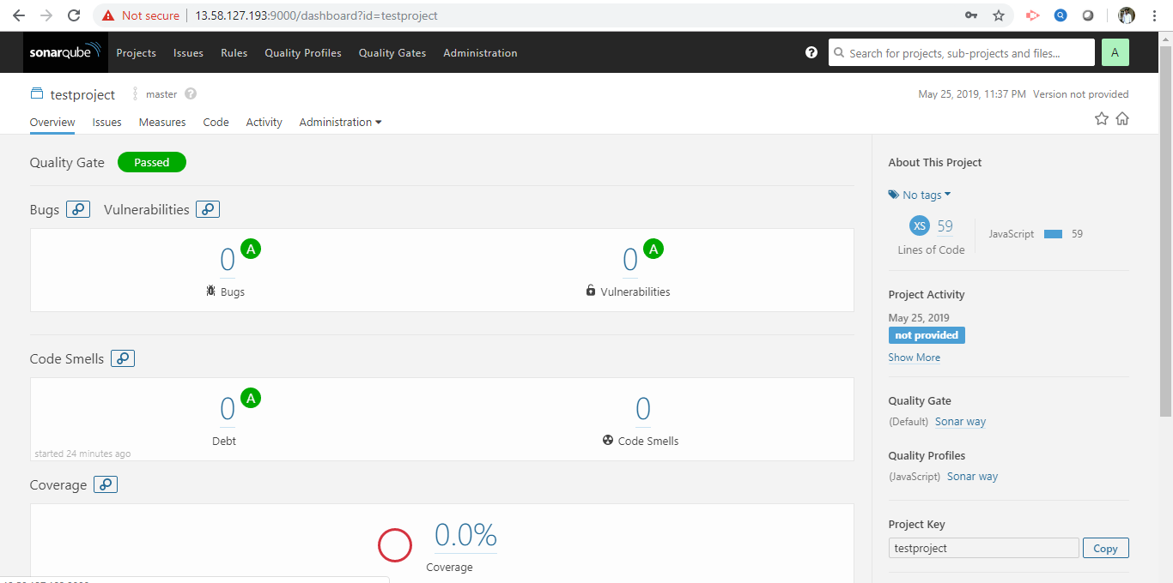

Slide 11
https://docs.sonarqube.org/display/SONARQUBE53/Analyzing+with+SonarQube+Scanner
https://<your Jenkins instance>/sonarqube-webhook/

