Slide 1
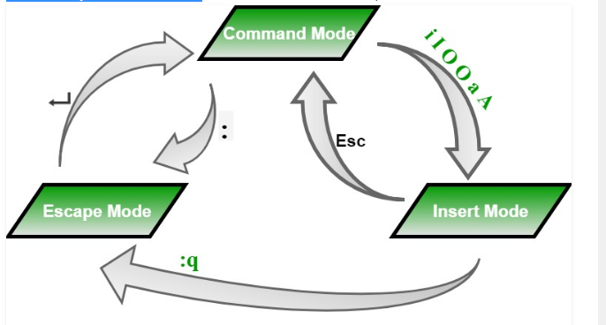
Modes of Operation in vi editor

Slide 2
Command Mode: When vi starts up, it is in Command Mode. This mode is where vi interprets any characters we type as commands and thus does not display them in the window. This mode allows us to move through a file, and to delete, copy, or paste a piece of text. To enter into Command Mode from any other mode, it requires pressing the [Esc] key. If we press [Esc] when we are already in Command Mode, then vi will beep or flash the screen.
Insert mode: This mode enables you to insert text into the file. Everything that’s typed in this mode is interpreted as input and finally, it is put in the file. The vi always starts in command mode. To enter text, you must be in insert mode. To come in insert mode you simply type i. To get out of insert mode, press the Esc key, which will put you back into command mode.
Last Line Mode(Escape Mode): Line Mode is invoked by typing a colon [:], while vi is in Command Mode. The cursor will jump to the last line of the screen and vi will wait for a command. This mode enables you to perform tasks such as saving files, executing commands.

Slide 3
Commands and their Description
k : Moves the cursor up one line.
j : Moves the cursor down one line.
h : Moves the cursor to the left one character position.
l : Moves the cursor to the right one character position.
0 or | : Positions cursor at beginning of line.
$ : Positions cursor at end of line.
W : Positions cursor to the next word.
B : Positions cursor to previous word.
( : Positions cursor to beginning of current sentence.
) : Positions cursor to beginning of next sentence.
H : Move to top of screen.
nH : Moves to nth line from the top of the screen.
M : Move to middle of screen.
L : Move to bottom of screen.
nL : Moves to nth line from the bottom of the screen.
colon along with x : Colon followed by a number would position the cursor on line number represented by x.

Slide 4
Control Commands(Scrolling):
CTRL+e : Moves screen up one line.
CTRL+y : Moves screen down one line.
CTRL+u : Moves screen up 1/2 page.
CTRL+d : Moves screen down 1/2 page.
CTRL+b : Moves screen up one page.
CTRL+f : Moves screen down one page.
Editing and inserting in Files(Entering and Replacing Text):
I : Inserts text before current cursor location.
A : Inserts text at end of current line.
O : Creates a new line for text entry below cursor location.
R : Replaces text from the cursor to right.
S :Replaces entire line.
Deleting Characters
X : Deletes the character before the cursor location.
Dw : Deletes from the current cursor location to the next word.
d^ : Deletes from current cursor position to the beginning of the line.
d$ : Deletes from current cursor position to the end of the line.
Dd : Deletes the line the cursor is on

Slide 5
Copy and Past Commands
Yy : Copies the current line.
9yy : Yank current line and 9 lines below.
p : Puts the copied text after the cursor.
P : Puts the yanked text before the curs
Save and Exit Commands of the ex Mode
q : Quit
q! : Quit without saving changes i.e. discard changes.
r fileName : Read data from file called fileName.
wq : Write and quit (save and exit).
w fileName : Write to file called fileName (save as).
w! fileName : Overwrite to file called fileName (save as forcefully).
Searching and Replacing in (ex Mode)
:/string To find the string
n to go to next word
N to go back pervious workd
:s/find/replace find and replace
:%s/find/replace all

