Slide 1
Learning about Online Learning
Project 3: Evan Isenstein

Slide 2



Slide 3
Features Available
Massive
Open
Online
Course
Course
Education
Enrollment Date
Events
Videos
Chapters
650,000
Student IDs

Slide 4
Who gets Certified?
Only registered
Only Viewed
Explored
Certified

Slide 5
Goal
Predict a Certified Student
Increase Revenue
Certificate = $75

Slide 6
Workflow
Dataverse
EDA

Slide 7
Workflow
Feature Engineering
Dataverse
EDA
MIT Intro to
Python

Slide 8
Workflow
Feature Engineering
Dataverse
EDA
MVP
F1 Score:
MIT Intro to
Python
XG Boost .92
Log. 91
R.Forest .89
KNN .86

Slide 9
Workflow
Feature Engineering
Full Dataset
Dataverse
EDA
MVP
Logistic RegressionCV
F1 Score: .85
F1 Score:
MIT Intro to
Python
XG Boost .92
Log. 91
R.Forest .89
KNN .86

Slide 10
Workflow
Feature Engineering
Feature Engineering
Full Dataset
Dataverse
EDA
MVP
Logistic RegressionCV
F1 Score: .71
Logistic RegressionCV
F1 Score: .85
Removing
Features
F1 Score:
MIT Intro to
Python
XG Boost .92
Log. 91
R.Forest .89
KNN .86

Slide 11
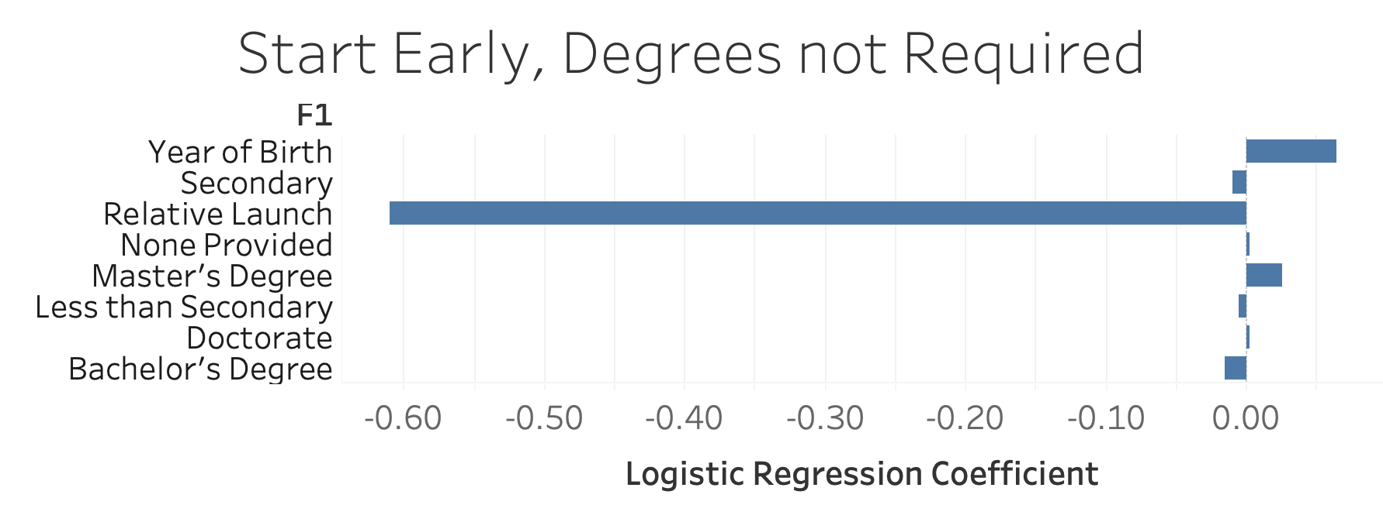
Date of Student Registration - Official Course Launch = Relative Launch
Ex. 6/1/2012 - 6/15/2012 = -14

Slide 12
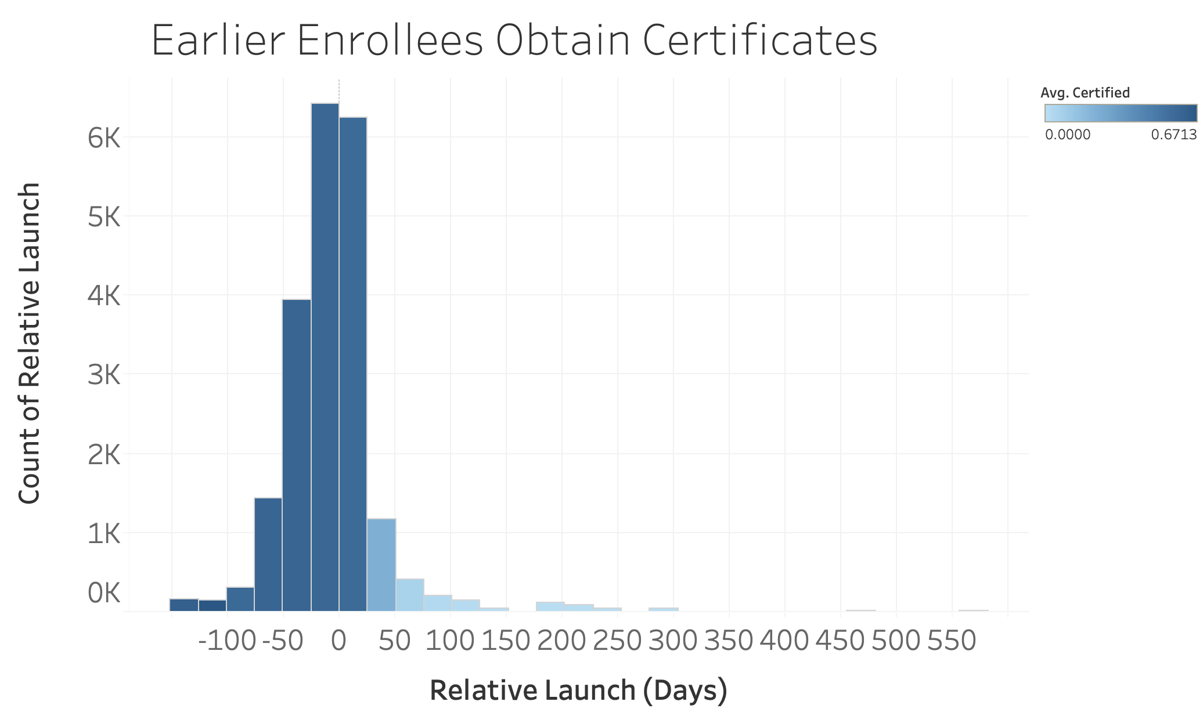

Slide 13
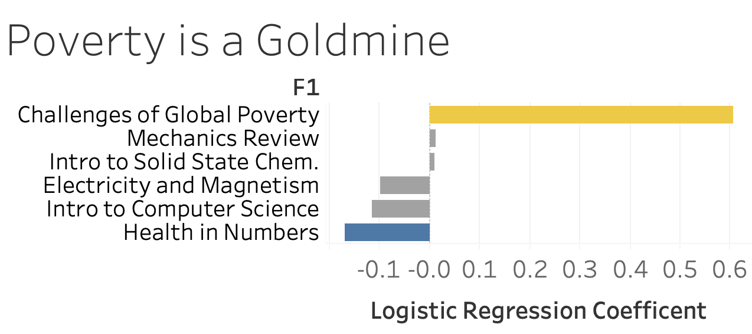

Slide 14
Recommendations
Late Student Extension
$10 Surcharge
Partner with UNICEF
Newsletter
Discount Code

Slide 15
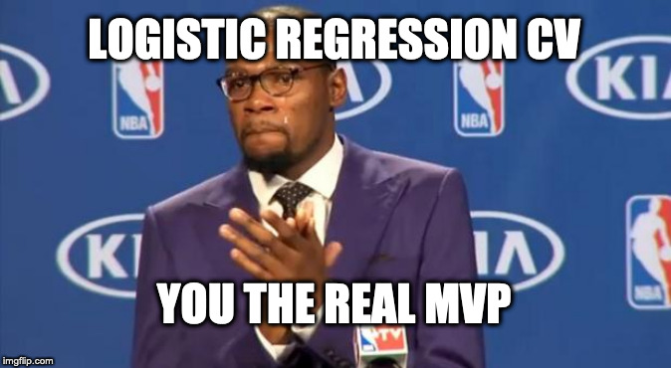
Questions?

