Slide 1



Talk Track AI:
A Real-Time Voice-Based
Presentation Assistant
Presented by :
E . Kavya (24AG1A6621)
B . Pradeepthi (24AG1A6610)
B . Ramcharan (24AG1A6609)

Slide 2
Abstract
Presentation Assistant Talk Track AI is a real-time voice-based presentation assistant that helps improve public speaking skills. It listens to live presentations and analyzes speech parameters such as clarity, pace, tone, pauses, and filler word usage. Using speech recognition, NLP, and machine learning, it provides instant feedback and actionable suggestions to enhance delivery and confidence. The system can be used in classrooms, interviews, and corporate training, acting as a smart virtual speaking coach to improve overall communication effectiveness.

Slide 3
.
Introduction
Talk Track AI: A Real-Time Voice-Based Presentation Assistant The title Talk Track AI represents an intelligent system designed to enhance presentation skills. “Talk Track” refers to the speaker’s flow and delivery during a presentation, while “AI” signifies the use of Artificial Intelligence to analyze speech patterns. As a real-time voice-based presentation assistant, the system listens to the speaker during a PPT presentation and provides instant feedback on clarity, pace, tone, and confidence. It acts as a smart communication coach to help users deliver more effective and confident presentations.

Slide 4
Overview
Talk Track AI is a real-time AI-powered presentation assistant.It listens to the speaker during a live presentation.The system processes voice input instantly.It analyzes speech using Artificial Intelligence algorithms.
The main goal of this project is:
To improve public speaking skills
To provide real-time feedback
To help speakers become confident communicators
This system works in parallel with PowerPoint presentations.It acts as a smart communication coach during live sessions.

Slide 5
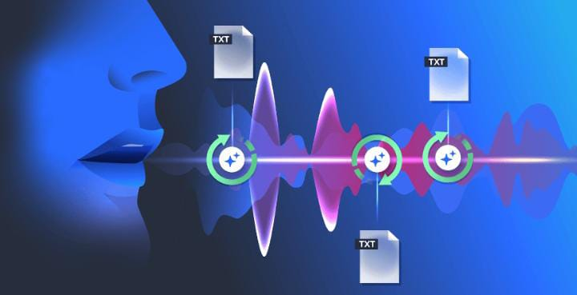
How system works
The working process includes 5 main steps:
Voice Input : Microphone captures live speech.
Speech-to-Text Conversion : Audio is converted into text using speech recognition
AI Analysis : The system analyses PronunciationSpeed , Tone , Filler words , Pauses
Performance Evaluation : AI compares speech with ideal communication patterns.
Real-Time Feedback : Feedback is shown instantly on screen

Slide 6
Technologies & Key Features
Technologies Used :
Speech Recognition Technology
Natural Language Processing (NLP)
Machine Learning Algorithms
Real-Time Audio Processing
PowerPoint Integration
Key Features :
Real-time speech monitoring
Detection of filler words
Speech pace analysis
Confidence score generation
Instant improvement suggestions

Slide 7
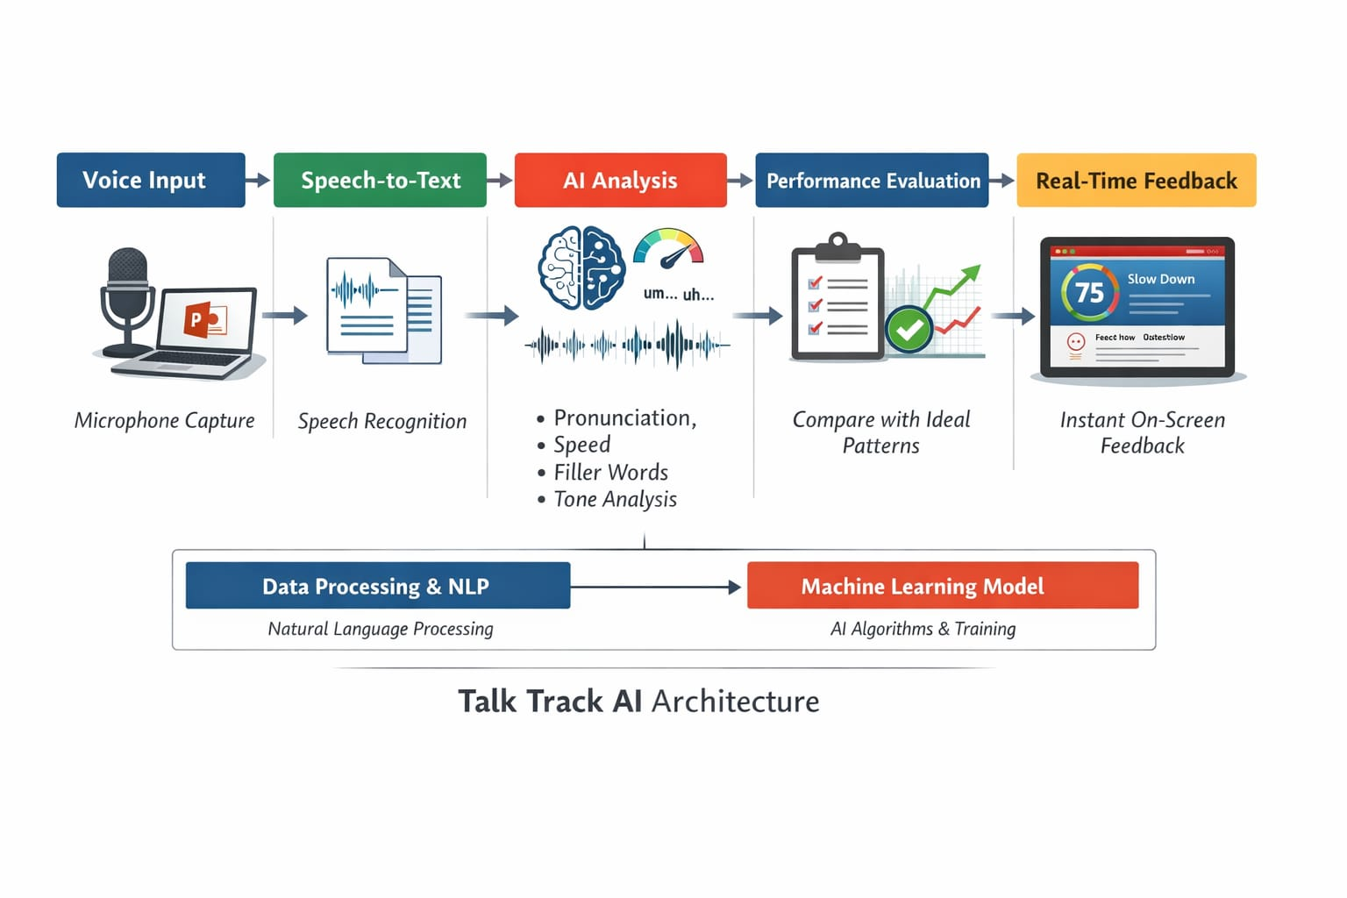
Architecture Diagram

Slide 8
REFERENCES
[1] Y. Chen et al., “PresentCoach: Dual-Agent Presentation Coaching through Exemplars and Interactive Feedback,” arXiv preprint arXiv:2511.15253, 2025.
[2] A. Sharma et al., “Voice AI-Intelligence Based Voice Assistant,” IEEE Conference Publication, 2024.
[3] S. Kumar and R. Patel, “Development of an AI-Powered Voice Assistant: Enhancing Speech Recognition and User Interaction,” International Journal of Scientific Research in Engineering and Technology, 2025.
[4] SlideWhisper, “AI-Narrated Presentations with Live Q&A,” 2024. [Online]. Available: https://www.slidewhisper.com
[5] Plus AI, “Presentation Narrator Feature,” 2024. [Online]. Available: https://www.plusai.com

Slide 9
Thank You

