Slide 1
Exensio Reference Tables (ERT) — Review
App overview, flows, and Databricks migration plan

Slide 2
Agenda
Title & Context
Current-state snapshot
Key flows: OnLot / OnProd / OnScribe / OnSlice / OnWmap
Integration landscape
Databricks migration plan
Next steps

Slide 3
Exensio Reference Tables (ERT) Web Service — Executive Snapshot
What it is**
Spring Boot REST layer standardising lot, product, scribe, slice, and wafer-map reference data across test & manufacturing.
Oracle/H2-backed cache that fronts slower upstream systems while preserving status provenance.
How it works**
Controllers normalise input, log traceability, and emit DTOs with `Status` enums (`FOUND`, `NO_DATA`, `ERROR`, `LOTG_MES_LTM_DW`, etc.).
Service tier orchestrates repository hits plus conditional enrichment from LotG DB/WS, LTM, Data Warehouse, Torrent/Genesis MES, and VID↔SCRIBE services.

Slide 4
Exensio Reference Tables Web Service
Top-level view of the Exensio Reference Tables (ERT) web service, covering its REST surface, orchestration services, shared infrastructure, and external data providers.
![ERT high-level architecture](ert-overview.png)
## Platform Snapshot
Spring Boot 2.x application exposing REST endpoints under `/api/**`.
Oracle (production) or H2 (local) database stores reference-table entities.
Controllers normalise inputs, delegate to domain services, and emit DTOs with status flags.

Slide 5
OnLot Retrieval & Enrichment
Detailed behaviour of the `OnLot` API (`/api/onlot/bylotid`) and the enrichment pipeline that merges LotG, LTM, Data Warehouse, and MES sources before persisting results.
## REST Entry Points
`GET /api/onlot/all` – dumps the local cache (`OnLotRepository.findAll`).
`GET /api/onlot/byid/{id}` – returns a single record by surrogate ID.
`GET /api/onlot/bylotid/{lotId}` – primary lookup that drives the enrichment workflow documented here.
Each request normalises textual inputs to upper-case and delegates to `OnLotService.findByLotId(lotId, alternateProduct, fab, dataType, site, onlyFromDb=false)`.

Slide 6
OnProd Retrieval & Enrichment
This note explains how `ON_PROD` records are exposed via the REST API and how they are populated when a lot lookup triggers upstream services (Data Warehouse, Torrent, Genesis, LotG) inside `OnLotService`.
## REST Endpoints
`GET /api/onprod/all` – returns every product entry (`OnProdController.all`).
`GET /api/onprod/byid/{id}` – loads a record by the internal surrogate key.
`GET /api/onprod/byproduct/{product}` – resolves a product by code; the controller normalises input to upper-case before delegating to `OnProdService.findByProduct`.
Each endpoint ultimately uses `OnProdRepository` (Spring Data JPA) for reads. If no entity is found, a DTO is returned with `Status.NO_DATA`.

Slide 7
OnScribe Retrieval & Wafer Resolution
End-to-end behaviour of the `OnScribe` REST layer and the wafer-identification pipeline that reconciles VID, scribe ID, and calculated wafer IDs using configuration-driven rules.
## REST Entry Points
`GET /api/onscribe/all` – dumps every cached record via `OnScribeRepository.findAll`.
`GET /api/onscribe/byid/{id}` – loads a specific entity by the surrogate key.
`GET /api/onscribe/bylotidandwafernum/{lotId}/{waferNum}` – canonical lookup when only the production lot is known.
`GET /api/onscribe/bylotidsandwafernum?lotId&waferNum&mfgLot` – allows callers to supply both the production lot and its manufacturing counterpart.

Slide 8
OnSlice Retrieval & Maintenance
Behaviour of the `OnSlice` REST layer and the persistence rules that back slice, puck, and wafer identifiers.
## REST Entry Points
`GET /api/onslice/all` – retrieves every cached row through `OnSliceService.findAll` → `OnSliceRepository.findAll`.
`GET /api/onslice/byid/{id}` – fetches a record by surrogate key.
`GET /api/onslice/byslice/{slice}` – canonical lookup based on the slice identifier.
`GET /api/onslice/byglobalwaferid/{globalWaferId}` – resolves a slice when only the global wafer ID is known.

Slide 9
Slide 1 – Title & Context
Exensio Reference Tables (ERT) Web Service**
Preparing for Databricks-enabled reference data orchestration
Audience: Manufacturing IT leadership, Data Engineering, Product Test teams

Slide 10
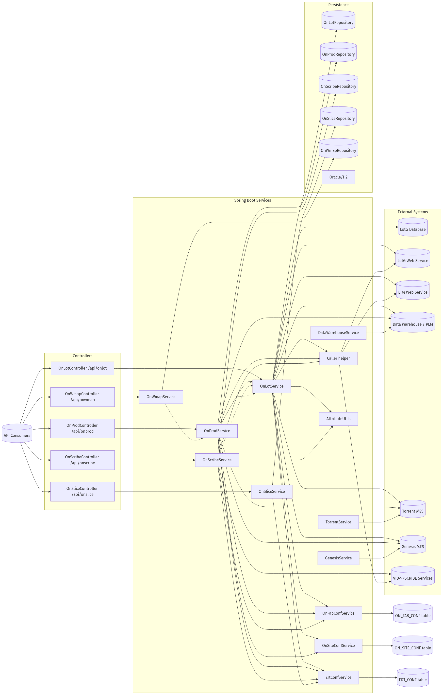
ERT OVERVIEW

Slide 11
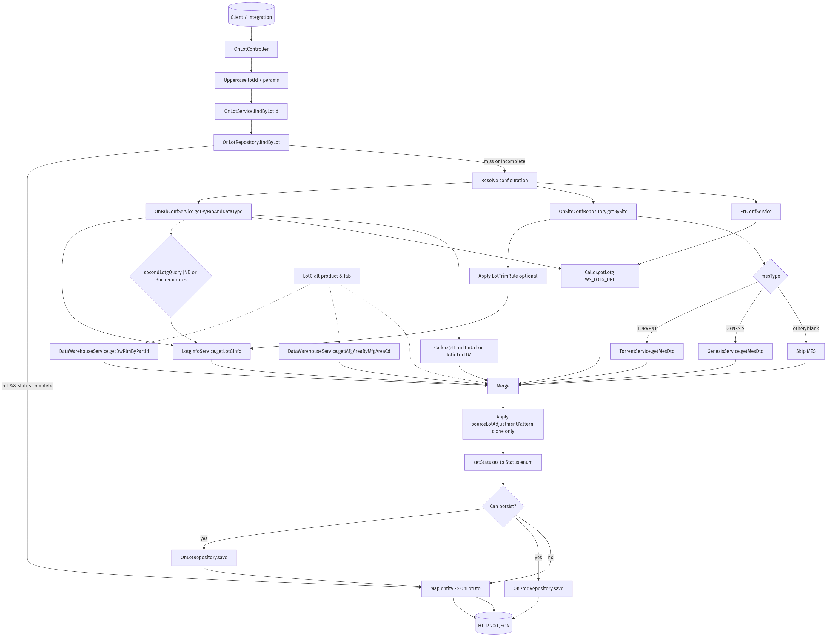
ONLOT DATAFLOW

Slide 12
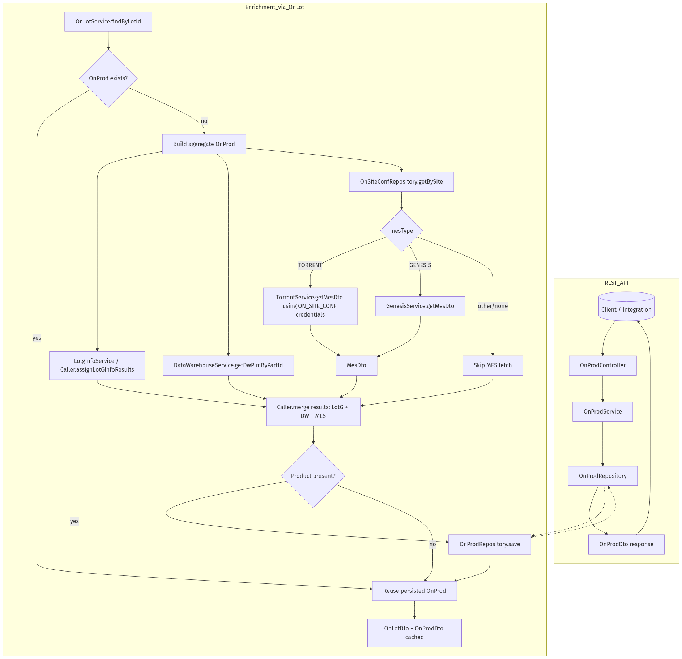
ONPROD DATAFLOW

Slide 13
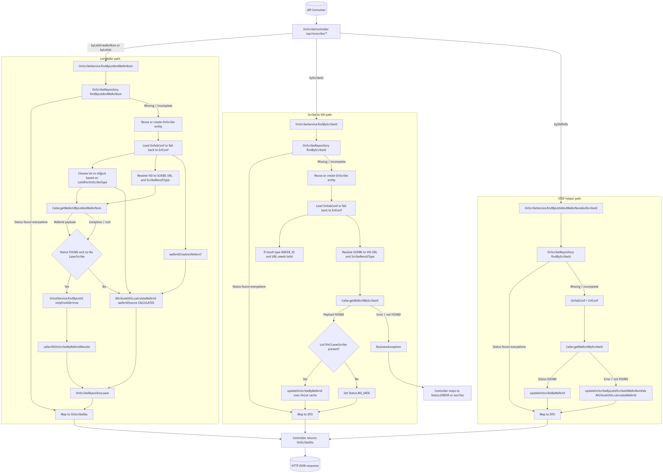
ONSCRIBE DATAFLOW

Slide 14
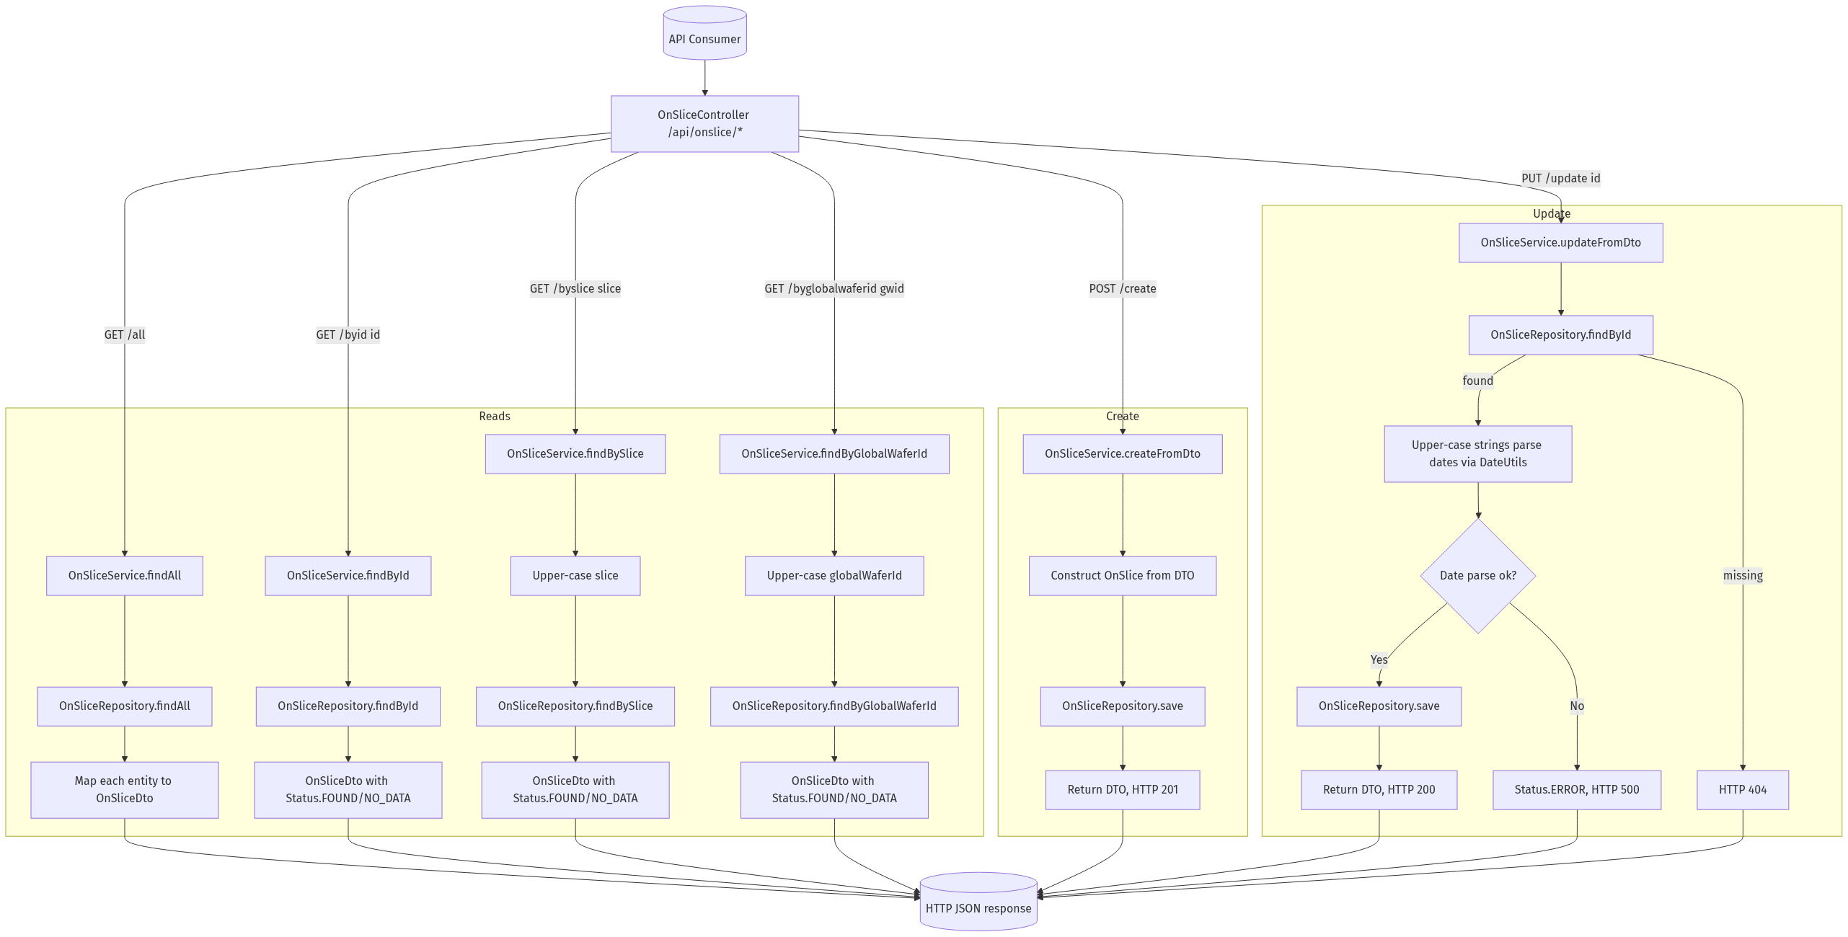
ONSLICE DATAFLOW

Slide 15
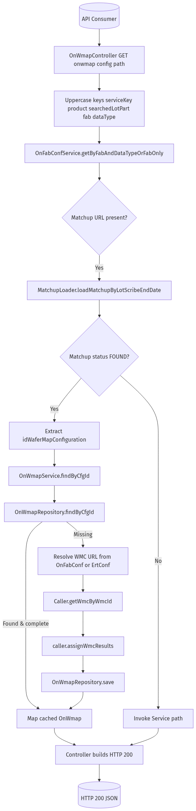
ONWMAP LEVEL2 CONFIG

Slide 16
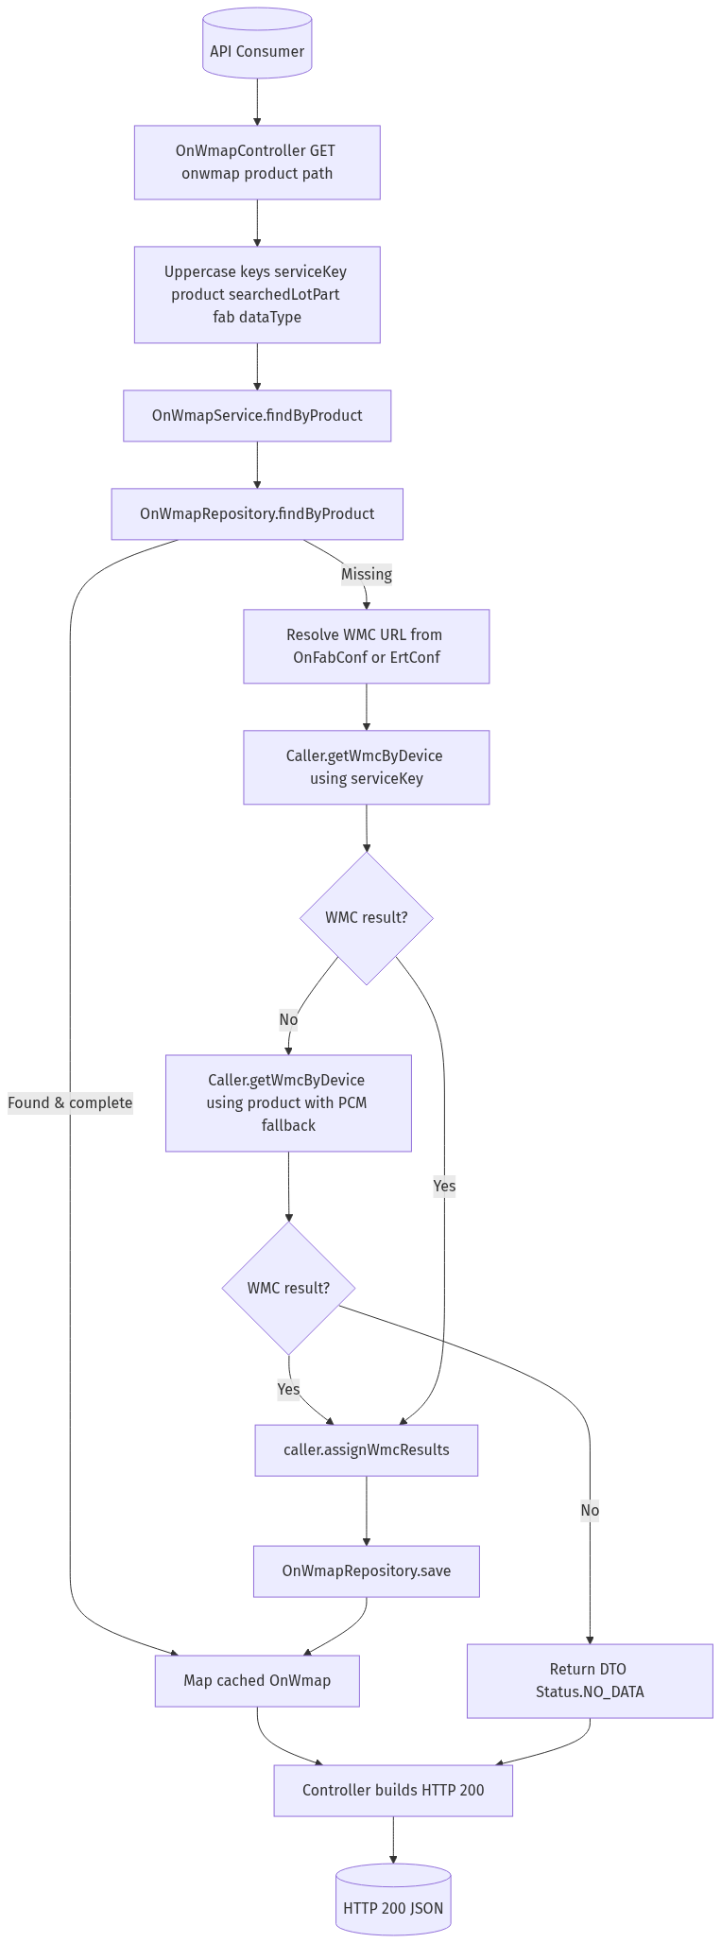
ONWMAP LEVEL2 PRODUCT

Slide 17
Databricks Migration: Summary
Exensio Reference Tables (ERT) Web Service**
Preparing for Databricks-enabled reference data orchestration
Audience: Manufacturing IT leadership, Data Engineering, Product Test teams

