Slide 1
Exensio Reference Tables (ERT) — Review
Focused: ExensioRefTables flows and operations

Slide 2
Agenda
Title & Context
Key flows: OnLot / OnProd / OnScribe / OnSlice / OnWmap
Integration overview
Operational notes

Slide 3
Exensio Reference Tables (ERT) Web Service — Executive Snapshot
What it is**
Spring Boot REST layer standardising lot, product, scribe, slice, and wafer-map reference data across test & manufacturing.
Oracle/H2-backed cache that fronts slower upstream systems while preserving status provenance.
How it works**
Controllers normalise input, log traceability, and emit DTOs with `Status` enums (`FOUND`, `NO_DATA`, `ERROR`, `LOTG_MES_LTM_DW`, etc.).
Service tier orchestrates repository hits plus conditional enrichment from LotG DB/WS, LTM, Data Warehouse, Torrent/Genesis MES, and VID↔SCRIBE services.

Slide 4
Exensio Reference Tables Web Service
Top-level view of the Exensio Reference Tables (ERT) web service, covering its REST surface, orchestration services, shared infrastructure, and external data providers.
![ERT high-level architecture](ert-overview.png)
## Platform Snapshot
Spring Boot 2.x application exposing REST endpoints under `/api/**`.
Oracle (production) or H2 (local) database stores reference-table entities.
Controllers normalise inputs, delegate to domain services, and emit DTOs with status flags.

Slide 5
OnLot Retrieval & Enrichment
Detailed behaviour of the `OnLot` API (`/api/onlot/bylotid`) and the enrichment pipeline that merges LotG, LTM, Data Warehouse, and MES sources before persisting results.
## REST Entry Points
`GET /api/onlot/all` – dumps the local cache (`OnLotRepository.findAll`).
`GET /api/onlot/byid/{id}` – returns a single record by surrogate ID.
`GET /api/onlot/bylotid/{lotId}` – primary lookup that drives the enrichment workflow documented here.
Each request normalises textual inputs to upper-case and delegates to `OnLotService.findByLotId(lotId, alternateProduct, fab, dataType, site, onlyFromDb=false)`.

Slide 6
OnProd Retrieval & Enrichment
This note explains how `ON_PROD` records are exposed via the REST API and how they are populated when a lot lookup triggers upstream services (Data Warehouse, Torrent, Genesis, LotG) inside `OnLotService`.
## REST Endpoints
`GET /api/onprod/all` – returns every product entry (`OnProdController.all`).
`GET /api/onprod/byid/{id}` – loads a record by the internal surrogate key.
`GET /api/onprod/byproduct/{product}` – resolves a product by code; the controller normalises input to upper-case before delegating to `OnProdService.findByProduct`.
Each endpoint ultimately uses `OnProdRepository` (Spring Data JPA) for reads. If no entity is found, a DTO is returned with `Status.NO_DATA`.

Slide 7
OnScribe Retrieval & Wafer Resolution
End-to-end behaviour of the `OnScribe` REST layer and the wafer-identification pipeline that reconciles VID, scribe ID, and calculated wafer IDs using configuration-driven rules.
## REST Entry Points
`GET /api/onscribe/all` – dumps every cached record via `OnScribeRepository.findAll`.
`GET /api/onscribe/byid/{id}` – loads a specific entity by the surrogate key.
`GET /api/onscribe/bylotidandwafernum/{lotId}/{waferNum}` – canonical lookup when only the production lot is known.
`GET /api/onscribe/bylotidsandwafernum?lotId&waferNum&mfgLot` – allows callers to supply both the production lot and its manufacturing counterpart.

Slide 8
OnSlice Retrieval & Maintenance
Behaviour of the `OnSlice` REST layer and the persistence rules that back slice, puck, and wafer identifiers.
## REST Entry Points
`GET /api/onslice/all` – retrieves every cached row through `OnSliceService.findAll` → `OnSliceRepository.findAll`.
`GET /api/onslice/byid/{id}` – fetches a record by surrogate key.
`GET /api/onslice/byslice/{slice}` – canonical lookup based on the slice identifier.
`GET /api/onslice/byglobalwaferid/{globalWaferId}` – resolves a slice when only the global wafer ID is known.

Slide 9
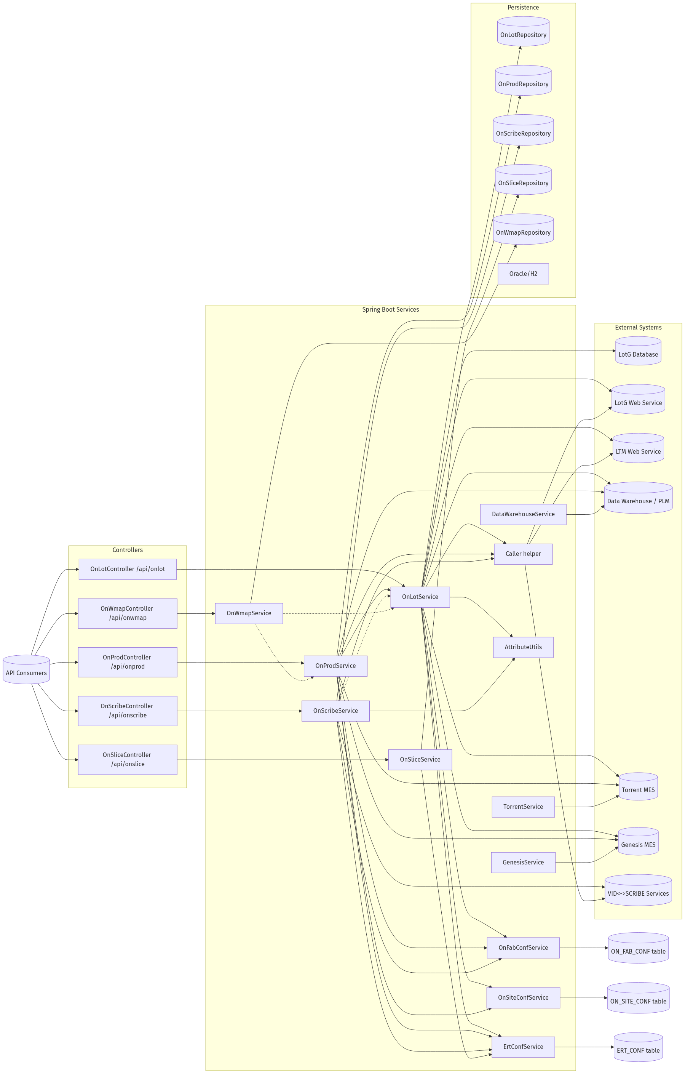
ERT OVERVIEW

Slide 10
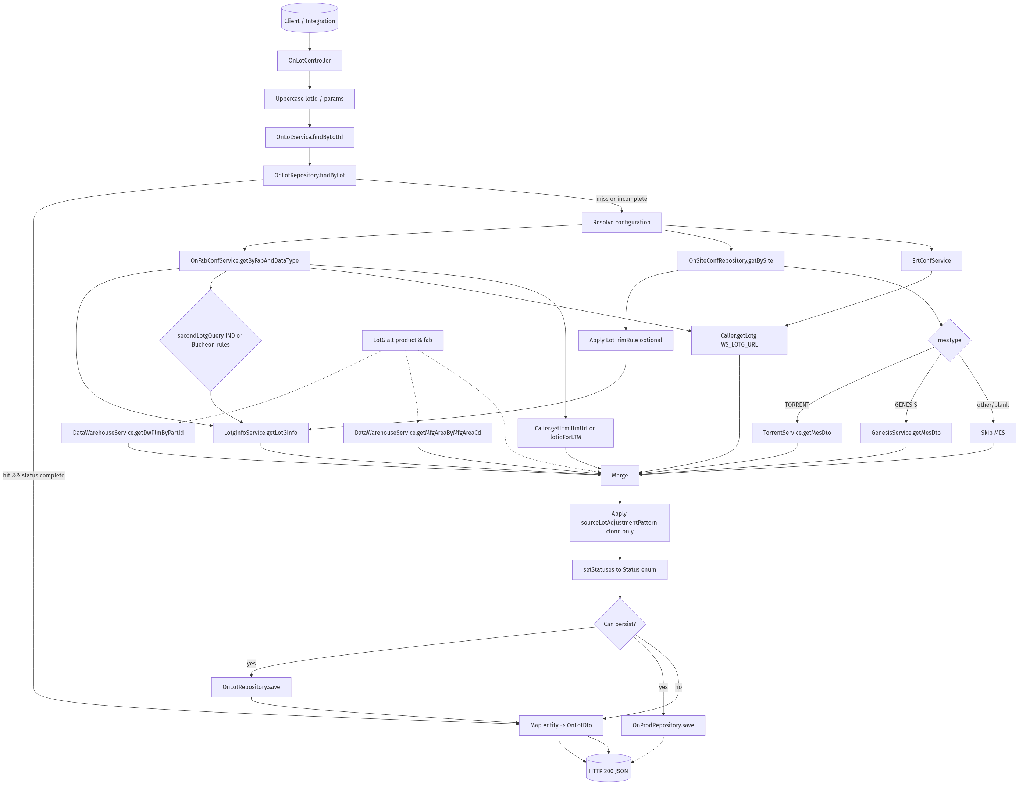
ONLOT DATAFLOW

Slide 11
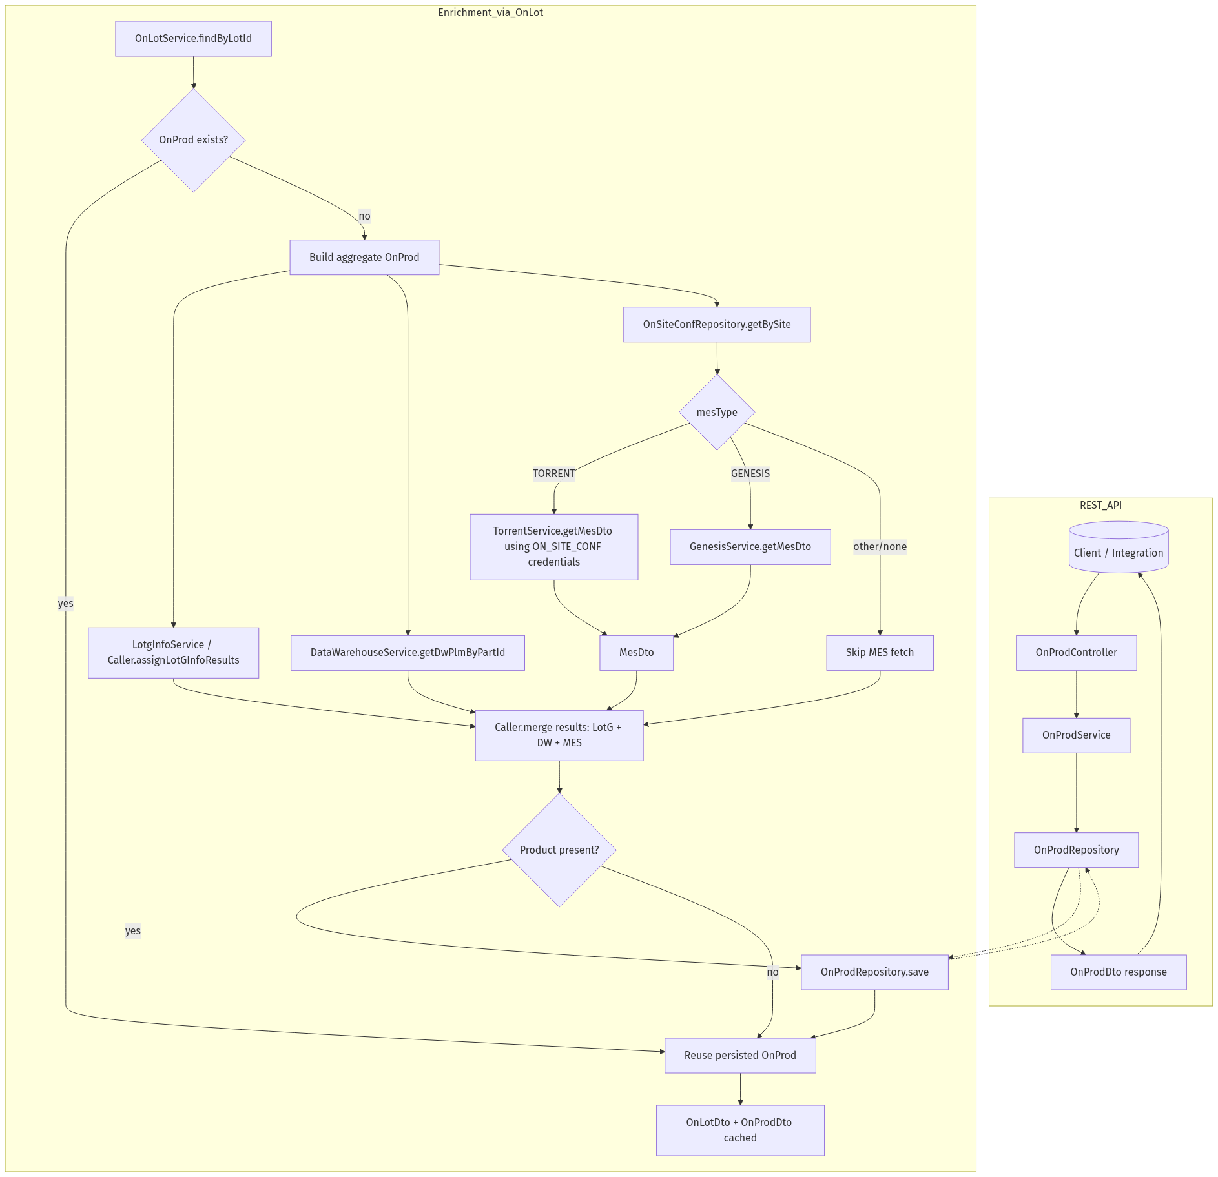
ONPROD DATAFLOW

Slide 12
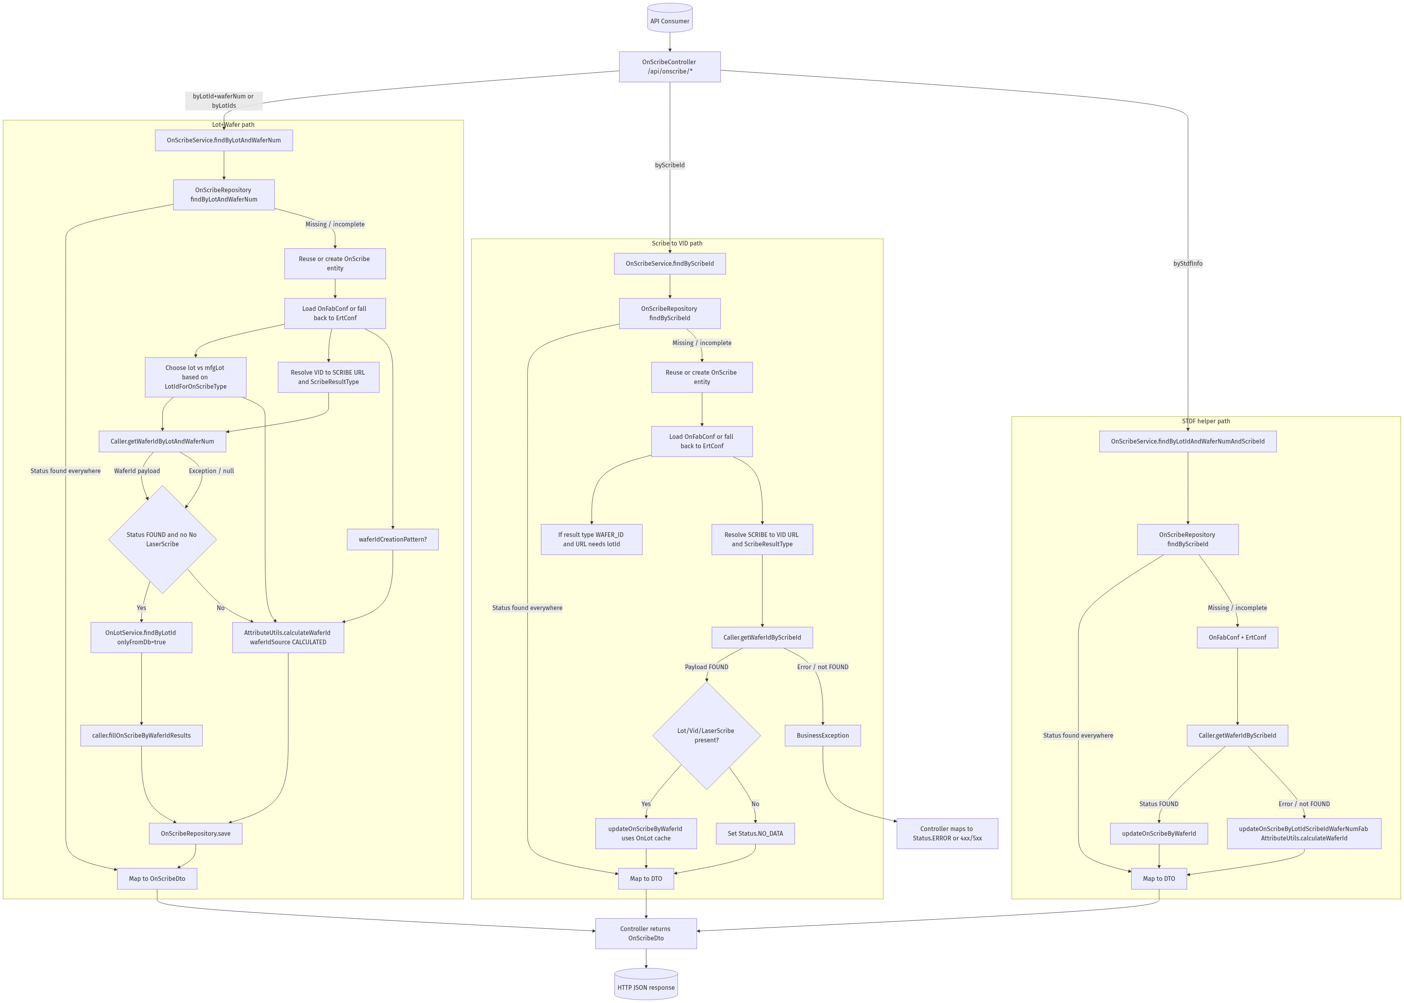
ONSCRIBE DATAFLOW

Slide 13
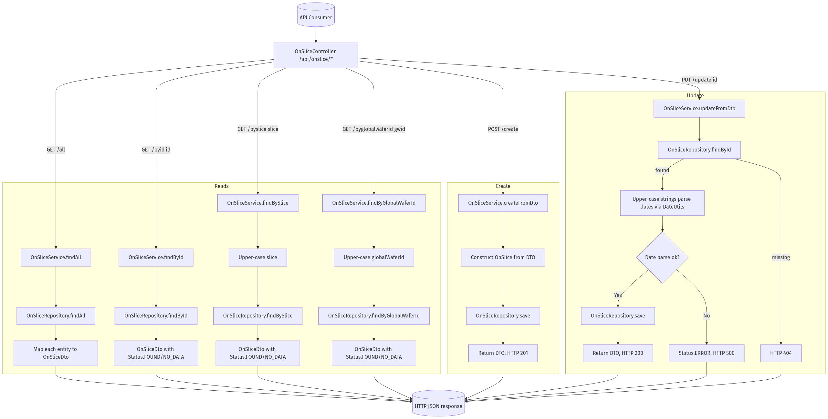
ONSLICE DATAFLOW

Slide 14
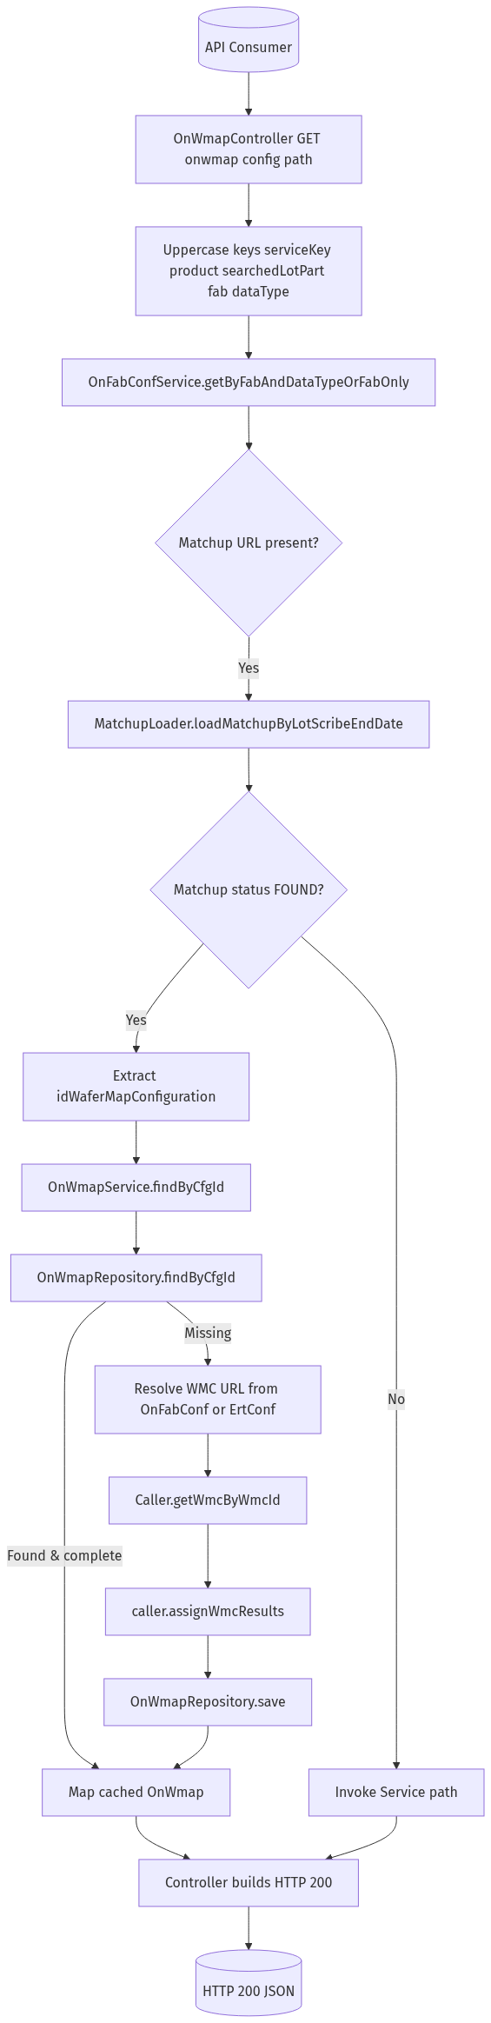
ONWMAP LEVEL2 CONFIG

Slide 15
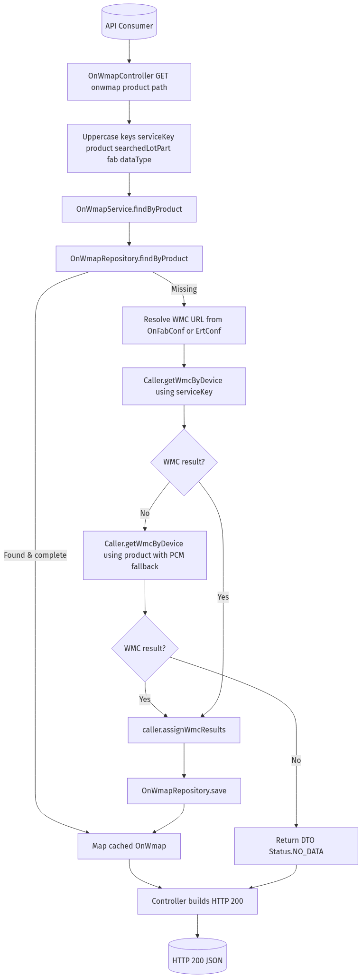
ONWMAP LEVEL2 PRODUCT

