Slide 1
Exensio Reference Tables (ERT) — Full-res Review
Images embedded at full resolution; speaker notes populated from docs/*.md

Slide 2
ERT Summary
What it is**
Spring Boot REST layer standardising lot, product, scribe, slice, and wafer-map reference data across test & manufacturing.
Oracle/H2-backed cache that fronts slower upstream systems while preserving status provenance.
How it works**
Controllers normalise input, log traceability, and emit DTOs with `Status` enums (`FOUND`, `NO_DATA`, `ERROR`, `LOTG_MES_LTM_DW`, etc.).
Service tier orchestrates repository hits plus conditional enrichment from LotG DB/WS, LTM, Data Warehouse, Torrent/Genesis MES, and VID↔SCRIBE services.
Configuration tables (`ON_FAB_CONF`, `ON_SITE_CONF`, `ERT_CONF`) toggle which identifiers to pass, which URLs to call, trimming rules, and how fallbacks (calculated wafer IDs) behave.
Key domains & endpoints**
Notes:
# Exensio Reference Tables (ERT) Web Service — Executive Snapshot
**What it is**
- Spring Boot REST layer standardising lot, product, scribe, slice, and wafer-map reference data across test & manufacturing.
- Oracle/H2-backed cache that fronts slower upstream systems while preserving status provenance.
**How it works**
- Controllers normalise input, log traceability, and emit DTOs with `Status` enums (`FOUND`, `NO_DATA`, `ERROR`, `LOTG_MES_LTM_DW`, etc.).
- Service tier orchestrates repository hits plus conditional enrichment from LotG DB/WS, LTM, Data Warehouse, Torrent/Genesis MES, and VID↔SCRIBE services.
- Configuration tables (`ON_FAB_CONF`, `ON_SITE_CONF`, `ERT_CONF`) toggle which identifiers to pass, which URLs to call, trimming rules, and how fallbacks (calculated wafer IDs) behave.
**Key domains & endpoints**
- `OnLot` `/api/onlot/bylotid` — seeds lot + product cache using LotG, LTM, MES, Data Warehouse.
- `OnProd` `/api/onprod/byproduct` — layers product-centric overrides (PLM, MES) on OnLot outputs.
- `OnScribe` `/api/onscribe/bystdfinfo` — resolves wafer IDs via VID↔SCRIBE or deterministic patterns with cached `sourceLot`.
- `OnSlice` `/api/onslice/byslice` — CRUD hub for slice/puck metadata.
- `OnWmap` `/api/onwmap/bylotid` — surfaces wafer-map references by reusing OnLot/OnProd context.
**Integration highlights**
- LotG native SQL handles multi-format lot probing with site-specific trimming heuristics.
- Torrent/Genesis MES connectors supply product version, technology, process, PTI, mask set when site configs permit.
- Data Warehouse service enriches part taxonomy (mask set, PAL4, mfg area) for both OnLot and OnProd.
- VID↔SCRIBE endpoints (configurable per fab) return laser-scribe data; failures trigger `AttributeUtils.calculateWaferId` fallbacks.
**Why it matters**
- Provides consistent reference data for downstream STDF processing, analytics, and MES integrations.
- Status-driven caching prevents redundant external calls and protects manual overrides.
- Config-driven architecture scales across fabs/sites without code changes.

Slide 3
Overview
![ERT high-level architecture](ert-overview.png)
Spring Boot 2.x application exposing REST endpoints under `/api/**`.
Oracle (production) or H2 (local) database stores reference-table entities.
Controllers normalise inputs, delegate to domain services, and emit DTOs with status flags.
Services enrich data by combining cached records with external systems (LotG, LTM, Data Warehouse, MES, VID↔SCRIBE).
Configuration tables (`ON_FAB_CONF`, `ON_SITE_CONF`, `ERT_CONF`, `ON_PROD_CONF`) dictate which integrations fire per fab, data type, or site.
| Domain | Primary Endpoints | Responsibilities | Key Entities |
| --- | --- | --- | --- |
Notes:
# Exensio Reference Tables Web Service
Top-level view of the Exensio Reference Tables (ERT) web service, covering its REST surface, orchestration services, shared infrastructure, and external data providers.
![ERT high-level architecture](ert-overview.png)
## Platform Snapshot
- Spring Boot 2.x application exposing REST endpoints under `/api/**`.
- Oracle (production) or H2 (local) database stores reference-table entities.
- Controllers normalise inputs, delegate to domain services, and emit DTOs with status flags.
- Services enrich data by combining cached records with external systems (LotG, LTM, Data Warehouse, MES, VID↔SCRIBE).
- Configuration tables (`ON_FAB_CONF`, `ON_SITE_CONF`, `ERT_CONF`, `ON_PROD_CONF`) dictate which integrations fire per fab, data type, or site.
## REST Domains
| Domain | Primary Endpoints | Responsibilities | Key Entities |
| --- | --- | --- | --- |
| Lot (`/api/onlot`) | `bylotid`, `all`, `byid` | Builds lot records from LotG DB/WS, LTM, Torrent/Genesis, Data Warehouse; seeds OnProd cache. | `OnLot`, `OnProd` companion |
| Prod (`/api/onprod`) | `byproduct`, `all`, `byid` | Extends OnLot with product-centric overrides and Data Warehouse metadata. | `OnProd` |
| Scribe (`/api/onscribe`) | `bylotidandwafernum`, `byscribeid`, `bystdfinfo` | Resolves wafer IDs via VID↔SCRIBE services or calculates fallbacks using OnLot cache. | `OnScribe` |
| Slice (`/api/onslice`) | `byslice`, `byglobalwaferid`, `create`, `update` | Maintains slicing metadata (slice IDs, puck/run info, global wafer IDs). | `OnSlice` |
| Wafer map (`/api/onwmap`) | `bylotid`, `byscribeid` | Supplies wafer-map references combining LotG, OnLot, and remote map stores. | `OnWmap` |
| Configuration (`/api/onfabconf`, `/api/onsiteconf`, `/api/ertconf`) | CRUD endpoints | Manage fab/site-level toggles that drive enrichment logic. | `OnFabConf`, `OnSiteConf`, `ErtConf` |
## Service Layer Responsibilities
- **OnLotService** – orchestrates the most complex flow; acts as the central cache feeding OnProd, OnScribe, and OnWmap.
- **OnProdService** – layers Data Warehouse attributes and Torrent/Genesis details on top of OnLot-derived records; persists both lot and product views.
- **OnScribeService** – resolves wafer IDs using VID↔SCRIBE services, falling back to calculated patterns with help from cached OnLot source lots.
- **OnSliceService** – provides CRUD-style management without external dependencies.
- **OnWmapService** – ties lot/product context back to wafer-map repositories, driven by OnLot and OnProd data.
- **Caller helper** – centralises outbound HTTP/SOAP calls (LotG WS, LTM, VID↔SCRIBE, Genesis) and field-mapping utilities.
## Shared Infrastructure
| Component | Purpose |
| --- | --- |
| `OnFabConfService` | Determines fab/data-type-specific settings (lot selection rules, URLs, result types, lot-trim heuristics, wafer ID equality flags).
| `OnSiteConfService` | Supplies site-level connection details (MES database connectivity, MES type, lot trimming regexes).
| `ErtConfService` | Provides global defaults (service URLs, feature toggles) when fab/site configs are absent.
| `DataWarehouseService` | Retrieves PLM and manufacturing-area metadata for lots/products when missing locally.
| `TorrentService` / `GenesisService` | Query MES backends for product/process/technology overrides, keyed by site configuration.
| `AttributeUtils` | Offers deterministic fallbacks (wafer ID calculation, JND/Bucheon lot trimming).
| `DateUtils` | Parses user-supplied timestamps during create/update flows.
## Request Lifecycle (Typical Enriched Flow)
1. **Controller** upper-cases textual inputs and logs the request.
2. **Service** checks the repository; `Status.isFoundAll()` short-circuits repeat lookups.
3. **Configuration** data is loaded (fab/site/global) to decide which external calls apply and which identifiers to pass downstream.
4. **External calls** execute in priority order (LotG native DB → LotG WS → LTM → Data Warehouse → MES → VID↔SCRIBE), folding results onto domain objects.
5. **Utility mappers** (`Caller.assign*`) harmonise source data, ensuring OnLot and OnProd remain aligned.
6. **Status resolution** marks successes/failures (e.g., `LOTG_MES_LTM_DW`, `FOUND`, `NO_DATA`).
7. **Persistence** writes entities back through repositories; services return DTOs for HTTP responses.
## External Systems & Access Paths
| System | Accessor | Triggered From | Notes |
| --- | --- | --- | --- |
| LotG database | `LotgInfoCustomRepository` | OnLot/OnProd | Native SQL against foundry tables; supports alternate lot formats and site trimming.
| LotG web service | `Caller.getLotg` | OnLot/OnProd | Adds manufacturing lot linkages when DB lacks data.
| LTM web service | `Caller.getLtm` | OnLot/OnProd | Supplies lot-type attributes.
| Data Warehouse (PLM/Mfg Area) | `DataWarehouseService` | OnLot/OnProd | Enriches part descriptions, mask sets, PAL4 codes.
| Torrent MES | `TorrentService.getMesDto` | OnLot/OnProd | Runs site-specific SQL for product/process/technology overrides.
| Genesis MES | `GenesisService.getMesDto` | OnLot/OnProd | SOAP/REST call alternative when `mesType=GENESIS`.
| VID↔SCRIBE services | `Caller.getWaferIdByLotAndWaferNum`, `Caller.getWaferIdByScribeId` | OnScribe | URL templates sourced from `ON_FAB_CONF` or `ERT_CONF`.
## Persistence & Status Conventions
- Each domain entity tracks `Status` enums summarising source coverage (`FOUND`, `LOTG_MES_LTM_DW`, `NO_DATA`, `ERROR`, `MANUAL`).
- Repositories act as caches; enrichment services avoid overwriting manual entries and stop early when data is already complete.
- `insertTime` timestamps use `DateUtils.getSqlDateNow()` on modification; create/update flows reject malformed timestamps.
## Diagram Regeneration
Mermaid source is stored in `docs/ert-overview.mmd`. After edits run:
```bash
jq -Rs '{diagram_source: .}' docs/ert-overview.mmd > /tmp/ert-overview.json
curl -s -H 'Content-Type: application/json' --data @/tmp/ert-overview.json \
https://kroki.io/mermaid/png --output docs/ert-overview.png
```

Slide 4
OnLot
`GET /api/onlot/all` – dumps the local cache (`OnLotRepository.findAll`).
`GET /api/onlot/byid/{id}` – returns a single record by surrogate ID.
`GET /api/onlot/bylotid/{lotId}` – primary lookup that drives the enrichment workflow documented here.
![OnLot data enrichment flow](onlot-dataflow.png)
1. **Initial local hit** – attempt `OnLotRepository.findByLot(lotId)`. If `onlyFromDb=true` the method returns here.
8. **MES integration** – if `site` is supplied the service loads `ON_SITE_CONF`:
`mesType=TORRENT` → `TorrentService.getMesDto` runs the site-specific SQL against the Torrent MES DB, returning lot, product, process, technology, PTI code, and mask set.
`mesType=GENESIS` → `GenesisService.getMesDto` calls the Genesis MES service.
Notes:
# OnLot Retrieval & Enrichment
Detailed behaviour of the `OnLot` API (`/api/onlot/bylotid`) and the enrichment pipeline that merges LotG, LTM, Data Warehouse, and MES sources before persisting results.
## REST Entry Points
- `GET /api/onlot/all` – dumps the local cache (`OnLotRepository.findAll`).
- `GET /api/onlot/byid/{id}` – returns a single record by surrogate ID.
- `GET /api/onlot/bylotid/{lotId}` – primary lookup that drives the enrichment workflow documented here.
Each request normalises textual inputs to upper-case and delegates to `OnLotService.findByLotId(lotId, alternateProduct, fab, dataType, site, onlyFromDb=false)`.
![OnLot data enrichment flow](onlot-dataflow.png)
## Control Flow Inside `OnLotService.findByLotId`
1. **Initial local hit** – attempt `OnLotRepository.findByLot(lotId)`. If `onlyFromDb=true` the method returns here.
2. **Status check** – if the record is missing or its `Status` is not "found everywhere" the service proceeds to enrichment.
3. **LotG lookup** – `LotgInfoService.getLotGInfo(lotVariant)` runs the native SQL in `LotgInfoCustomRepository` using up to four lot formats. `LotIdForLotGWS` in `ON_FAB_CONF` may force use of the manufacturing lot when a cached row already exists.
4. **Site-specific trimming** – optional `ON_SITE_CONF.lotTrimRule` can transform the lot before calling LotG; JND/Bucheon second-pass logic applies additional heuristics when `ON_FAB_CONF.secondLotgQuery=true`.
5. **LTM call** – `Caller.getLtm(ltmUrl, lot)` hits the LTM web service chosen by `ON_FAB_CONF.ltmUrl`. `LotIdForLTM` controls whether `lot` or `mfgLot` is used.
6. **LotG reference data** – `Caller.getLotg` fetches foundry/fab lots via the `WS_LOTG_URL` constant stored under `ERT_CONF` (unless DB already has mfg-lot info).
7. **Data Warehouse** – `DataWarehouseService.getDwPlmByPartId(alternateProduct)` and `getMfgAreaByMfgAreaCd(fab)` load PLM and manufacturing-area descriptors when not already present.
8. **MES integration** – if `site` is supplied the service loads `ON_SITE_CONF`:
- `mesType=TORRENT` → `TorrentService.getMesDto` runs the site-specific SQL against the Torrent MES DB, returning lot, product, process, technology, PTI code, and mask set.
- `mesType=GENESIS` → `GenesisService.getMesDto` calls the Genesis MES service.
- Missing or other types skip MES, but statuses acknowledge MES availability.
9. **Prioritised merge** – `Caller` utilities align and prioritise results:
- `assignLotGInfoResults` seeds `OnLot`/`OnProd` with LotG product/fab/source-lot data.
- `assignLotgResults` adds manufacturing lot info from the LotG web service.
- `assignLtmResults` enriches lot type.
- `assignDwhpResults` and `assignDwMfgaResults` pull PLM/mfg-area metadata.
- `assignMesResults` overlays MES values (process, technology, product version, PTI, mask set).
10. **Source-lot adjustments** – `ON_FAB_CONF.sourceLotAdjustmentPattern` can alter only the returned DTO (clone) while leaving the persisted entity intact.
11. **Status resolution** – `setStatuses` evaluates which sources succeeded (LotG, MfgLot, MES, LTM, DW) and assigns a composite enum like `LOTG_MFGLOT_MES_LTM_DW`.
12. **Persistence** – if the final `OnLot` has a non-empty `lot` and the pipeline either succeeded or properly skipped MES, the entity is saved; the companion `OnProd` (built concurrently) is also persisted when populated.
## Key Configuration/Data Sources
| Source | Access Path | Configuration | Data Returned |
| --- | --- | --- | --- |
| LotG native DB | `LotgInfoCustomRepository.SQL_LOTG_QUERY` | Uses hard-coded SQL; optional `ON_FAB_CONF.secondLotgQuery`, site trim rules | Product, fab, source lot, wafer-part alt product, lot class/type, mask set, production code |
| LotG Web Service (MFG Lot) | `Caller.getLotg` | `ERT_CONF.WS_LOTG_URL`; `ON_FAB_CONF.lotidForLotGWS` | Foundry/fab lot pairings, used to populate `mfgLot` |
| LTM Web Service | `Caller.getLtm` | `ON_FAB_CONF.ltmUrl`; `ON_FAB_CONF.lotidForLTM` | Lot type metadata |
| Data Warehouse | `DataWarehouseService` | `onlot` status gating; needs LotG alt product & fab code | PLM attributes (mask set, PAL4, part class/type, description) and mfg area descriptors |
| Torrent MES | `TorrentService.getMesDto` | `ON_SITE_CONF` (driver, URL, credentials, SQL) | Lot, fab, product, product version, family, lot type, process, technology, PTI, mask set |
| Genesis MES | `GenesisService.getMesDto` | `ON_SITE_CONF.mesType=GENESIS` | Same logical fields as Torrent via SOAP/REST |
| Alternate product override | Request parameter or fallback | Provided by caller | Used when LotG / MES do not supply product ID |
## Source-Lot Formatting Heuristics
- JND sites (fab codes beginning with `JND`) can trigger a second LotG query: `AttributeUtils.getNewJNDLotFromOldLot` derives the new lot format.
- Bucheon (`fab` contains `BUCHEON` and starts with `KR`) applies regex rules to strip or replace characters based on USME lot patterns.
- `ON_SITE_CONF.lotTrimRule` (parsed into `LotTrimRule`) allows per-site trimming before LotG calls.
## Status Semantics
`Status` flags combine data source contributions:
- `LOTG_*` components indicate `LotgInfo` or manufacturing lot data succeeded.
- `_MES` suffixes show Torrent/Genesis calls either succeeded or were available/called.
- `_LTM`, `_DW`, `_MFGLOT` portions reflect LTM, Data Warehouse, and LotG mfg-lot fetches.
- `MANUAL` overrides prevent automatic overwrites when the user set a record manually.
## Regenerating the Diagram
Mermaid source lives in `docs/onlot-dataflow.mmd`. After edits run:
```bash
jq -Rs '{diagram_source: .}' docs/onlot-dataflow.mmd > /tmp/onlot-dataflow.json
curl -s -H 'Content-Type: application/json' --data @/tmp/onlot-dataflow.json \
https://kroki.io/mermaid/png --output docs/onlot-dataflow.png
```

Slide 5
OnProd
`GET /api/onprod/all` – returns every product entry (`OnProdController.all`).
`GET /api/onprod/byid/{id}` – loads a record by the internal surrogate key.
`GET /api/onprod/byproduct/{product}` – resolves a product by code; the controller normalises input to upper-case before delegating to `OnProdService.findByProduct`.
![OnProd runtime data flow](onprod-dataflow.png)
1. **Initial lookup** – `OnProdRepository.findByProduct` is checked first.
3. **MES integration** – if the referenced site has a record in `ON_SITE_CONF`, the service inspects `mesType`:
`GENESIS` → `GenesisService.getMesDto(site, lot)` (SOAP/REST client) fills MES DTO fields.
`TORRENT` → `TorrentService.getMesDto(site, lot)` opens a JDBC connection defined by `ON_SITE_CONF` and executes `SQL_LTM_PRODUCT_REPLACEMENT` to retrieve product metadata.
Notes:
# OnProd Retrieval & Enrichment
This note explains how `ON_PROD` records are exposed via the REST API and how they are populated when a lot lookup triggers upstream services (Data Warehouse, Torrent, Genesis, LotG) inside `OnLotService`.
## REST Endpoints
- `GET /api/onprod/all` – returns every product entry (`OnProdController.all`).
- `GET /api/onprod/byid/{id}` – loads a record by the internal surrogate key.
- `GET /api/onprod/byproduct/{product}` – resolves a product by code; the controller normalises input to upper-case before delegating to `OnProdService.findByProduct`.
Each endpoint ultimately uses `OnProdRepository` (Spring Data JPA) for reads. If no entity is found, a DTO is returned with `Status.NO_DATA`.
![OnProd runtime data flow](onprod-dataflow.png)
## When Are OnProd Rows Populated?
The application does not call Torrent or Genesis directly from the `/api/onprod` endpoints. Instead, enrichment happens inside `OnLotService.findByLotId` whenever an `ON_LOT` lookup needs product data:
1. **Initial lookup** – `OnProdRepository.findByProduct` is checked first.
2. **LotG / Data Warehouse** – if the lot pipeline pulls alternate product information (`LotgInfo`, `DataWarehousePlm`), those results update the in-memory `OnProd` aggregate.
3. **MES integration** – if the referenced site has a record in `ON_SITE_CONF`, the service inspects `mesType`:
- `GENESIS` → `GenesisService.getMesDto(site, lot)` (SOAP/REST client) fills MES DTO fields.
- `TORRENT` → `TorrentService.getMesDto(site, lot)` opens a JDBC connection defined by `ON_SITE_CONF` and executes `SQL_LTM_PRODUCT_REPLACEMENT` to retrieve product metadata.
- Other values → MES is skipped.
4. **Merge rules** – the `Caller` helper copies MES, Data Warehouse, and LotG facts onto both `OnLot` and `OnProd`, following a priority order (MES overrides DW overrides LotG, etc.).
5. **Persistence** – if the merged `OnProd` now has a non-empty `product`, `OnProdRepository.save` is invoked so future REST calls can read from the local database.
## Data Warehouse Participation
`OnLotService.findByLotId` calls `DataWarehouseService` whenever the current `OnLot`/`OnProd` status indicates Data Warehouse enrichment has not already happened:
- **Input**: the product identifier returned by LotG (`LotGInfo.getWaferPartAlternateProduct`) becomes the `partId` parameter.
- **Calls**:
- `DataWarehouseService.getDwPlmByPartId(partId)` → uses `DataWarehouseCustomRepository.getDwPlmByPartId`. The XML-backed `DataWarehousePlm` model includes attributes such as `ERP_RESOURCE_FAB_CD`, `FAB_SITE_ID`, `MASK_SET_NO_PART_VAL`, `PAL4_CD`, `FAM_PLATFORM_GROUP_TYPE`, `PART_DESC`, `PART_TYPE`, and other descriptors used for die/wafer context.
- `DataWarehouseService.getMfgAreaByMfgAreaCd(fab)` → maps the fab code to a descriptive record (`DataWarehouseMfgArea`) with `MFG_AREA_DESC`, `MFG_AREA_TYPE_CD`, and `COUNTRY_CD`.
- **Usage**: the shared `Caller` helper pushes these values onto `OnProd` and `OnLot` via `assignDwhpResults` and `assignDwMfgaResults`, filling fields like `maskSet`, `technology`, `family`, `fab`, and descriptive metadata used by callers.
## Torrent MES Participation
For sites configured with `MES_TYPE = TORRENT` in `ON_SITE_CONF`, the enrichment pipeline pulls product details directly from the Torrent MES database:
| ON_SITE_CONF Column | Purpose |
| --- | --- |
| `DRIVER_CLASS_NAME` | JDBC driver class for the site-specific Torrent database. |
| `CONNECTION_STRING` | JDBC URL, typically pointing at Oracle or SQL Server instances. |
| `DB_USERNAME` / `DB_PASSWORD` | Credentials used by `TorrentSiteDataSources` to build a pooled connection. |
| `SQL_LTM_PRODUCT_REPLACEMENT` | Parameterised SQL query executed with the lot ID. |
`TorrentService.getMesDto(site, lot)` obtains a connection and executes the configured statement. The result set populates `MesDto` columns:
- `LOTID` → `MesDto.lot`
- `SRC_FAB` → `MesDto.fab`
- `PARTNAME` → `MesDto.product`
- `PARTVERSION` → `MesDto.productVersion`
- `FAMILY` → `MesDto.family`
- `LOT_TYPE` → `MesDto.lotType`
- `PROCESS` → `MesDto.process`
- `TECHNOLOGY` → `MesDto.technology`
- `PTI_CODE` → `MesDto.pti4`
- `MASK_SET` → `MesDto.maskSet`
The `Caller.assignMesResults` method merges these MES values into the `OnProd` entity, overriding Data Warehouse or LotG fields when present.
## Genesis MES Participation
If `MES_TYPE = GENESIS`, `OnLotService` calls `GenesisService.getMesDto(site, lot)` (SOAP/REST client). Although the implementation differs, it returns the same `MesDto` structure as Torrent. The `Caller.assignMesResults` path is identical, ensuring consistent downstream mapping.
## LotG & Additional Inputs
- **LotGInfo** – retrieved through `LotgInfoService.getLotGInfo`. Supplies initial product and fab codes used to seed both `OnLot` and `OnProd`.
- **LTM Web Service** – when configured via `OnFabConf`, the LTM payload adds lot-type information merged into the DTO.
- **Alternate Product** – user-supplied or LotG-sourced fallback used if neither MES nor Data Warehouse provides a product code.
## Torrent Configuration Details
`TorrentService` relies on runtime configuration stored in `ON_SITE_CONF`:
| Column | Purpose |
| --- | --- |
| `MES_TYPE` | Selects Torrent vs Genesis; must be `TORRENT` for this path. |
| `DRIVER_CLASS_NAME`, `CONNECTION_STRING`, `DB_USERNAME`, `DB_PASSWORD` | Used to construct a site-specific JDBC connection pool (`TorrentSiteDataSources`). |
| `SQL_LTM_PRODUCT_REPLACEMENT` | Query executed with the lot ID as bind parameter; returns part, family, process, technology, PTI code, etc. |
The resulting `MesDto` is consumed by `Caller.assignMesResults`, which maps fields such as `product`, `family`, `process`, `technology`, and `maskSet` onto the `OnProd` entity.
## Diagnostics & Status
- Successful enrichment sets `Status` on both `OnLot` and `OnProd` to a composite value like `LOTG_MFGLOT_MES_LTM_DW`, reflecting which upstream systems responded.
- If Torrent/Genesis calls fail, the service logs the problem and falls back to previously cached data (LotG, DataWarehouse) before returning.
- Manual edits (status `MANUAL`) are preserved because `setOnLotOnProdStatus` will not override manual entries.
## Regenerating the Diagram
Mermaid source lives in `docs/onprod-dataflow.mmd`. After edits run:
```bash
jq -Rs '{diagram_source: .}' docs/onprod-dataflow.mmd > /tmp/onprod-dataflow.json
curl -s -H 'Content-Type: application/json' --data @/tmp/onprod-dataflow.json \
https://kroki.io/mermaid/png --output docs/onprod-dataflow.png
```

Slide 6
OnScribe
`GET /api/onscribe/all` – dumps every cached record via `OnScribeRepository.findAll`.
`GET /api/onscribe/byid/{id}` – loads a specific entity by the surrogate key.
`GET /api/onscribe/bylotidandwafernum/{lotId}/{waferNum}` – canonical lookup when only the production lot is known.
`GET /api/onscribe/bylotidsandwafernum?lotId&waferNum&mfgLot` – allows callers to supply both the production lot and its manufacturing counterpart.
`GET /api/onscribe/byscribeid/{scribeId}` – resolves a VID/lot pair when only the scribe mark is provided.
`GET /api/onscribe/bystdfinfo/{lotId}/{waferNum}/{scribeId}` – STDF helper that attempts the scribe lookup first but falls back to a calculated wafer ID when the external call fails.
![OnScribe wafer resolution flow](onscribe-dataflow.png)
3. **Configuration handshake** – `OnFabConfService.getByFabAndDataTypeOrFabOnly` determines:
Notes:
# OnScribe Retrieval & Wafer Resolution
End-to-end behaviour of the `OnScribe` REST layer and the wafer-identification pipeline that reconciles VID, scribe ID, and calculated wafer IDs using configuration-driven rules.
## REST Entry Points
- `GET /api/onscribe/all` – dumps every cached record via `OnScribeRepository.findAll`.
- `GET /api/onscribe/byid/{id}` – loads a specific entity by the surrogate key.
- `GET /api/onscribe/bylotidandwafernum/{lotId}/{waferNum}` – canonical lookup when only the production lot is known.
- `GET /api/onscribe/bylotidsandwafernum?lotId&waferNum&mfgLot` – allows callers to supply both the production lot and its manufacturing counterpart.
- `GET /api/onscribe/byscribeid/{scribeId}` – resolves a VID/lot pair when only the scribe mark is provided.
- `GET /api/onscribe/bystdfinfo/{lotId}/{waferNum}/{scribeId}` – STDF helper that attempts the scribe lookup first but falls back to a calculated wafer ID when the external call fails.
Every endpoint upper-cases inbound strings before delegating to `OnScribeService`, which encapsulates the enrichment logic illustrated below.
![OnScribe wafer resolution flow](onscribe-dataflow.png)
## `OnScribeService.findByLotAndWaferNum`
1. **Repository probe** – call `OnScribeRepository.findByLotAndWaferNum`. When a row exists and `Status.isFoundAll()` is true, the service returns immediately.
2. **Entity bootstrap** – reuse the partially populated entity or instantiate a fresh `OnScribe` and stamp `insertTime`.
3. **Configuration handshake** – `OnFabConfService.getByFabAndDataTypeOrFabOnly` determines:
- Which lot identifier to pass downstream (`LotIdForOnScribeType` toggles between production and manufacturing lot).
- Whether the wafer ID must equal the scribe ID (`onScribeWaferIdEqualsScribeId`).
- The VID→SCRIBE endpoint (`vid2ScribeUrl`) and expected payload style (`ScribeResultType`).
- Optional `waferIdCreationPattern` overrides for calculated fallbacks.
Missing `OnFabConf` entries fall back to `ErtConfService` URLs and default result types.
4. **External VID lookup** – `Caller.getWaferIdByLotAndWaferNum` invokes the chosen VID→SCRIBE service. Any exception is logged; the pipeline keeps going with a calculated fallback.
5. **OnLot context** – request `OnLotService.findByLotId(..., onlyFromDb=true)` to borrow cached `sourceLot` and LotG metadata without triggering new remote calls.
6. **Success path** – when the VID service returns a payload without a `No LaserScribe` error, `Caller.fillOnScribeByWaferIdResults` copies the response into the entity, optionally mirroring wafer ID into the scribe ID.
7. **Fallback path** – when the VID service fails, `AttributeUtils.calculateWaferId` synthesises a wafer ID using the (possibly trimmed) lot, wafer number, cached `sourceLot`, and `waferIdCreationPattern`. The entity is marked with `WaferIdSource.CALCULATED`.
8. **Persistence & response** – save through `OnScribeRepository.save` and wrap the entity in `OnScribeDto` for the controller response.
## `OnScribeService.findByScribeId`
1. **Repository reuse** – `OnScribeRepository.findByScribeId` short-circuits when the cached row already reports a "found everywhere" status.
2. **Configuration** – `OnFabConf` (or `ErtConf`) provides the SCRIBE→VID endpoint (`scribe2VidUrl`), result type, and the `onScribeWaferIdEqualsScribeId` flag.
3. **Pre-flight validation** – if the result type is `WAFER_ID` and the URL expects `{lotId}`, the service enforces that `lotId` is present; otherwise a `BusinessException` is thrown.
4. **External lookup** – `Caller.getWaferIdByScribeId` drives the resolution. When the payload contains the expected VID, lot, and laser-scribe values, `updateOnScribeByWaferId` hydrates the entity and persists it. Missing data triggers `Status.NO_DATA`; hard failures bubble up as `BusinessException`.
## `OnScribeService.findByLotIdAndWaferNumAndScribeId`
1. **Repository reuse** – identical short-circuit to the other flows.
2. **SCRIBE→VID attempt** – the service first tries `Caller.getWaferIdByScribeId`. If the call succeeds, the `updateOnScribeByWaferId` path is reused.
3. **Graceful degradation** – when the call fails or returns a non-`FOUND` status, `updateOnScribeByLotIdScribeIdWaferNumFab` synthesises the wafer ID by:
- Upper-casing inputs and parsing `waferNum` into an integer.
- Pulling cached `OnLot` data (`onlyFromDb=true`) to recover `sourceLot` for pattern-based calculations.
- Applying `AttributeUtils.calculateWaferId`, setting `WaferIdSource.CALCULATED`, and saving the entity.
4. **Error handling** – invalid wafer numbers result in a `BusinessException`; other issues are logged and surfaced to the caller as `Status.ERROR` via the controller.
## Data Sources & Configuration Contracts
| Source | Access Path | Notes | Key Outputs |
| --- | --- | --- | --- |
| OnScribeRepository | `findByLotAndWaferNum`, `findByScribeId`, `save` | Acts as cache; `Status.isFoundAll()` prevents repeated external traffic. | Historical OnScribe rows, persisted wafer IDs, statuses. |
| OnFabConf | `OnFabConfService.getByFabAndDataTypeOrFabOnly` | Defines lot selection (`LotIdForOnScribeType`), wafer↔scribe equality, VID/SCRIBE endpoint URLs, result types, and creation patterns. | URL templates, booleans, enums consumed by OnScribeService. |
| ErtConf | `ErtConfService.getStringByName` | Provides default VID↔SCRIBE endpoints when `OnFabConf` is missing or incomplete. | Global fallback URLs. |
| OnLot cache | `OnLotService.findByLotId(..., onlyFromDb=true)` | Supplies `sourceLot` and LotG metadata without launching fresh MES/LotG calls. | Cached lot mappings, source lot identifiers. |
| VID↔SCRIBE services | `Caller.getWaferIdByLotAndWaferNum`, `Caller.getWaferIdByScribeId` | External HTTP calls configured per fab/data type; may return partial or missing data. | VID, lot, wafer ID, laser scribe, and error/status flags. |
| AttributeUtils | `AttributeUtils.calculateWaferId` | Deterministic fallback when remote services cannot return a wafer ID. | Calculated wafer ID string aligned with site-specific patterns. |
## Status Semantics
- `FOUND` – wafer ID resolved (either from web service or calculation) and persisted.
- `NO_DATA` – external call succeeded but returned incomplete payload (e.g., missing VID or laser scribe).
- `ERROR` – unexpected exception; controller maps it to HTTP 500 with the error message.
- `MANUAL` – pre-existing entries marked manual are not overwritten by the enrichment routines.
## Regenerating the Diagram
Mermaid source lives in `docs/onscribe-dataflow.mmd`. After any edits run:
```bash
jq -Rs '{diagram_source: .}' docs/onscribe-dataflow.mmd > /tmp/onscribe-dataflow.json
curl -s -H 'Content-Type: application/json' --data @/tmp/onscribe-dataflow.json \
https://kroki.io/mermaid/png --output docs/onscribe-dataflow.png
```

Slide 7
OnSlice
Behaviour of the `OnSlice` REST layer and the persistence rules that back slice, puck, and wafer identifiers.
`GET /api/onslice/all` – retrieves every cached row through `OnSliceService.findAll` → `OnSliceRepository.findAll`.
`GET /api/onslice/byid/{id}` – fetches a record by surrogate key.
`GET /api/onslice/byslice/{slice}` – canonical lookup based on the slice identifier.
`GET /api/onslice/byglobalwaferid/{globalWaferId}` – resolves a slice when only the global wafer ID is known.
`POST /api/onslice/create` – inserts a new record from an `OnSliceDto` payload.
`PUT /api/onslice/update/{id}` – updates selected fields of an existing record.
![OnSlice controller/service flow](onslice-dataflow.png)
Notes:
# OnSlice Retrieval & Maintenance
Behaviour of the `OnSlice` REST layer and the persistence rules that back slice, puck, and wafer identifiers.
## REST Entry Points
- `GET /api/onslice/all` – retrieves every cached row through `OnSliceService.findAll` → `OnSliceRepository.findAll`.
- `GET /api/onslice/byid/{id}` – fetches a record by surrogate key.
- `GET /api/onslice/byslice/{slice}` – canonical lookup based on the slice identifier.
- `GET /api/onslice/byglobalwaferid/{globalWaferId}` – resolves a slice when only the global wafer ID is known.
- `POST /api/onslice/create` – inserts a new record from an `OnSliceDto` payload.
- `PUT /api/onslice/update/{id}` – updates selected fields of an existing record.
Each controller method upper-cases incoming identifiers (where applicable) before delegating to `OnSliceService`. Responses are wrapped in `OnSliceDto`, carrying status flags for clients.
![OnSlice controller/service flow](onslice-dataflow.png)
## Read Path (`findBy*`)
1. **Input normalisation** – controller upper-cases `slice` and `globalWaferId` when present.
2. **Repository query** – `OnSliceService` hands off to `OnSliceRepository` (`findAll`, `findById`, `findBySlice`, `findByGlobalWaferId`). There are no remote calls or enrichment passes.
3. **Status derivation** – controller inspects the optional result and sets `Status.FOUND` when present or `Status.NO_DATA` when absent. Exceptions bubble up as `Status.ERROR` with a message.
## Create Path (`createFromDto`)
1. **DTO mapping** – `OnSliceService.createFromDto` constructs a domain entity via the `OnSlice(OnSliceDto)` constructor.
2. **Persistence** – `OnSliceRepository.save` writes the row and returns the managed entity.
3. **Response** – service wraps the saved entity in a DTO and responds with HTTP 201.
## Update Path (`updateFromDto`)
1. **Lookup** – controller resolves the existing entity with `findById`. Missing rows trigger HTTP 404 before any updates are attempted.
2. **Selective field updates** – `OnSliceService.updateFromDto` copies only non-null DTO fields, upper-casing text values and parsing date fields via `DateUtils`.
3. **Validation** – `DateUtils.convertStringToDate` guards `SliceStartTime` and `InsertTime`; parsing failures return `Status.ERROR` with HTTP 500.
4. **Persistence & Status** – successful saves return HTTP 200 with the refreshed DTO and `Status.FOUND` inferred from the entity; errors surface as `Status.ERROR`.
## Data Fields & Transformations
| Field | Notes |
| --- | --- |
| `slice`, `puckId`, `runId`, `sliceSourceLot`, `startLot`, `fabWaferId`, `fabSourceLot`, `slicePartname`, `sliceLottype`, `sliceSuplierid` | Converted to upper-case when updated to keep canonical formatting. |
| `sliceStartTime`, `insertTime` | Parsed using `DateUtils`. Invalid formats stop the update with `Status.ERROR`. |
| `puckHeight` | Passed through as-is (floating-point height metric). |
| `globalWaferId` | Stored as provided; used for lookups via `/byglobalwaferid`. |
## Status Semantics
- `FOUND` – successful read or update; DTO contains populated entity data.
- `NO_DATA` – repository returned empty result set for requested key.
- `ERROR` – exception encountered (parsing, persistence, or unexpected runtime failure).
## Regenerating the Diagram
Mermaid source lives in `docs/onslice-dataflow.mmd`. After edits run:
```bash
jq -Rs '{diagram_source: .}' docs/onslice-dataflow.mmd > /tmp/onslice-dataflow.json
curl -s -H 'Content-Type: application/json' --data @/tmp/onslice-dataflow.json \
https://kroki.io/mermaid/png --output docs/onslice-dataflow.png
```

Slide 8
OnWmap
flowchart TD
Client[(API Consumer)] --> Controller[OnWmapController GET onwmap byproduct endpoint params]
Controller --> Normalize[Uppercase keys serviceKey product searchedLotPart fab dataType]
Normalize --> ResolveFab[OnFabConfService.getByFabAndDataTypeOrFabOnly]
ResolveFab --> HasMatchup{Matchup URL present?}
HasMatchup -- Yes --> MatchupCall[MatchupLoader.loadMatchupByLotScribeEndDate]
MatchupCall --> MatchupResult{Matchup status FOUND?}
MatchupResult -- Yes --> UseCfgId[Extract idWaferMapConfiguration]
Notes:
flowchart TD
Client[(API Consumer)] --> Controller[OnWmapController GET onwmap byproduct endpoint params]
Controller --> Normalize[Uppercase keys serviceKey product searchedLotPart fab dataType]
Normalize --> ResolveFab[OnFabConfService.getByFabAndDataTypeOrFabOnly]
ResolveFab --> HasMatchup{Matchup URL present?}
HasMatchup -- Yes --> MatchupCall[MatchupLoader.loadMatchupByLotScribeEndDate]
MatchupCall --> MatchupResult{Matchup status FOUND?}
MatchupResult -- Yes --> UseCfgId[Extract idWaferMapConfiguration]
UseCfgId --> ServiceCfg[OnWmapService.findByCfgId]
ServiceCfg --> RepoCfg[OnWmapRepository.findByCfgId]
RepoCfg -- Found & complete --> MapFoundCfg[Map cached OnWmap]
RepoCfg -- Missing --> WmcUrlCfg[Resolve WMC URL from OnFabConf or ErtConf]
WmcUrlCfg --> CallerCfg[Caller.getWmcByWmcId]
CallerCfg --> AggregateCfg[caller.assignWmcResults]
AggregateCfg --> PersistCfg[OnWmapRepository.save]
PersistCfg --> MapFoundCfg
MatchupResult -- No --> FallbackService[Invoke Service path]
HasMatchup -- No --> FallbackService
FallbackService --> ServiceProd[OnWmapService.findByProduct]
ServiceProd --> RepoProd[OnWmapRepository.findByProduct]
RepoProd -- Found & complete --> MapFoundProd[Map cached OnWmap]
RepoProd -- Missing --> WmcUrlProd[Resolve WMC URL from OnFabConf or ErtConf]
WmcUrlProd --> CallerPrimary[Caller.getWmcByDevice using serviceKey]
CallerPrimary --> PrimaryFound{WMC result?}
PrimaryFound -- No --> CallerSecondary[Caller.getWmcByDevice using product with PCM fallback]
CallerSecondary --> SecondaryFound{WMC result?}
SecondaryFound -- No --> NoData[Return DTO Status.NO_DATA]
SecondaryFound -- Yes --> AggregateProd[caller.assignWmcResults]
PrimaryFound -- Yes --> AggregateProd
AggregateProd --> PersistProd[OnWmapRepository.save]
PersistProd --> MapFoundProd
MapFoundCfg --> ControllerResponse[Controller builds HTTP 200]
MapFoundProd --> ControllerResponse
NoData --> ControllerResponse
ControllerResponse --> ClientResponse[(HTTP 200 JSON)]

Slide 9
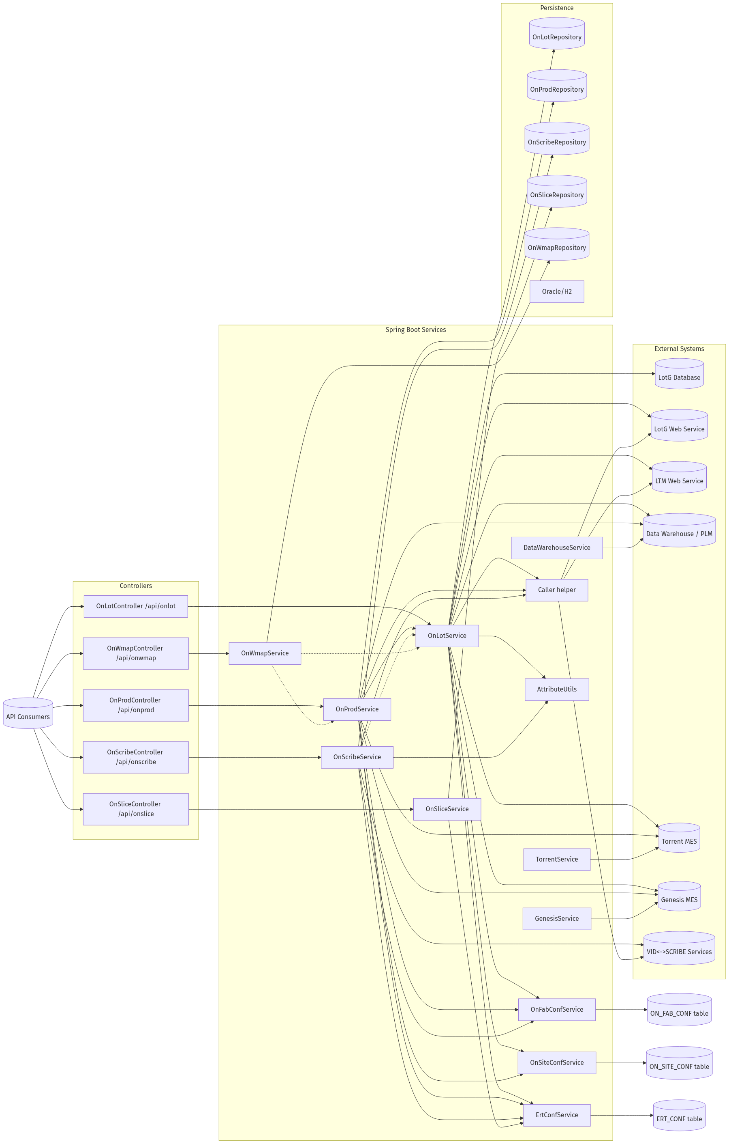
ERT OVERVIEW
Notes:
Source image: ert-overview.png

Slide 10
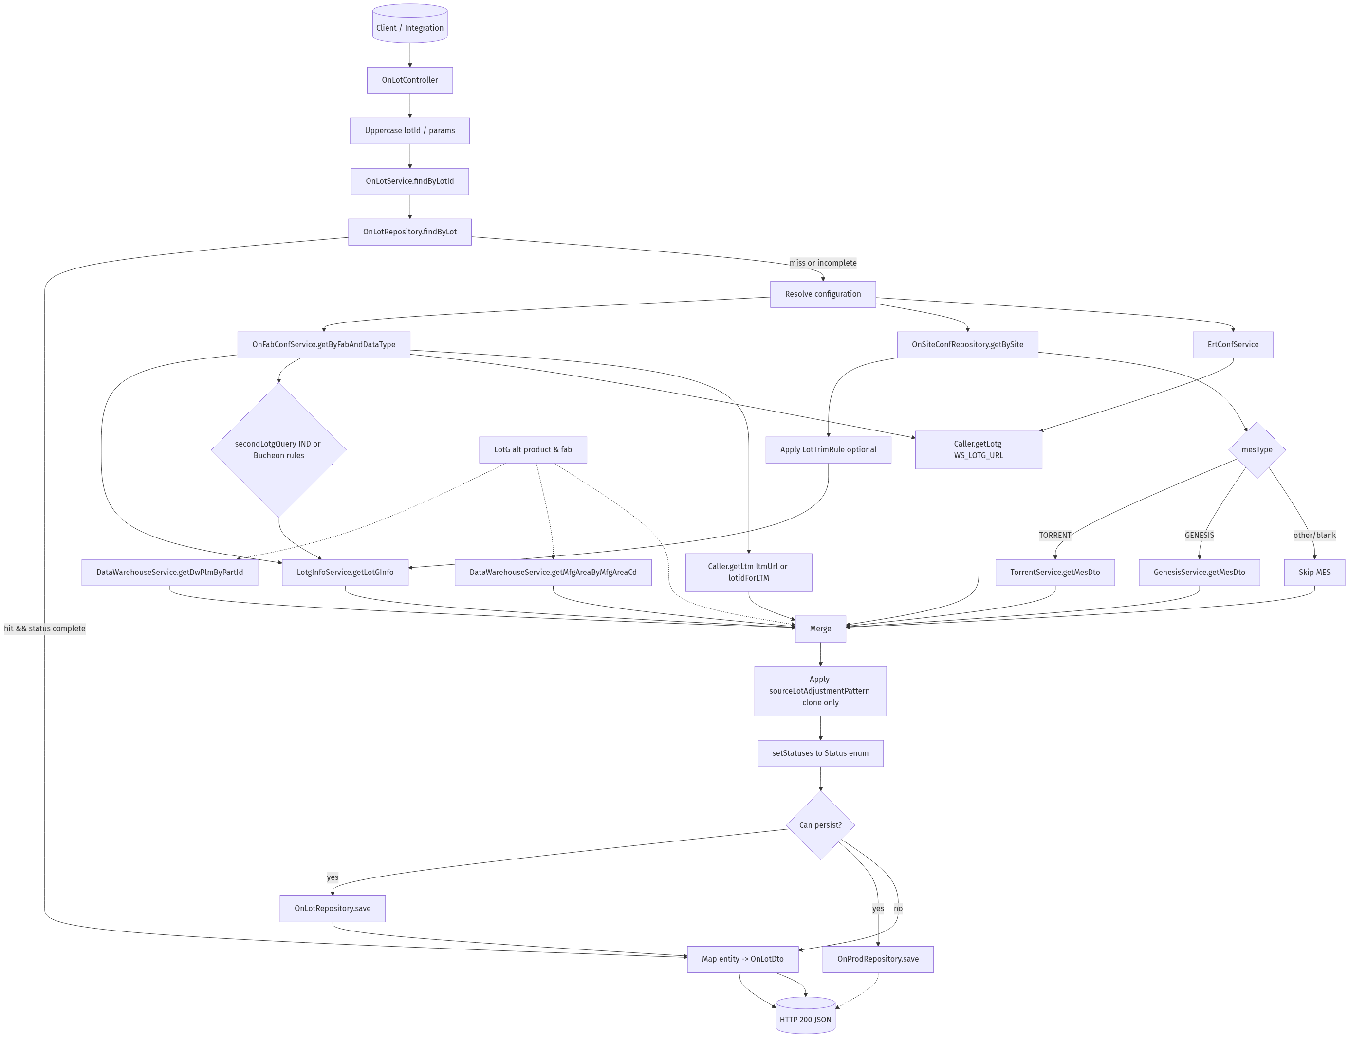
ONLOT DATAFLOW
Notes:
Source image: onlot-dataflow.png

Slide 11
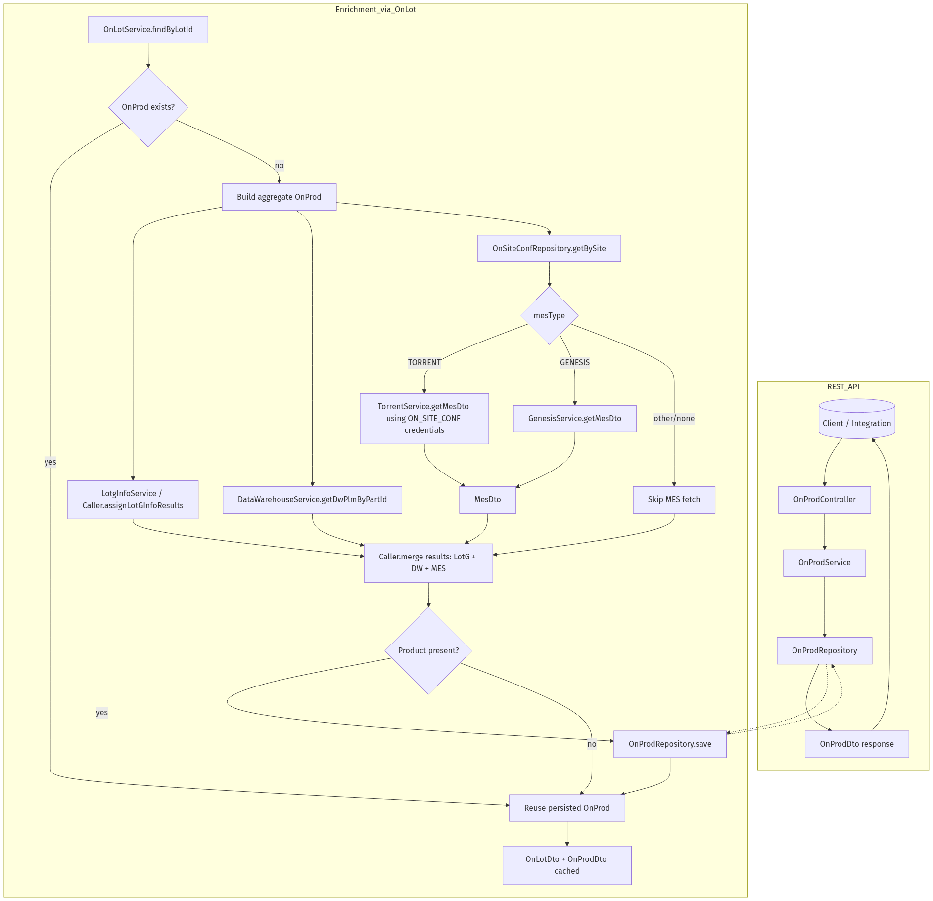
ONPROD DATAFLOW
Notes:
Source image: onprod-dataflow.png

Slide 12
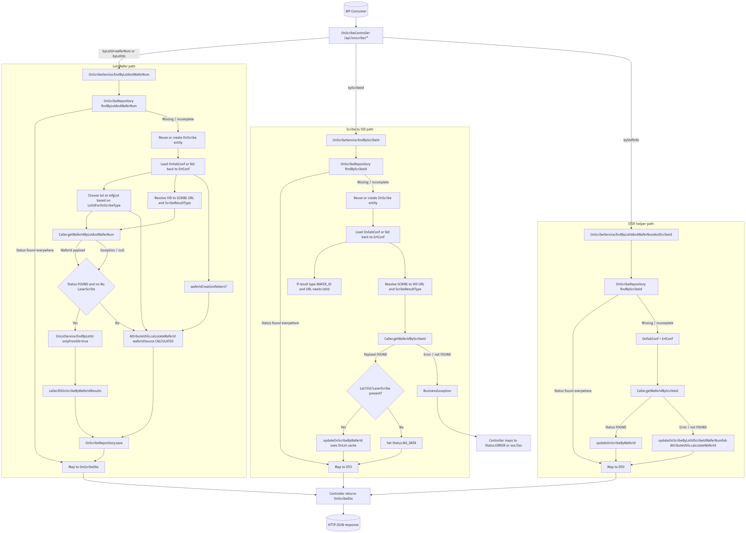
ONSCRIBE DATAFLOW
Notes:
Source image: onscribe-dataflow.png

Slide 13
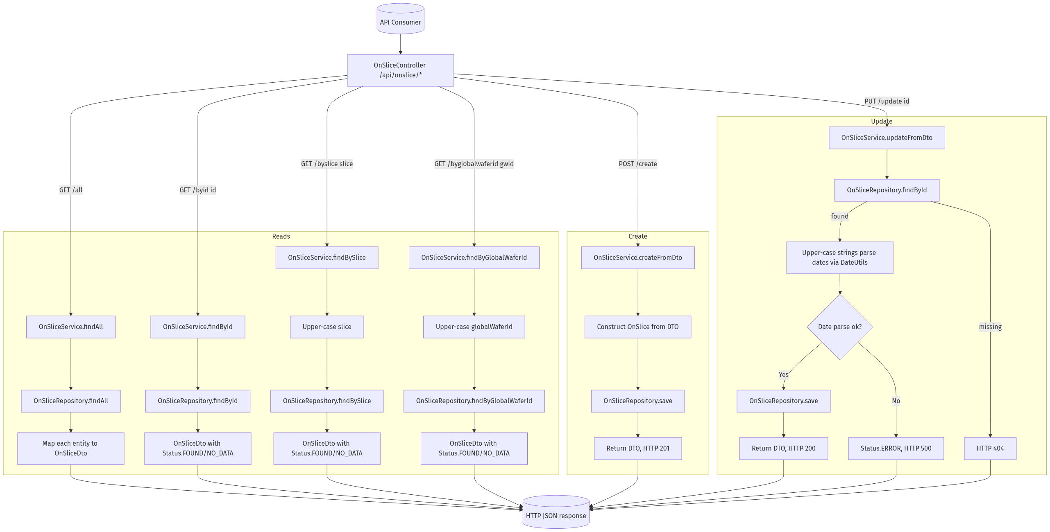
ONSLICE DATAFLOW
Notes:
Source image: onslice-dataflow.png

Slide 14
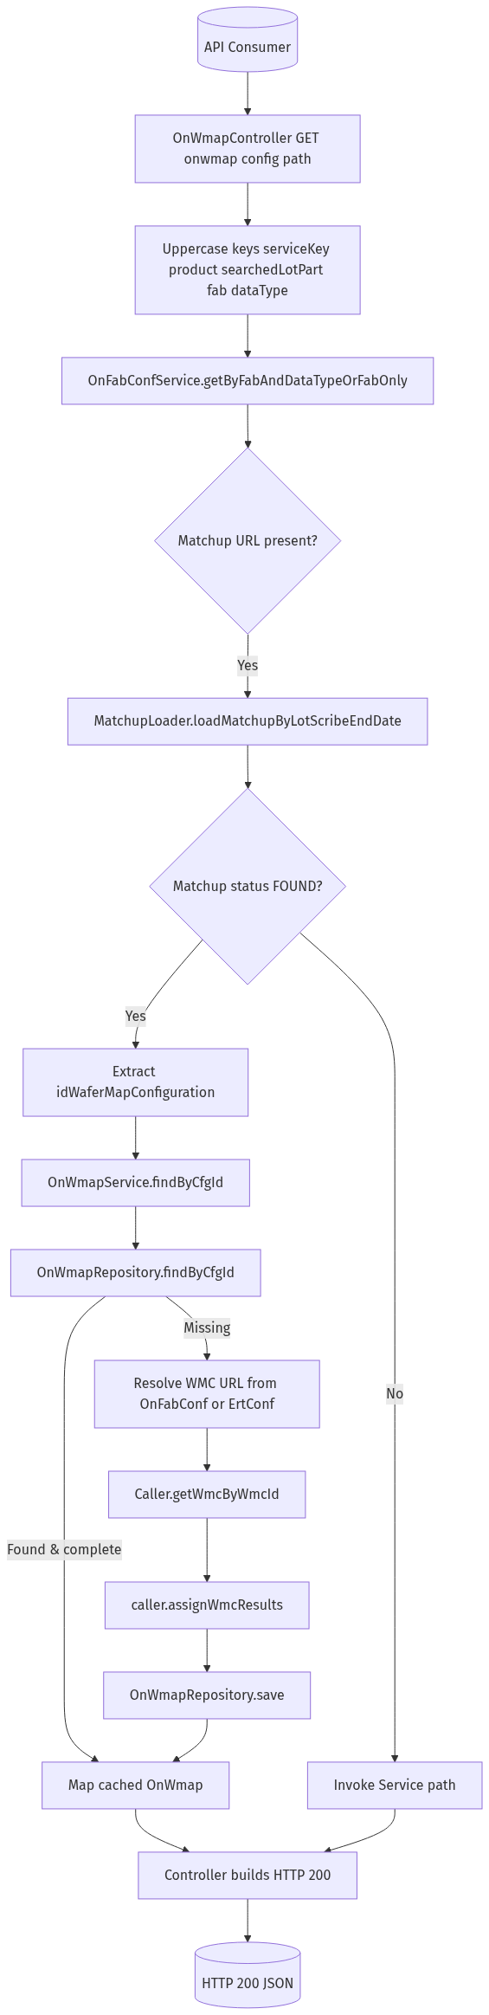
ONWMAP LEVEL2 CONFIG
Notes:
Source image: onwmap-level2-config.png

Slide 15
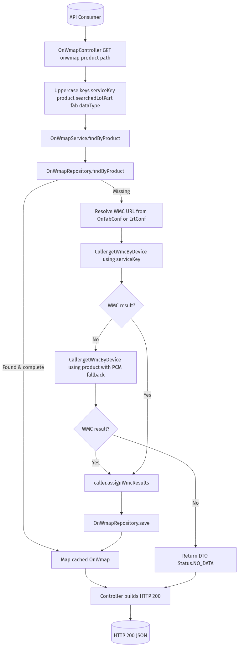
ONWMAP LEVEL2 PRODUCT
Notes:
Source image: onwmap-level2-product.png

