Slide 1
Exensio REFDB endpoints — data sources to final tables
Focus: ON_LOT, ON_PROD, ON_SCRIBE, ON_SLICE, ON_WMAP (+ PP_LOTPROD context)

Slide 2
Legend: acronyms and precedence
Acronyms:
LotG = Legacy genealogy DB (native SQL) and LotG Web Service
LTM = Lot Type Management Web Service
DW = Data Warehouse (PLM/MfgArea lookups)
MES = Manufacturing Execution System (Torrent/Genesis)
WMC = Wafer Map Configuration service; Matchup = lot/scribe→config
VID/SCRIBE = Wafer ID ↔ Laser Scribe web services
eCofA = Epi/raw silicon data provider used in slice genealogy
REFDB = Local Exensio reference tables (ON_LOT, ON_PROD, ON_SCRIBE, ON_SLICE, ON_WMAP)
PP_LOTPROD = Internal table/endpoint for lot→product/fab
Precedence notation: A > B > C means A overwrites B overwrites C when present

Slide 3
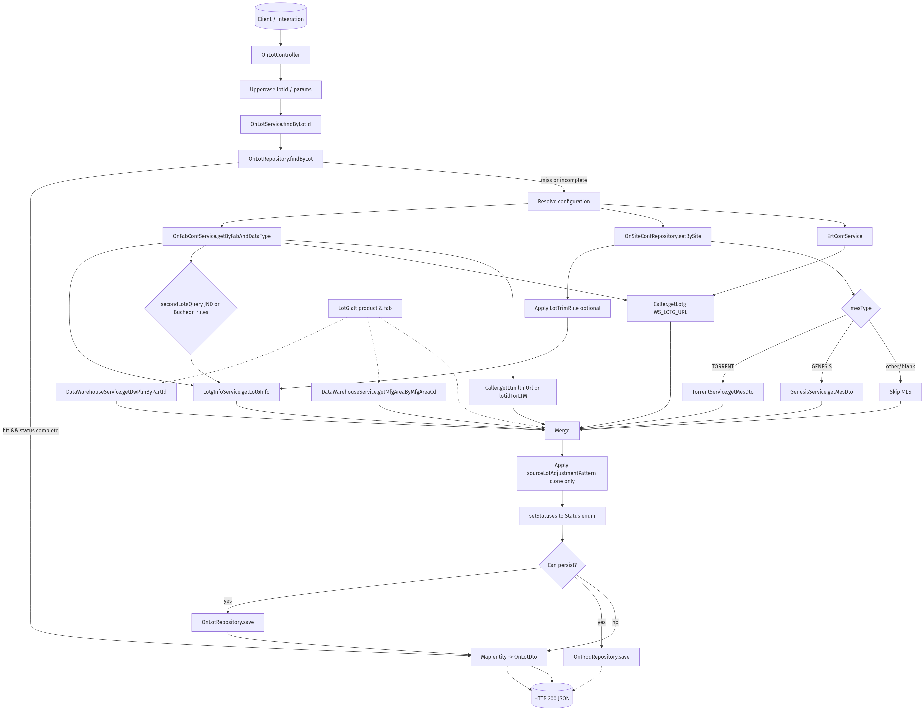
OnLot
Data sources and sink:
• Sources: LotG (native + WS), LTM WS, Data Warehouse, MES (Torrent/Genesis)
• Config: ON_FAB_CONF, ON_SITE_CONF, ERT_CONF; trimming/heuristics for JND/Bucheon
• Final tables: ON_LOT, ON_PROD (persisted when enriched)

Slide 4
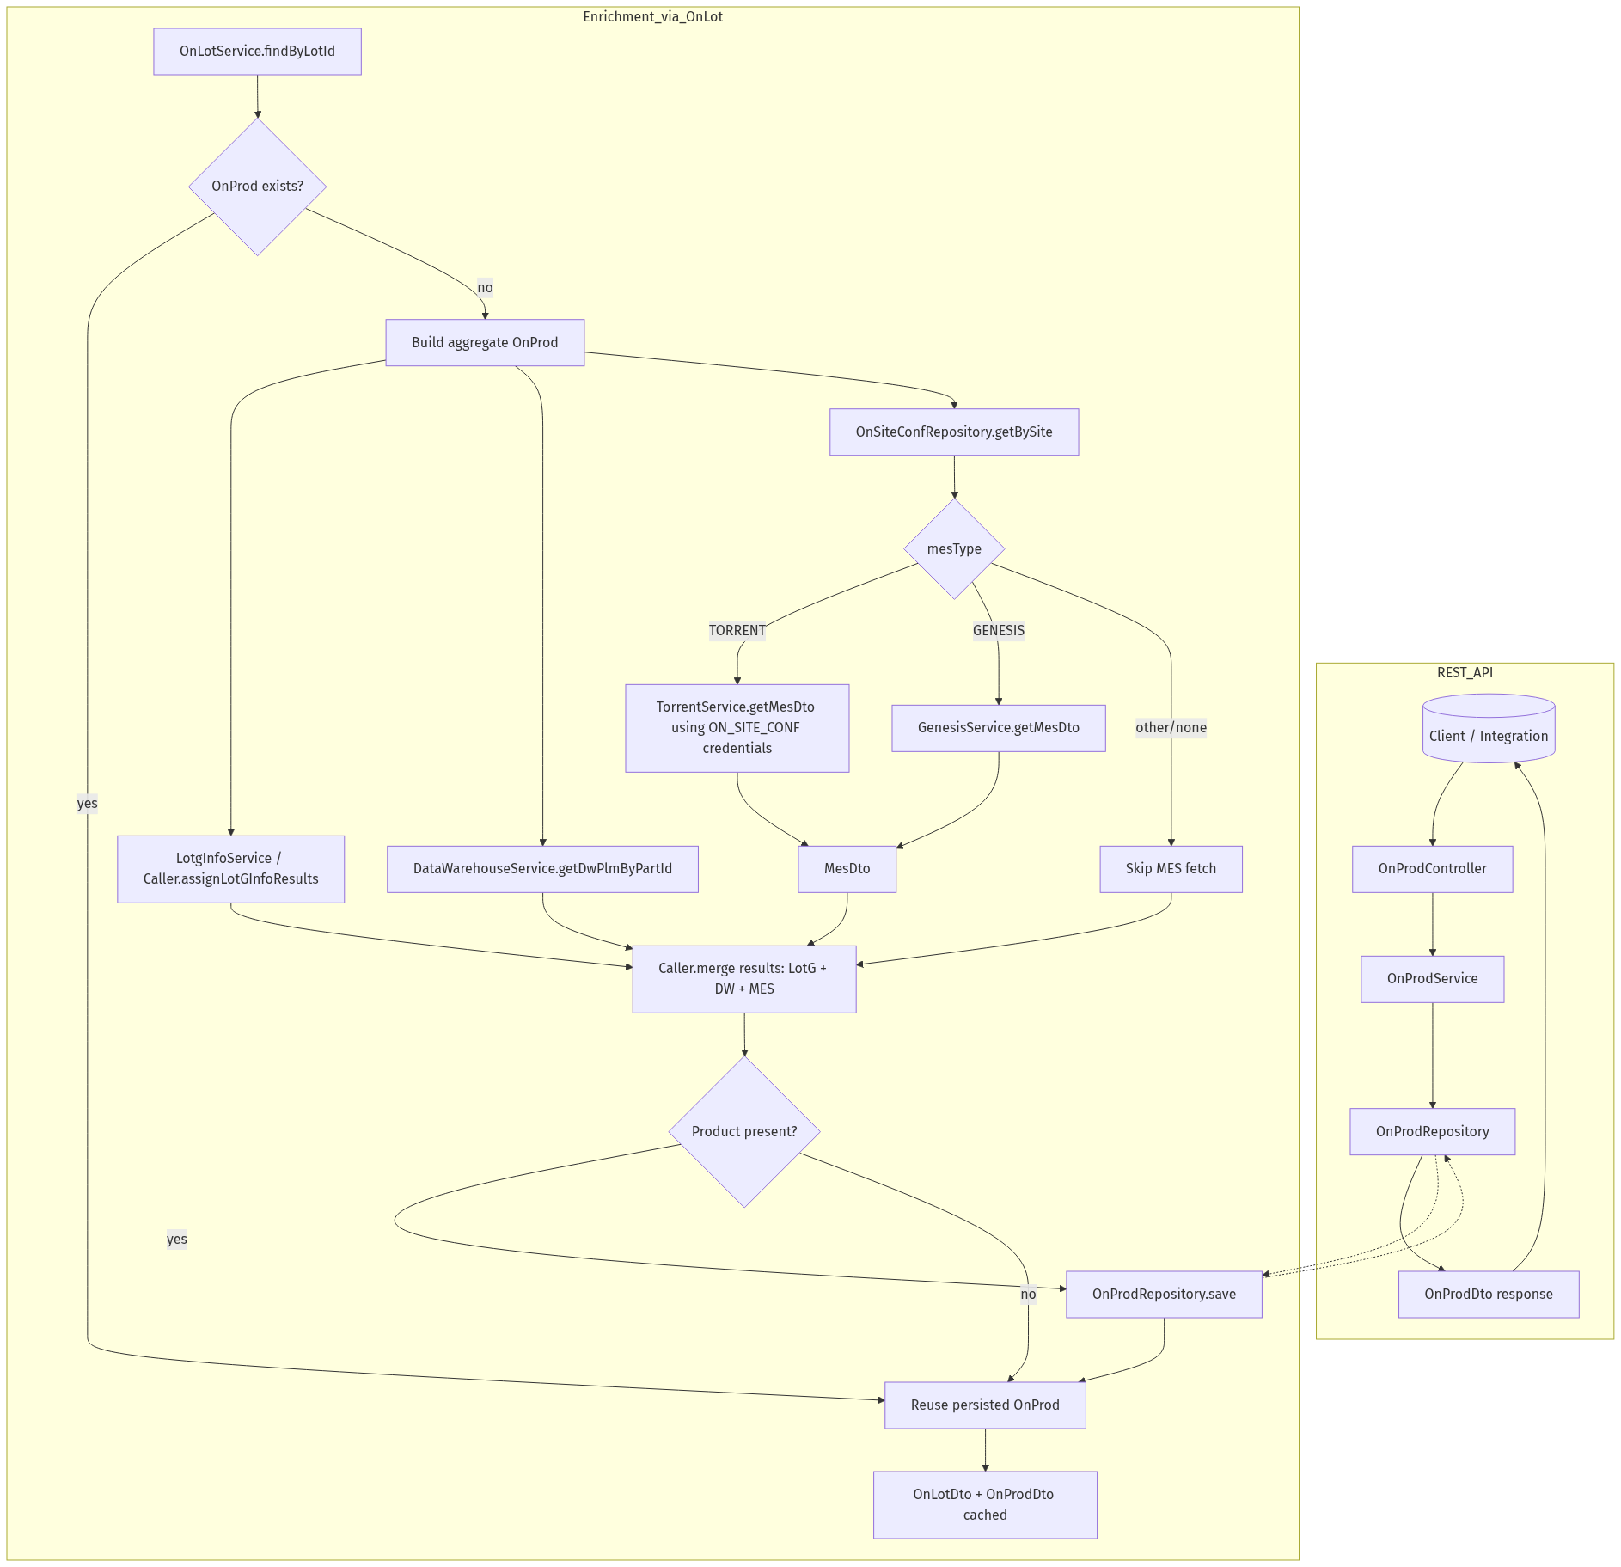
OnProd
Data sources and sink:
• Sources (triggered by OnLot): LotG, Data Warehouse PLM/MfgArea, MES (Torrent/Genesis)
• Priority: MES overrides DW overrides LotG; alternate product fallback
• Final table: ON_PROD

Slide 5
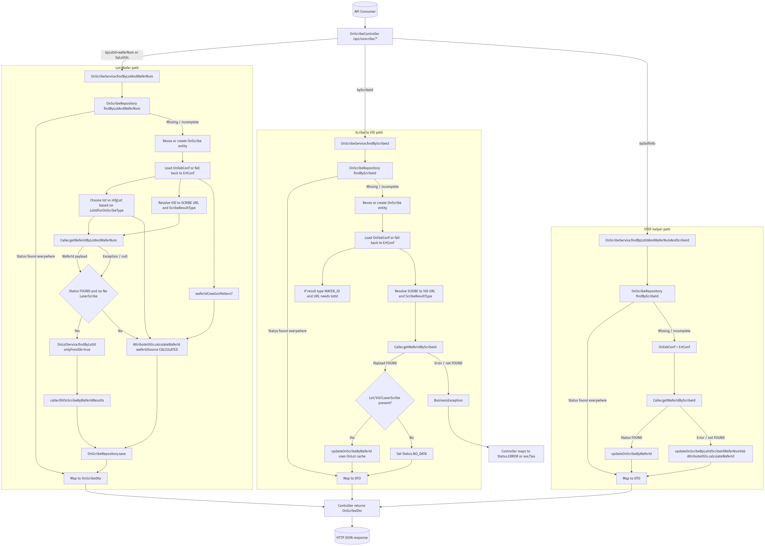
OnScribe
Data sources and sink:
• Sources: VID↔SCRIBE services (per fab), OnLot cache, AttributeUtils patterns
• Config: OnFabConf/ErtConf URLs, result types, onScribeWaferIdEqualsScribeId, waferIdCreationPattern
• Final table: ON_SCRIBE

Slide 6
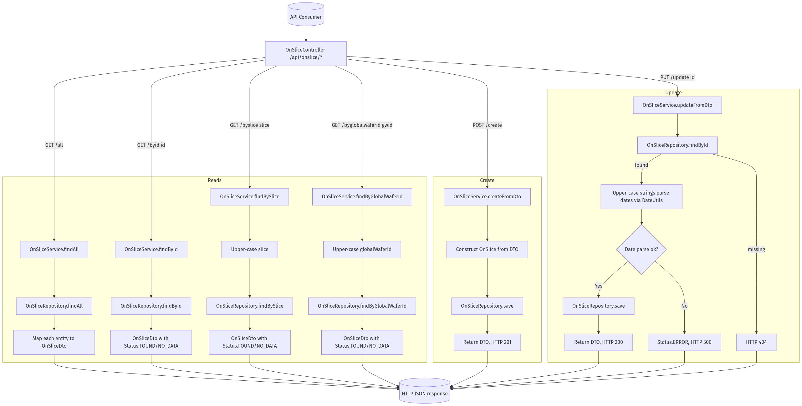
OnSlice
Data sources and sink:
• Sources: Direct repository (no remote), admin writes via DTO create/update
• Fields: slice, puckId, runId, globalWaferId, fabWaferId, source lots, part/lottype
• Final table: ON_SLICE

Slide 7
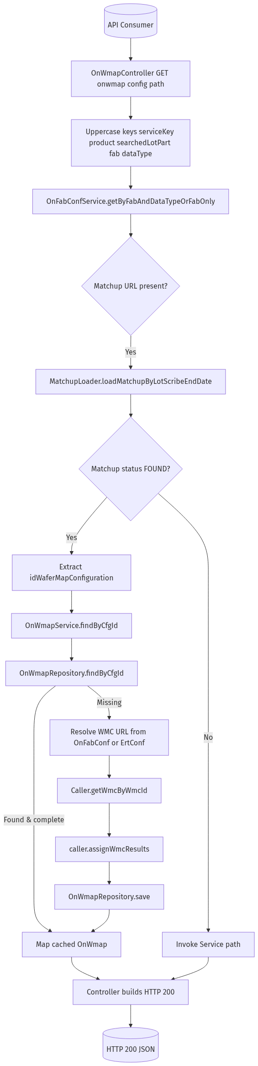
OnWmap (Config)
Data sources and sink:
• Sources: Matchup service (MatchupLoader), WMC service via Caller
• Config resolution: OnFabConf or ErtConf; fetch by configuration ID
• Final table: ON_WMAP

Slide 8
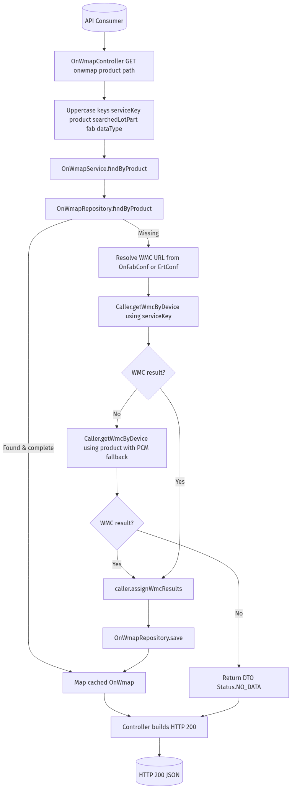
OnWmap (Product)
Data sources and sink:
• Sources: WMC by device; primary via serviceKey, secondary fallback by product
• Config resolution: OnFabConf/ErtConf; cached in repo if found
• Final table: ON_WMAP

Slide 9
PP_LOTPROD (context)
Used by ingestion scripts to resolve source lot and fab via /api/pplotprod/bylotid.
Source: internal PP_LOTPROD table via Exensio WS endpoint
Consumers: getCamstarWafer2AssemblyGenealogy.pl, getSnowflakeE142ModuleTrace.pl
Outputs: lot→product/fab context feeding ON_LOT/ON_PROD usage

Slide 10
OnLot: per-column source precedence
Column | Source precedence
product | MES.product > DW.PLM.partId > LotG.waferPartAlternateProduct > request alternateProduct
fab | MES.fab > LotG.fab
sourceLot | LotG native SQL SOURCE_LOT > LotG WS > adjusted by ON_FAB_CONF.sourceLotAdjustmentPattern
mfgLot | LotG Web Service (foundry/fab lot) > existing (manual preserved)
lotType | LTM Web Service > MES > DW > LotG
maskSet | MES.maskSet > DW.PLM.MASK_SET
process | MES.process > DW
technology | MES.technology > DW
PTI | MES.PTI_CODE (if configured) > existing
family | MES.family > DW

Slide 11
OnProd: per-column source precedence
Column | Source precedence
product | MES.product > DW.PLM.partId > LotG.waferPartAlternateProduct
productVersion | MES.productVersion > existing
family | MES.family > DW
process | MES.process > DW
technology | MES.technology > DW
maskSet | MES.maskSet > DW.PLM.MASK_SET
fab | MES.fab > DW/ LotG

Slide 12
OnScribe: per-column source precedence
Column | Source precedence
waferId | VID→SCRIBE service success > AttributeUtils.calculateWaferId (fallback)
scribeId | VID payload laser-scribe; if onScribeWaferIdEqualsScribeId=true then waferId
lot | From request; production vs manufacturing chosen by OnFabConf.LotIdForOnScribeType
waferNum | From request (validated)
status | Computed: FOUND | NO_DATA | ERROR; MANUAL not overwritten
insertTime | Set on persist

Slide 13
OnSlice: per-column source precedence
Column | Source precedence
globalWaferId | REFDB existing > eCofA.GWID > guessed from slice (strip dashes/truncate)
puckId | REFDB.PUCK_ID > derived from slice/vendor rules (non-GTAT → puck; GTAT → runId logic)
fabWaferId | MES CRLT fab-trace > replace only if missing or CHANGED_WAFERS indicates remap
fabSourceLot | MES CRLT source lot > write when missing
sliceOrder | REFDB.SLICE_ORDER > eCofA slice order
sliceLottype | fab-trace lot_type when missing > existing
slicePartname | REFDB.slice_partname > Maine EPI product > existing
sliceStartTime | REFDB; filled by ingestion when CZ2/eCofA/TORRENT supply

Slide 14
OnWmap: per-column source precedence
Column | Source precedence
idWaferMapConfiguration | Matchup by lot/scribe when available > WMC by config/product
device/product mapping | WMC by device (serviceKey primary) > WMC by product (PCM fallback)
metadata | From WMC payload; cached in ON_WMAP

Slide 15
Endpoint → REFDB tables, columns, and sources
Endpoint | Final REFDB table(s) | Key columns populated | Primary sources
OnLot | ON_LOT; ON_PROD | lot, mfgLot, product, fab, sourceLot, lotType, maskSet, process, technology, PTI, family | LotG (native+WS), LTM WS (lotType), Data Warehouse (PLM/MfgArea), MES (Torrent/Genesis)
OnProd | ON_PROD | product, productVersion, family, process, technology, maskSet, fab | MES (Torrent/Genesis), Data Warehouse PLM/MfgArea, LotG
OnScribe | ON_SCRIBE | lot, waferNum, waferId, scribeId, insertTime, status | VID↔SCRIBE services (fab-configured); calculated fallback via AttributeUtils; OnLot cache for sourceLot context
OnSlice | ON_SLICE | slice, globalWaferId, puckId, runId, sliceSourceLot, startLot, fabWaferId, fabSourceLot, slicePartname, sliceLottype, sliceSupplierId, puckHeight, sliceOrder, sliceStartTime | Primary writes via admin DTO/API; upstream ingestion uses BIWMES+eCofA+TORRENT to populate/maintain rows
OnWmap | ON_WMAP | idWaferMapConfiguration, product/device mapping, metadata per WMC | Matchup service (by lot/scribe) and WMC service (by config/product) via Caller
PP_LOTPROD (context) | PP_LOTPROD | lot, product, fab (frontend provenance) | Internal PP_LOTPROD DB exposed via /api/pplotprod/bylotid; consumed by ingestion scripts

