Slide 1
Exensio REFDB endpoints — data sources to final tables
Focus: ON_LOT, ON_PROD, ON_SCRIBE, ON_SLICE, ON_WMAP (+ PP_LOTPROD context)

Slide 2
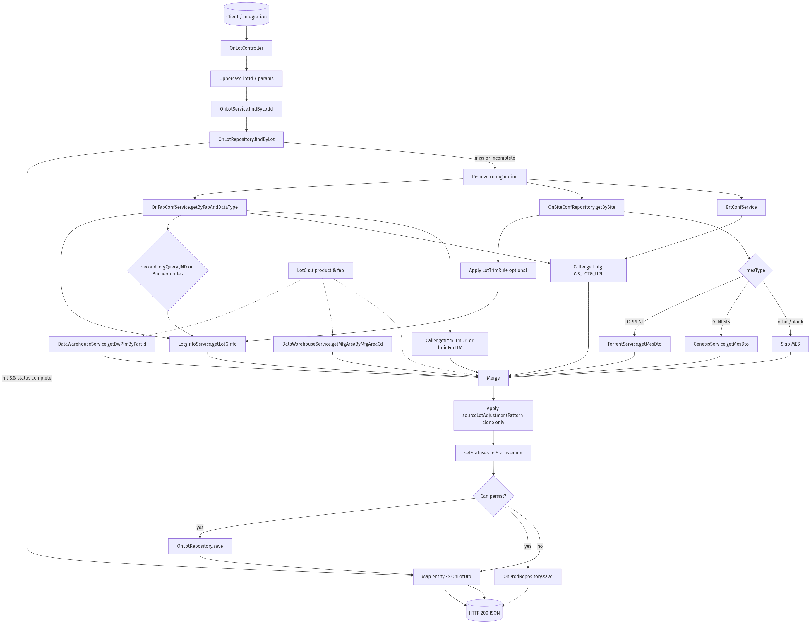
OnLot
Data sources and sink:
• Sources: LotG (native + WS), LTM WS, Data Warehouse, MES (Torrent/Genesis)
• Config: ON_FAB_CONF, ON_SITE_CONF, ERT_CONF; trimming/heuristics for JND/Bucheon
• Final tables: ON_LOT, ON_PROD (persisted when enriched)

Slide 3
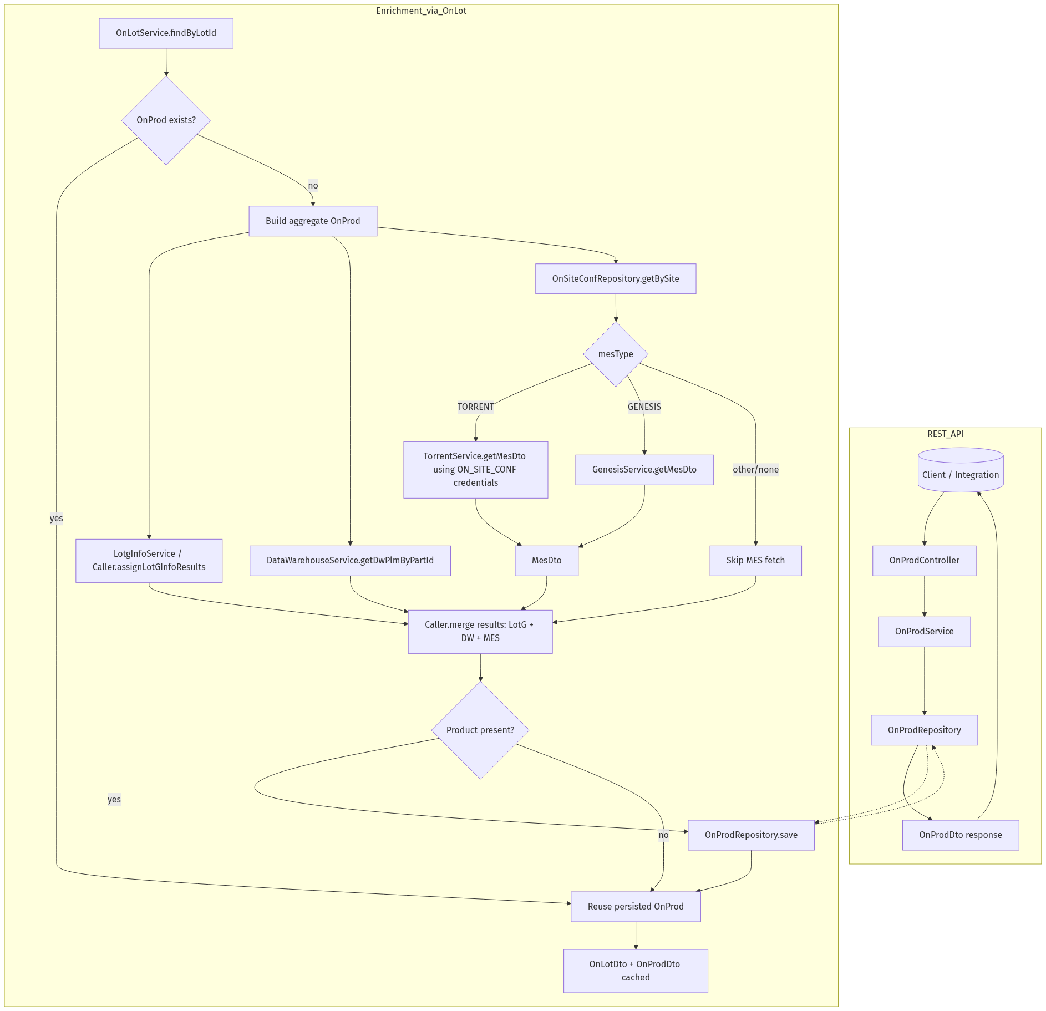
OnProd
Data sources and sink:
• Sources (triggered by OnLot): LotG, Data Warehouse PLM/MfgArea, MES (Torrent/Genesis)
• Priority: MES overrides DW overrides LotG; alternate product fallback
• Final table: ON_PROD

Slide 4
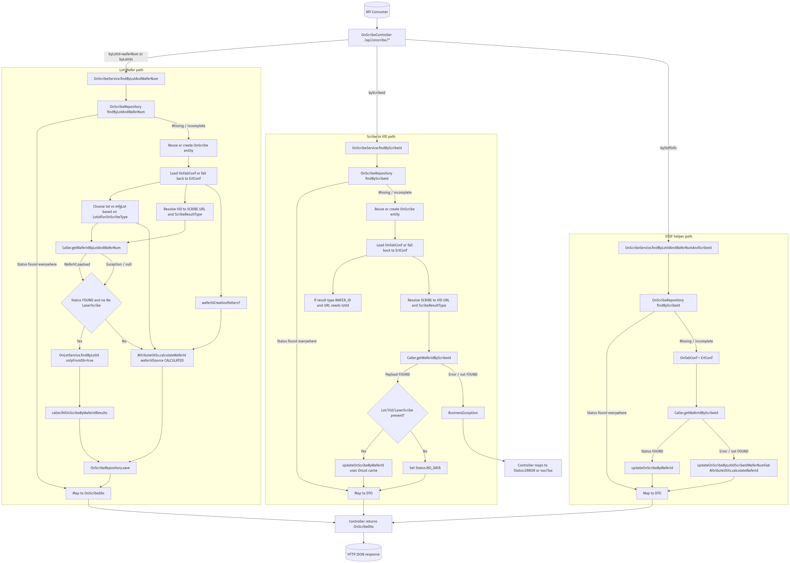
OnScribe
Data sources and sink:
• Sources: VID↔SCRIBE services (per fab), OnLot cache, AttributeUtils patterns
• Config: OnFabConf/ErtConf URLs, result types, onScribeWaferIdEqualsScribeId, waferIdCreationPattern
• Final table: ON_SCRIBE

Slide 5
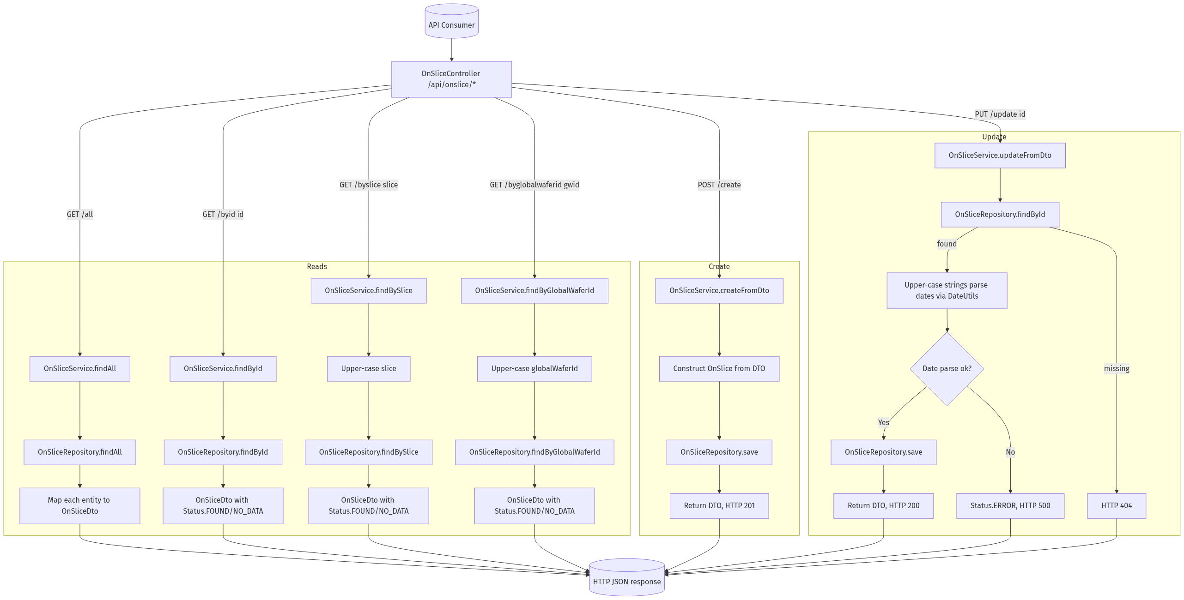
OnSlice
Data sources and sink:
• Sources: Direct repository (no remote), admin writes via DTO create/update
• Fields: slice, puckId, runId, globalWaferId, fabWaferId, source lots, part/lottype
• Final table: ON_SLICE

Slide 6
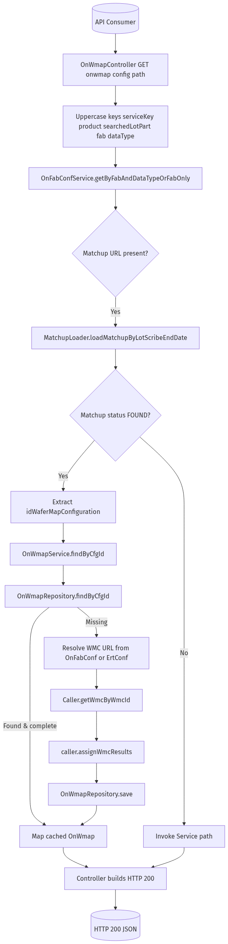
OnWmap (Config)
Data sources and sink:
• Sources: Matchup service (MatchupLoader), WMC service via Caller
• Config resolution: OnFabConf or ErtConf; fetch by configuration ID
• Final table: ON_WMAP

Slide 7
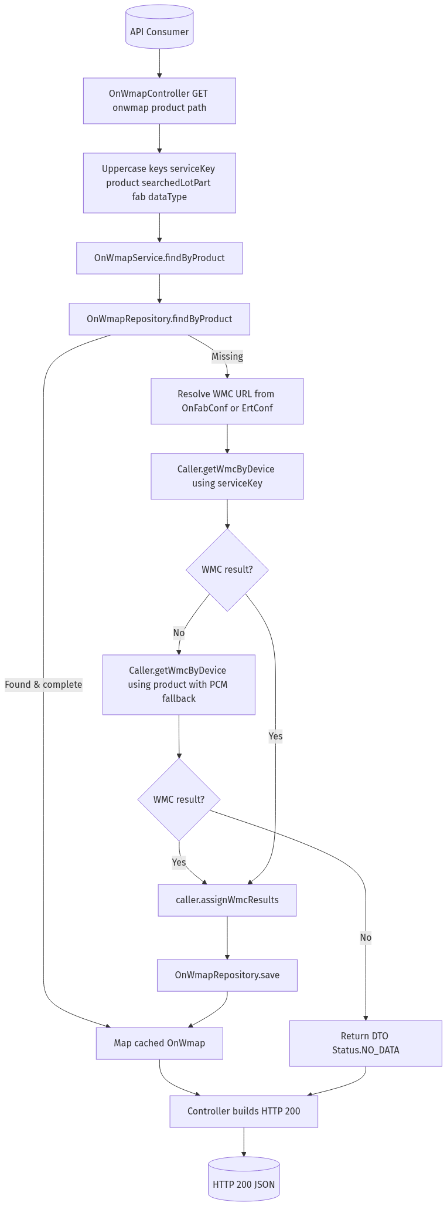
OnWmap (Product)
Data sources and sink:
• Sources: WMC by device; primary via serviceKey, secondary fallback by product
• Config resolution: OnFabConf/ErtConf; cached in repo if found
• Final table: ON_WMAP

Slide 8
PP_LOTPROD (context)
Used by ingestion scripts to resolve source lot and fab via /api/pplotprod/bylotid.
Source: internal PP_LOTPROD table via Exensio WS endpoint
Consumers: getCamstarWafer2AssemblyGenealogy.pl, getSnowflakeE142ModuleTrace.pl
Outputs: lot→product/fab context feeding ON_LOT/ON_PROD usage

Slide 9
Endpoint → REFDB tables, columns, and sources
Endpoint | Final REFDB table(s) | Key columns populated | Primary sources
OnLot | ON_LOT; ON_PROD | lot, mfgLot, product, fab, sourceLot, lotType, maskSet, process, technology, PTI, family | LotG (native+WS), LTM WS (lotType), Data Warehouse (PLM/MfgArea), MES (Torrent/Genesis)
OnProd | ON_PROD | product, productVersion, family, process, technology, maskSet, fab | MES (Torrent/Genesis), Data Warehouse PLM/MfgArea, LotG
OnScribe | ON_SCRIBE | lot, waferNum, waferId, scribeId, insertTime, status | VID↔SCRIBE services (fab-configured); calculated fallback via AttributeUtils; OnLot cache for sourceLot context
OnSlice | ON_SLICE | slice, globalWaferId, puckId, runId, sliceSourceLot, startLot, fabWaferId, fabSourceLot, slicePartname, sliceLottype, sliceSupplierId, puckHeight, sliceOrder, sliceStartTime | Primary writes via admin DTO/API; upstream ingestion uses BIWMES+eCofA+TORRENT to populate/maintain rows
OnWmap | ON_WMAP | idWaferMapConfiguration, product/device mapping, metadata per WMC | Matchup service (by lot/scribe) and WMC service (by config/product) via Caller
PP_LOTPROD (context) | PP_LOTPROD | lot, product, fab (frontend provenance) | Internal PP_LOTPROD DB exposed via /api/pplotprod/bylotid; consumed by ingestion scripts

