Slide 1
Soccer Home Field Advantage by Team 7

Slide 2




The World of Soccer
Soccer leagues are the most popular leagues in most of European nation
The data generated by these leagues on yearly bases provides insights into each leagues performance and popularly
There are many questions we can ask to get valuable insight.
Today we are going to attempt to answer a question that you have wondered many time but even used it vaguely yourself during conversation.
Does homefield advantage really exist?
Notes:
Motivates the topic
Total 1300 matches?

Slide 3
Journey to The Facts and Analysis
Weather
Home Game
Away Game
Audience Attendance
Home Attendance vs. Away Attendance
Game Performance since COVID19
Avg score before vs. Avg score after
Away Game
Weather Vs. Avg total score
Weather vs. Avg total score
Home Game
Weather vs. Avg wins for same weather fact
Away Game
Weather vs. Avg wins for same weather fact
Home Game
Avg score before vs. Avg score after
Home avg. score vs. Away avg. score
Notes:
Where the data came from
Limitation of the data that we saw

Slide 4
Summary data
Notes:
How and were we got the data (Attendance, weather)
Total matches, matches before and after COVID, average weather temperatures
Limitation to combine the limitation to summarize the data.
Limitation, how did we over come the limitation
What we did to answer the question
General roadmap

Slide 5
Weather Impact on Games

Slide 6
Game Vs. Weather (Home & Away Game)
Weather analysis
Limitation of the data
Bottom line information
Notes:
Where and how did we get the data
What was found and what was assumed
Chart1:
Avg Temp to Home Game scores
Char2:
Avg. Temp to Away Game scores
Create bins look at the score range vs temp
40 to 50 , 60 to 70 (Compute average of those score)
Group by temp. mean()
Weather vs average total score

Slide 8
Audience impact on game

Slide 9
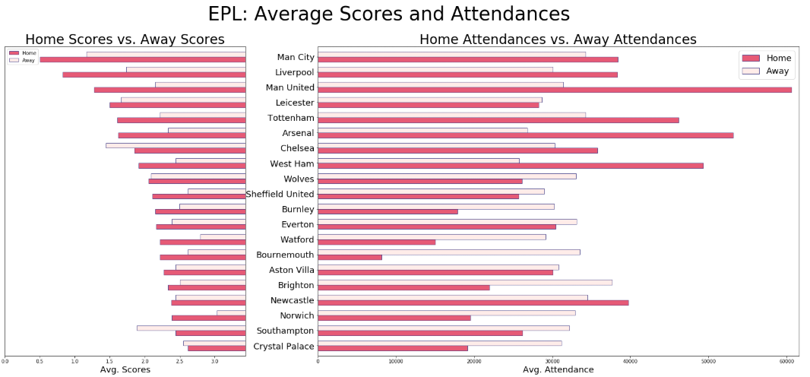
Average Scores & Attendances
The number of matches of EPL teams until 2020-07-13 is 351
The number of matches of EPL teams after COVID-19 is 62
Notes:
Where and how did we get the data
What was found and what was assumed
Attendance data analysis
Limitation of the data
Bottom line information

Slide 10
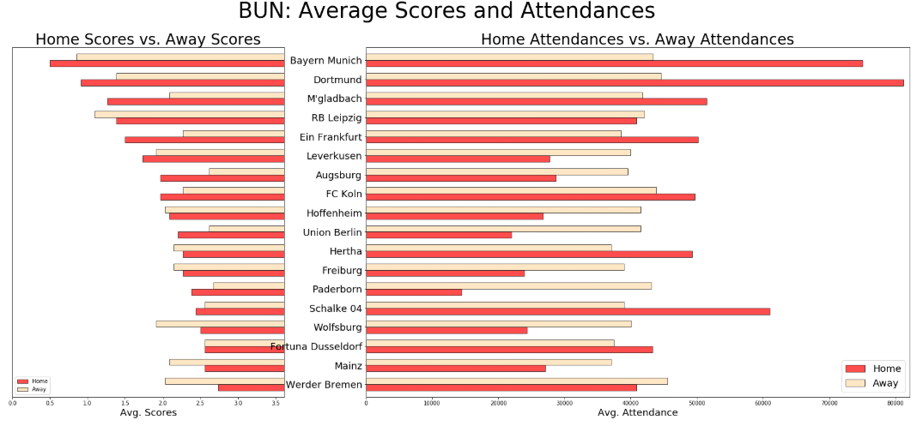
Average Scores & Attendances
The number of matches of BUN teams until 2020-06-27 is 306
The number of matches of BUN teams after COVID-19 is 82
Notes:
Where and how did we get the data
What was found and what was assumed
Attendance data analysis
Limitation of the data
Bottom line information

Slide 11
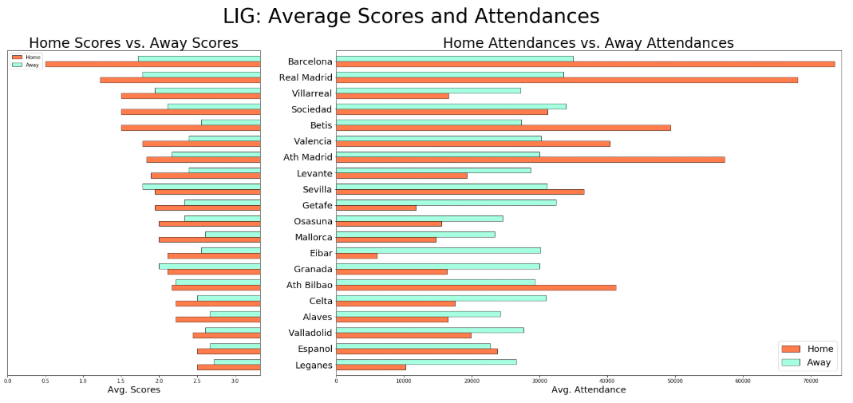
Average Scores & Attendances
The number of matches of LIG teams until 2020-07-13 is 360
The number of matches of LIG teams after COVID-19 is 90
Notes:
Where and how did we get the data
What was found and what was assumed
Attendance data analysis
Limitation of the data
Bottom line information

Slide 12
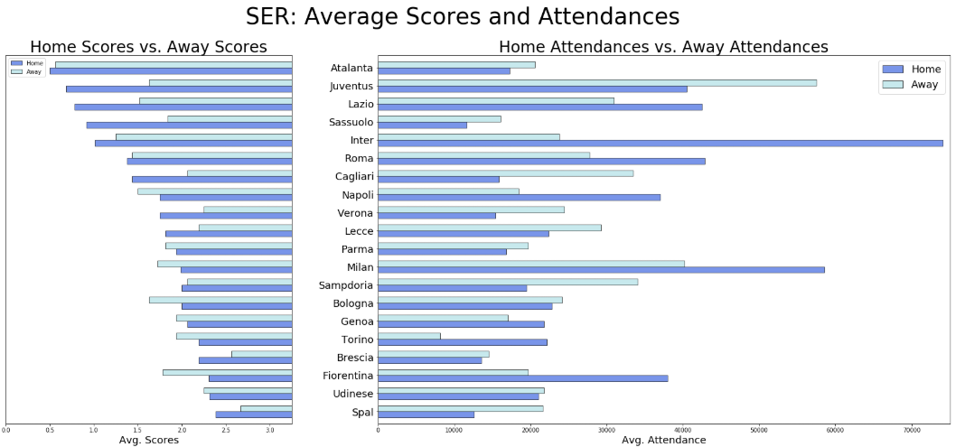
Average Scores & Attendances
The number of matches of SER teams until 2020-07-13 is 320
The number of matches of SER teams after COVID-19 is 64
Notes:
Where and how did we get the data
What was found and what was assumed
Attendance data analysis
Limitation of the data
Bottom line information

Slide 13
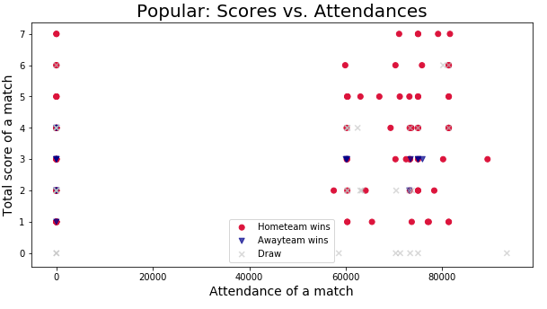
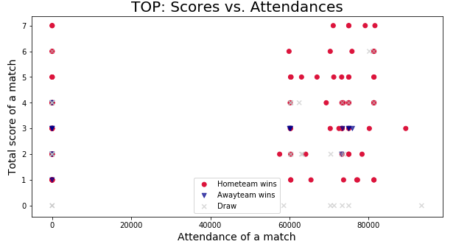
Most Popular & Top Score Team

Slide 14
Game Before/After COVID

Slide 15
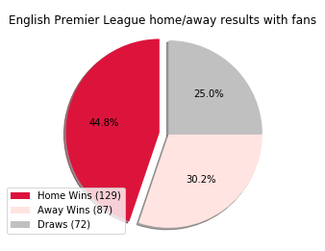
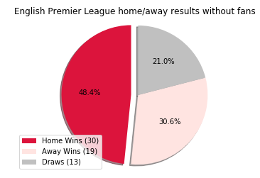
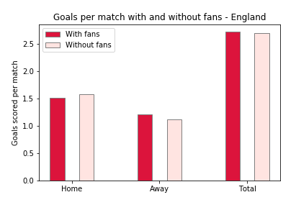
Game Before COVID Vs. Game After COVID
Games Before COVID
Games After COVID
The number of matches of EPL teams until 2020-07-13 is 351
The number of matches of EPL teams after COVID-19 is 62
Notes:
Where and how did we get the data
What was found and what was assumed
Attendance data analysis
Limitation of the data
Bottom line information

Slide 16
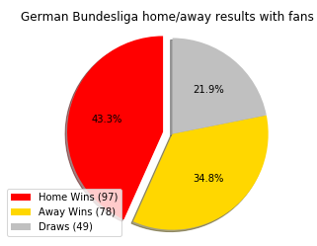
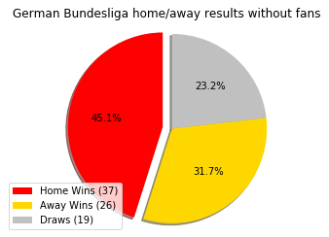
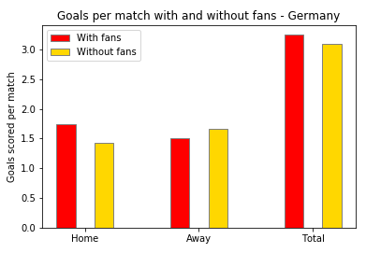
Game Before COVID Vs. Game After COVID
Games Before COVID
Games After COVID
The number of matches of BUN teams until 2020-06-27 is 306
The number of matches of BUN teams after COVID-19 is 82
Notes:
Where and how did we get the data
What was found and what was assumed
Attendance data analysis
Limitation of the data
Bottom line information

Slide 17
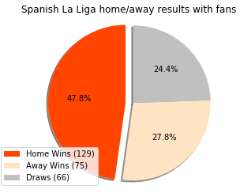
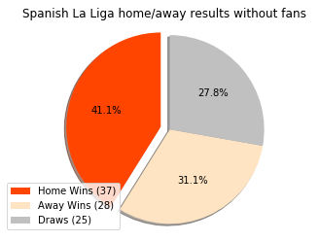
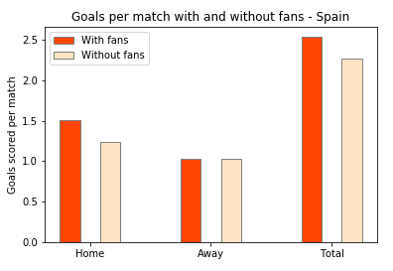
Game Before COVID Vs. Game After COVID
Games Before COVID
Games After COVID
The number of matches of LIG teams until 2020-07-13 is 360
The number of matches of LIG teams after COVID-19 is 90
Notes:
Where and how did we get the data
What was found and what was assumed
Attendance data analysis
Limitation of the data
Bottom line information

Slide 18
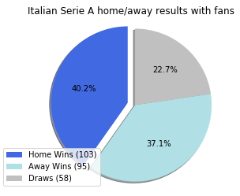
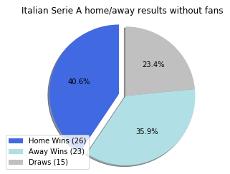
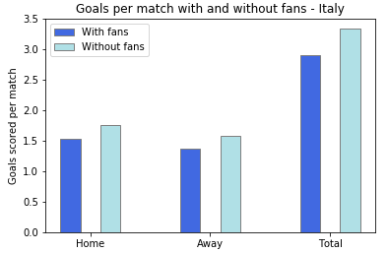
Game Before COVID Vs. Game After COVID
Games Before COVID
Games After COVID
The number of matches of SER teams until 2020-07-13 is 320
The number of matches of SER teams after COVID-19 is 64
Notes:
Where and how did we get the data
What was found and what was assumed
Attendance data analysis
Limitation of the data
Bottom line information

Slide 19
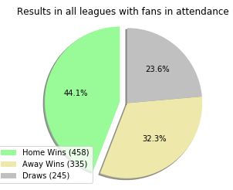
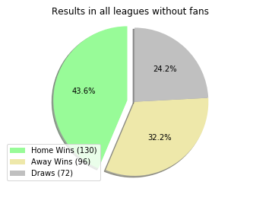
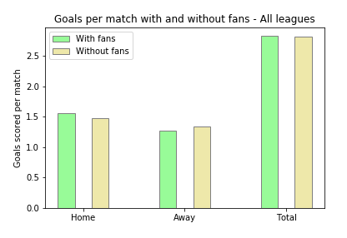
All leagues games
Games Before COVID
Games After COVID

Slide 20
Thank you

Slide 21
Backup Slides

Slide 22
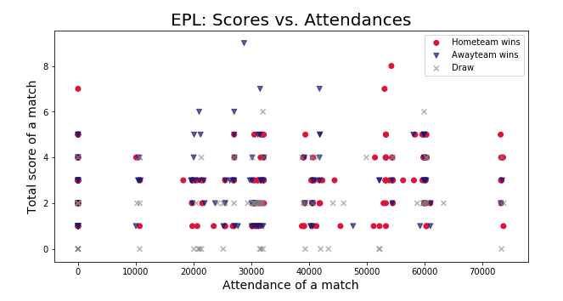
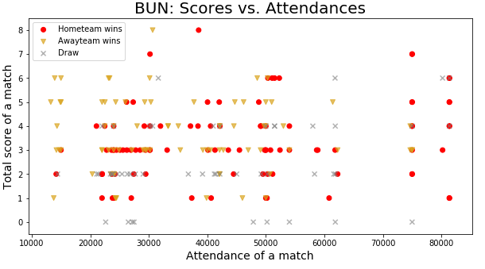
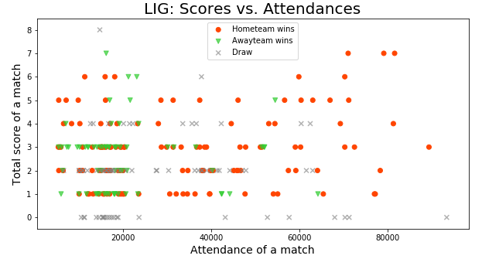
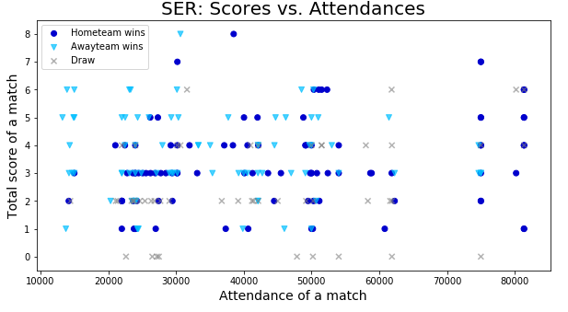
Scatter plot for all matches of match total scores and attendances

Slide 23
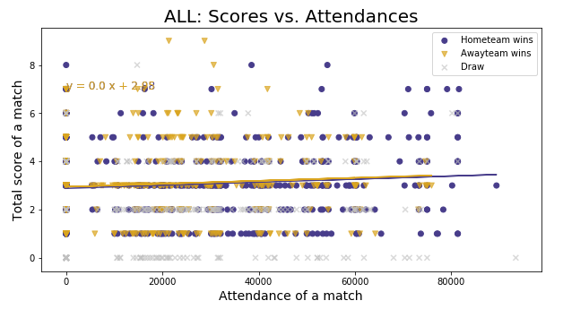

Slide 24
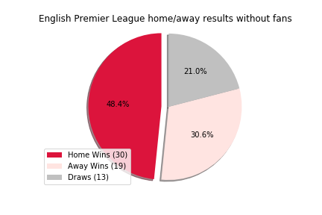
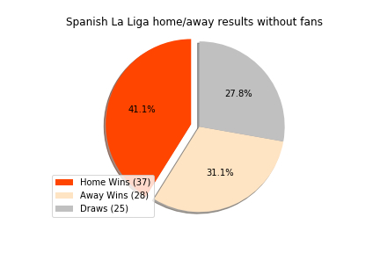
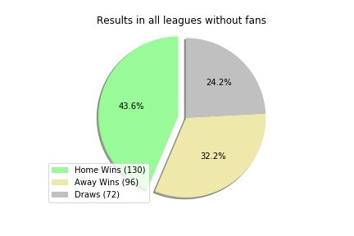
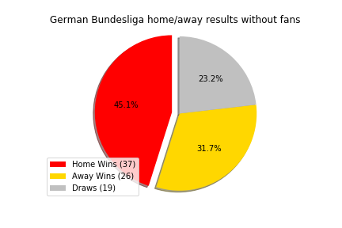
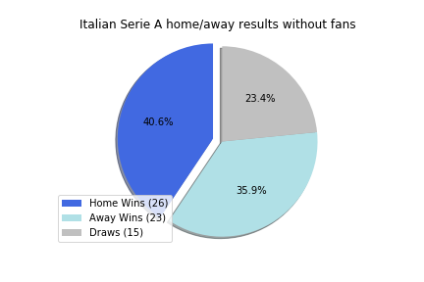
Game Before COVID Vs. Game After COVID
COVID data analysis
Limitation of the data
Bottom line information
Notes:
Where and how did we get the data
What was found and what was assumed
All of the tams before and after COVID charts
What statistically significant test should we run.

Slide 25
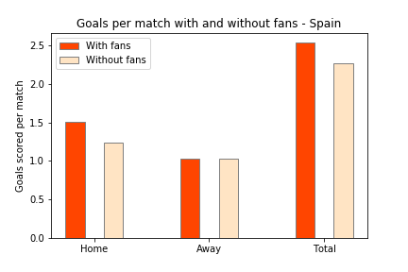
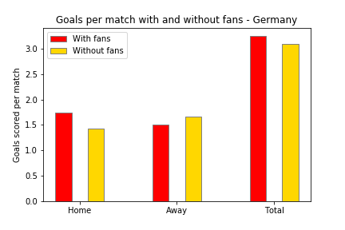
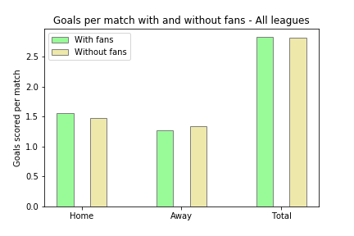
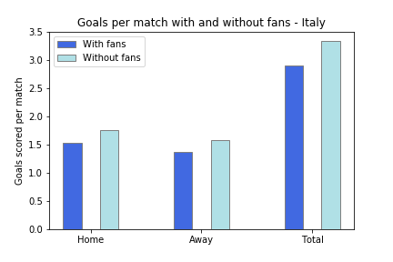
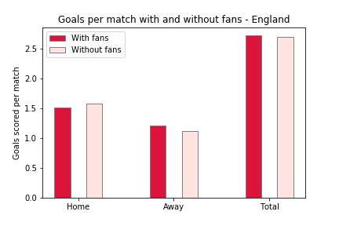
Notes:
Overall all leagues does not show the significant variance

