Slide 1
Lecture 23: The Mathematics of Thermodynamics
Thermodynamic Potentials & Legendre Transforms CBE 20260 / Thermodynamics I

Slide 2
Introduction: From Concepts to Math

Slide 3
Moving from Concepts to Mathematics
So far: We analyzed equipment (turbines, pumps) and cycles using the 1st and 2nd Laws.
The Method: We relied heavily on tables and charts to find $U$, $H$, and $S$.
The Problem: Where do those tables come from?
You cannot directly measure Internal Energy ($U$) or Entropy ($S$) with a meter.
You can only measure Temperature ($T$), Pressure ($P$), Volume ($V$), and Heat Capacity ($C_{p}$).
The Goal: Develop a mathematical framework to rewrite thermodynamics entirely in terms of measurable variables.

Slide 4
The Fundamental Equation

Slide 5
The Fundamental Equation of Thermodynamics
Let’s combine the First and Second Laws for a closed, single-component system.
First Law (Energy Balance):
$$dU=δQ+δW$$
Reversible Process Assumptions: * 2nd Law: $δQ_{rev}=TdS$
Mechanical Work: $δW_{rev}=−PdV$
Substitute:
$$dU=TdS−PdV$$

Slide 6
Properties of the Fundamental Equation
$$dU=TdS−PdV$$
Crucial Note: Even though we assumed a reversible process, $U$, $S$, and $V$ are all state functions.
This equation holds true for any process between two equilibrium states, reversible or irreversible!
It shows the “natural” independent variables for Internal Energy:
$$U=U\left(S,V\right)$$

Slide 7
Math Review: Exact Differentials

Slide 8
Exact Differentials
Because $U$, $S$, and $V$ are state functions, their differentials are exact.
From multivariable calculus, for a function $F\left(x,y\right)$:
$$dF={\left(\frac{∂F}{∂x}\right)}_{y}dx+{\left(\frac{∂F}{∂y}\right)}_{x}dy$$
Let’s define the partial derivatives as coefficients:
$$dF=M\left(x,y\right)dx+N\left(x,y\right)dy$$
Key Property: The mixed second partial derivatives must be equal:
$${\left(\frac{∂M}{∂y}\right)}_{x}={\left(\frac{∂N}{∂x}\right)}_{y}$$

Slide 9
Applying Exact Differentials to U
Apply this framework to our fundamental equation:
$$dU=TdS−PdV$$
We immediately see that:
$$T={\left(\frac{∂U}{∂S}\right)}_{V} \text{and} −P={\left(\frac{∂U}{∂V}\right)}_{S}$$
Temperature and Pressure are simply the partial derivatives (or slopes) of the Internal Energy surface!

Slide 10
Legendre Transforms

Slide 11
The Variable Problem
$U\left(S,V\right)$ contains all fundamental thermodynamic information.
However: $S$ and $V$ are highly inconvenient variables for chemical engineers. It is very hard to hold entropy constant in a lab.
We prefer to work with Temperature and Pressure.
We need to swap variables ($S→T$ and $V→P$) without losing information.

Slide 12
Why Simple Swapping Fails
Suppose we have a generic function $y=f\left(x\right)$ and want to replace $x$ with the slope $m=\frac{df}{dx}$.
If we just write $y=g\left(m\right)$, it fails.
Parallel curves have the exact same slope $m$ at a given $x$.
Swapping variables loses the integration constant—we lose physical data!

Slide 13
The Legendre Solution
How do we uniquely identify a curve using only its slopes? Define it as an envelope of tangent lines.
Tangent line: $y=mx+b$
Solve for the y-intercept: $b=y−mx$
Because every point has a unique tangent intercept, the function $b\left(m\right)$ contains the exact same info as $y\left(x\right)$!
The Legendre Transform:
$$F_{new}=F_{old}−x\left(\frac{∂F_{old}}{∂x}\right)$$

Slide 14
1. Enthalpy ($H$)
Let’s swap Volume ($V$) for Pressure ($P$). The conjugate slope to $V$ is $−P$.
Definition: $H≡U−V\left(−P\right)=U+PV$
Differential: $dH=dU+PdV+VdP$
Substitute $dU$: $dH=\left(TdS−PdV\right)+PdV+VdP$
Result:
$$dH=TdS+VdP$$
Natural variables: $H\left(S,P\right)$.

Slide 15
2. Helmholtz Free Energy ($A$)
Let’s swap Entropy ($S$) for Temperature ($T$). The conjugate slope to $S$ is $T$.
Definition: $A≡U−S\left(T\right)=U−TS$
Differential: $dA=dU−TdS−SdT$
Substitute $dU$: $dA=\left(TdS−PdV\right)−TdS−SdT$
Result:
$$dA=−SdT−PdV$$
Natural variables: $A\left(T,V\right)$.

Slide 16
3. Gibbs Free Energy ($G$)
Let’s swap both $V→P$, and $S→T$. Apply the transform twice.
Definition: $G≡U−V\left(−P\right)−S\left(T\right)=U+PV−TS=H−TS$
Differential: $dG=dH−TdS−SdT$
Substitute $dH$: $dG=\left(TdS+VdP\right)−TdS−SdT$
Result:
$$dG=−SdT+VdP$$
Natural variables: $G\left(T,P\right)$. (Most useful for Chemical Engineers!)

Slide 17
The Thermodynamic Square

Slide 18
The Four Fundamental Potentials
We now have four fundamental equations of state:
$dU=TdS−PdV$
$dH=TdS+VdP$
$dA=−SdT−PdV$
$dG=−SdT+VdP$
Memorizing these and their signs is tedious. Let’s use a mnemonic device…

Slide 19
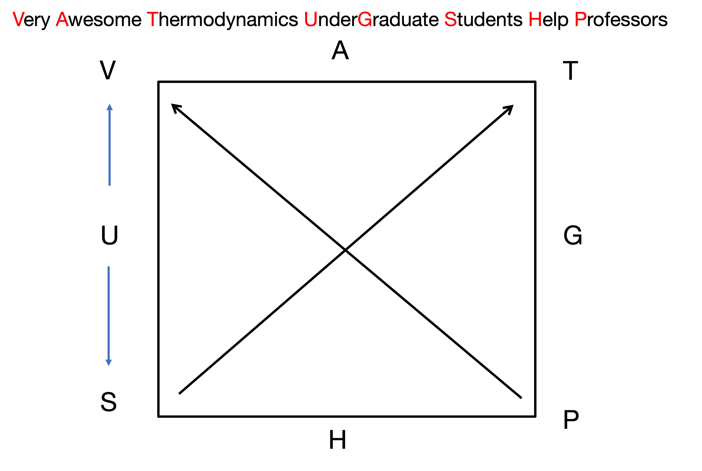
The Thermodynamic Square
Very Awesome Thermodynamics Under Graduate Students Help Professors!
Fig. 1: The thermodynamic square.

Slide 20
Arrows point from S to T, and from P to V.

Slide 21
How to Read the Square
Let’s find the differential for Helmholtz Free Energy ($dA$):
Natural Variables: The two corners adjacent to $A$ are $T$ and $V$.
$dA=\left(…\right)dT±\left(…\right)dV$
Coefficients: Look across the square.
Across from $T$ is $S$.
Across from $V$ is $P$.
Sign Rule: Move against arrow = negative. Move with arrow = positive.
$T→S$ is against the arrow ($−S$)
$V→P$ is against the arrow ($−P$)
Result: $dA=−SdT−PdV$

