Slide 1
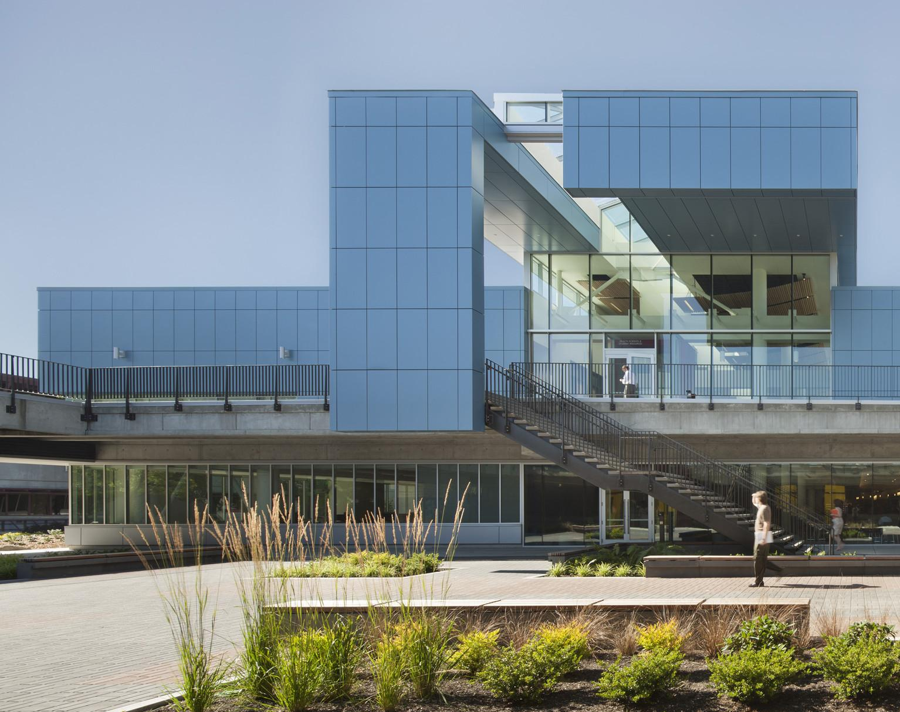
SCADA Power Grid Simulator (GridMaster)
Eric Psy Anthony
Turan
Notes:
TODO:
• Swap out the image for something that works for you
• Read these notes carefully
• Read the “Appendix: Rubric” slide (at the end of this deck) carefully so you know what people are looking for

Slide 2
Project Concept
Web-based platform that simulates a small electrical power grid
Shows real-time grid data through an interactive dashboard
Monitors frequency, voltage, load, generator output, and alarms
Allows for a user to interact with the grid through a control panel.
Allows users to emulate and solve disturbance scenarios
Notes:
TODO:
• Add objectives
• Add images if desired

Slide 3
Tech Stack
Python: supports FastAPI and pandapower libraries
React (+MUI): to create responsive dashboard
Docker: packages all service, easy distribution
FastApi: web framework that handles backend API requests
pandapower: industry-standard Python library for power system simulation. Solves AC power flow equations using real electrical physics, calculates bus voltages, line flows, and losses across the grid.

Slide 4
Challenges and Process
Challenges | How We Figured It Out
MUI dark theme integration | Established consistent card backgrounds (#1a1a1a)
Alarm state management across components | Created severity-based styling with MUI icons
Testing component behavior | Built comprehensive test suites (14 tests for MetricCard.js)
Coordinating with backend team | Implement mock data toggle (USE_MOCK_DATA)
Notes:
TODO:
• Add growth notes
• Add images if desired

Slide 5
Challenges and Process
Challenges | How We Figured It Out
Dealing with missing data and implementation | Used mock data, tested with API endpoints in Swagger
Coordinating with business students | Plan bi-weekly meetings between leads
Deciding scope of project | Narrow down technical aspects with business students
Managing Upcoming Deadlines | Rescheduling meetings and assigning tasks based on availability and current workload
Notes:
TODO:
• Add growth notes
• Add images if desired

Slide 6
Learning and Development
Learned more about backend monitoring and control systems
Improved understanding of real-time data handling
Gained experience with GitHub workflows and team collaboration
Learned how small backend logic changes affect the overall system
Gained backend testing experience
Notes:
TODO:
• Add growth notes
• Add images if desired

Slide 7
Business Plan Progress
Target Audience: educational space, college students
Competitor Analysis
How we make money: free demo, subscription with pricing tiers
Minimum Viable Product and Success Metrics
Technical Specifications: will stay a web app in early stages
Notes:
TODO:
• Add growth notes
• Add images if desired

Slide 8
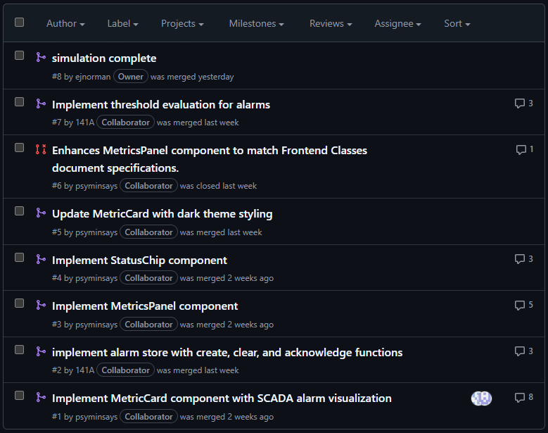
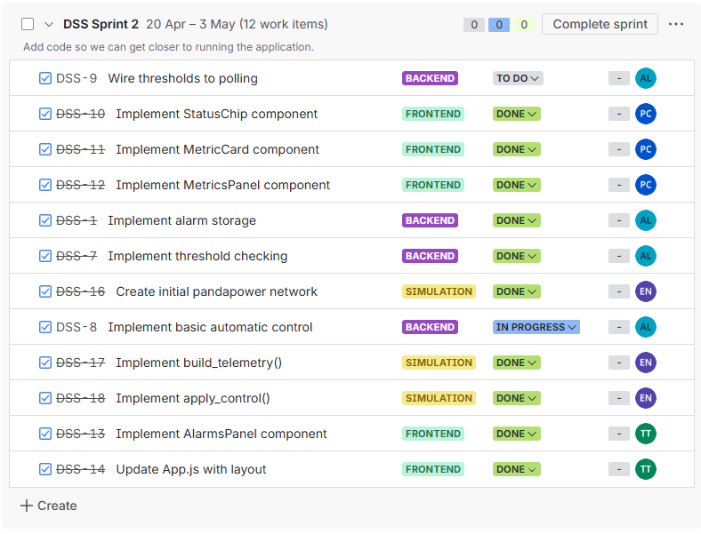
Tracking Project Progress
Github PRs and JIRA tickets
Notes:
TODO:
• Add growth notes
• Add images if desired

Slide 9
What has been done so far
Frontend
Components built
Test environment configured with Jest
Mock data set up to develop frontend independently
Backend
Set up API endpoints
Threshold checking
Control component
Backend testing
Simulation
pandapower fully integrated
Multiple interactive grid scenarios
Notes:
TODO:
• Add growth notes
• Add images if desired

Slide 10
Demo
Notes:
TODO:
• Get the audience ready for the demo
• Add an image if desired
• During the demo, come back through objectives, growth, and impact

Slide 11

Questions?
Notes:
TODO: Replace the artwork, if desired.

Slide 12
Links
Video: https://youtu.be/TBO6OkgBHqM
GitHub: https://github.com/ejnorman/Simulated-Grid-System-SCADA-
JIRA: https://epdat.atlassian.net/jira/software/projects/DSS/boards/2
Notes:
TODO:
• Add growth notes
• Add images if desired

