Slide 1
Office Supplies Management
Elijah Banks, Geoffery Greiner,
Adam Deisz, Mark McDonough

Slide 2
The Project
A tool for inventorying and tracking office supplies. This includes:
Maintaining an inventory of various office supplies
Pencils, pens, paper, paper clips, staples, erasers, folders, etc.
Handling requests for new supplies
Maintaining a list of supplies and their prices
Ability to sort and search
Administrative functions; adding or deleting employees, orders, supplies, and other applicable values

Slide 3
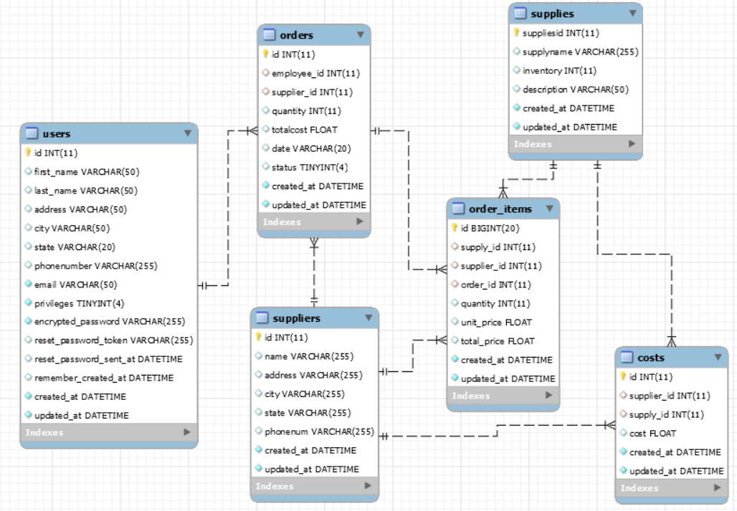
Database
Constraints
Primary Keys
Supplies ID
Supplier ID
Order ID
Cost ID
User ID
Order Item ID
Foreign Keys
Supply ID
Supplier ID
User ID
Order ID

Slide 4
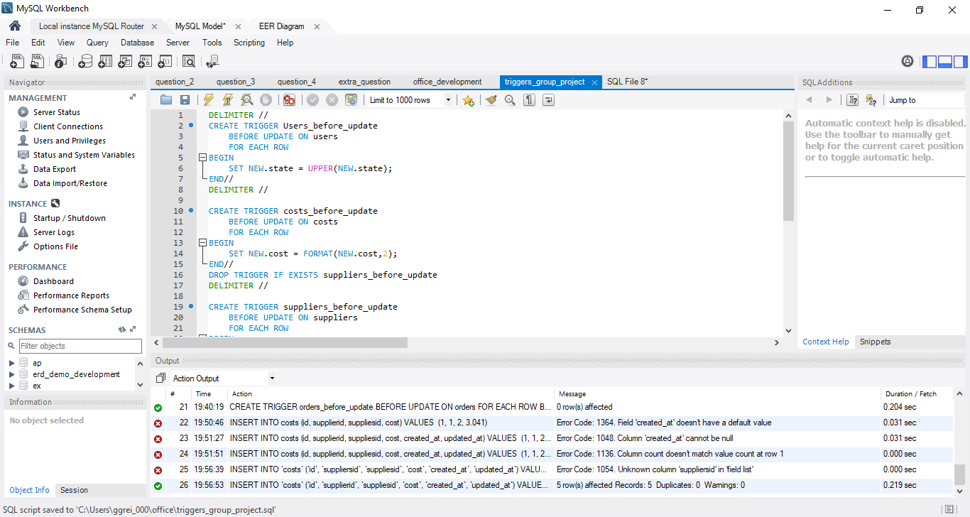
Triggers
2 that correct mixed-case state names in the users and suppliers database.
2 that format float variables to 2 decimal places for cost in the costs table and total cost in the orders table.

Slide 5
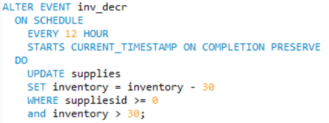
Triggers cont.
Decrement Inventory
Used to simulate inventory being used or sold

Slide 6
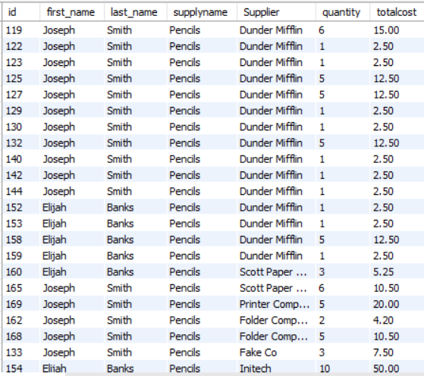
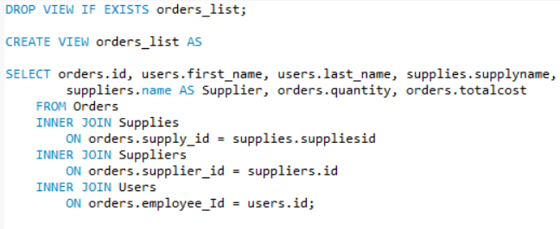
View

Slide 7
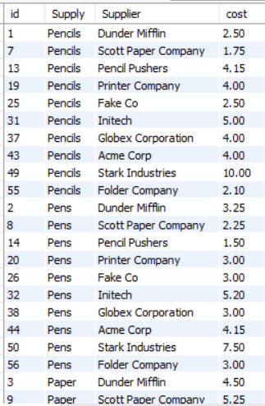
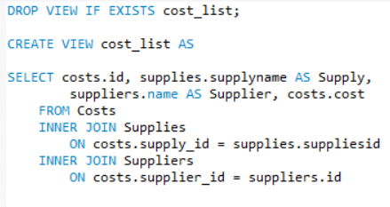
Another View

Slide 8
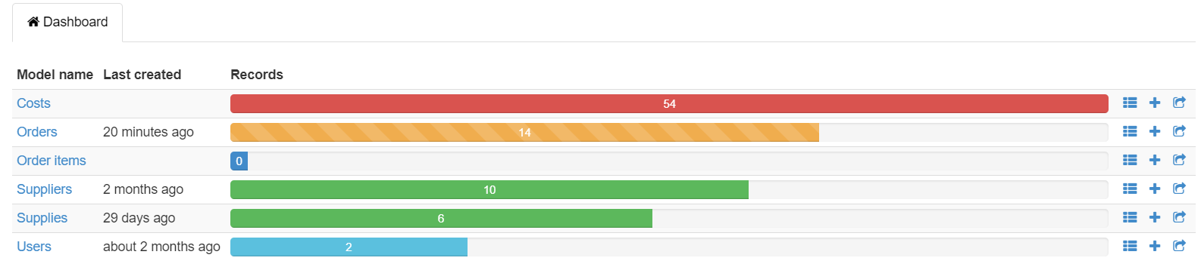
Gems We Used
Devise: User authentication
Rails Admin: Administrative functions & data management.
Bootstrap: Styling the views.
Font Awesome: Added icons to buttons.
RDoc: Documentation

Slide 9
Demo

Slide 10
End

