Slide 1
The Central Algorithm
Name：Ijaz Ul Haq

Slide 2
primary coverage
Process management
Processor allocation algorithms
The central algorithm
The flow of the central algorithm
Analysis

Slide 3
Process management
Processor allocation: determines where a process is to be run
Scheduling
Migration

Slide 4
Processor allocation algorithms
The central algorithm
The up-down algorithm
The logical hierarchy algorithm
The logical ring algorithm
A sender-initiated algorithm
A receiver-initiated algorithm

Slide 5
The central algorithm
This algorithm consists of two main parts: load information centre(LIC) and workstations(WS)
LIC:
•Makes decisions for processor allocation
•Maintains load information for all processors
•Receives updates of load information every P seconds from all the other computers

Slide 6
The central algorithm
WS:
•Run local processes
•Use transfer policy to decide whether a process should run locally or remotely
•Send processor allocation request to the LIC
•Send load information to the LIC every P seconds
•Move processes to run on other workstations
•Accept and run processes from other workstations

Slide 7
The flow
Ws: Whether a process should be executed remotely
Case 1:yes.
•Firstly,send a request together with the current value of its load to the LIC.
•Secondly, When LIC receives a request, it will selects the computer with the shortest queue length as the destination processor, and informs the originating computer about the destination, updates the load of the destination by increment 1.Then,the ws will moves the selected process to the destination.
Case 2:no.
•The process is executed locally, updates the load information of this ws by increment 1.

Slide 8
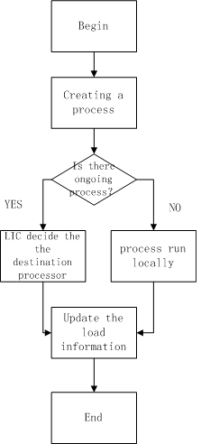

Slide 9
Analysis
Good system performance (average response time) can be achieved;
The update of load information for all processors generates a big overhead cost;
It is a centralized algorithms, hence not robust.

Slide 10
End thanks

