Slide 1
Frisbee Flight Dynamics
Final Project PHYS 416
Errol Jordheim

Slide 2
Motivation
Presents a very intuitive system for modeling, though not very well studied
Frisbee acts as both gyroscope and wing, meaning analytic solution impossible to calculate
Very complicated mechanical system that can be accurately approximated using decomposition of forces
Goal:
To implement this model using Python 3 with adaptive methods
To add onto the base model by incorporating both static and dynamic wind conditions
To easily allow for further additions and optimization

Slide 3
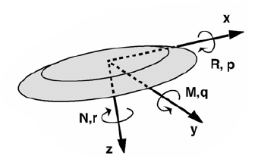
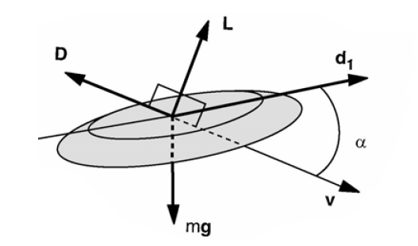
Coordinate frames
Two reference frames are used
Observer frame
Centered at origin
Z-axis defined down
Disc Frame
Centered at Center of Mass (COM)
X-axis defined as projection of velocity onto disc plane
Z-axis defined down
Disc figure from Hummel thesis

Slide 4
COM and COP offset
While gravity acts on the COM, lift and drag act on the center of pressure (COP)
This is accounted for by shifting the forces to the COM and adding rotational moments
Results in 3 forces and 3 moments acting on the disc
Requires 10 constants of the disc

Slide 5
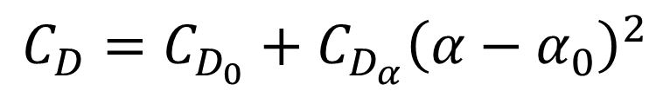



Coefficients
Aerodynamic Coefficients
Moment Coefficients
Lift
Drag
Pitch
All other coefficients are taken to be constants
Values determined from experimental methods
Wind tunnel and flight measurements
Inherent
Lift
Induced
Lift
Inherent
Pitch
Induced
Pitch
$$C_{L}=C_{L_{0}}+C_{L_{α}}α$$
$$C_{M}=C_{M_{0}}+C_{M_{α}}α$$
Angle of
attack
Angle of
attack
$$−\frac{C_{L_{0}}}{C_{L_{α}}}$$
$$C_{D}=C_{D_{0}}+C_{D_{α}}{\left(α−α_{0}\right)}^{2}$$
Inherent
Drag
Induced
Drag
Angle of
attack

Slide 6
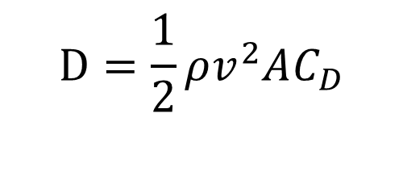
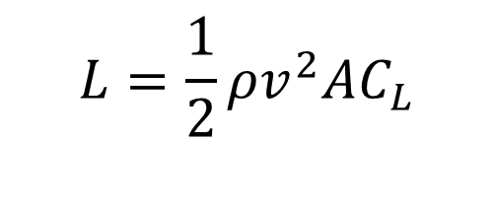
Aerodynamic Forces
Lift
Drag
Lift acts on the disc at the center of mass, perpendicular to the velocity
Magnitude given by
Lift acts on the disc at the center of mass, parallel and opposite to the velocity
Magnitude given by
Air density
Lift coefficient
Air density
Drag coefficient
$$L=\frac{1}{2}ρv^{2}AC_{L}$$
Drag force
$$D=\frac{1}{2}ρv^{2}AC_{D}$$
Lift force
Speed
Area of disc
Speed
Area of disc
Disc figure from Hummel thesis

Slide 7



Moments
Pitch moment
Angle of
attack
Wobble damping
Area of disc
Diameter of disc
Pitch Moment
Acts about y-axis
$$M=\left({C_{M_{0}}+C}_{M_{α}}α+C_{M_{q}}q\right)\frac{1}{2}ρv^{2}Ad$$
Zeroing
coefficient
Angle of attack offset
Pitch angular momentum
Speed
Air pressure
Roll Moment
Acts about x-axis
Area of disc
Diameter of disc
Spin moment
Spin angular momentum
Area of disc
Diameter of disc
Roll moment
Spin angular momentum
Wobble damping
$$R=\left(C_{R_{r}}r+C_{R_{p}}p\right)\frac{1}{2}ρv^{2}Ad$$
Spin Moment
Acts about z-axis
$$N=\left(C_{N_{r}}r\right)\frac{1}{2}ρv^{2}Ad$$
Speed
Spin down coefficient
Speed
Spin coefficient
Roll angular momentum
Air pressure
Air pressure
Disc figure from Hummel thesis

Slide 8
Wind
Wind acts to shift the relative velocity of the disc in relation to the air
In no wind case, velocity is relative to the observer frame
With wind, velocity is relative to the wind frame
This implementation assumes that the density of the air is unchanged by the wind
Also assumes that the direction of the wind does not differ substantially on differing areas of the disc
Allows assumption that the wind can be assumed to be acting on the disc COM

Slide 9
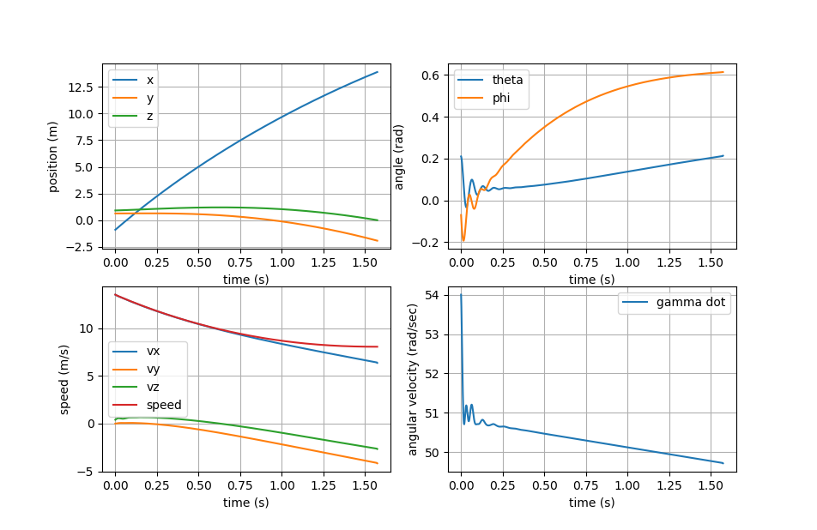
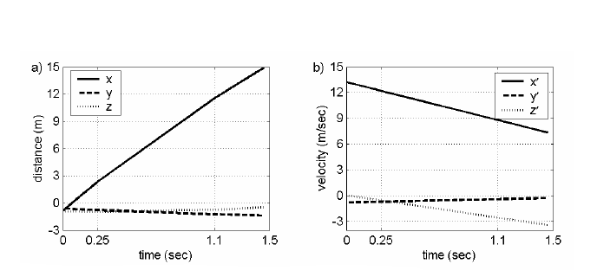
Model Validation
My code
Experimental data
Experimental figure from Hummel thesis

Slide 10
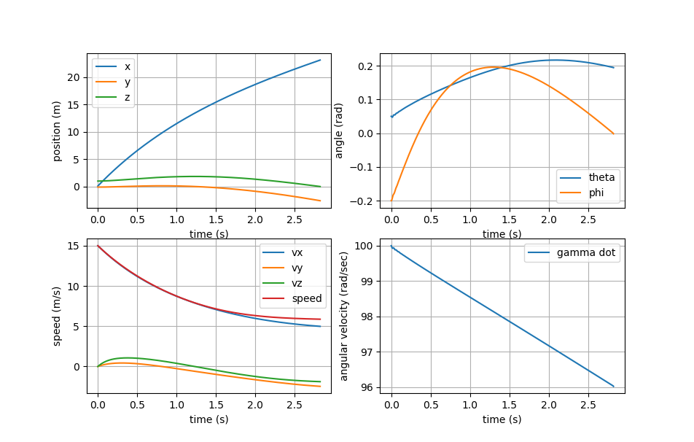
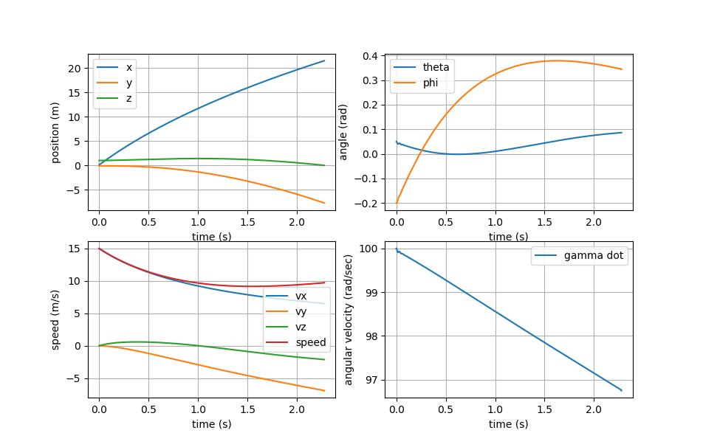
Effect of Wind on Trajectory
Still Conditions
Crosswind 5m/s Right

Slide 11
Code Demonstration

Slide 12
References
Hummel, S. A., “Frisbee flight simulation and throw biomechanics.” 2003.

