Slide 1

Atomic Spectroscopy of Hydrogenic Atoms
Erik Porter
MIT Department of Physics, Junior Lab
ejporter@mit.edu
May 13, 2019

Slide 2
Why do we care about these things

Slide 3
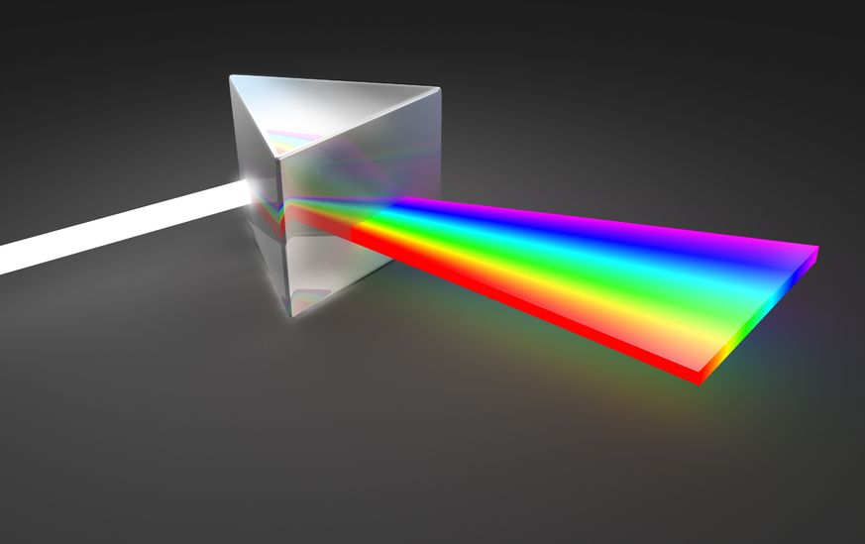
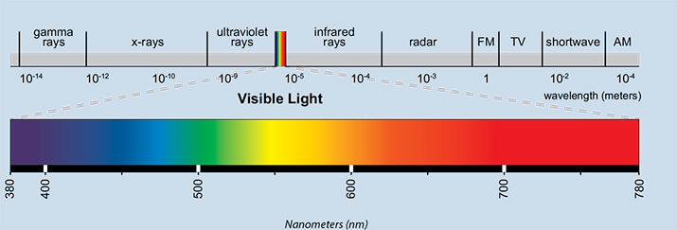
What we want to measure and how we will do it
The emission of our samples is
https://www.polymersolutions.com/
Historically this was done using prisms.
https://eyelighting.com

Slide 4


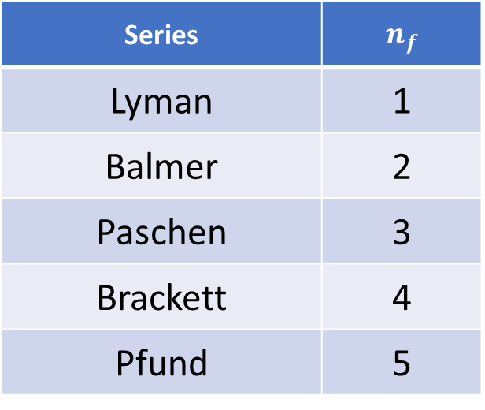
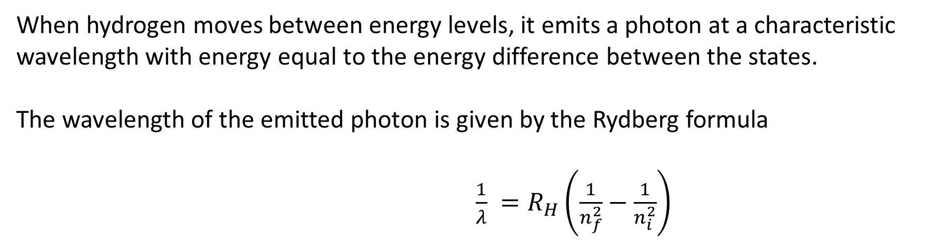

Rydberg Formula and Hydrogen Spectral Series
When hydrogen moves between energy levels, it emits a photon at a characteristic wavelength with energy equal to the energy difference between the states.
The wavelength of the emitted photon is given by the Rydberg formula
$\frac{1}{λ} =R_{H}\left(\frac{1}{n_{f}^{2}}−\frac{1}{n_{i}^{2}}\right)$
Series | $$n_{f}$$
Lyman | 1
Balmer | 2
Paschen | 3
Brackett | 4
Pfund | 5
$$R_{H}=R_{∞}\left(\frac{m_{H}}{m_{h}+m_{e}}\right)$$
$$R_{∞}=\frac{m_{e}e^{4}}{8ε_{0}^{2}h^{3}c}$$
The Balmer Series of Hydrogen
https://en.wikipedia.org/wiki/Balmer_series

Slide 5
Controlling the Measured Wavelength
PMT
First spherical mirror collimates incident light.
Rotating the grating changes the wavelength that passes through second slit.
Chosen wavelength is then measured via a PMT.
Grating
Jobin Yvon 1250M Monochromator

Slide 6
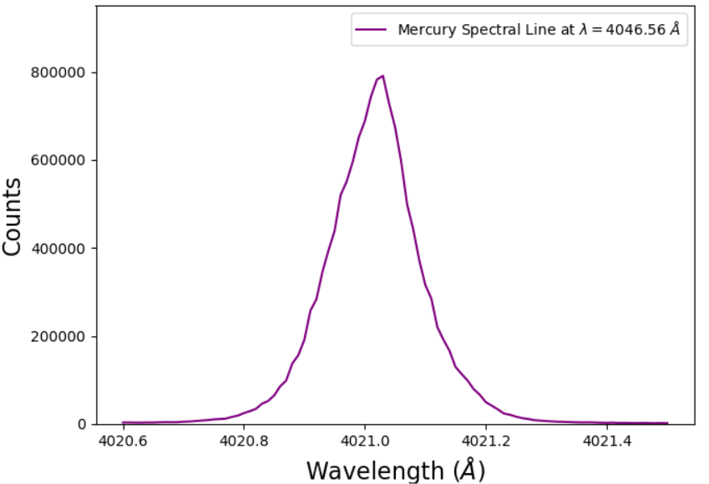


Spectral Line Width
Spectral lines are not precisely defined, have some natural thickness.
FWHM for this measurement is approximately $0.15$monochromator counts.
Contributions from:
Doppler Shift
Quantum Uncertainty
Collisional Broadening
Pressure Broadening
$$≈0.15$$
And more!
Monochromator Count

Slide 7
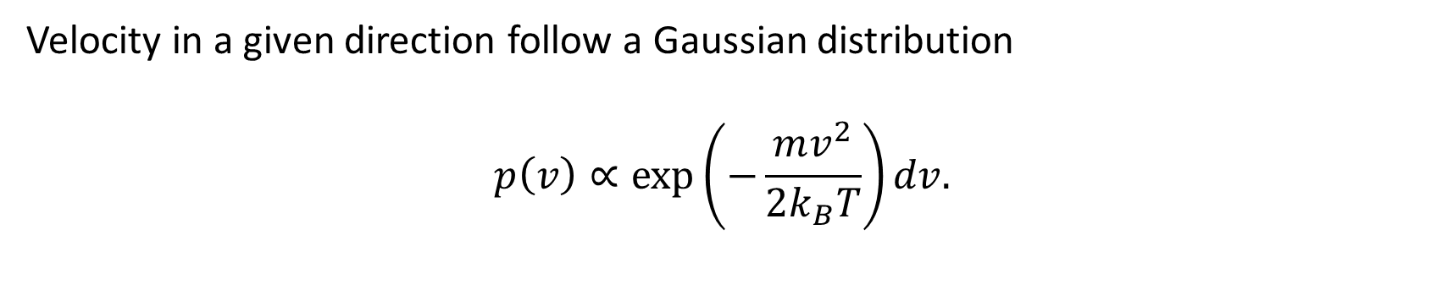
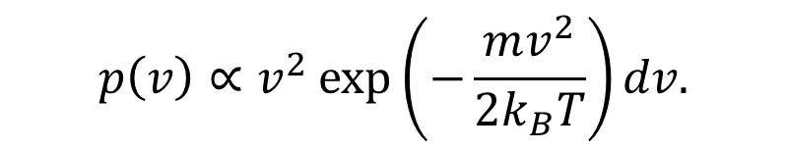


Spectral Line Width – Doppler Shift (Thermal Broadening)
Particles in a gas have a distribution of speeds
$$p\left(v\right)∝v^{2}\exp\left(−\frac{mv^{2}}{2k_{B}T}\right)dv.$$
Velocity in a given direction follow a Gaussian distribution
$$p\left(v\right)∝\exp\left(−\frac{mv^{2}}{2k_{B}T}\right)dv.$$
This effect has a Gaussian profile and has a temperature and wavelength dependent broadening.
$$Δλ=\frac{λ}{c}\sqrt{\frac{2k_{B}T}{m}}$$
$$≈0.05 Å$$

Slide 8
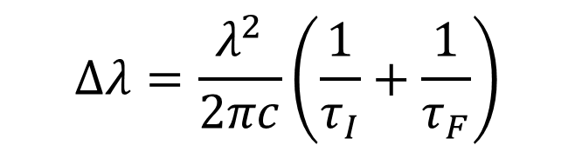
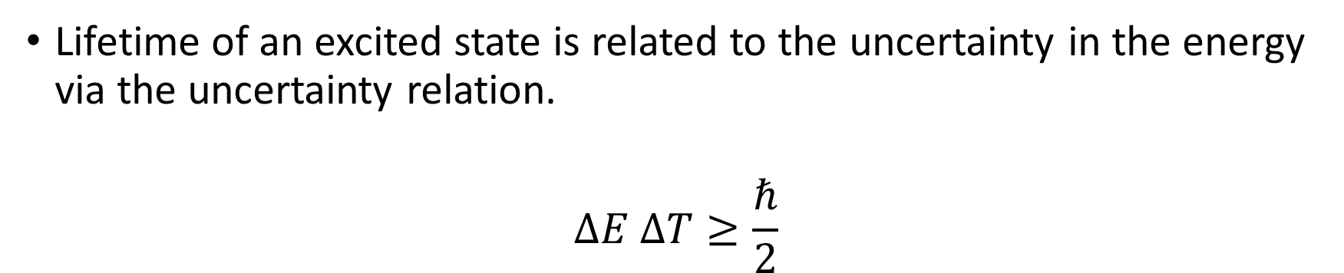

Spectral Line Width – Quantum Uncertainty
Lifetime of an excited state is related to the uncertainty in the energy via the uncertainty relation.
$$ΔE ΔT≥\frac{ℏ}{2}$$
Natural Broadening
This effect has a Lorentzian profile and is dependent on wavelength the lifetime of the initial/final states.
$$Δλ=\frac{λ^{2}}{2πc}\left(\frac{1}{τ_{I}}+\frac{1}{τ_{F}}\right)$$
$$≈{10}^{−4} Å$$

Slide 9
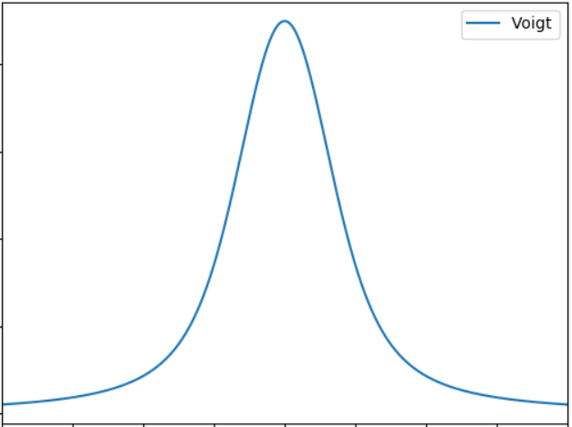
Spectral Line Width – Voigt Distribution
Gaussian and Lorentzian profiles are the dominant broadening sources. The convolution of these effects is a Voigt distribution with summed FWHM
The Voigt profile is the true shape of our spectral lines.
It has no closed form, so we will use a Gaussian approximation for determining our wavelength
FWHM

Slide 10
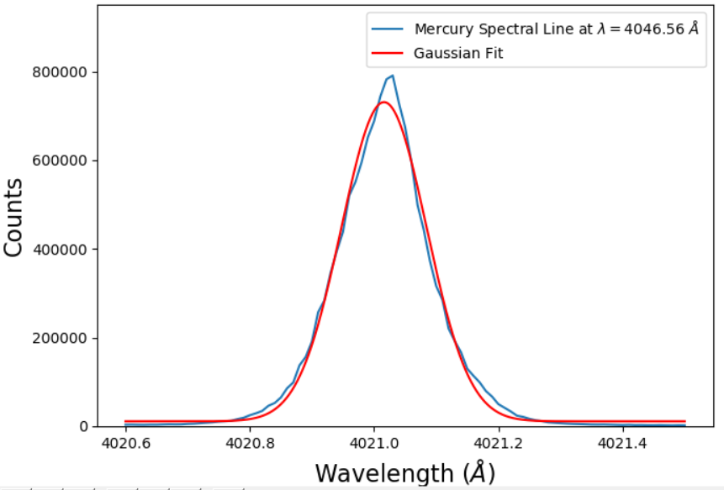
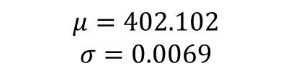
Determining the Relevant Wavelength for a Measurement
Example measurement
For each measurement we will
Sweep a small region around the expected wavelength.
Fit a Gaussian.
Extract mean and standard deviation
Gaussian has parameters:
$$μ=402.102$$
$$σ=0.0069$$
Monochromator Count

Slide 11
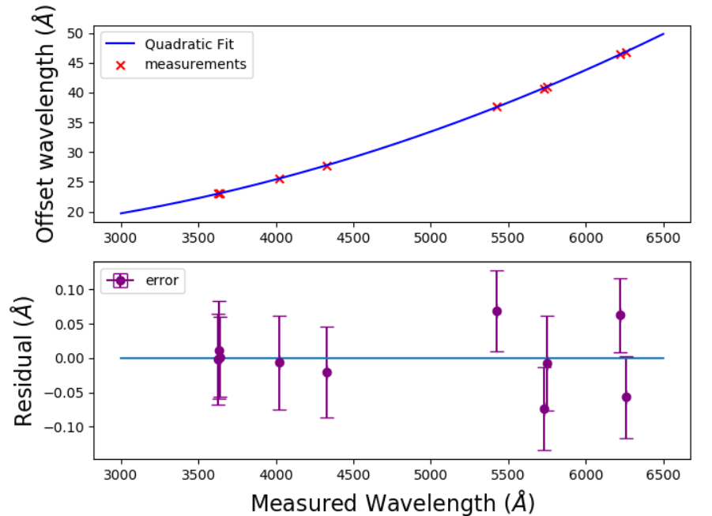
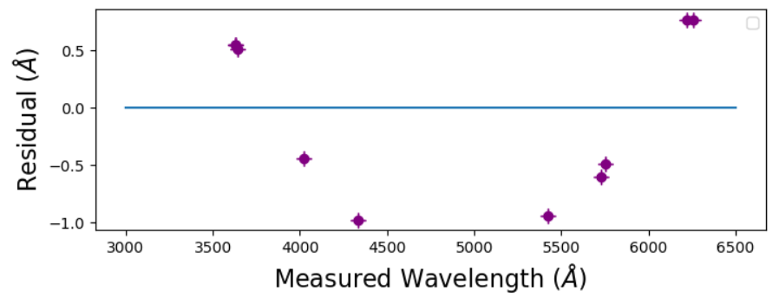


Calibration
The readout of the computer is not the correct wavelength, so we must calibrate using known spectral lines.
Residuals from a linear fit with a clear quadratic dependence
Fit: $αλ^{2}+βλ+γ$
$$α=\left(1.16±0.02\right)×{10}^{−6} nm^{−1}$$
$β=\left(−2.4±0.3\right)×{10}^{−3}$
$γ= 16.6±$ 0.7 nm
$$χ^{2}=0.79$$
$$p=0.595$$
Monochromator Count
Monochromator Count

Slide 12
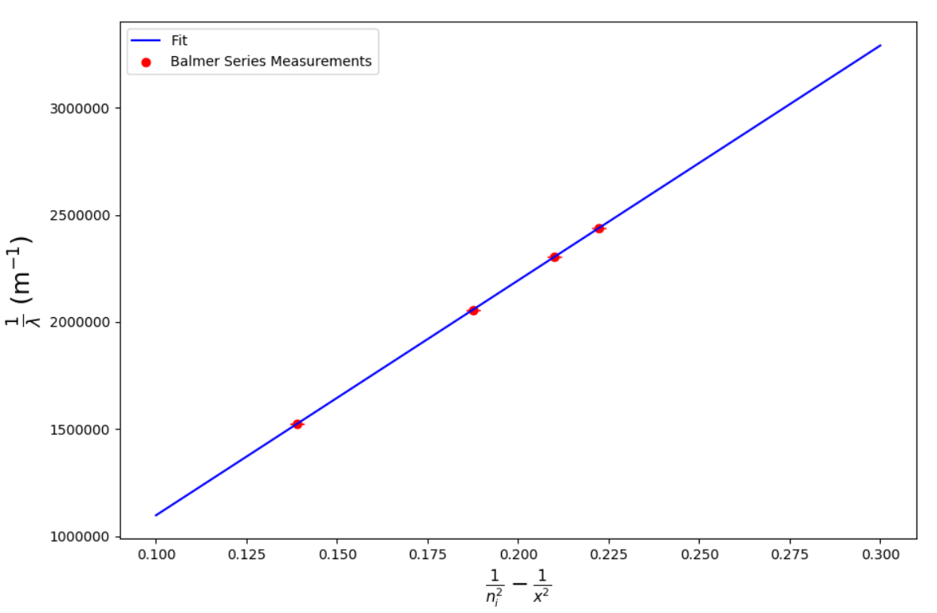

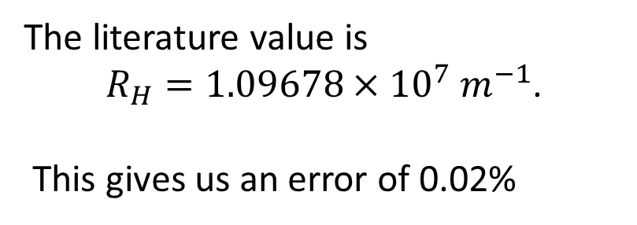

Calculating the Hydrogen Rydberg Constant, $R_{H}$
We now have a way to get accurate measurements of the hydrogen spectrum.
Using the Balmer series lines we can plot $\frac{1}{λ}$ vs. $\frac{1}{n_{f}^{2}}−\frac{1}{n_{i}^{2}}$ , where $n_{f}=2$.
Counts
$$R_{H}=(1.0970±0.0004)×{10}^{7} m^{−1}$$
The literature value is
$R_{H}=1.09678×{10}^{7} m^{−1}$.
This gives us an error of 0.02%
$$\frac{1}{n_{f}^{2}}−\frac{1}{n_{i}^{2}}$$

Slide 13
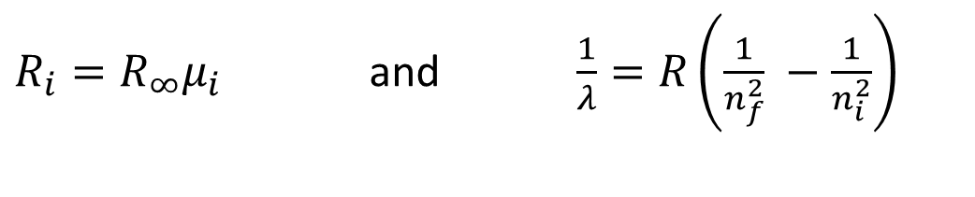
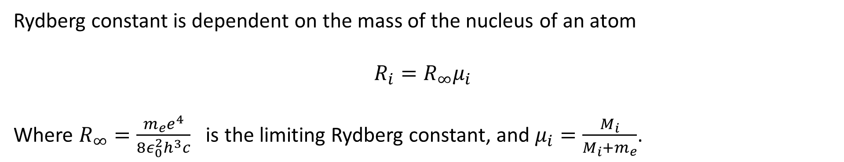
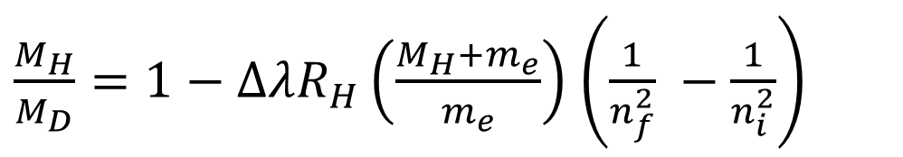
Calculating the Mass Ratio from Isotope Shift
Rydberg constant is dependent on the mass of the nucleus of an atom
$$R_{i}=R_{∞}μ_{i}$$
Where $R_{∞}=\frac{m_{e}e^{4}}{8ε_{0}^{2}h^{3}c}$ is the limiting Rydberg constant, and $μ_{i}=\frac{M_{i}}{M_{i}+m_{e}}$.
Using
$R_{i}=R_{∞}μ_{i}$ and $\frac{1}{λ}=R\left(\frac{1}{n_{f}^{2}} −\frac{1}{n_{i}^{2}}\right)$
Balmer Series will shift down if we measure the emission of a heavier element – deuterium.
$\frac{M_{H}}{M_{D}}=1−ΔλR_{H}\left(\frac{M_{H}+m_{e}}{m_{e}}\right)$ $\left(\frac{1}{n_{f}^{2}} −\frac{1}{n_{i}^{2}}\right)$

Slide 14
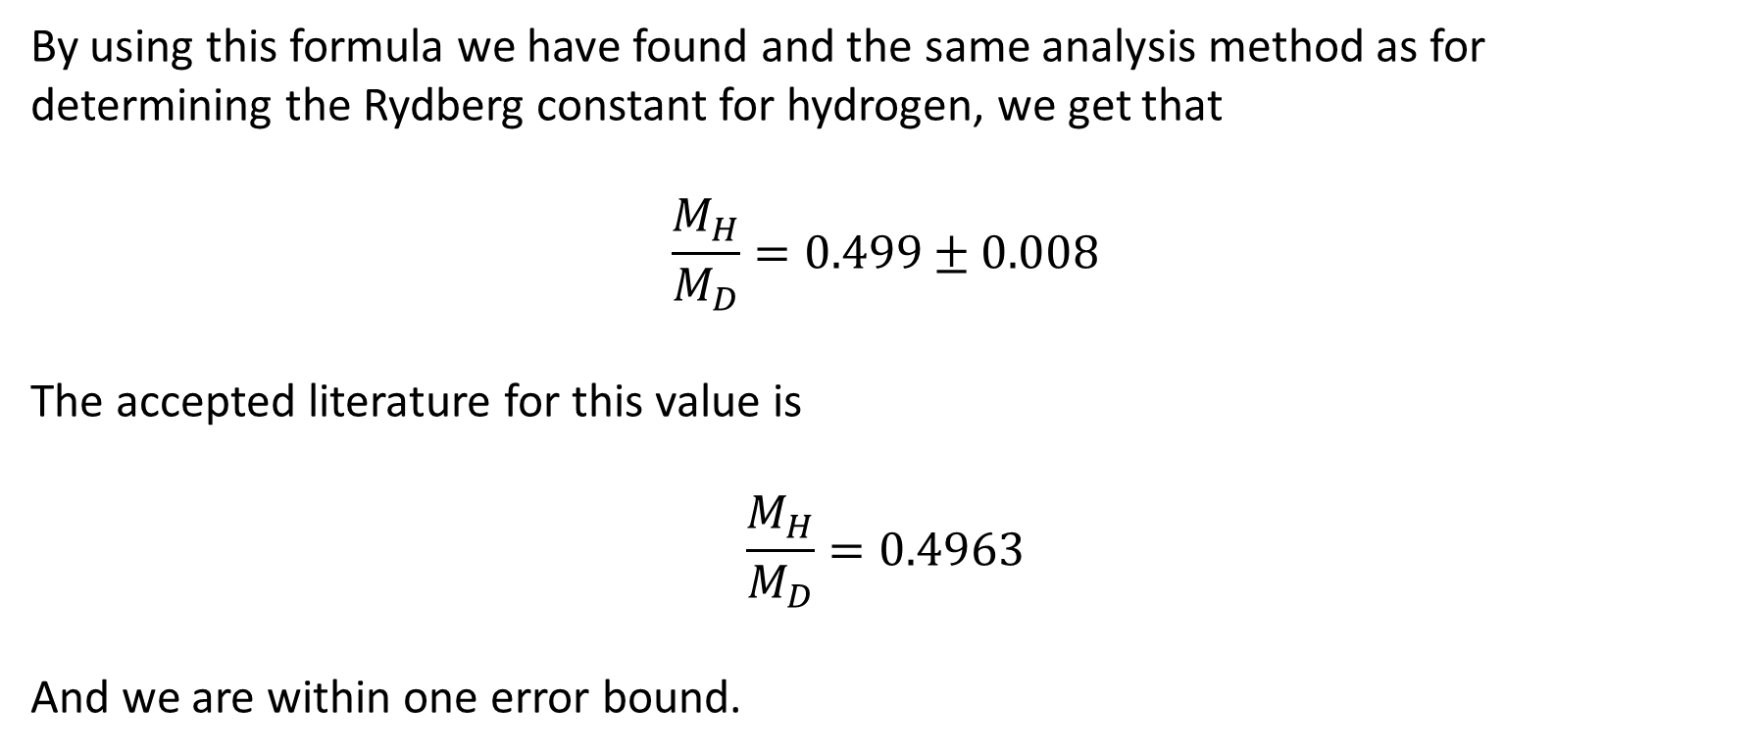
Mass Ratio from Isotope Shift
By using this formula we have found and the same analysis method as for determining the Rydberg constant for hydrogen, we get that
$$\frac{M_{H}}{M_{D}}=0.499±0.008$$
The accepted literature for this value is
$$\frac{M_{H}}{M_{D}}=0.4963$$
And we are within one error bound.

Slide 15
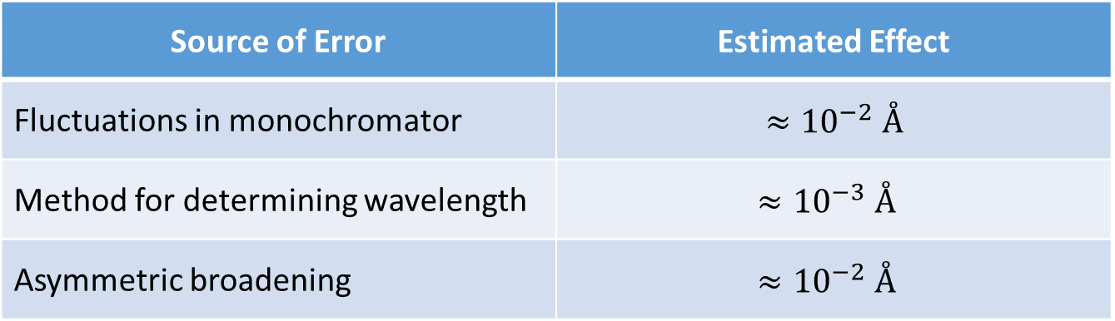
Sources of Uncertainty
Source of Error | Estimated Effect
Fluctuations in monochromator | $$≈{10}^{−2} Å$$
Method for determining wavelength | $$≈{10}^{−3} Å$$
Asymmetric broadening | $$≈{10}^{−2} Å$$

Slide 16

Conclusions + Why Do We Care?
We were able to determine
$$R_{H}=\left(1.0970±0.0001\right)×{10}^{7} m^{−1}$$
$$\frac{M_{H}}{M_{D}}=0.499±0.008$$
Making use of atomic spectroscopy, we were able to analyze the spectrum of hydrogen and other atoms to learn more about their structure and confirm theoretical results!

Slide 17
References
https://ocw.mit.edu/courses/physics/8-13-14-experimental-physics-i-ii-junior-lab-fall-2016-spring-2017/experiments/optical-emission-spectra-of-hydrogenic-atoms/MIT8_13-14F16-S17exp17.pdf
https://en.wikipedia.org/wiki/Balmer_series
https://en.wikipedia.org/wiki/Voigt_profile
http://www-star.st-and.ac.uk/~kw25/teaching/nebulae/lecture08_linewidths.pdf

