Slide 1
MAKERERE UNIVERSITY IST2106
JengaConnect
Customer, solution and business model validation
EVENING A GROUP 6 KAMPALA, UGANDA 1 NOVEMBER 2026 PHASE 2
Member | Registration number
LUYOBYA VICENT | 25/U/03863/EVE
YIGA AKRAM | 23/U/18680/PS
KWAGALA ELVIS | 25/U/0365
MUGANWA EDRINE | 25/U/03890/EVE
MUJUNI NASEEM | 25/U/03899/EVE
1

Slide 2
Venture and problem addressed
Problem (from Phase 1)
People holding usable surplus building materials struggle to find nearby buyers before storage or transport cost outweighs its value. Small buyers struggle to find the right quantity in a condition they can judge.
Where the evidence stands
Completed customer respondents (Phase 1): 0
Prototype feedback sessions completed: 0 of at least 5
Findings below are hypotheses until sessions are done.
2

Slide 3
Primary customer and persona
Self-builder or small contractor buying small quantities in Kampala and Wakiso. Sellers of surplus are the secondary segment. Provisional persona; A = assumption to test.
Trait | Provisional persona | Basis
Profile | Adult artisan or household builder building or extending in stages, buying small quantities near Kampala or Wakiso. | P1 (artisan / household builder)
Goal | Find the right quantity of usable material nearby, in a condition they can inspect, at a total collection cost that is worth the trip. | P2
Motivation | Keep a build moving and control cost. | A
Frustrations | Uncertain availability, unsuitable quantities, quality doubts and transport cost. | P2
Behaviour today | Asks personal contacts, visits hardware shops, looks at general classified listings. | P1 alternatives list
Context | A small shortfall appears mid-build and work waits until it is solved. Uses a mobile phone for search. | A
3

Slide 4
Customer journey and key pain points
Stage | Today | Pain point | Opportunity
1 Recognise need | Finds a shortfall or leftover gap during building. | Unsure whether usable leftovers exist nearby. | Browse by material, quantity and area.
2 Search | Asks contacts, calls or visits hardware shops, scans classifieds. | Scattered sources; time and travel before knowing availability. | One material-specific listing view.
3 Evaluate | Compares price, distance and condition by phone or photo. | Condition and quantity unclear; seller authority unknown. | Photos, condition, unit and quantity on every listing.
4 Select / use | Agrees price, inspects and arranges transport. | Transport cost and a wasted trip if stock differs. | Questions, inspection arrangement and collection window.
5 After use | Uses the material; keeps or disposes of leftovers. | No simple route to report a problem or list leftovers. | Completion status and a simple complaints route.
Journey stages are hypotheses to be confirmed by fieldwork.
4

Slide 5
Value proposition and differentiation
For self-builders and small contractors in Kampala and Wakiso who struggle to find small quantities of usable building materials whose condition and total collection cost they can judge, JengaConnect is a mobile-web listing platform that connects them with nearby holders of surplus, unlike personal contacts, hardware shops and general classified listings, because every listing states the material, quantity, condition and collection arrangements.
Alternative | Gap JengaConnect aims to close
Personal contacts | Limited by one's own network
Hardware shops | May not hold reusable surplus
General classifieds | Not material-specific; condition unclear
5

Slide 6
Technology solution and essential features
A mobile-web listing platform: no app install, works on a basic smartphone browser.
Feature | What it does
1 Material search and filters | Browse by material, quantity, broad area and collection option.
2 Structured listing | Photos, condition, unit, quantity and asking price; exact site address hidden.
3 Seller contact and inspection | Pre-set questions and an inspection arrangement.
4 Collection coordination | Agreed quantity, collection window and completion status.
5 Moderation and reporting | Listing checks, seller permission and a report button.
Needs: hosting, database, photo storage, moderators. Limits: stock accuracy, seller permission, moderation, reliable collection. Payments, escrow, USSD and delivery are out of scope.
6

Slide 7
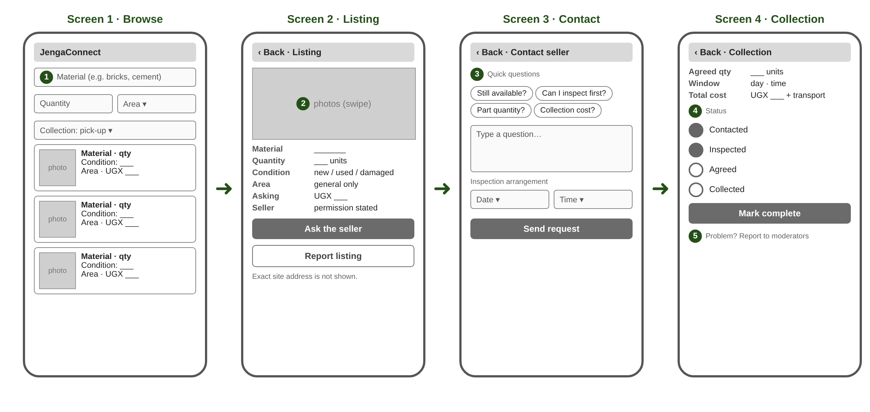
Low-fidelity prototype: wireframes
Flow: Browse > Listing > Contact > Collection. Numbers 1-5 mark features. View-only link: [add link]
7

Slide 8
Customer feedback and changes made
Sessions completed: 0 of at least 5
Results and changes are added after real sessions.
Code | Role | Main feedback | Change and reason
P01 | [pending] | [pending] | [pending]
P02 | [pending] | [pending] | [pending]
P03 | [pending] | [pending] | [pending]
P04 | [pending] | [pending] | [pending]
P05 | [pending] | [pending] | [pending]
Fieldwork video V05: pending [add unlisted YouTube link]
8

Slide 9
Business Model Canvas
Key Partnerships
Hardware shops, site managers, independent delivery providers
Key Activities
Maintain listings; recruit users; moderate reports; support collection
Value Propositions
Buyers: small quantities nearby, condition visible. Sellers: route to move surplus
Customer Relationships
Listing support; status updates; complaints route
Customer Segments
Buyers: self-builders, small contractors. Sellers: site managers, hardware sellers
Key Resources
Listing platform; authorised material data; support staff; funds
Channels
Mobile website; outreach to site and shop contacts; shareable links
Cost Structure
Hosting, data, support, moderation, outreach, verification (amounts: Week 3)
Revenue Streams
Seller listing fee or transaction charge to test (payer and price unknown)
All blocks are hypotheses: completing the canvas does not validate it.
9

Slide 10
Critical assumptions, lessons and next steps
Assumption | How we will test it | If wrong
A1 Enough suitable surplus exists within a practical collection area. | Ask sellers about one recent surplus event: what, how much, what happened to it. Count real examples. | Narrow materials or area, or recruit hardware shops as a steadier supply source.
A2 Buyers accept the total cost and effort after inspection and transport. | Compare each buyer's last purchase with a worked listing example including collection cost. | Add shared collection or delivery partners, or target larger quantities.
A3 A clearly identified payer will pay a fee that supports operating costs. | Ask sellers and buyers which side would pay, in what form (flat fee or share of price), and at what level. | Test the other payer, a different fee form, or a partner-funded model.
Lessons so far: customer evidence is still to be collected; the concept stays a hypothesis.
Next: complete 5+ feedback sessions, update the prototype, source costs and test the fee (Week 3).
Videos: V04, V05, V06 pending [add unlisted YouTube links]
10

