Slide 1
MAKERERE UNIVERSITY IST2106
JengaConnect
Venture plan and commercialization
A mobile-web marketplace where people list surplus building materials for nearby buyers in Kampala and Wakiso. EVENING A GROUP 6
Member | Registration number
LUYOBYA VICENT | 25/U/03863/EVE
YIGA AKRAM | 23/U/18680/PS
KWAGALA ELVIS | 25/U/0365
MUGANWA EDRINE | 25/U/03890/EVE
MUJUNI NASEEM | 25/U/03899/EVE
1

Slide 2
Vision, mission and SMART objectives
Vision
A Uganda where usable building materials are reused instead of wasted, and every small builder can find what they need nearby.
Mission
To connect people holding surplus building materials with nearby buyers through a trusted, simple mobile-web marketplace.
Proposed SMART objectives
1. Within 90 days of pilot launch, onboard 40 verified sellers and publish 120 listings.
2. Within 90 days of pilot launch, complete 50 exchanges confirmed by both sides, at least 70% rated 4 or 5 of 5.
3. Within 90 days, run the pilot within the founders' budget of UGX 936,556 and decide on seeking investment using the stop or go gates.
2

Slide 3
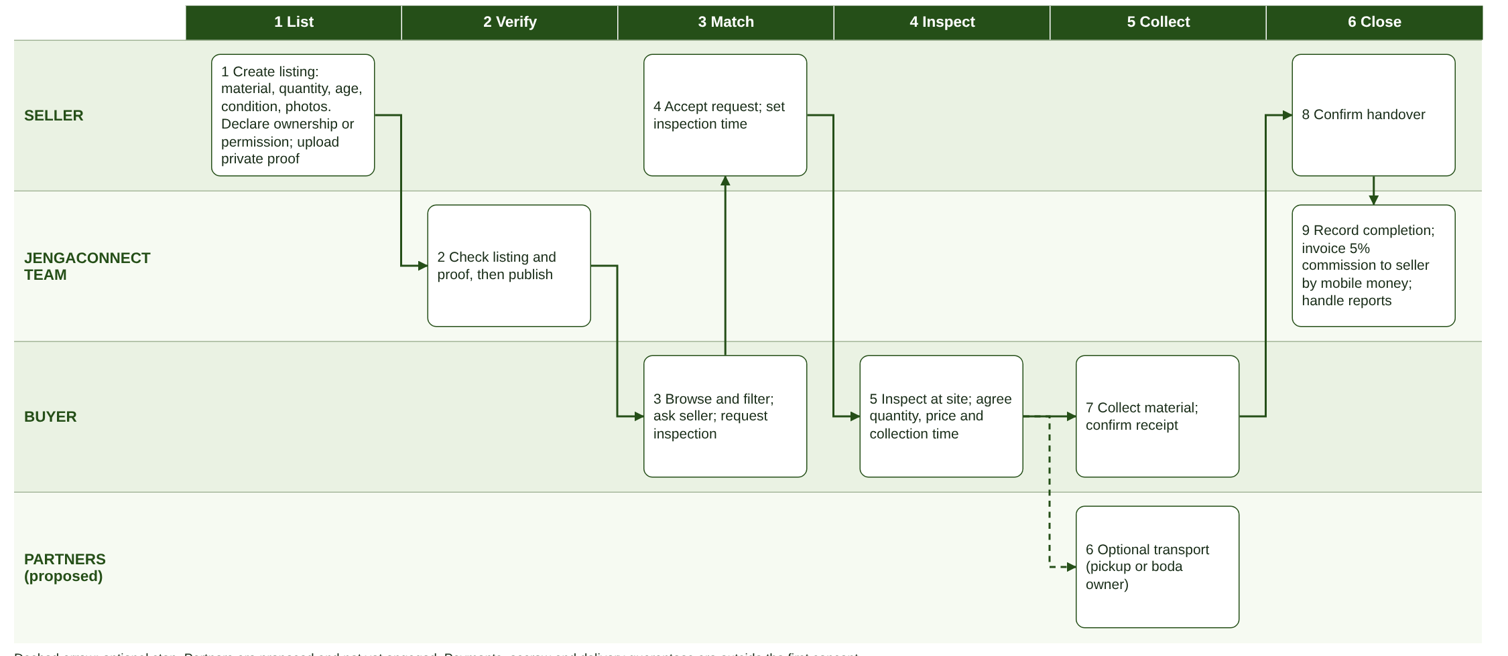
Operating model and business activities
Customers use a mobile browser.
Support: phone, WhatsApp link and a report button.
Commission (5%, minimum UGX 3,000) is invoiced to the seller after both sides confirm.
3

Slide 4
Resource requirements and key partnerships
Resource | Pilot (90 days) | Later growth
Human | 5 founders (unpaid) as developers and moderators | Paid moderators and a developer, after the gates are passed
Technology | Free tiers for hosting, database and storage. Only the .com domain is bought. | Paid hosting and mobile money API
Equipment, data | Own phones and laptops listings and private ownership records | Office, test phones, price and demand data
Partnerships | 10 small contractors or artisans or hardware shops, 1 or 2 transport owners (proposed) | Shop chains, builders' associations
Finance | Founders' contributions of UGX 936,556 | Investment, only if the gates are passed
No partner has been contacted or agreed. Partners are proposed: hardware shops and site managers (listings), pickup or boda owners (transport) and mobile money providers.
4

Slide 5
Startup and operating cost estimates
One-off startup cost | UGX | Basis
Domain, .com first year (Namecheap, 2026) | 67,956 | Listed price
PDPO registration and trading licence | 200,000 | Estimate
Legal review, launch materials | 200,000 | Estimate
Total one-off | 467,956
Monthly operating cost | UGX
Hosting, database, storage | Free tiers
Mobile data, 2 x 20 GB (Pulse Uganda, 2026) | 52,000
Founders (5), moderation | unpaid
Outreach and promotion | 90,000
10% contingency | 14,200
Total monthly | 156,200
Pilot need = 467,956 + (3 x 156,200) = UGX 936,556, within the UGX 1.5 million founders' ceiling (UGX 187,311 each).
Rate: UGX 4,200 per USD. A 10% change moves the need to 929,760 or 943,352. Incorporation and trademark (UGX 345,000, URSB, 2026a, 2026b) wait until after the pilot. Fees not confirmed and other figures are team estimates.
5

Slide 6
Financing and revenue strategy
Financing: the founders fund the pilot. Investment is sought only if the 90-day gates are passed.
5% alone: a UGX 30,000 bag earns 1,500 and a UGX 150,000 exchange earns 7,500. Lean cost 156,200 a month needs 105 bag-sized or 21 larger exchanges. Sustainable cost 607,200 needs 405 or 81. A UGX 3,000 minimum cuts these to 53 and 203 bag-sized.
Expected monthly income (UGX) | Cautious | Base | Strong
Commission: 15, 30, 50 exchanges at 3,000, 5,000, 7,500 | 45,000 | 150,000 | 375,000
Subscriptions: 0, 5, 10 shops at 20,000 | 0 | 100,000 | 200,000
Featured listings: 0, 10, 30 at 5,000 | 0 | 50,000 | 150,000
Transport referrals: 0, 20, 60 at 2,000 (proposal) | 0 | 40,000 | 120,000
Verified-seller checks: 0, 5, 15 at 10,000 | 0 | 50,000 | 150,000
Total expected monthly income | 45,000 | 390,000 | 995,000
Total over 90 days at that rate | 135,000 | 1,170,000 | 2,985,000
Against lean cost 156,200 | -111,200 | +233,800 | +838,800
Against sustainable cost 607,200 | -562,200 | -217,200 | +387,800
Scenarios under assumptions, not promised income. Only commission is expected in the first 90 days.
6

Slide 7
Intellectual property, legal and ethical considerations
Area | Relevance to JengaConnect | Action
Intellectual property | Code, designs and guides (copyright), name (trademark after the pilot), seller data | Assignment agreement, trademark later, licence for listing photos
Data protection | Holds names, phones, photos and ownership proofs. | Register with PDPO; consent; privacy notice; hide exact address
Registration, cyber | Invoice and receive mobile money, fake listings damage trust | Trading licence now, incorporation after the pilot, HTTPS, backups, accepted terms
Ethics and safety | 4 of 5 raised ownership or theft; hazardous items | Declaration, report button, banned-items list, human review of any AI aid
Legal points to be confirmed with a lawyer.
7

Slide 8
Commercialization pathway
Stage | What happens | When
Idea | Surplus materials wasted; small buyers cannot find the right quantity | Done (Weeks 1, 2)
Validation | 5 customer interviews; prototype tested; fee changed to a commission after a sale | Done, small sample
Product development | Minimum viable product: listings, ownership declaration, moderation, inspection request, completion tracking | Days 1 to 30
Pilot | Kampala and Wakiso; 40 sellers; 120 listings; 50 confirmed exchanges | Days 31 to 90
Market entry | All sellers in Kampala and Wakiso; add partners; set commission level | Months 4 to 6
Growth | Mukono and other towns; transport partners; mobile money checkout | After month 6
Initial market: Kampala and Wakiso. Pricing: 5% seller commission with a UGX 3,000 minimum after completion. Channels: mobile website, shop and site contacts, shareable listing links.
Stages after Validation are proposed. No product, pilot or revenue exists yet.
8

Slide 9
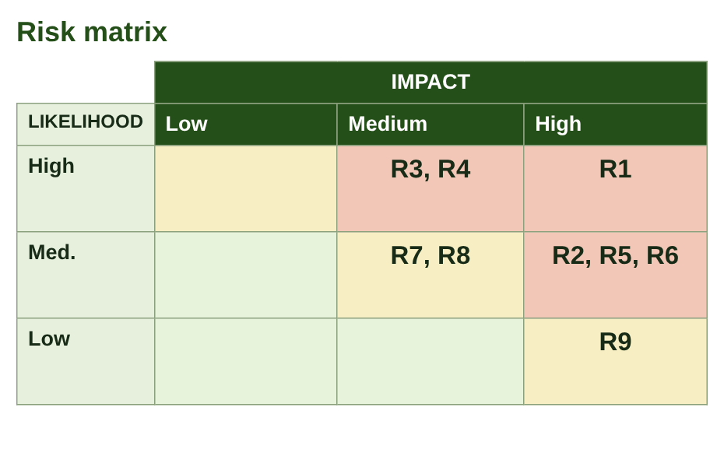
90-day roadmap and key risks
Days | Key activities | Output
1 to 30 | Register with PDPO and get the licence, build on free tiers, recruit 10 sellers | Site live, 10 sellers
31 to 60 | Launch in Kampala and Wakiso, moderate every listing, weekly check-ins | Atleast 25 sellers and 20 exchanges
61 to 90 | Reach 40 sellers and 50 exchanges, review the stop or go gates | Pilot report and decision: stop, change or seek investment
Top risks: R1 stolen or misdescribed goods, R2 too few listings, R3 sellers lack permission, R4 deals made offline skip commission, R5 data breach, R6 funding or free-tier limits.
Day-90 gates: exchanges, measured average value, deals taken offline, repeat use. Roadmap is proposed, not implemented.
9

Slide 10
Strategic lessons and preparation for Week 4
Lessons: trust in ownership decides adoption. Sellers pay only after a sale, so the fee is a commission. 5% alone does not sustain paid staff, so other income and the 90-day gates decide the next step.
Week 4: brand identity and positioning, digital customer persona and journey, social media platforms, content pillars and a four-week calendar, campaign budget and KPIs, final venture pitch.
Recorded group discussion (unlisted YouTube): [add link]
10

