Slide 1
MAKERERE UNIVERSITY IST2106
JengaConnect
Customer, solution and business model validation
EVENING A GROUP 6
Member | Registration number
LUYOBYA VICENT | 25/U/03863/EVE
YIGA AKRAM | 23/U/18680/PS
KWAGALA ELVIS | 25/U/0365
MUGANWA EDRINE | 25/U/03890/EVE
MUJUNI NASEEM | 25/U/03899/EVE
1

Slide 2
Venture and problem addressed
Problem
People holding usable surplus building materials struggle to find nearby buyers before storage or transport cost outweighs its value. Small buyers struggle to find the right quantity in a condition they can judge.
Where the evidence stands
Prototype feedback responses collected: 5 of at least 5
2

Slide 3
Primary customer and persona
Self-builder or small contractor buying small quantities in Kampala and Wakiso. Sellers of surplus are the secondary segment. Provisional persona; A = assumption to test.
Trait | Provisional persona | Basis
Profile | Adult artisan or household builder building or extending in stages, buying small quantities near Kampala or Wakiso. | P1 (artisan / household builder)
Goal | Find the right quantity of usable material nearby, in a condition they can inspect, at a total collection cost that is worth the trip. | P2
Motivation | Keep a build moving and control cost. | A
Frustrations | Uncertain availability, unsuitable quantities, quality doubts and transport cost. | P2
Behaviour today | Asks personal contacts, visits hardware shops, looks at general classified listings. | P1 alternatives list
Context | A small shortfall appears mid-build and work waits until it is solved. Uses a mobile phone for search. | A
3

Slide 4
Customer journey and key pain points
Stage | Today | Pain point | Opportunity
1 Recognise need | Finds a shortfall or leftover gap during building. | Unsure whether usable leftovers exist nearby. | Browse by material, quantity and area.
2 Search | Asks contacts, calls or visits hardware shops, scans classifieds. | Scattered sources; time and travel before knowing availability. | One material-specific listing view.
3 Evaluate | Compares price, distance and condition by phone or photo. | Condition and quantity unclear; seller authority unknown. | Photos, condition, unit and quantity on every listing.
4 Select / use | Agrees price, inspects and arranges transport. | Transport cost and a wasted trip if stock differs. | Questions, inspection arrangement and collection window.
5 After use | Uses the material; keeps or disposes of leftovers. | No simple route to report a problem or list leftovers. | Completion status and a simple complaints route.
4

Slide 5
Value proposition and differentiation
For self-builders and small contractors in Kampala and Wakiso who struggle to find small quantities of usable building materials whose condition and total collection cost they can judge, JengaConnect is a mobile-web listing platform that connects them with nearby holders of surplus, unlike personal contacts, hardware shops and general classified listings, because every listing states the material, quantity, condition and collection arrangements.
Alternative | Gap JengaConnect aims to close
Personal contacts | Limited by one's own network
Hardware shops | May not hold reusable surplus
General classifieds | Not material-specific; condition unclear
5

Slide 6
Technology solution and essential features
A mobile-web listing platform: no app install, works on a basic smartphone browser.
Feature | What it does
1 Material search and filters | Browse by material, quantity, broad area and collection option.
2 Structured listing | Photos, condition, unit, quantity and asking price; exact site address hidden.
3 Seller contact and inspection | Pre-set questions and an inspection arrangement.
4 Collection coordination | Agreed quantity, collection window and completion status.
5 Moderation and reporting | Listing checks, seller permission and a report button.
Needs: hosting, database, photo storage, moderators. Limits: stock accuracy, seller permission, moderation, reliable collection. Payments, escrow, USSD and delivery are out of scope.
6

Slide 7
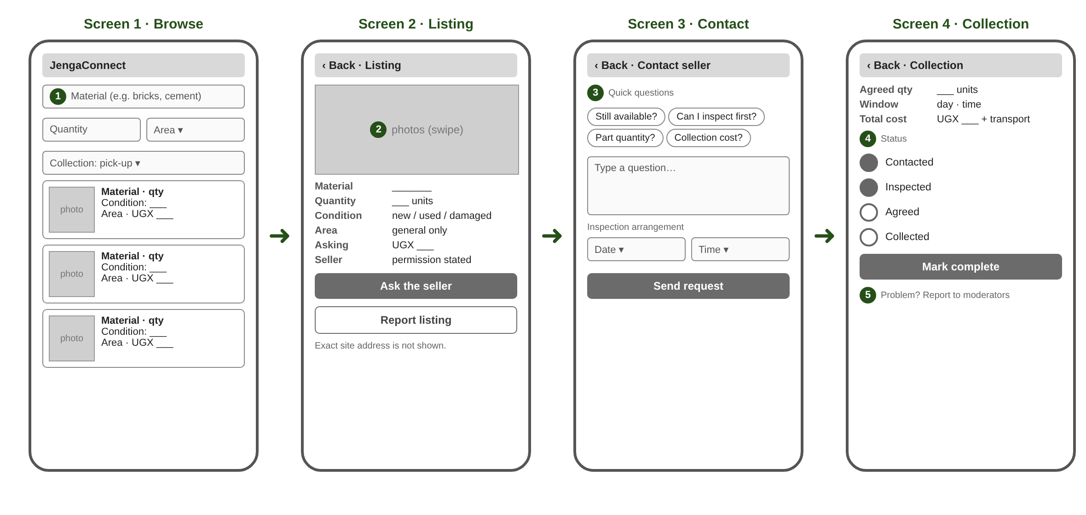
Low-fidelity prototype – buyer wireframe
Flow: Browse > Listing > Contact > Collection.
Prototype link: https://ejr-arch.github.io/jengaConnect
7

Slide 8
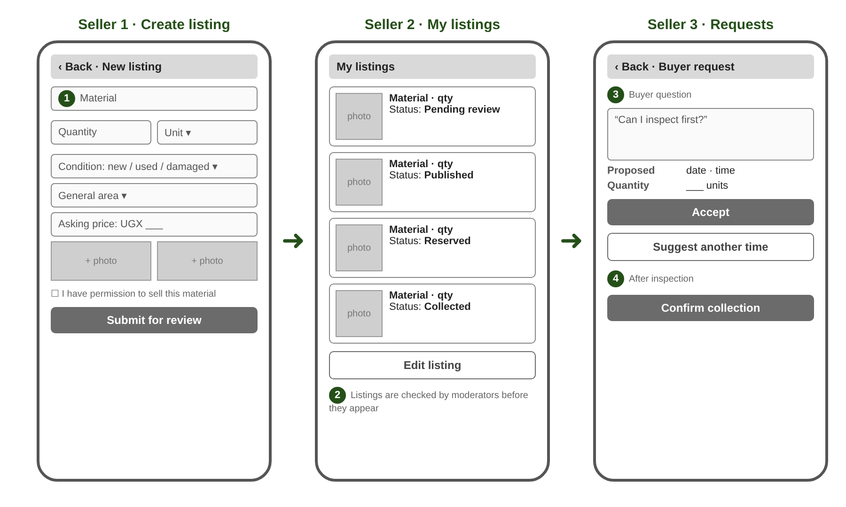
Low-fidelity prototype – seller wireframe
Flow: Create Listing > view Listings > Accept inspection > Collection.
Prototype link: https://ejr-arch.github.io/jengaConnect
7

Slide 9
Customer feedback and changes made
Interviews completed: 5 of at least 5 (1 Nov 2026)
All five said it solves a problem they have.
Code | Role | Main feedback | Change and reason
P01 | Seller (artisan) | Buys only the quantity needed. Fears stolen goods; wants proof of ownership. | Ownership tick, private proof upload, Age field.
P02 | Buyer | All ratings 5; likes photos. Slow responses; saw it as a delivery company. | Browse note: no sale or delivery.
P03 | Both | Values all features. Ownership, privacy and fee worries; ratings 1,5,1,5. | Proof private; 'confirmed' on listing.
P04 | Both | Wants proof of ownership. Would stop if charged before a sale. Asks for listing status. | Fee only after a completed sale.
P05 | Both | Finds goods nearby without travel. Fears stolen goods; no fee without a buyer. | Fee only after a completed sale.
Feedback form (no recordings): https://forms.gle/veDxmqMqBfvS9Rgb6
8

Slide 10
Business Model Canvas
Key Partnerships Hardware shops site managers Delivery providers. | Key Activities Maintain listings recruit sellers and buyers moderation customer support | Value Propositions Buyers: find small quantities of usable material nearby with condition and quantity visible before travelling or delivery. Sellers: a way to sell surplus material rather than incurring storage or transport costs. | Customer Relationships Listing support for sellers listing status updates on a material. A complaints route and moderation of reports. | Customer Segments Buyers: self-builders, artisans and small contractors. Sellers: site managers, contractors and hardware sellers with usable, non-hazardous surplus.
 | Key Resources Listing platform and hosting material information(proof of ownership and sales agreements) support and moderation staff operating funds. |  | Channels Mobile website direct outreach to site managers. shareable listing links.
Cost Structure Hosting, mobile data, support and management, outreach and verification, tax and legal compliances |  |  | Revenue Streams A seller commission charged only after a completed exchange.
9

Slide 11
Critical assumptions, lessons and next steps
Assumption | How we will test it | If wrong
A1 Enough suitable surplus exists within a practical collection area. | Ask sellers about one recent surplus event: what, how much, what happened to it. Count real examples. | Narrow materials or area, or recruit hardware shops as a steadier supply source.
A2 Buyers accept the total cost and effort after inspection and transport. | Compare each buyer's last purchase with a worked listing example including collection cost. | Add shared collection or delivery partners, or target larger quantities.
A3 A clearly identified payer will pay a fee that supports operating costs. | Ask sellers and buyers which side would pay, in what form (flat fee or share of price), and at what level. | Test the other payer, a different fee form, or a partner-funded model.
Lessons (5 responses): ownership trust is the main barrier; 4 of 5 name the seller as payer, 3 only after a sale, so the fee is now a post-sale commission.
Next: Reserved status, test commission level, hardware shops (Week 3).
Videos: group discussion https://drive.google.com/file/d/1CTWrszgR6Pe66uDFjBaxbb8G03cJURLg/view?usp=drivesdk
10

