Slide 1
One-class SVM to identify candidates to Rerefence Genes based on the augment of RNA-seq data with Generative Adversarial Networks
Edwin J. Rueda Rommel Ramos
Edian F. Franco Orlando Belo Jefferson Morais
Edwin J. Rueda
Federal University of Para
edwin.rojas@icen.ufpa.br
July x, 2020
<número>
Notes:
Hello everyone, my name is edwin, and i’m a student from Federal University of Para in Brazil, and i’m here to present “One-class SVM to identify candidates to reference genes based on the augment of RNA-seq data with Generative Adversarial Networks, this work was developed by me and my colleagues

Slide 2
SUMMARY
Introduction
Proposed Method
Experiments and Results
Conclusions and Future Works
Notes:
Here is the summary of the presentation, first, I will give you an introduction of the reference genes and the identification of these genes, and then, I will talk about our proposed method and then I will show the experiments and results.
finally, I will talk about the conclusions and future works

Slide 3
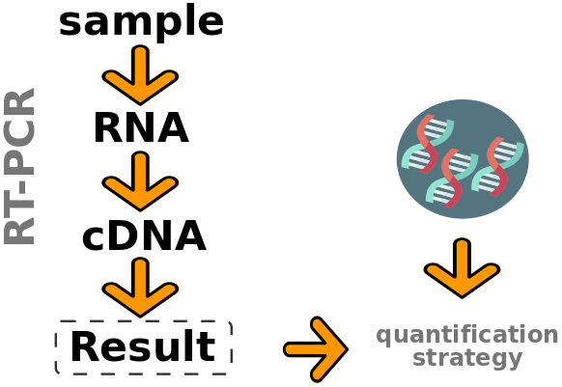
Introduction
Reference Genes (RG)
  Constitutive genes
  Expressed in all cells
  Used in internal controls (gene expression analysis)
Normalize gene expression
Demonstrates the variability and imperfections of the technology
Notes:
So, the reference genes are constitutive genes necessary for the maintenance of basic cellular function. These genes are used in internal controls in investigations of gene expression analysis because their level of expression remains almost constant under normal or abnormal conditions.
For example, in RT-PCR the reference genes are used to normalize the gene expression obtained, since this expression may vary due to the imperfections of the technology used.

Slide 4
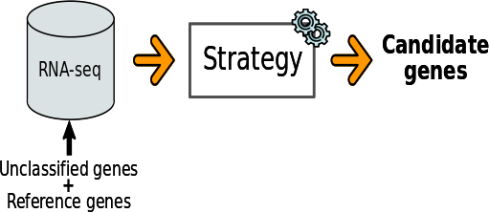
Introduction
Identify candidates for Reference Genes
Pipeline:
Strategies:
  Based on clustering (Euclidean distance)
  Based on optimization algorithms
Notes:
There are different methods to identify candidates for reference genes, the picture shows the general pipeline, wherefrom a strategy, and an RNA-seq data set, which contains some reference genes, candidate for reference genes can be identified.
The main disadvantage of current strategies is the small number of reference genes available for some tissues or cells, and generally, current methods use the Euclidean distance as a metric of similarity between genes, which we consider inappropriate because there may be genes that have a high value for this metric, but their level of expression remains stable.

Slide 5
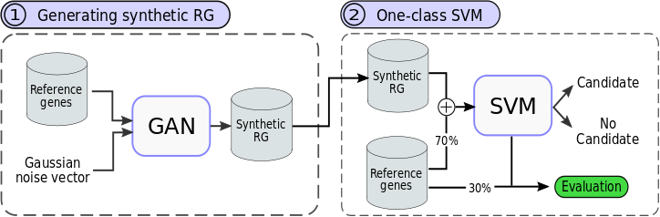
Proposed Method
Steps:
  Generative Adversarial Networks to augment of RNA-seq data
  One-Class SVM to select candidate genes
Initial step: data processing
Notes:
For this, we can proposed a new approach to identify candidates for reference genes. This approach consist in two main step. First, a GAN is used to increase the set of reference genes, this allows increasing the diversity of these data. Second, an One-class SVM based on novelty detection is trained using some real RG and synthetic genes generated by the GAN architecture in the first step.
Finally, Remembering that there is an initial step, in this step, we process the data.

Slide 6
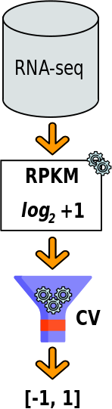
Proposed Method
Data processing
Pipeline:
  Normalization with RPKM:
  Remove outliers based on the Coefficient of Variation (CV):
  Data scaled between [-1, 1]
Notes:
So, for the data processing, we can normalized by RPKM and applying logarithm of base two plus one to mitigate the number of outliers and increase the proximity of the data features.
Later, we removed the genes that presented a CV outside their interquartile range.
and finally, the data was scaled between minus one and one because we implemented a hyperbolic tangent activation in the GAN architecture.

Slide 7
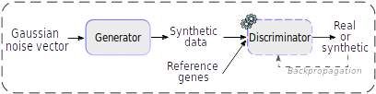
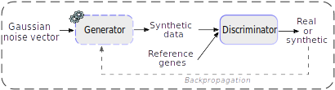
Proposed Method
Generative Adversarial Networks (GAN)
Steps:
  Training the Discriminator network and freezing their weights
  Training the Generator network
Notes:
So, the GAN architecture training occurs in two steps:
First, the discriminator network is trained based on the reference genes and the synthetic genes generated by the Generator network. After this training, the weights of the discriminator network are frozen (these weights are not updated in the second step). Second, the generator network is trained based on an input noise vector to maximize the probability that Discriminator network makes a mistake.
so, after repeating steps one and two for a defined number of epochs, the generator network will be able to generate synthetic genes similar to the reference genes.

Slide 8
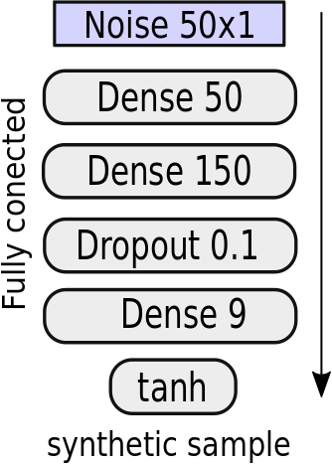
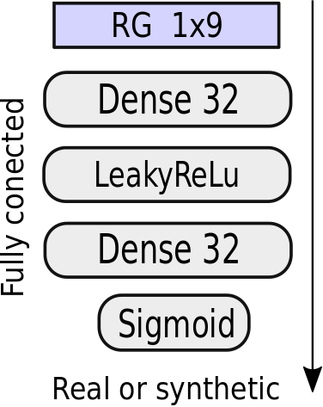
Proposed Method
Proposed architecture
Generator network
Discriminator network
A normal distribution N(0,1) as a noise vector
Stochastic Gradient Descent to compute the gradients
Notes:
This is the proposed architecture. The generator and the discriminator networks are fully connected networks.
- so, the generator network receives as input a noise vector based on a Gaussian distribution with a mean of zero and standard deviation of one and its output is synthetic gen.
- and the discriminator network receives a gene as input and classifies it as real or synthetic.

Slide 9
Proposed Method
Evaluation
A proposed Similarity metric S(x,x’) to evaluate the performance of the GAN:
: Class predicted by D network for a synthetic gene
: Set of synthetic genes generated by the G network
: Set of Reference Genes
: Number of Reference Genes
: Number of synthetic genes
: Number of features (gene expression)
Notes:
To evaluate the performance of the GAN architecture, we used a similarity metric between synthetic and real genes. This metric uses the absolute distance between each reference gene with the other synthetic genes and also considers the precision of the Discriminator network.

Slide 10
Proposed Method
Evaluation
A proposed E(x’) metric to select the best sample of synthetic data:
: Coefficient of variation
: Set of synthetic genes generated by the G network
: Number of synthetic genes
Other metrics: Binary Cross-Entropy, Precision score
Notes:
We also propose an E metric to select the best set of synthetic genes. For this approach, we generated 300 synthetic genes.
Finally, we employ other metrics such as binary cross-entropy and precision score to evaluate the performance of the GAN architecture.

Slide 11
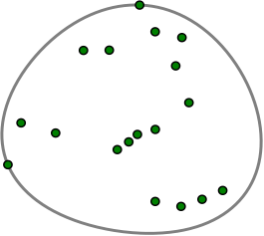
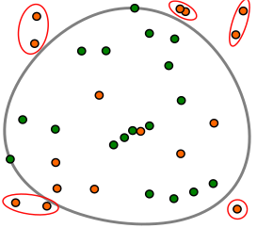
Proposed Method
One-Class SVM
Decision boundary
Novelty detection
Implements the RBF kernel (Gaussian kernel):

Slide 12
Proposed Method
One-Class SVM
Implements the RBF kernel (Gaussian kernel)
Recall score to evaluate the performance of the One-Class SVM:
: True Positives
: False Negatives
Recall score allows to measure the ability of the classifier to find all positive samples (RG)
A Recall score close to one indicates that the classifier has a good performance
Notes:
we train the one-class SVM with a Gaussian kernel and evaluated its performance using the recall score, since we olny had the positive class (the reference genes class)
Finally, a recall score close to one, indicates that the classifier has a good performance.

Slide 13
Experiments and Results
Dataset
  Escherichia coli MG1655
  3 different samples at 30, 60 and 90 min
  20 Reference Genes:
  The idnT gene was not considered
Number of initial genes | Number of genes expressed | Outliers based on the CV | Final Dataset
4293 | 4191 | 3 | 4188
Reference Genes
cysG, hcaT, rrSA, ihfB, ssrA, gyrA, recA, rpoB, rpoA, gyrB, rho, ftsZ, secA, rpoC, gmk, adk, rpoD, dnaG, glnA, recF

Slide 14
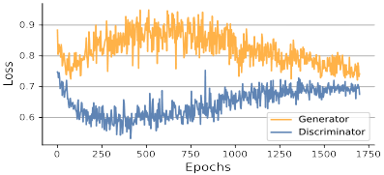
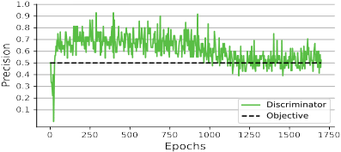
Experiments and Results
This approach was evaluated with the Escherichia coli MG1655 dataset
Parameters used for training the GAN architecture
Parameter | Generator | Discriminator
Optimizer | SGD | SGD
Learning rate | 0.00015 | 0.001
Decay rate | 0.00015/1700 | 0.001/1700
Momentum | 0.92 | 0.9
Epochs | 1700 | 1700
Convergence process
Notes:
- SO, now, I’m going to talk about the experiments and results.
- The proposed method was evaluated with and escherichia coli dataset.
- The table shows the parameters used to train the GAN architecture, and the pictures show the convergence process.
- From this convergence process we can see that the GAN architecture converges close to 0.7, indicating that the generator network is generating synthetic genes similar to the real genes. Also, the precision of the discriminator network converges close to 0.5, indicating that the discriminator network fails to distinguish between real and synthetic genes.

Slide 15
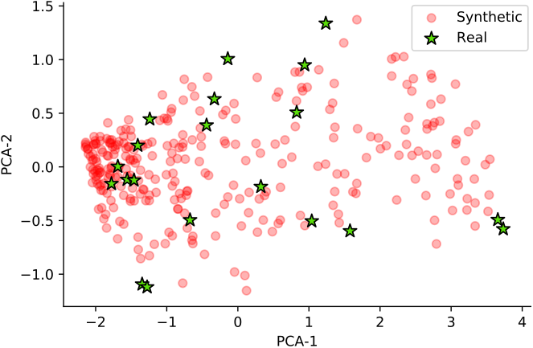
Experiments and Results
Selection of synthetic genes
  We generated 5000 sets of 300 synthetic genes and selected the set with the smallest value of E(x’)
Notes:
- With the metric E, we choose the set of three hundred best synthetic genes.
- the picture shows a representation in two principal components, where the stars represent the reference genes and the circles represent the synthetic genes.
- here, we can see that the genes generated by the GAN architecture are not distant from the real RG.

Slide 16
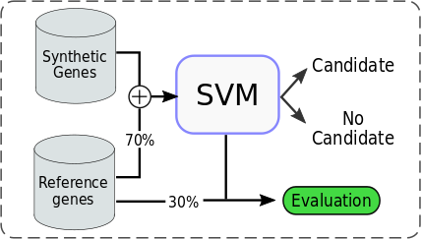
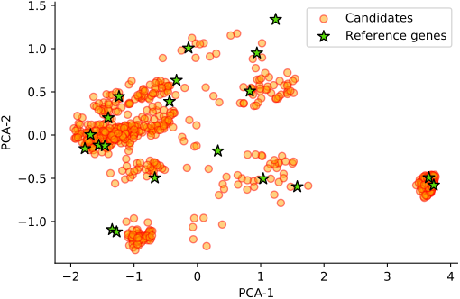
Experiments and Results
Selection of candidate genes
Recall score on test and training data
Metrics | Training data |  | Test data
 | Augmented data | Reference Genes (70%) | Reference Genes (30%) | Synthetic data
Recall | 98.40% | 92.85% | 85.71% | 98.26%
We selected the 11 most relevant candidate genes
Notes:
Do, for the selection of the candidate genes, we train the one-class classifier with 70% of the reference genes and with the set of synthetic genes.
The picture on the right, shows a two principal components representation, where the stars represent the reference genes and the circles represent the candidate genes.
And the table shows the recall precision obtained in the training and test data.
Finally, we selected eleven candidate genes that coincided with another study.

Slide 17
Experiments and Results
Comparing results with augmented and unaugmented data:
Reference Genes | Recall score
 | Training data | Test data
Augmented | 98.40% | 85.71%
Unaugmented | 85.71% | 66.66%
With augmented dataset, we improved recall score of proposed classifier by 19%
Notes:
FFinally, to show that increasing the set of reference genes using the GAN architecture improves the performance of the classifier. We trained the proposed classifier based only on the unaugmented data (70 percent for training and 30 percent for testing) and compared with the trained classifier with augmented data.
- The table shows that with the increased data set, we improved the recall score for the proposed method by nineteen percent.

Slide 18
Experiments and Results
The most relevant candidates genes
Gene | Product
ftsX | Cell division protein ftsX
ftsY | Cell division protein ftsY
glyY | tRNA_{glyY}
mutY | Adenine DNA glycosylase
ndk | Nucleoside diphosphate kinase
nfuA | Iron-sulfur cluster scaffold protein
rrsE | 16S ribosomal RNA (rrsE)
rrsG | 16S ribosomal RNA (rrsG)
spoT | (p)ppGpp synthase
thrW | tRNA_{thrW}
zupT | Heavy metal divalent cation transporter ZupT

Slide 19
Conclusions
With the proposed method we were able to identify 807 possible candidate genes from a total of 4170 unclassified genes from the Escherichia coli MG1655 dataset.
Augmenting the set of RG we can increase the performance of the One-class svm classifier
Code is being maintained on GitHub: https://github.com/ejrueda/20_ICCSA_RG_GAN
Notes:
Entonces, nosotros podemos concluir que aumentar el conjunto de genes de referencia aumenta el rendimiento del clasificador propuesto.
Además, podemos concluir que implementar redes GAN y clasificadores de una clase es una solución adecuada para resolver el problema de la identificación de genes de referencia.
Finally, the code for this approach is being maintained in my GitHub account

Slide 20
Future Works
Other GAN architecture can be tested
A more extensive hyperparameter tuning could also be applied in the training of the GAN architecture
Other One-class classifiers can be tested (Ex: GAN)
Notes:
Entonces, para trabajos futuros nosotros esperamos implementar otras arquitecturas GAN, Como tambien esperamos hacer un mejor ajuste de hiperparámetros. También, esperamos probar otros clasificadores de una clase, como por ejemplo, los badados en arquitecturas GAN

Slide 21
One-class SVM to identify candidates to Rerefence Genes based on the augment of RNA-seq data with Generative Adversarial Networks
Thank you!
Edwin J. Rueda
Federal University of Para
edwin.rojas@icen.ufpa.br
July x, 2020
<número>
Notes:
And finally, thank you for your attention .

