Slide 1
  pmMDA
  poor man MDA
  Adrian Bachofen, bbv Software Services
  Marcel Baumann, bbv Software Services

Slide 2
Contents
MDD / MDA Overview
  Advantages of a MDA approach
  Limitations and drawbacks
pmMDA an Open Source Implementation
  Achieved Results
  Open Source Approach
  Limitations and next steps
Open Discussion & Demonstration

Slide 3
MDD/MDA Principles

Slide 4
MDD / MDA Principles
PIM Platform Independent Model
PSM Platform Specific Model
UML Unified Modeling Language
XMI XML Metadata Interchange
OMG Object Management Group
MOF Meta Object Facility

Slide 5
MDA – Code Generation
The designers work with the business model. The model is not polluted with platform aspect.
Model changes are fast and cost effective - PIM to source code artifacts -
Designers love code generators. Programmers don't like them
pmMDA implements a subset of MDA approach. No PSM is supported.

Slide 6
Code Generators
Advantages
Design model and source code are synchronized
Streamline and unify coding guidelines
Eliminate copy & paste errors
No side effects in getters and setters
Allow controlled extensions
Drawbacks
Maintainers are responsible for the generators
Does not support own coding styles and approaches
Complex logic must be implemented separately

Slide 7
MDA in an Insurance Project
Business model changed every two weeks during eighteen months – about 36 changes impacting user interface, client server communication, database schema, business model
Business roles changed every two weeks and were not fully specified – about 1200 rules were regularly updated
The application is deployed in fifteen environments – separate server, database, version

Slide 8
MDA in an Insurance Project
Gains
Business model, database, communication layers are automatically generated
Documentation is automatically updated
Only one document to modify to implement one change
Incompatible changes are detected at compile time
Losses
Programmers never fully understood the concept and therefore fought against
Changes in the code generators had complex consequences – visitor pattern semantic change -
Database DB2 do not like drop of complete database – extensive and slow operation -

Slide 9
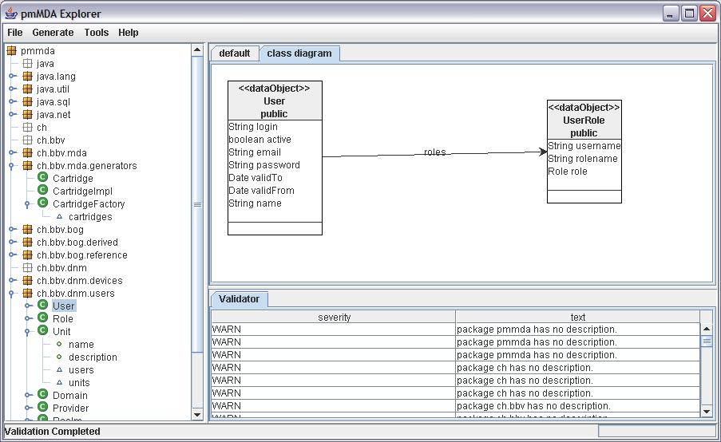
pmMDA

Slide 10
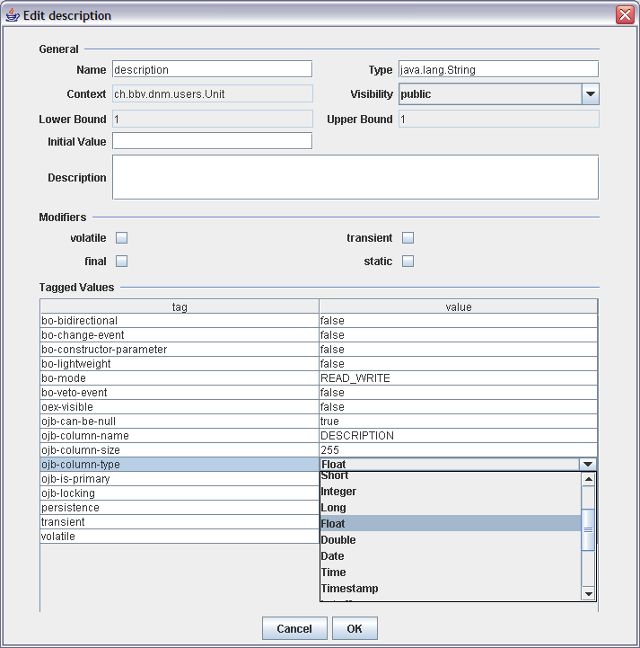
pmMDA

Slide 11
pmMDA

Slide 12
pmMDA
Goals
  UML compatible
Ideas
  Persistence layer
  Business model and SOA based
  UML model oriented
Targets
  2 tiers, CORBA, J2EE/RMI, Swing explorer interface

Slide 13
pmMDA Frameworks
Data Object Graph
  Data Transfer Object, Graph DTO, Lightweight
Explorer Framework
  Declarative model, Meta Types, Reflection
Application
  Locator, startup & shutdown
  Validation
  Command line

Slide 14
Open Source Projects
Development Tools
  JDK, Eclipse, Ant, CVS, JavaDoc, Forrest, etc.
  Source forge
Design Tools
  ArgoUML, Poseidon
  Open Office
Quality Assurance
  Metrics, JUnit, Logger, DocCheck, etc.

Slide 15
Open Source Libraries
Java Libraries
  Apache Jakarta – Tomcat, Velocity, bean utilities, logger, etc.
  Others: graph, forms, glazed lists, etc
Databases
  MySQL, PostgresSQL, Derby
Interfaces
  NSUML, MDR, JMI, CORBA, XSTREAM, Xerces

Slide 16
Open Source Philosophy
Meritocracy
  Show what you can. If it is good you receive the rights to do more
One person owns a package
  He can delegate ownerships. Nobody else has the right to modify models or source code
Artifacts checked in compiles and run

Slide 17
Open Source Philosophy
Everything is accessible
  For example using CVS
  You are not happy with the project, make a copy and make your own changes or start from scratch
Open source developers often do not like Microsoft
  Don't use closed source or standards
  Secrets are bad – example NTFS is not documented -
  Some of these developers behave childish

Slide 18
Open Discussion
MDA/MDD
pmMDA
Open Source
Demonstration
  pmMDA
  Example
  pmmda.sourceforge.net

