Slide 1
  Software Project Management
  Experiences & Pitfalls
  Marcel Baumann, bbv Software Services
Notes:
The following aspects should be discussed in this session of the workshop.
Are documents used in real projects
School IEEE SRS
Swiss Re checklists, requirements, change management, error tracking
Swiss Life requirement, formal interface, Kintana, AES
Siemens ACS RequisitePro,
Sourceforge Tracker (JIRA), CVS, forums, email lists
Which are the typical problems with documents?
Do we have similar problems with Models
School UML/RUP
Swiss Re Zachmann, UML, SRUP, Corporate Modeler, Rational Rose
Swiss Life UML, RUP, Jtogether
Siemens ACS UML, RUP
Sourceforge agile methods, UML
Examples of planning & Controlling
Swiss Re escalation through review board, ITSolRT, customers
Swiss Life escalation through Kintana and weekly coordination meetings for project dependencies
Siemens ACS bi-weekly coordination meetings
Sourceforge meritocracy and free time enablers
Actual discussions
CMM, CMMI, ISO-9000, ISO-9000/2000 versus agile method
Process definition versus slack or in other words throughput versus delivery time
Compliance and legal risks

Slide 2
Contents
Principles Software Project Management
Approaches & Roles
Planning & Controlling
Process
Human Factors
Experiences: Real-world cases
Notes:
Presentation Goals
Overview of software project management
Duality CMM/ISO versus Agile Methods/Peopleware or duality process versus problem solving

Slide 3
Principles
What is a project?
Selling the idea – Winning support -
Prove You can do it
Realize it
Drink the taste of success

Slide 4
What is a project (1/2)
A project realizes something unique
  A new product, a new service
A project has a start and an end
A project has customers
A project has a budget
A project has a team
A project must be integrated in the company
Notes:
What is the cost of one man day or one man hour?
How many hours do you work a day, a week, a year?
Which is the percentage of productive/sold hours?
Think about time to market. Is it worth to diminish project costs but risk to loose time to market opportunities.

Slide 5
What is a project (2/2)
Project Initiation Document
  Defines the project
  Records the project justification
  Set out the expenditure and time plans
The PID shows
  Organization and responsibilities
  Risk management policy
  Quality control standards
Notes:
Team members will normally belongs to the company so they have a line manager.
They will also report to the project manager.
No servant can serve two masters... he will hate the one and love the other [Luke 16:13]

Slide 6
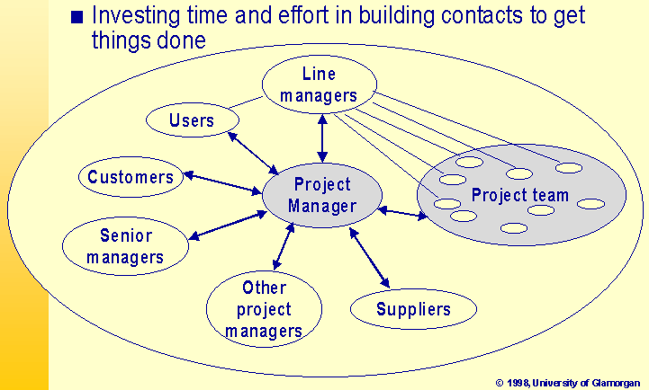
Selling the idea (1/3)

Slide 7
Selling The Idea (2/3)
Stakeholders
  People who are interested in the project
  Care about stakeholders
  Projects which have executive management support and user involvement – our two top criteria for IT project success – have 50 % greater chance of success [Boucher, Standish Group 1998]

Slide 8
Selling The Idea (3/3)
Sponsor
  The people funding the project
Champion (often informal role)
  Has the vision to get the project going
  Pushes for a project to be accepted where they are competing priorities
  Keeps things going when difficulties arise
  Often a senior grey eminence either customer or supplier

Slide 9
Approaches & Roles
Various approaches to manage a software project exist: WBS, Waterfall, USA Department of Defense standards, USDP, Hermes, etc.
Swiss companies have often the concept of milestones with a set of deliveries.
Often the approach is documented in the ISO-9000 quality manual.
bbv uses USDP and follows “agile methods”.
Notes:
We are making the transition from a process oriented project management to a problem solving oriented project management. This transition does not mean that our teams are against processes and work procedures. Rather they are looking to way of solving problems and succeeding in projects. During the last years a question surfaced again in the literature. Can software engineering be formalized? Is software engineering more of a repetitive task or more of a creative one?

Slide 10
Roles
Customer – he pays and wants to see something -
Project Manager – administration and relations -
Project Leader – leads the project -
Architect – the one who technically decides -
IT: Key developers, developers, specialists, toolsmith, QS, support, infrastructure, help desk, security, etc.
Suppliers

Slide 11
Planning & Controlling
Initial planning and resources definition
Iteration planning
Risk management
Controlling
Quality Assurance
Plans are nothing. But planning is everything. [Gen. Dwight Eisenhower]
Notes:
Tools
IDE Eclipse
Compiler Sun JDK, GNU Tools
Editors Open Office
Change Management Bugzilla
Version & Control Management Subversion
Email
News
Wiki
Instant Messenger

Slide 12
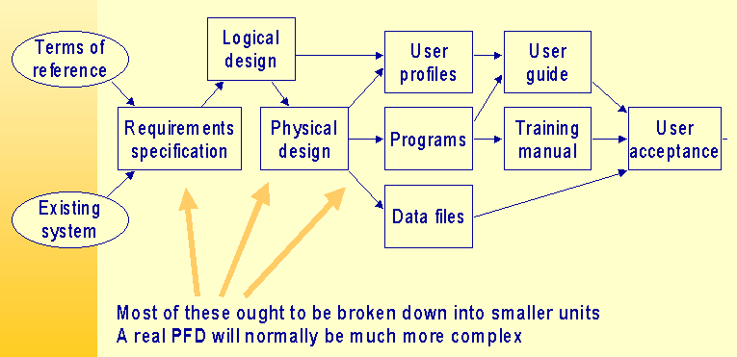
Initial Planning
Notes:
Requirement Management
Ad-hoc Text sheets
Tools Jira, Scarab, Bugzilla, Doors, RequisitePro
Change Management
Jira, Scarab, Bugzilla, Doors, Kintana, SIR
Version & configuration management
CVS, Subversion, ClearCase, SourceSafe
Project Management
Planning
Gantt charts, task planner
To do list
Controlling
Reports

Slide 13
Trade-Offs
Notes:
Seen in a photograph shop
“You can have your photos fast, you can have them in high quality, you can have them cheap. Please choose two of the three items.”
In modern marketing theory the trade-off is between time to market, less costs and functionality.

Slide 14
Risk Management
Identify risks and document them
Evaluate consequences if situation arises
Define scenarios to eliminate them
Do it
Verify that risks are under control
Always ask if new ones are around

Slide 15
Control
Goal
  On time, on budget, with the expected quality
Control progress against the plan
Control that risks disappeared
Control that the product is build
Control that costs are on budget
Notes:
Control schedule
Check against the plan and allocated resources
Check against planned and used buffers
Check against overtime reports
Control functions
Check against the definition of iterations
Check against use cases
Control defects
Check against the change management tool
Control risk
Check against the list of risks

Slide 16
Quality Assurance
Do we build the correct product?
Do we build the product correctly?
QA: Commercial & Technical
  How to handle when things go off plan?
  What if you cannot sleep?
Quality assurance is measurement
  cost, schedule, effort, product features, software metrics, open defects, etc.

Slide 17
Process
Unified Software Development Process
  Workflow
  Phases
  Missing elements
    Agile methods
    Enterprise view

Slide 18
USDP
Notes:
This diagram is a huge help to understand project life-cycle and iterations. The missing elements are the integration in a corporate environment and the human factors.

Slide 19
Goals of USDP
Make software projects more manageable
Help detecting risks earlier
Scale to different systems, environments, organizations
Project management becomes more complex and requires more effort

Slide 20
Inception Phase
Launching the project
Formulate the scope of the project
Plan and prepare the business cases
Synthesize an architecture
Prepare the environment for the project
Notes:
In the last projects I worked for we had always to tackle with business process reengineering. Automation of processes is completed in almost all industrial and financial area. Now we must define better process or find new ones before implementing them.

Slide 21
Elaboration Phase
Define and validate the architecture
Refine the vision based on new discoveries
Understand the critical use cases and their impact on the architecture and planning
Refine the iteration planning
Document and deploy the architecture
Deploy the development environment

Slide 22
Construction Phase
Manage resources, control and act
Complete component development, test and deploy them
Assess product releases against acceptance criteria and change requests

Slide 23
Transition
Execute the deployment plans
Finalize end-user support material
Test the delivered product at customer premises
Create a product release
Fine tune the product based on feedback
Deploy the product to the customers

Slide 24
Iterations
Nightly builds and automatic unit tests
Major internal releases every two weeks
Major external releases every month
We use agile methods – XP –
Major work is to document what is in a release. Without tools you cannot manage complex systems.

Slide 25
Iterations
Iterating costs. Why should you pay?
You can only iterate if the architecture is defined and first version implemented.
The architects act as coaches and cannot anymore extend the architecture, only complete it.
A task has at least one day and no more than five days. A task is completed when a concrete result is available.
The worst tool for planning is MS-Project.

Slide 26
Missing elements
Managing people
  Hiring, training, coaching, promoting, firing
Managing budget
  Defining, allocating, requesting, corrections
Managing contracts
  User contracts, supplier contracts
Politics
  Marketing to the team, the company and the customer

Slide 27
Human Factors
Ethics
How to get good people?
How to transfer no more needed people?
How to motivate – team building process -

Slide 28
Y Theory - contrary of X - (1/2)
Physical or mental effort is a natural play
Want to reach own objectives
Commitment to objectives is a function of reward
People want to learn and seek responsibility
Imagination and creativity is widely distributed
People's potentials are only partially utilized
Stress means going back to X

Slide 29
Y Theory - contrary of X - (2/2)
The litany of failed, over-budget, late projects is legendary and seems to be added every week.
The solution usually proposed is more and better management. Few people propose the opposite: less management.
The former approach requires a great deal of resources for planning, coordination and monitoring.
Highly qualified and skilled people do not generally respond well to being closed managed. They prefer to be set objectives, provided the necessary resources and left to deliver the goods
[Howard, 1995]

Slide 30
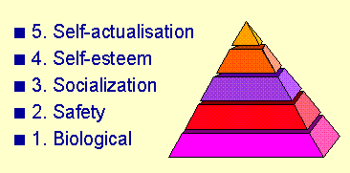
Maslow Pyramid

Slide 31
Project Management Skills
Leadership
Communications
Problem solving
  Solve best problems before they are here
Negotiating
Influencing the organization
  Show the future, playing games, politics
Mentoring, Process and technical expertise

Slide 32
Ethics
What are your code of ethics?
Which culture do you promote in your team?
My Ethics are
  Never tell lies
  I am an engineer first. Second I am a manager.
  IEEE/ACM code of ethics

Slide 33
Experiences
Risk Management
Think small
Architecture & architects
Top team

Slide 34
Risk Management
Common sense
  Gut feel, doesn't feel right, a sense of uneasiness
Past experience
  Learning from other or our mistakes
Historical data
  Database about events, planning, post-mortem
Independent assessors
  Not always very effective due to unfamiliarity

Slide 35
Think Small (1/2)
Keep requirements tight and focused
One milestone at a time
Smaller, incremental chunks
As simple as possible but no simpler
Fast, cheap, good. Choose two.

Slide 36
Think Small (2/2)
Keep It Simple, Stupid
First simple and working, after more complex
Don't be too ambitious
Work, don't stay in meetings
Buy, don't make! Use open source!
Be hard especially when closing the project
  You are not Santa Claus

Slide 37
Architecture
The architecture makes a product beautiful or ugly.
The architecture makes it possible to add new functions or not.
The architects sell their framework to the whole team. Again and again and again through coaching, mentoring, hand holding.

Slide 38
Top Team
Experienced, efficient and friendly team
  Developer productivity 10 to 1 range
  Improvements: selection, organization, motivation
Let team building process happen
  Optimal size: less than 10 developers
Get rid of any non integrated member
Love them, train them, help them
People know if you really care or just want something
Notes:
Time overruns decreased to 63 % compared to 222%
Cost overruns were down to 45 % compared to 189 %
Required features were up to 67 % compared to 61 %
78'000 IT projects successful vs 28'000 (USA)

Slide 39
15 PM Job Functions
Define scope of project
Identify stakeholders, escalation procedures
Develop task list (WBS)
Estimate time
Develop project flow chart
Identify required resources
Manage the change control process
Evaluate project requirements
Identify and evaluate risks
Identify interdependencies
Identify and track milestones
Participate in project phase review
Secure needed resources
Report project status

Slide 40
Conclusion
Questions & Answers
Quality Evaluation
  Was it interesting
  Did I miss something
  Would you came again to a similar workshop

