Slide 1
  Software Project Management
  Experiences & Pitfalls
  Marcel Baumann, bbv Software Services
Notes:
The following aspects should be discussed in this session of the workshop.
Are documents used in real projects
School IEEE SRS
Swiss Re checklists, requirements, change management, error tracking
Swiss Life requirement, formal interface, Kintana, AES
Siemens ACS RequisitePro,
Sourceforge Tracker (JIRA), CVS, forums, email lists
Which are the typical problems with documents?
Do we have similar problems with Models
School UML/RUP
Swiss Re Zachmann, UML, SRUP, Corporate Modeler, Rational Rose
Swiss Life UML, RUP, Jtogether
Siemens ACS UML, RUP
Sourceforge agile methods, UML
Examples of planning & Controlling
Swiss Re escalation through review board, ITSolRT, customers
Swiss Life escalation through Kintana and weekly coordination meetings for project dependencies
Siemens ACS bi-weekly coordination meetings
Sourceforge meritocracy and free time enablers
Actual discussions
CMM, CMMI, ISO-9000, ISO-9000/2000 versus agile method
Process definition versus slack or in other words throughput versus delivery time
Compliance and legal risks

Slide 2
Contents
Principles Software Project Management
Approaches & Roles
Planning & Controlling
Process
Experiences: Real-world cases
Notes:
Presentation Goals
Overview of software project management
Duality CMM/ISO versus Agile Methods/Peopleware or duality process versus problem solving

Slide 3
Project Management Principles
What is a project?
Selling the idea – Winning support -
Prove You can do it
Realize it
Drink the taste of success

Slide 4
What is a project
A project realizes something unique
  A new product, a new service
A project has a start and an end
A project has customers
A project has a budget
A project has a team
Notes:
What is the cost of one man day or one man hour?
How many hours do you work a day, a week, a year?
Which is the percentage of productive/sold hours?
Think about time to market. Is it worth to diminish project costs but risk to loose time to market opportunities.

Slide 5
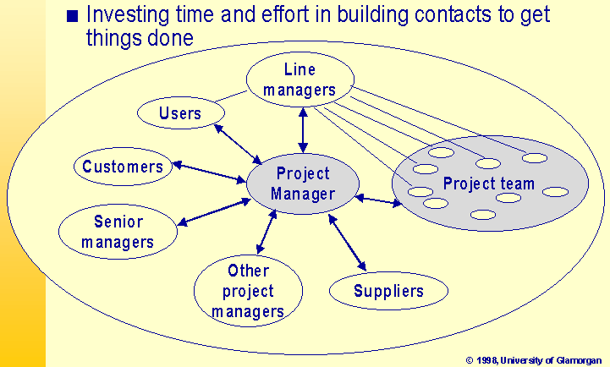
Selling the idea (1/3)

Slide 6
Selling The Idea (2/3)
Stakeholders
  People who are interested in the project
  Care about stakeholders
  Projects which have executive management support and user involvement – our two top criteria for IT project success – have 50 % greater chance of success [Boucher, Standish Group 1998]

Slide 7
Selling The Idea (3/3)
Sponsor
  The people funding the project
Champion (often informal role)
  Has the vision to get the project going
  Pushes for a project to be accepted where they are competing priorities
  Keeps things going when difficulties arise

Slide 8
Approaches & Roles
Various approaches to manage a software project exist: WBS, Waterfall, USA Department of Defense standards, USDP, Hermes, etc.
Swiss companies have often the concept of milestones with a set of deliveries.
Often the approach is documented in the ISO-9000 quality manual.
bbv uses USDP and follows “agile methods”.
Notes:
We are making the transition from a process oriented project management to a problem solving oriented project management. This transition does not mean that our teams are against processes and work procedures. Rather they are looking to way of solving problems and succeeding in projects. During the last years a question surfaced again in the literature. Can software engineering be formalized? Is software engineering more of a repetitive task or more of a creative one?

Slide 9
Roles
Customer – he pays and wants to see something -
Project Manager – administration and relations -
Project Leader – leads the project -
Architect – the one who technically decides -
IT: Key developers, developers, specialists, toolsmith, QS, support, infrastructure, help desk, security, etc.
Suppliers

Slide 10
Planning & Controlling
Initial planning and resources definition
Iteration planning
Risk management
Controlling
Quality Assurance
Plans are nothing. But planning is everything. [Gen. Dwight Eisenhower]
Notes:
Tools
IDE Eclipse
Compiler Sun JDK, GNU Tools
Editors Open Office
Change Management Bugzilla
Version & Control Management Subversion
Email
News
Wiki
Instant Messenger

Slide 11
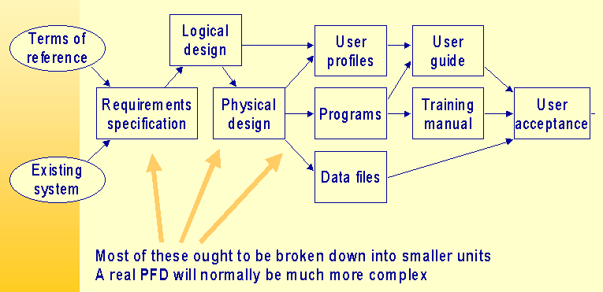
Initial Planning
Notes:
Requirement Management
Ad-hoc Text sheets
Tools Jira, Scarab, Bugzilla, Doors, RequisitePro
Change Management
Jira, Scarab, Bugzilla, Doors, Kintana, SIR
Version & configuration management
CVS, Subversion, ClearCase, SourceSafe
Project Management
Planning
Gantt charts, task planner
To do list
Controlling
Reports

Slide 12
Trade-Offs
Notes:
Seen in a photograph shop
“You can have your photos fast, you can have them in high quality, you can have them cheap. Please choose two of the three items.”
In modern marketing theory the trade-off is between time to market, less costs and functionality.

Slide 13
Risk Management
Identify risks and document them
Evaluate consequences if situation arises
Define scenarios to eliminate them
Do it
Verify that risks are under control
Always ask if new ones are around

Slide 14
Control
Goal
  On time, on budget, with the expected quality
Control progress against the plan
Control that risks disappeared
Control that the product is build
Control that costs are on budget
Notes:
Control schedule
Check against the plan and allocated resources
Check against planned and used buffers
Check against overtime reports
Control functions
Check against the definition of iterations
Check against use cases
Control defects
Check against the change management tool
Control risk
Check against the list of risks

Slide 15
Quality Assurance
Do we build the correct product?
Do we build the product correctly?
QA: Commercial & Technical
  How to handle when things go off plan?
  What if you cannot sleep?
Quality assurance is measurement
  cost, schedule, effort, product features, software metrics, open defects, etc.

Slide 16
Process
Unified Software Development Process
  Work-flow
  Phases
  New elements
    Agile methods
    Enterprise view

Slide 17
USDP
Notes:
This diagram is a huge help to understand project life-cycle and iterations. The missing elements are the integration in a corporate environment and the human factors.

Slide 18
Goals of USDP
Make software projects more manageable
Help detecting risks earlier
Scale to different systems, environments, organizations
Project management becomes more complex and requires more effort

Slide 19
Iterations and Agile Methods
Nightly builds and automatic unit tests
Major internal releases every two weeks
Major external releases every month
We use agile methods – XP –
Major work is to document what is in a release. Without tools you cannot manage complex systems.

Slide 20
Iterations
Iterating costs. Why should you pay?
You can only iterate if the architecture is defined and first version implemented.
The architects act as coaches and cannot anymore extend the architecture, only complete it.
A task has at least one day and no more than five days. A task is completed when a concrete result is available.
The worst tool for planning is MS-Project.

Slide 21
Missing elements of USDP
Managing people
  Hiring, training, coaching, promoting, firing
Managing budget
  Defining, allocating, requesting, corrections
Managing contracts
  User contracts, supplier contracts
Politics
  Marketing to the team, the company and the customer

Slide 22
Projects
Insurance contract management
E-Health invoices and financial management
Elevator control system
Small building control system

Slide 23
Insurance Contract Management
Budget around 15 MCHF
Team: 12 SW, 15 Testers, 25 Business Analysts, 45 Power Users, 20 Stakeholders
Duration: 5 years, Users: 2000
UML and MDA approach
Discussion
  During the workshop (requirements, team, budget, management hype, business reengineering, outsourcing, technology changes)

Slide 24
E-Health Invoices
Budget around 5 MCHF
Team: 12 SW, 1 Testers, 1 Business Analysts, 2 Power Users
Duration: 3 years, Users: 50
UML and eXtreme approach
Discussion
  During the workshop (requirements, budget, deadlines, team, business engineering, outsourcing, technology changes)

Slide 25
Elevator Control System
Budget around 12 MCHF
Team: 12 SW, 15 Testers, 25 Business Analysts, 45 Power Users
Duration: 10 years, Elevators: 20'000 per year
UML and framework approach
Discussion
  During the workshop (budget, management hype, team changes, requirements, insourcing)

Slide 26
Small Building Control System
Budget around 1.5 MCHF
Team: 4 SW, 3 Testers, 2 Business Analysts, 15 Power Users
Duration: 2 years, Users: a few thousands
UML and framework approach
Discussion
  During the workshop (requirements, planning, insourcing, technology changes)

Slide 27
Risk Management
Common sense
  Gut feel, doesn't feel right, a sense of uneasiness
Past experience
  Learning from other or our mistakes
Historical data
  Database about events, planning, post-mortem
Independent assessors
  Not always very effective due to unfamiliarity

Slide 28
Architecture
The architecture makes a product beautiful or ugly.
The architecture makes it possible to add new functions or not.
The architects sell their framework to the whole team. Again and again and again through coaching, mentoring, hand holding.

Slide 29
Top Team
Experienced, efficient and friendly team
  Developer productivity 10 to 1 range
  Improvements: selection, organization, motivation
Let team building process happen
  Optimal size: less than 10 developers
Get rid of any non-integrated member
Love them, train them, help them
People know if you really care or just want something
Notes:
Time overruns decreased to 63 % compared to 222%
Cost overruns were down to 45 % compared to 189 %
Required features were up to 67 % compared to 61 %
78'000 IT projects successful vs 28'000 (USA)

Slide 30
Conclusion
Questions & Answers
Quality Evaluation
  Was it interesting
  Did I miss something
  Would you came again to a similar workshop

