Slide 1
CAPSTONE PROJECT | MODULE 3
Saudi Arabia
Used-Car Price Prediction
A regression-based approach to estimate used-vehicle listing prices in SAR
Data understanding • EDA • Preprocessing • Modeling • Evaluation
Presenter: Elbert Joss Susantong]
SAUDI ARABIA USED-CAR PRICE PREDICTION | CAPSTONE PROJECT
1

Slide 2
EXECUTIVE SUMMARY
Project at a glance
Business goal
Dataset
Best model
Test performance
Estimate used-car prices to support more informed pricing decisions.
5,624 listings from the Saudi Arabia used-cars dataset (Syarah.com).
Tuned Extra Trees Regressor with 300 trees.
R² 0.7767 | MAE SAR 17,366 | RMSE SAR 33,421
Key takeaway
The model explains about 77.7% of price variation in the held-out test set. It performs most reliably for mid-priced vehicles and has larger errors at the low and high ends of the market.
Scope note: predictions are decision support, not a formal vehicle valuation or guaranteed market price.
SAUDI ARABIA USED-CAR PRICE PREDICTION | CAPSTONE PROJECT
2

Slide 3
PROBLEM FRAMING
Business understanding
Problem
Proposed analytical solution
Used-car prices vary with vehicle age, mileage, engine specifications, manufacturer, model, region and trim. Manual price assessment can be inconsistent.
Build a supervised regression model that learns relationships between listing attributes and observed prices, then estimates a reference price for a car.
Potential business users
Buyers
Sellers / dealers
Marketplace teams
Compare asking prices with a model-based reference.
Support initial pricing and listing review.
Prioritise listings for review and improve price transparency.
Target variable: Price (Saudi Riyal, SAR) | Problem type: Supervised learning – regression
SAUDI ARABIA USED-CAR PRICE PREDICTION | CAPSTONE PROJECT
3

Slide 4
DATA UNDERSTANDING
Dataset and variables
Dataset overview
5,624
SAR
Syarah.com
Regression
Original listing records
Target price currency
Dataset source
Prediction task
Variable | Description | Data Type
Type | Vehicle model | Categorical
Make | Manufacturer / brand | Categorical
Region | Selling region | Categorical
Gear_Type | Gear type | Categorical
Origin | Vehicle origin | Categorical
Options | Trim / equipment level | Categorical
Year → Car_Age | Manufacturing year transformed to age | Numerical
Engine_Size | Vehicle specifications | Numerical
Mileage | Vehicle usage | Numerical
Price | Observed listing price in SAR | Target
SAUDI ARABIA USED-CAR PRICE PREDICTION | CAPSTONE PROJECT
4

Slide 5
PREPROCESSING
Data quality and cleaning decisions
Missing values
Negotiable listings
Unknown category
No missing values were discovered in the inspected dataset columns.
Price = 0 represents negotiable listings. Exclude these from regression because zero is not an actual transaction/listing price.
Keep the literal Origin = 'Unknown' category as supplied by the dataset; do not treat it as a missing value.
Low-price records flagged for investigation
Price threshold | Records below threshold
SAR 500 | 1
SAR 1,000 | 7
SAR 2,000 | 46
SAR 3,000 | 61
SAR 5,000 | 68
Outlier strategy
• Do not remove records based only on IQR or statistical extremeness.
• Investigate suspicious low prices and extreme listings against vehicle attributes.
• Retain genuine luxury and unusual vehicles; remove/correct only confirmed data errors.
SAUDI ARABIA USED-CAR PRICE PREDICTION | CAPSTONE PROJECT
5

Slide 6
EDA
Exploratory data analysis (EDA)
What the initial exploration established
Encoding implication
Categorical features have different cardinalities:
Type = 320
Make = 56
Region = 27
Lower-cardinality fields:
Gear_Type = 2
Origin = 4
Options = 3
Numerical predictors selected: Car_Age, Engine_Size and Mileage.
Price values span multiple market segments, including very low-priced and high-value vehicles.
High-cardinality categories need a compact encoding strategy; low-cardinality categories can use one-hot encoding.
Outlier implication
Extreme prices may be valid market observations, so data review is preferable to automatic deletion.
Feature engineering
Car_Age = 2026 − Year, using 2026 as the chosen reference year.
SAUDI ARABIA USED-CAR PRICE PREDICTION | CAPSTONE PROJECT
6

Slide 7
PREPROCESSING
Feature engineering and preprocessing
Feature engineering
Target leakage control
Selected predictors
Car_Age = 2026 − Year
Use Car_Age instead of Year to represent vehicle age.
Exclude Negotiable because it is derived from Price = 0 and would reveal information about the target.
Type, Region, Make, Gear_Type, Origin, Options, Car_Age, Engine_Size, Mileage.
Feature group | Columns | Transformation
Numerical | Car_Age, Engine_Size, Mileage | StandardScaler
High-cardinality categorical | Type, Region, Make | Binary Encoding
Low-cardinality categorical | Gear_Type, Origin, Options | One-Hot Encoding
Implementation: ColumnTransformer + Pipeline. The preprocessing steps are fitted on training data only and then applied to test data.
SAUDI ARABIA USED-CAR PRICE PREDICTION | CAPSTONE PROJECT
7

Slide 8
MODELING
Model development and comparison
Train/test approach
80% training
20% testing
Evaluation metrics
Model fitting and 5-fold CV tuning
Held-out evaluation after model selection
MAE, RMSE and R²
Model | MAE (SAR) | RMSE (SAR) | R²
Extra Trees | 15954.10 | 37610.59 | 0.76
Random Forest | 117673.86 | 40408.12 | 0.72
Gradient Boosting | 21009.42 | 40206.97 | 0.72
Ridge Regression | 32869.07 | 56900.17 | 0.44
Linear Regression | 32874.19 | 56897.85 | 0.44
Model selected
Extra Trees achieved the lowest MAE and RMSE and highest R² among the compared models.
SAUDI ARABIA USED-CAR PRICE PREDICTION | CAPSTONE PROJECT
8

Slide 9
MODELING
Hyperparameter tuning
RandomizedSearchCV setup
Hyperparameter | Best value
n_estimators | 500
max_depth | None
min_samples_split | 2
min_samples_leaf | 1
max_features | 0.7
• Estimator: ExtraTreesRegressor inside the preprocessing Pipeline.
• Search method: RandomizedSearchCV.
• Cross-validation: 5 folds.
• Scoring: negative mean absolute error (MAE).
• Search budget: 30 parameter combinations (150 fits).
Best cross-validation MAE
SAR 15300.69 (average validation MAE across the five folds; not the final test MAE).
SAUDI ARABIA USED-CAR PRICE PREDICTION | CAPSTONE PROJECT
9

Slide 10
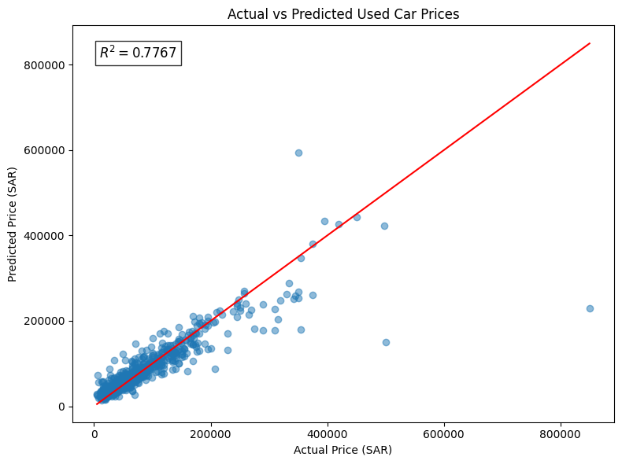
EVALUATION
Final model evaluation
R² = 0.7767
The model explains approximately 77.67% of variation in test-set prices.
MAE = SAR 15300.69
Average absolute prediction error on the held-out test set.
Interpretation
• All three test metrics improved slightly after tuning compared with the original Extra Trees model.
• RMSE is substantially higher than MAE, indicating that some predictions have large errors.
• R² indicates useful explanatory performance, but does not mean 77.67% of individual predictions are accurate.
RMSE = SAR 36074.2
Penalises large errors more heavily than MAE.
SAUDI ARABIA USED-CAR PRICE PREDICTION | CAPSTONE PROJECT
10

Slide 11
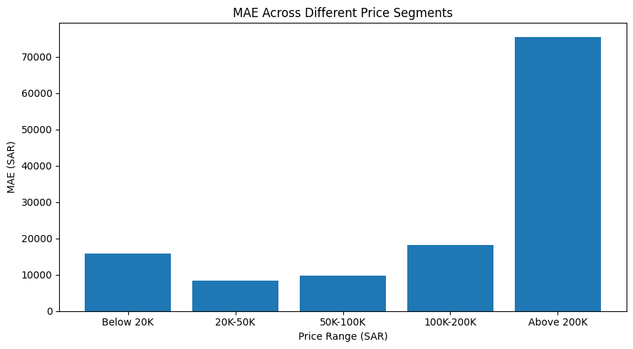
EVALUATION
Performance across price segments
Actual price range | MAE (SAR) | Test records
Below 20K | 15924.81 | 62
20K–50K | 8411.06 | 235
50K–100K | 9756.01 | 266
100K–200K | 18229.79 | 138
Above 200K | 75551.55 | 44
Best segment: SAR 20K–50K. Highest error: above SAR 200K. The high-price segment has only 39 test records, so its estimate is less stable.
SAUDI ARABIA USED-CAR PRICE PREDICTION | CAPSTONE PROJECT
11

Slide 12
EVALUATION
Prediction bias and error analysis
Price range | Average error (Actual − Predicted) | Direction
Below 20K | -15711.95 | Overprediction
20K–50K | -6624.41 | Overprediction
50K–100K | -2195.10 | Slight overprediction
100K–200K | 8633.53 | Underprediction
Above 200K | 60299.45 | Underprediction
Lower-price cars
Model tends to overestimate prices.
Higher-price cars
Model tends to underestimate prices.
SAUDI ARABIA USED-CAR PRICE PREDICTION | CAPSTONE PROJECT
12

Slide 13
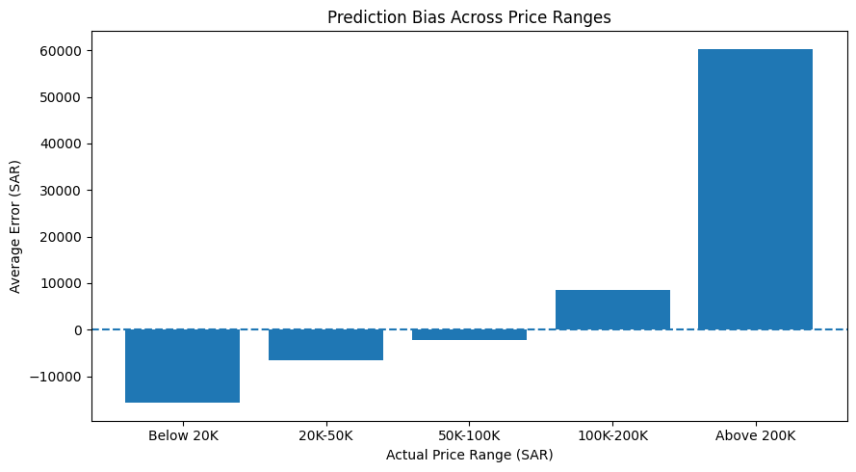
EVALUATION
Prediction bias and error analysis
Largest individual errors included several high-value cars underpredicted by more than SAR 175K, and one SAR 2,300 listing predicted at approximately SAR 133.6K. These records should be inspected, not automatically removed.
SAUDI ARABIA USED-CAR PRICE PREDICTION | CAPSTONE PROJECT
12

Slide 14
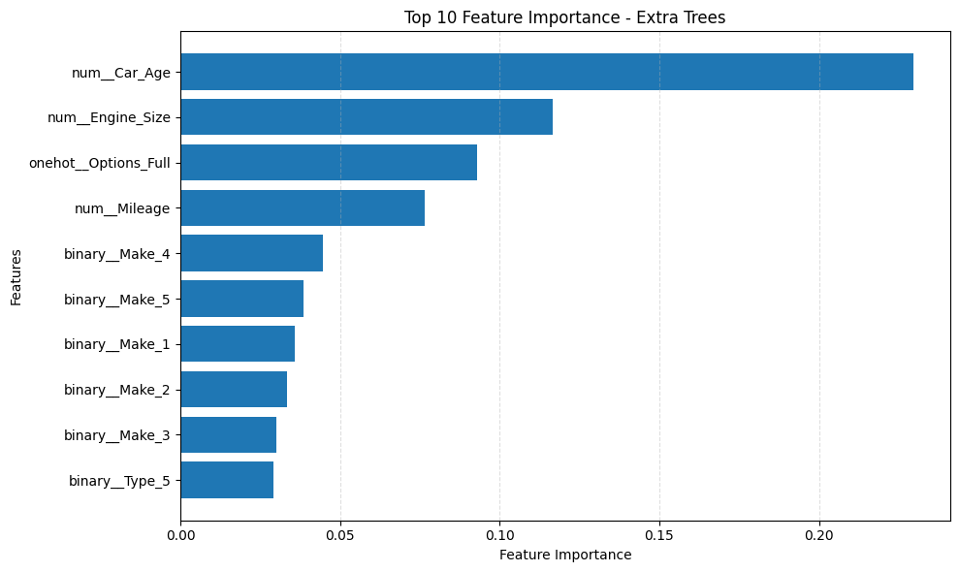
MODEL INTERPRETATION
What drives the model?
Top predictor
Car_Age (0.2296) is the strongest individual encoded feature.
Other contributors
Engine_Size, full options and Mileage also rank highly.
Caution: Binary encoding splits Make and Type across multiple columns. Individual encoded-column importances should not be interpreted as the total importance of the original feature. Importance is not causation and does not show direction of effect.
SAUDI ARABIA USED-CAR PRICE PREDICTION | CAPSTONE PROJECT
13

Slide 15
RECOMMENDATIONS
Business recommendations
1. Use as a reference
2. Flag extreme estimates
3. Improve vehicle data
Show model estimates as a pricing reference range, not a definitive selling price.
Send unusually high-error or high-value listings for manual review.
Collect condition, accident history, service records, ownership and richer trim details.
4. Expand premium coverage
5. Monitor by segment
6. Recalibrate regularly
Add more representative high-priced vehicle listings to improve learning in the premium segment.
Track MAE and bias separately for affordable, mid-range and premium vehicles.
Retrain and validate as market prices, vehicle supply and demand change.
Operational safeguard: retain human review for final pricing decisions, especially when the model is applied outside the price ranges well represented in training data.
SAUDI ARABIA USED-CAR PRICE PREDICTION | CAPSTONE PROJECT
14

Slide 16
LIMITATIONS
Limitations and future work
• Listing prices may differ from final transaction prices; the target reflects observed listing data.
• Important variables such as vehicle condition, accident history, service records and ownership history are not included in the selected predictors.
• Prediction errors are higher at the low and high ends of the price distribution; the >SAR 200K test segment contains only 39 records.
• Car_Age uses a fixed 2026 reference year; this should be updated when the model is reused in a later year.
• Impurity-based feature importance can be biased by feature structure and encoding; permutation importance can provide a complementary view.
• Model performance may change across regions, brands, market conditions and future listing periods.
Future work: add richer vehicle attributes, test time-based validation, compare additional boosting methods, and monitor prediction drift after deployment.
SAUDI ARABIA USED-CAR PRICE PREDICTION | CAPSTONE PROJECT
15

Slide 17
CLOSING
Conclusion
A useful baseline for data-driven used-car pricing — with clear opportunities to improve premium and low-price predictions.
Best model
Explained variation
Average absolute error
Tuned Extra Trees Regressor
R² = 0.7767
MAE = SAR 17,366.37
Thank you | Questions & discussion
SAUDI ARABIA USED-CAR PRICE PREDICTION | CAPSTONE PROJECT
16

