Slide 1
EXP 3 - GOOD SCREEN DESIGN BY HEURISTIC EVALUATION
By Elvis Dsouza (8333)

Slide 2
OBJECTIVES
To stress the importance of a good interface design
To understand the importance of human psychology in designing good interfaces.
To motivate students to apply HMI in their day – to – day activities.

Slide 3
OUTCOMES
To understand and apply principles of a good interface design.
To analyze the local and global impact of computing on individuals, organizations, and society.

Slide 4
DESIGN GOALS
Aesthetically Pleasing
Clarity
Compatibility
Comprehensibility
Configurability
Consistency
Control
Directness
Efficiency
Familiarity
Flexibility
Forgiveness
Predictability
Recovery
Transparency

Slide 5
PROCEDURE
Principles | Yatra | goibibo | makemytrip | Expedia | easemytrip
Predictability | Average | Average | Very Good | Very Good | Excellent
Directness | Very Good | Excellent | Excellent | Good | Good
Aesthetically Pleasing | Good | Good | Very Good | Very Good | Good
Comprehensibility | Good | Average | Excellent | Excellent | Good
Efficiency | Poor | Poor | Good | Excellent | Very Good
Control | Poor | Good | Average | Very Good | Average
Clarity | Excellent | Good | Excellent | Excellent | Average
Websites

Slide 6
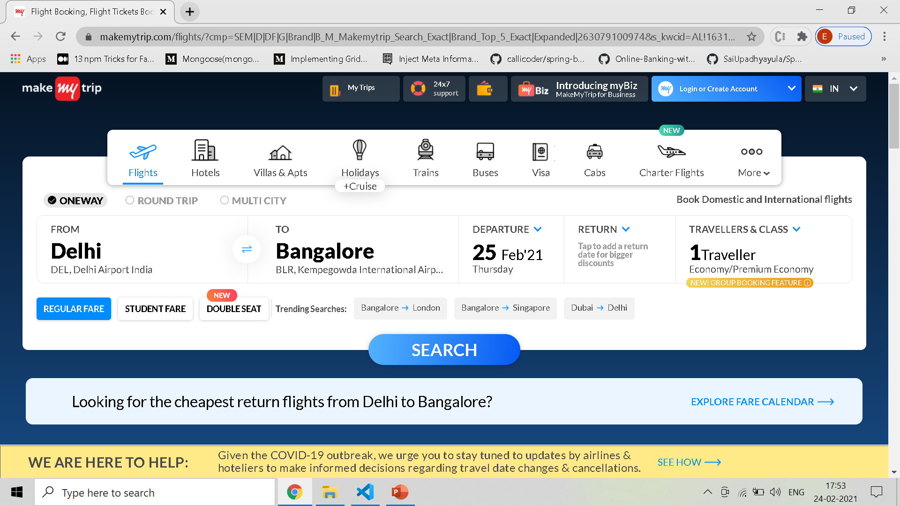
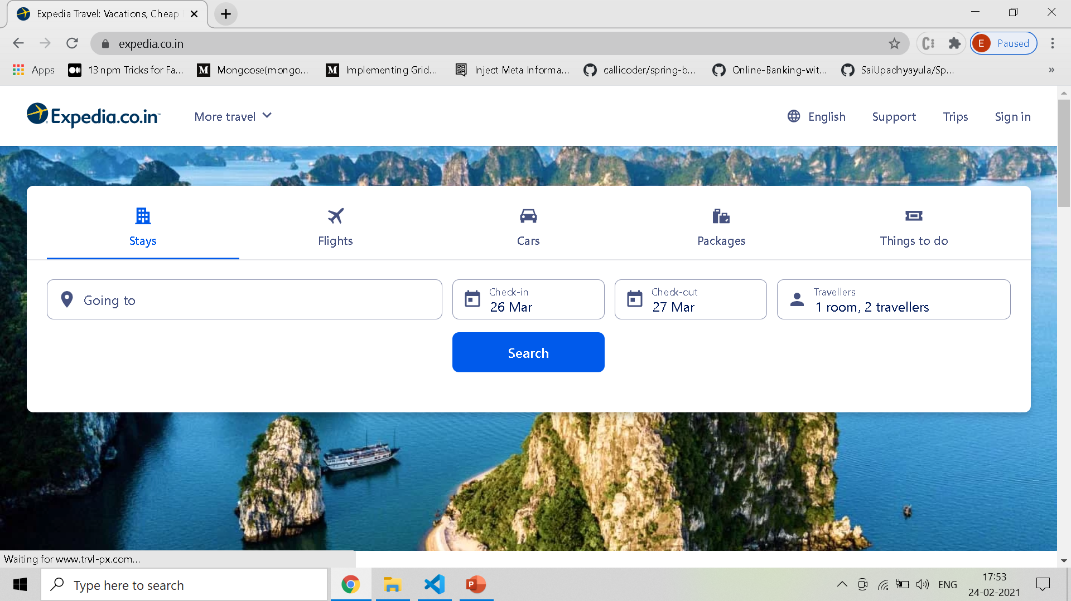
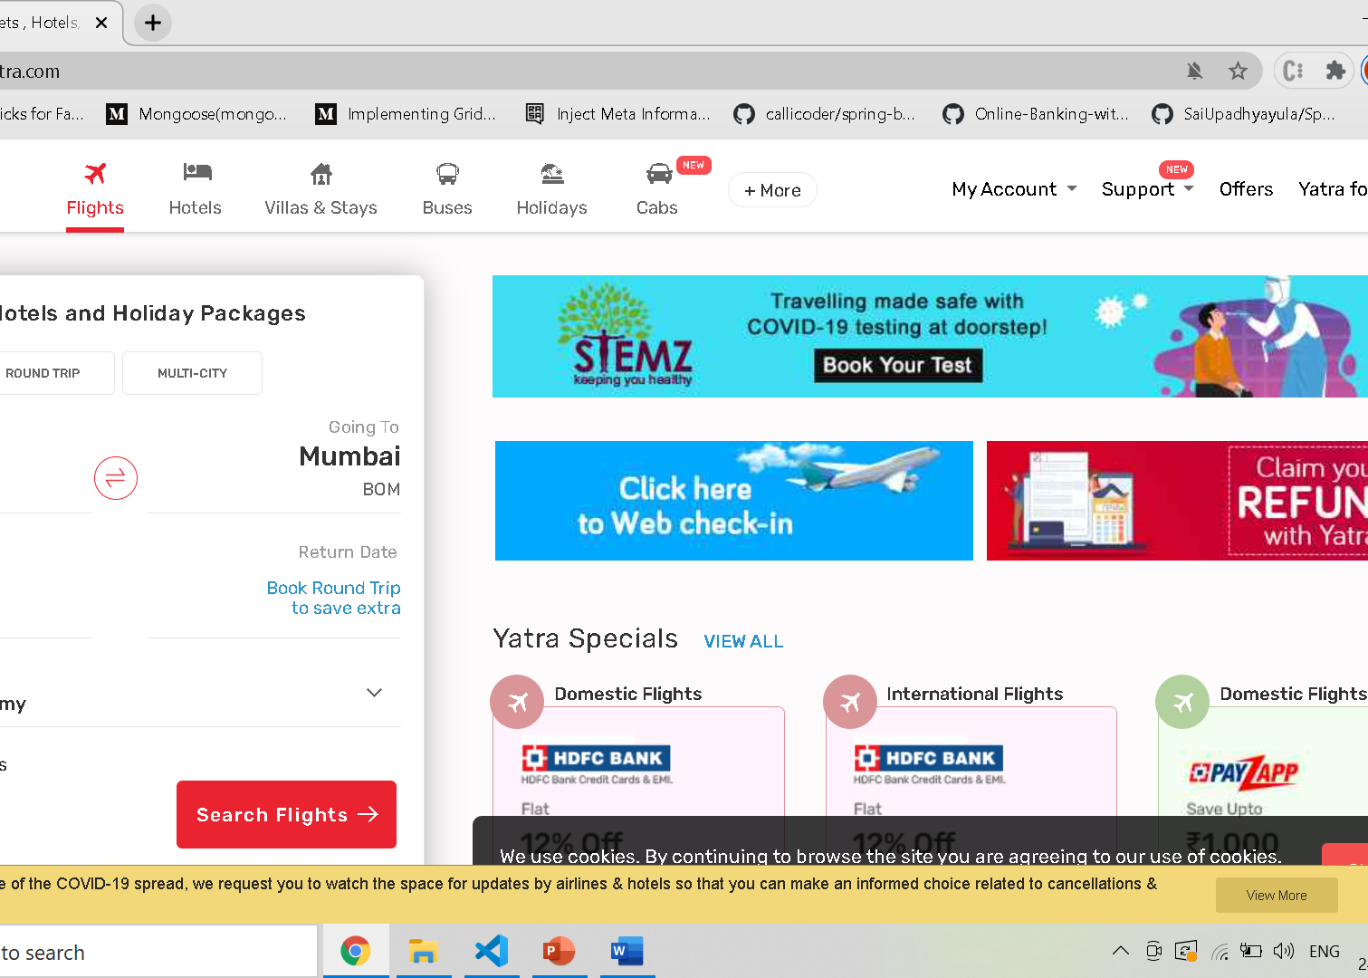
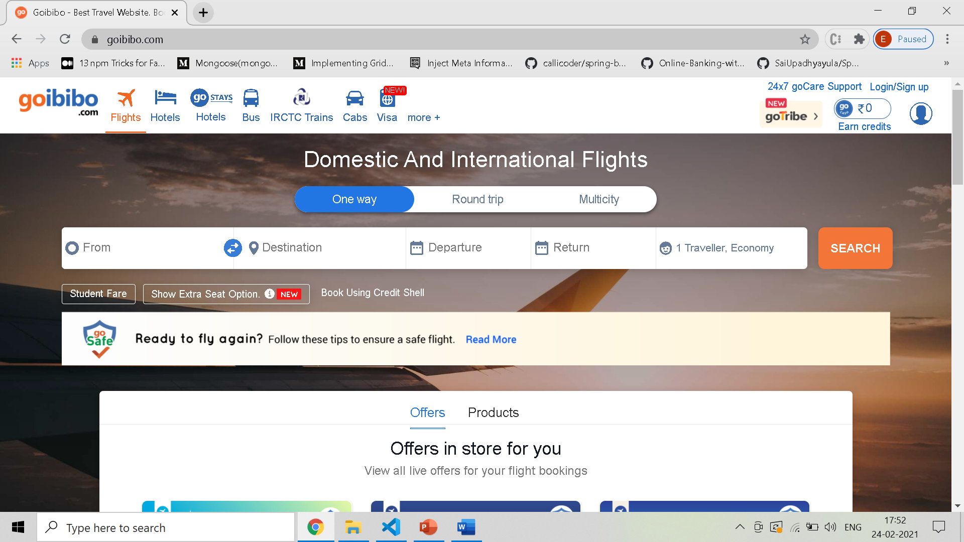
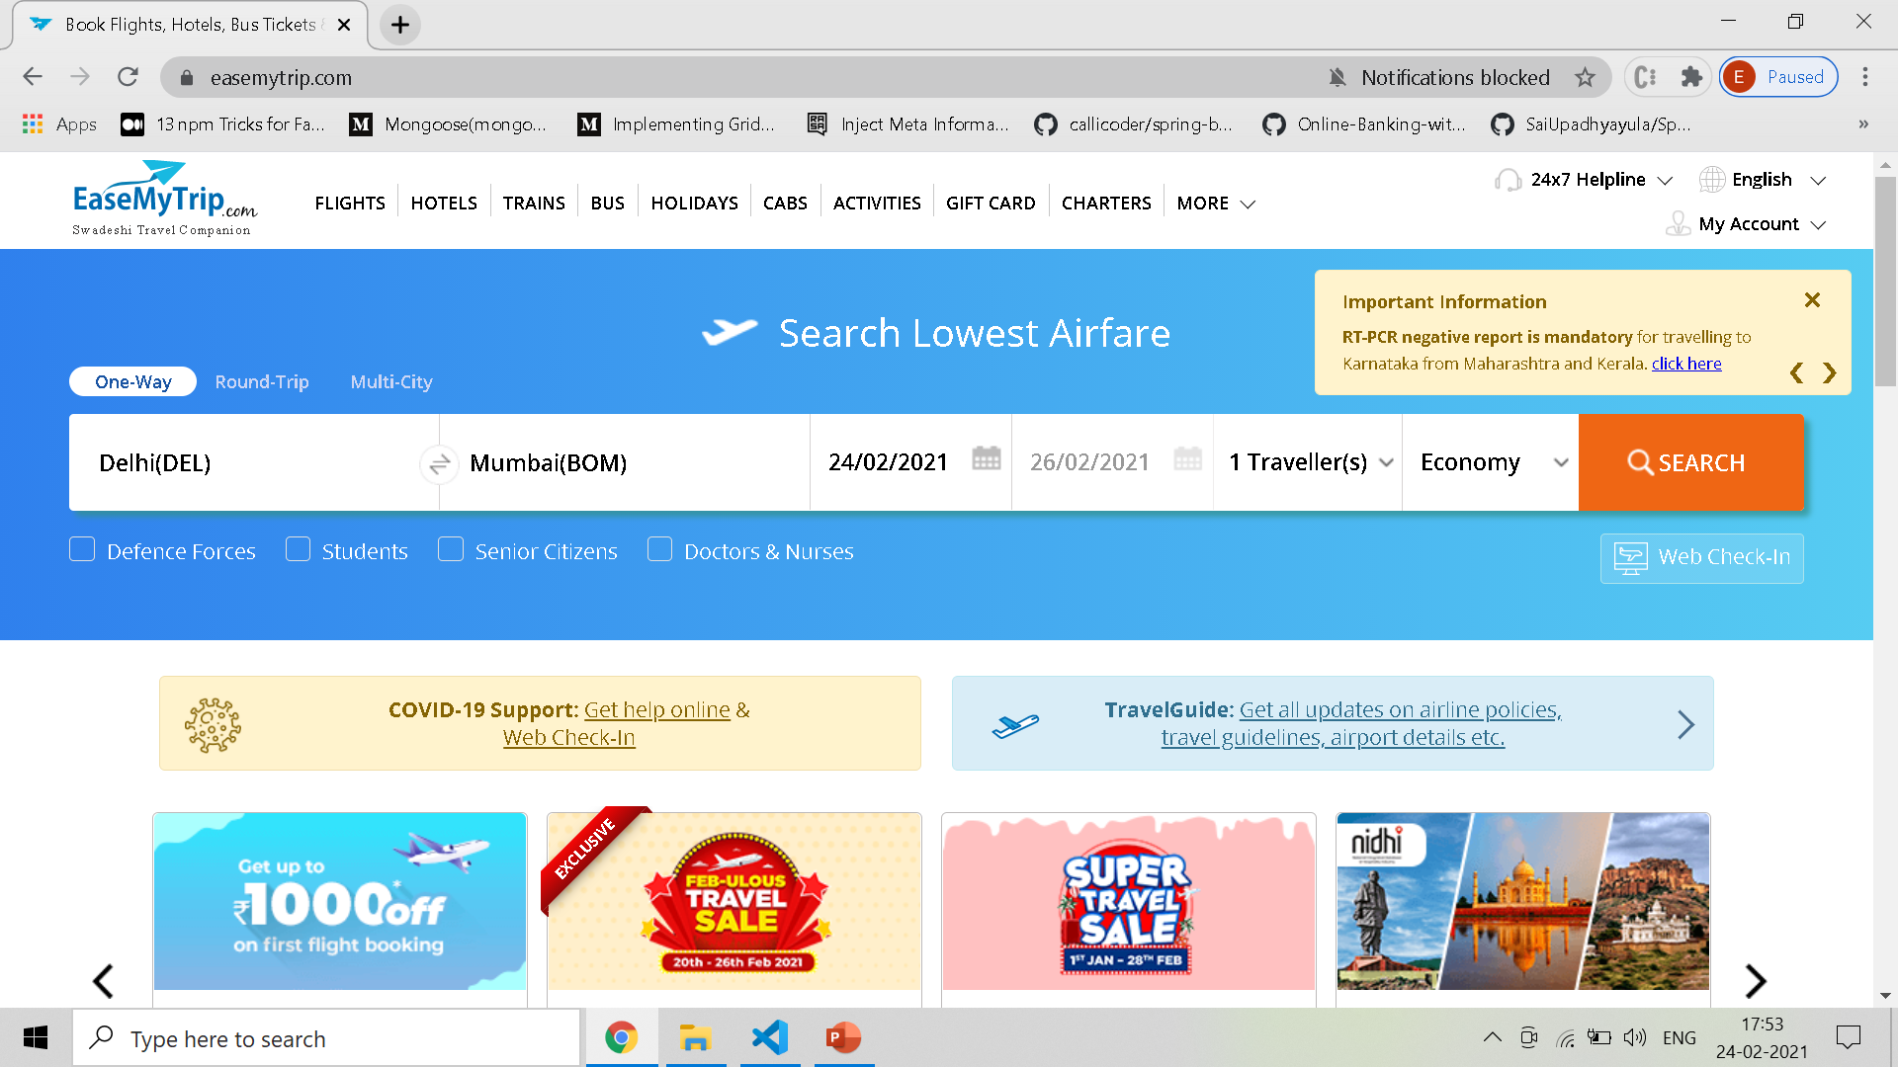

Slide 7
CONCLUSION
The design goals in creating user interface are fundamental to the implementation of all effective interfaces including GUI and Web ones. These principles are general characteristics of the interface and they apply to all aspects.

Slide 8
THANK YOU

