Slide 1
Icon Designing
Sherwyn D’souza (8334)

Slide 2
What is an Icon?
An icon is a small graphical representation of a program or file.
When you double-click an icon, the associated file or program will be opened. For example, if you were to double-click My Computer icon, it would open Windows Explorer.
Icons are a component of GUI operating systems, including Apple macOS X and Microsoft Windows.
Icons help users quickly identify the type of file represented by the icon.
The image is an example of "My Computer" icons in different versions of Microsoft Windows.

Slide 3
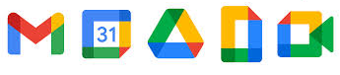
Some examples of Icons
Mail Calendar Drive Docs Meet

Slide 4
What is Icon Designing?

Slide 5
Icon design principles
Coherency: The style, the color schemes you chose to design icons should be consistent throughout the interface. It should resonate with the other elements of the interface. The consistency helps in better understandability of the interface, as the user can relate with the previous interactions, he had with the interface.
Clarity: Icons should be understandable to the user in a single glance. They should be designed & drawn clearly and relative to the context or object you are trying to represent. The clarity in icons enhances the memorability of the design as the user can recognize from the prior references. For example, the icon of an airplane for putting the phone to a flight mode is easily understandable by the user.
Color Schemes: Color schemes you chose for your icons are essential as well. The color palette you choose or the style guide you decide for your icons defines a lot about the brand and the visual appearance of the icons. Every color you choose should have a meaning attached to it. Correctly chosen colors can set the look and style aside and helps in delivering the correct message.

Slide 6
Steps for Icon Designing
Define purpose: To begin the design process, first define the icon’s purpose and use. Have the design team brainstorm about possible ideas, considering real-world metaphors.
Collect, evaluate, and sketch ideas: Start by designing on paper, not on the computer. Do not worry about too much detail; exact pixel requirements are not necessary at this time.
Draw in black and white: Many icons will be displayed in monochrome. Color is an enhancing property; consider it as such.
Test for expectation, recognition, and learning: Choosing the objects and actions, and the icons to represent them, is not a precise process, and will not be easy. So, as in any screen design activity, adequate testing and possible refinement of developed images must be built into the design process.
Test for legibility: Verify the legibility and clarity of the icons in general. Also, verify the legibility of the icons on the screen backgrounds chosen. White or gray backgrounds may create difficulties. An icon mapped in color, then displayed on a monochrome screen, may not present itself satisfactorily.
Register new icons in the system’s registry: Create and maintain a registry of all system icons. Provide a detailed and distinctive description of all new icons.

Slide 7
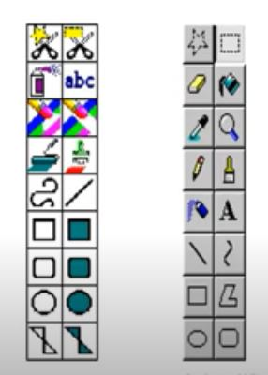
Good vs Bad Icon Designing
An early version of paintbrush displayed visually incoherent icons
Lower icons are simple and visually lightweight whereas upper icons are very heavy.
Redesigned icons on right are more balanced and consistent

Slide 8



Designed Icons for experiment
Chosen domain: Medicine & Healthcare Bot App
Icon 1
Icon 2
Icon 3

Slide 9

Performing User Test on Icon 1
1. Is the meaning of the icon clear?
Answer: Yes. The message and the medicine specify a medi-bot application.
2. Is colour used sensibly and consistently?
Answer: Yes. The colours chosen are vibrant and lively which is appealing to the user.
3. Will the icon’s meaning still be clear in black and white?
Answer. The icon’s meaning is not so clear in black and white.
4. Is the icon simple and familiar?
Answer: Yes. The icon is simple and familiar which can be easily understood by the user.
5. What is the overall effect of the icons when viewed together?
Answer: When overall viewed on the website, the icon looks clean, simple yet elegant. There is no excessive use of colour and or complex design in the icon. The purpose for which the icon was created is satisfied by it.
6. Is the icon Discriminable.
Answer: The icon is Discriminable
Similarly performing User test on Icon 2 & 3...

Slide 10
Final Chosen Icon
Choose final icon based on User tests.
Chosen Icon is Icon 3

Slide 11

Icon on Interface

Slide 12
Thank You

