Slide 1
Study of Serial Position Effect and Fitts Law
Aim: To study serial positioning effect and Fitts Law and relate its effect in designing interfaces

Slide 2
What is Serial Position Effect?

Slide 3
Serial Position Effect in Psychology
Experiments show that when participants are presented with a list of words, they tend to remember the first few and last few words and are more likely to forget those in the middle of the list.
This is known as the serial position effect.
The tendency to recall earlier words is called the primacy effect
While the tendency to recall the later words is called recency effect.

Slide 4
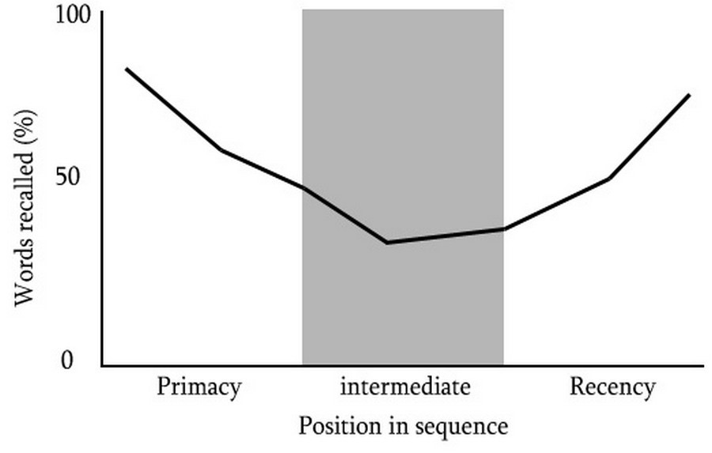
Position In Sequence

Slide 5
Examples and Output

Slide 6
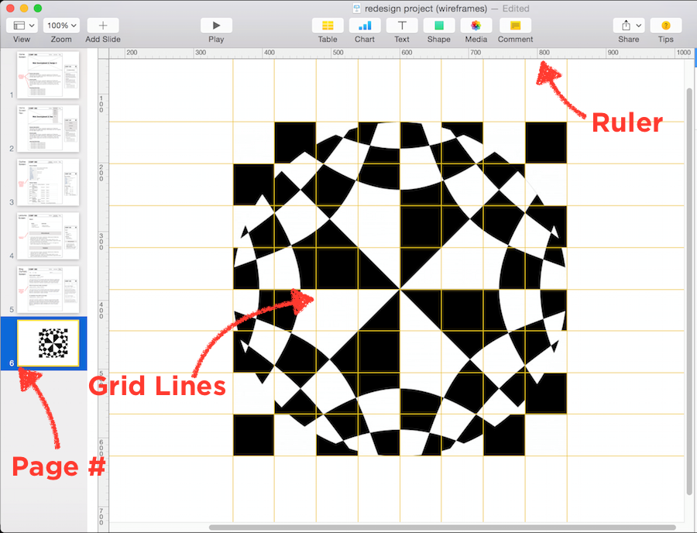
Maintain Task-relevant Information within the User Interface
Notes:
Keynote, a presentation software application developed by the multi-national technology company, Apple Inc., maintains task-relevant information for users so that they can more easily create presentation slides by providing things like page number and status, grid lines, and rulers.

Slide 7
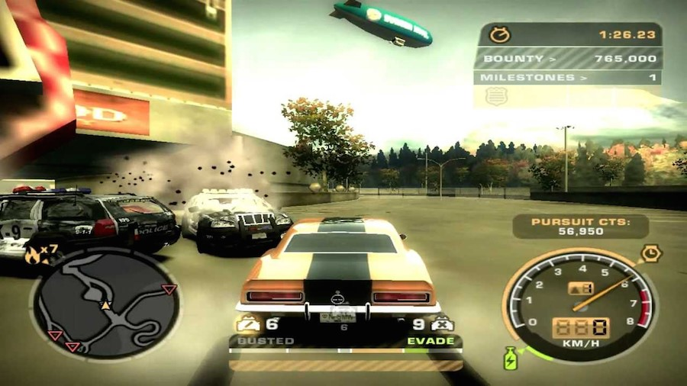
Include Cues in the User Interface
Notes:
Need for Speed, a racing video game developed by American gaming company, Electronic Arts, Inc., includes cues in the user interface to let the user know where they’re at at all times by providing a map on the bottom left and a speedometer on the bottom right.

Slide 8
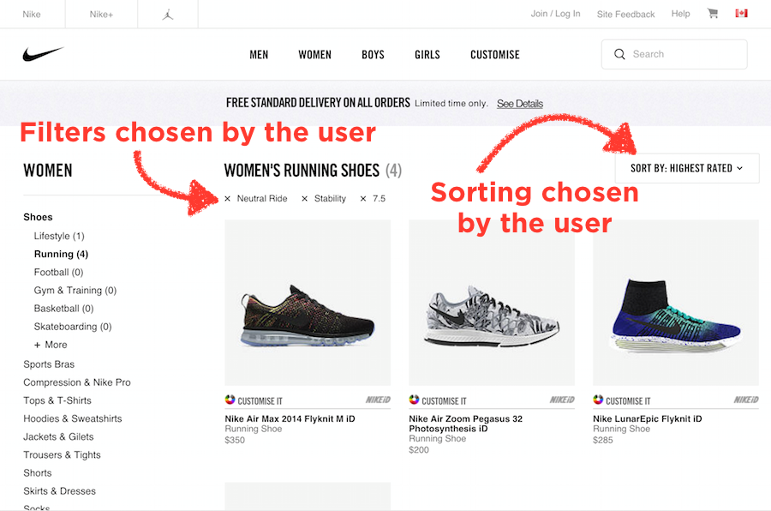
Limit the Amount of Recall Required
Notes:
The website by Nike Inc., the multinational corporation providing apparel and equipment, shows what filters the user has chosen at every step in their shopping experience, as well as what the products are sorted by.

Slide 9
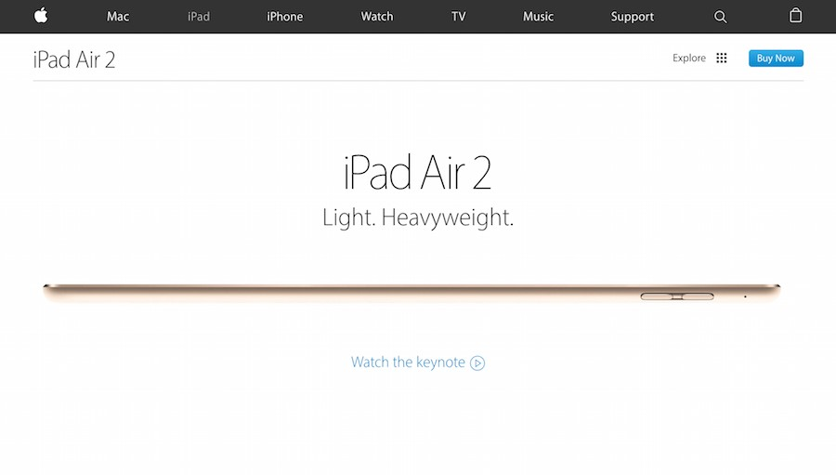
Emphasize Key Information in the Beginning and End
The first section of the landing page that sells the iPad Air 2, a product by Apple Inc., communicates the key reason why you should buy their product at the beginning of the page sequence.
Notes:
The website by Nike Inc., the multinational corporation providing apparel and equipment, shows what filters the user has chosen at every step in their shopping experience, as well as what the products are sorted by.

Slide 10

Contd.
In the middle of the landing page sequence of the iPad Air 2, there are chunks of relatively less important information compared to the beginning and the end of the page.
Notes:
The website by Nike Inc., the multinational corporation providing apparel and equipment, shows what filters the user has chosen at every step in their shopping experience, as well as what the products are sorted by.

Slide 11
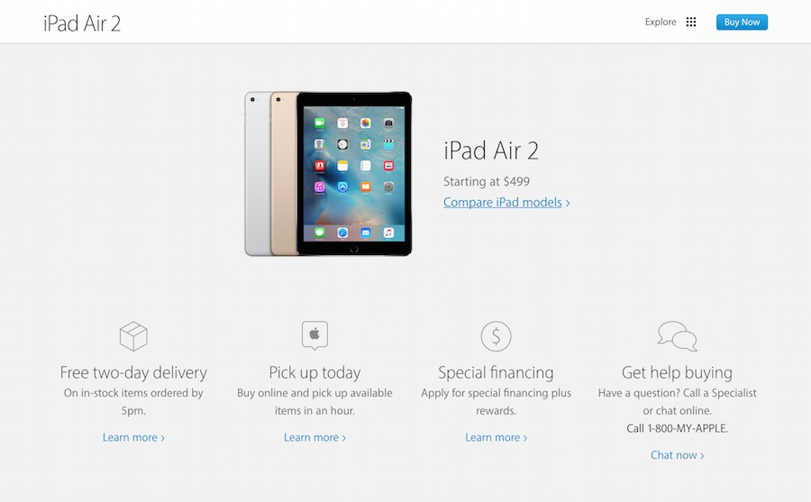
Contd.
The final section of iPad Air 2’s landing page, provides the call-to-action activities a user would expect to find at the end of any sales pitch. Need special financing? Need fast delivery? Get help buying and click to learn more.
Notes:
The website by Nike Inc., the multinational corporation providing apparel and equipment, shows what filters the user has chosen at every step in their shopping experience, as well as what the products are sorted by.

Slide 12
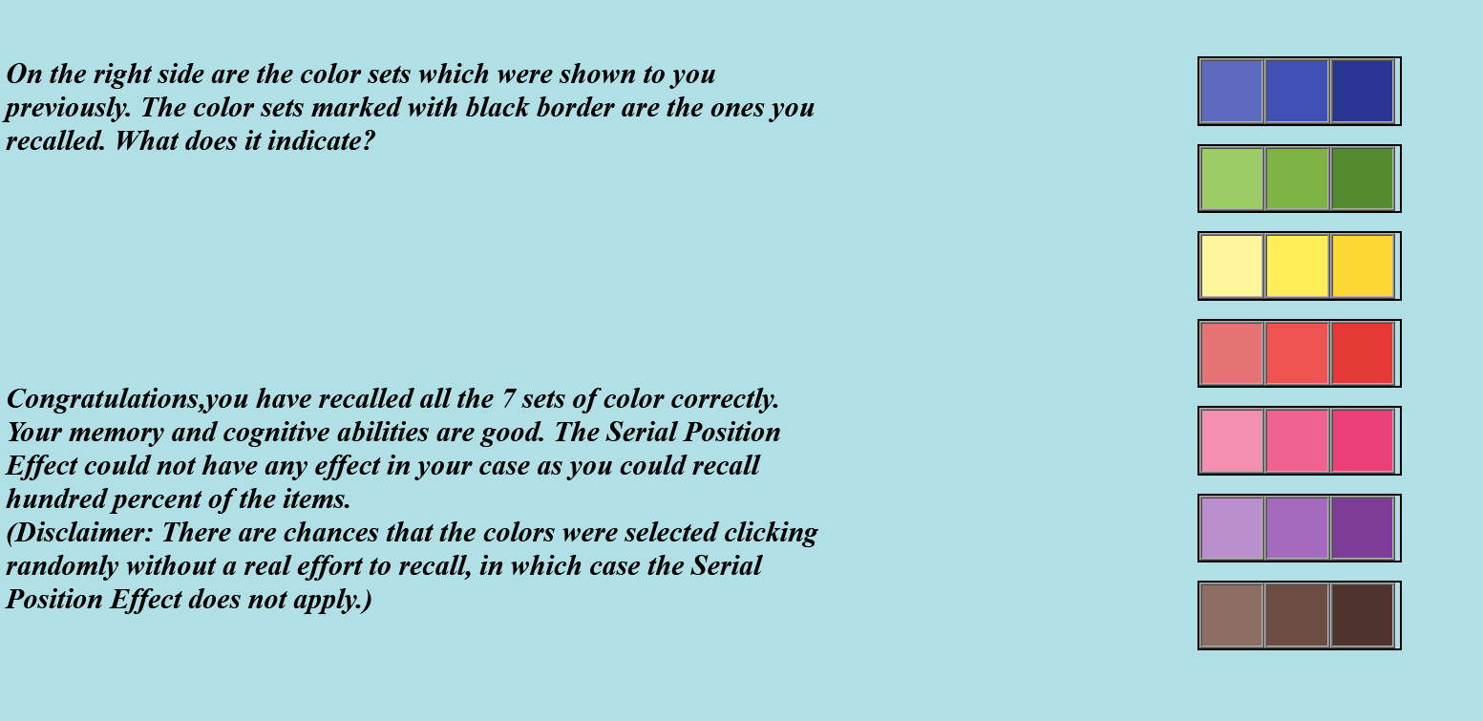
Example - 1.1
URL - https://www.iitg.ac.in/cseweb/vlab/creative-design-prototyping/Experiments/SERIAL%20POSITION%20EFFECT/color%20sequence%20instructions.html

Slide 13
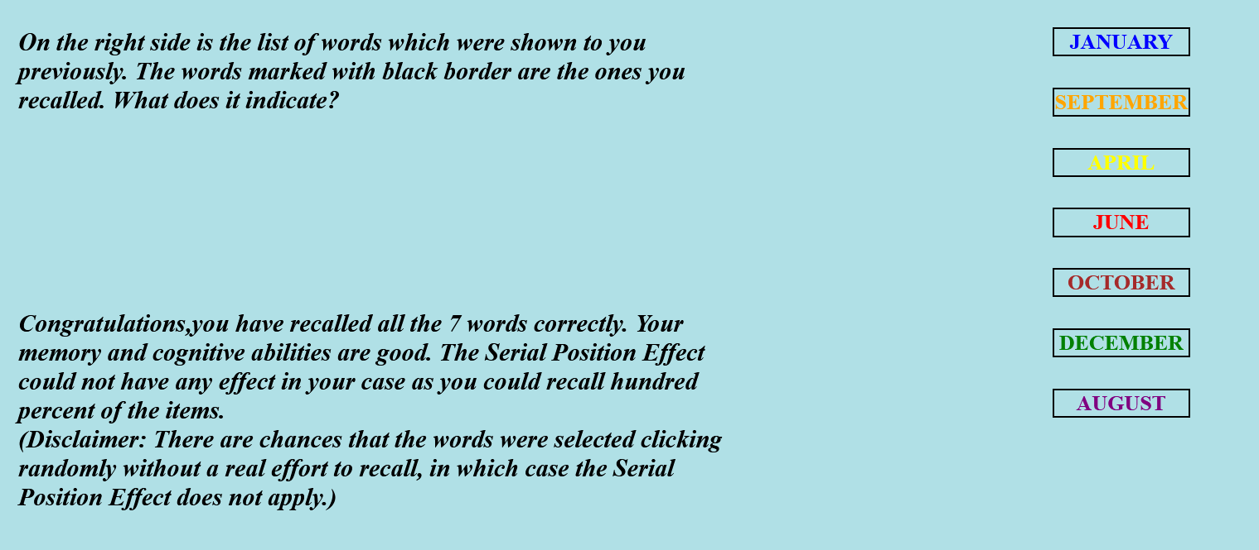
Example - 1.2
URL - https://www.iitg.ac.in/cseweb/vlab/creative-design-prototyping/Experiments/SERIAL%20POSITION%20EFFECT/word%20sequence%20instructions.html

Slide 14
What is Fitts Law?

Slide 15
Definition
Fitt’s law predicts that the time required to rapidly move to a target area is a function of the ratio between the distance to the target and the width of the target.
The Fitt’s law can be represented by the following equation.
MT = a + b * log₂(2A/W)
Here, MT represents the movement time to hit the target, a and b are empirically determined constants.
A represents the amplitude, which is the distance of the center of the target from the starting location
W is the target width

Slide 16
Examples and Output

Slide 17
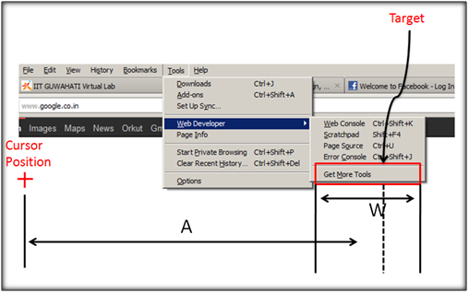
Main Menu

Slide 18
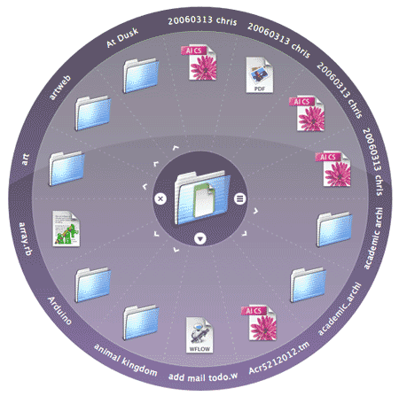
Radial Menu

Slide 19
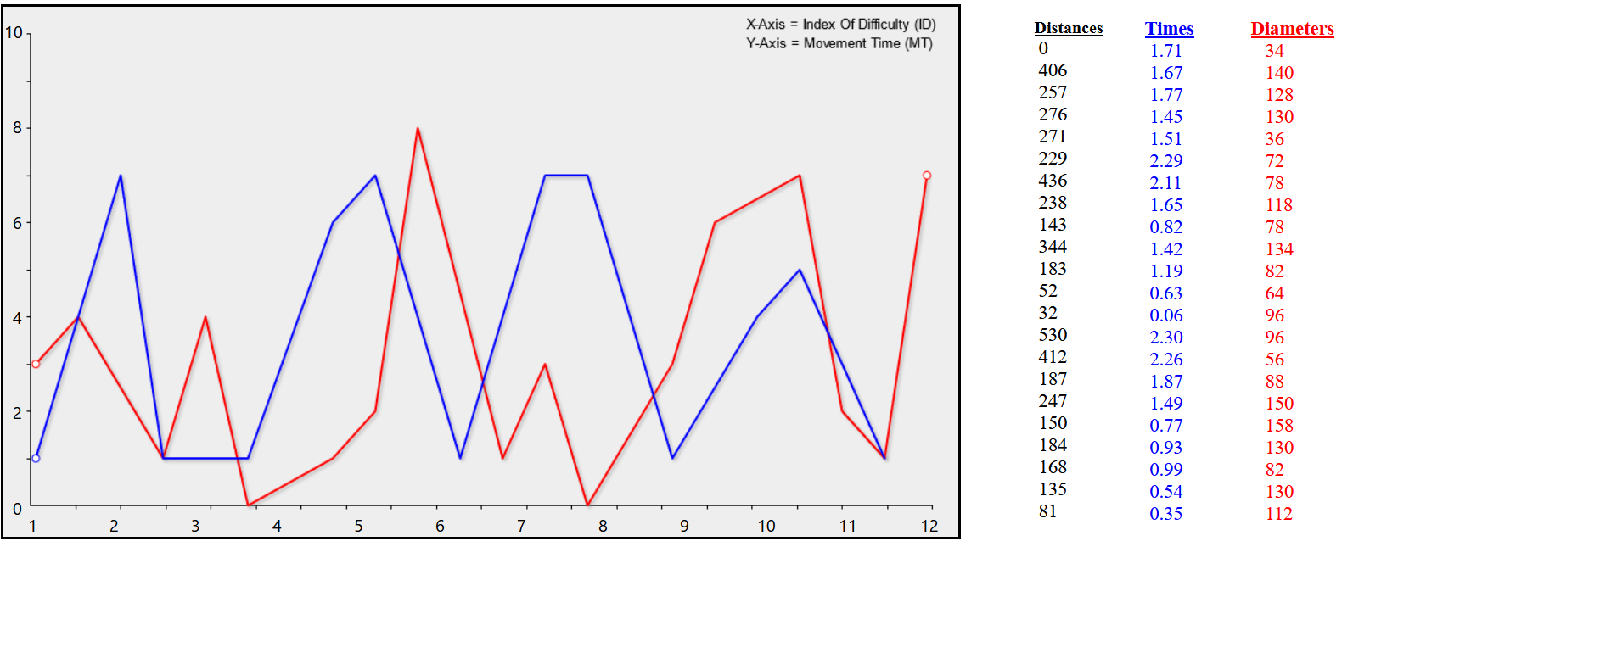
Example - 2
URL - https://www.iitg.ac.in/cseweb/vlab/creative-design-prototyping/Experiments/FITT'S%20LAW/test2.html

