Slide 1
Natural Language Processing
EXP 7 : CHUNKING
Prepared by:
Sherwyn D’souza (8334)
Darlene Nazareth (8353)
Cassia Vaz (8374)

Slide 2
Today’s Agenda
What is Chunking?
Why is it needed?
Regex Based Chunking
Representing Chunks: Tags vs Trees
Tagger Based Chunking
Classification Based Chunking
Over to the Code =>
Procedure
Regex
Types of Phrases

Slide 3
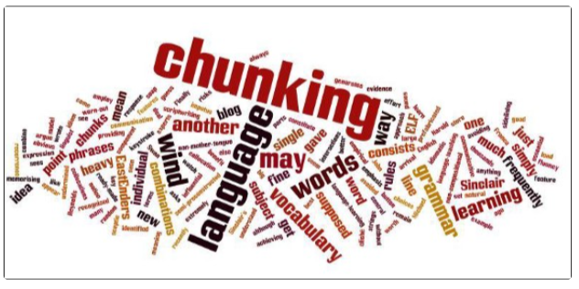
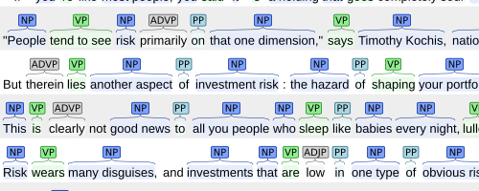
What is Chunking?
1
Chunking is a process of extracting phrases from unstructured text.
Rather than using single words for text processing, chunking focuses on extracting phrases from the text.
It is also known as Partial or Shallow Parsing.
Chunking works on top of POS (Part of Speech) Tagging.

Slide 4
Why is it needed?
Chunking breaks sentences into phrases which are more useful than individual words and yield meaningful results.
It is important when we wish to extract information from text such as locations, person’s name, etc.
Eg: Using the phrase “South Africa” as a single word instead of “South” and “Africa” as separate words.

Slide 5
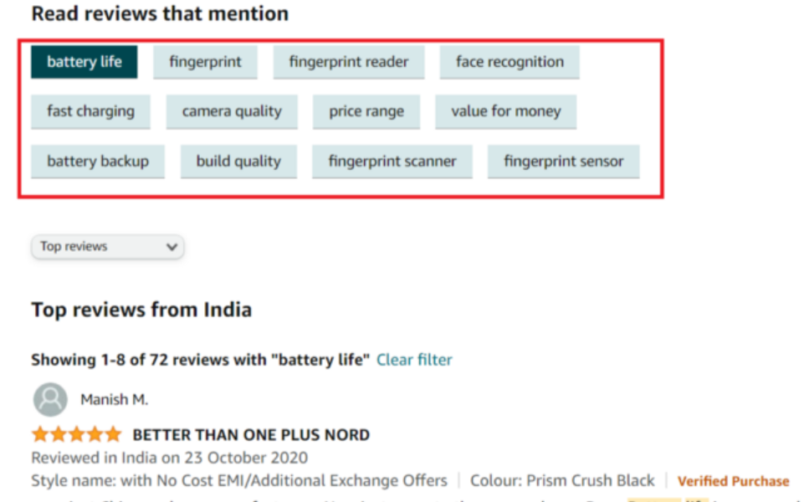
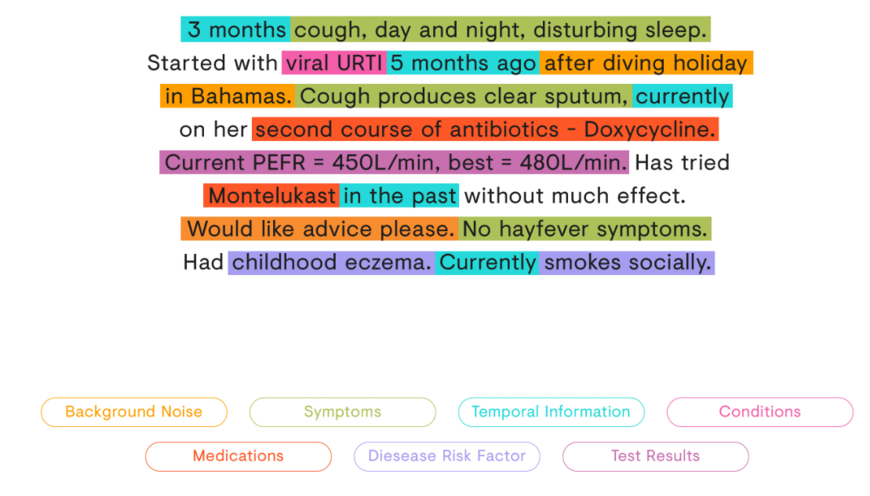
Use cases of Chunking
To automate extraction of key phrases from customer reviews
Extract Doctor’s Suggestions from Consultation notes

Slide 6
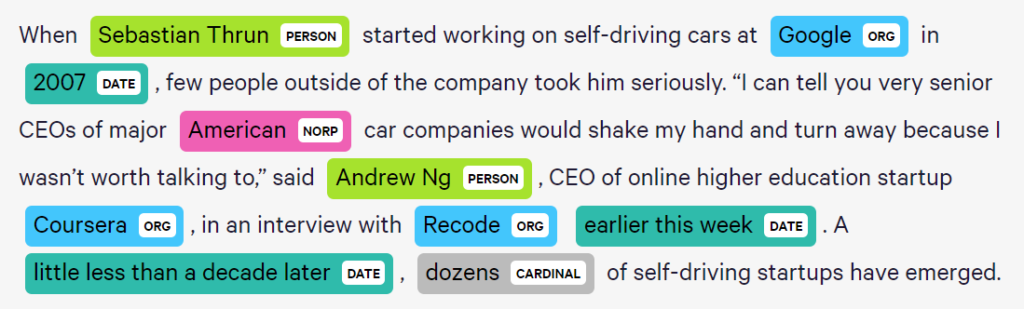
More use cases of Chunking...
Chunking is used for Named Entity Recognition. An entity is that part of the sentence by which machine gets the value for any intention.

Slide 7
Regex Based Chunking
Perform tokenization ie splitting the sentence into its corresponding words.
Apply POS Tagging (NN, JJ, VBD, etc)
The chunk to be extracted is defined using Regex along with POS_Tags.

Slide 8
Regex (Regular Expression)
? = 0 or 1 match of the preceding expression
* = 0 or more match of the preceding expression
+ = 1 or more match of the preceding expression
. specifies any single character except new line

Slide 9
Types of Phrases
Group of words make phrases. :
Noun Phrase (NP)
Verb Phrase (VP)
Adjective Phrase (ADJP)
Adverb Phrase (ADVP)
Prepositional Phrase (PP)
Eg: “Chunk: {<DT>✴<NNP>✴<NN>✴}” can be used for extracting the proper nouns from the sentence like The Manchester City football club

Slide 10
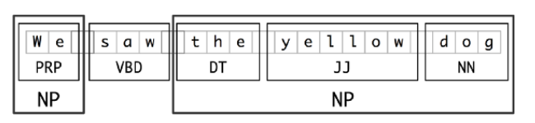
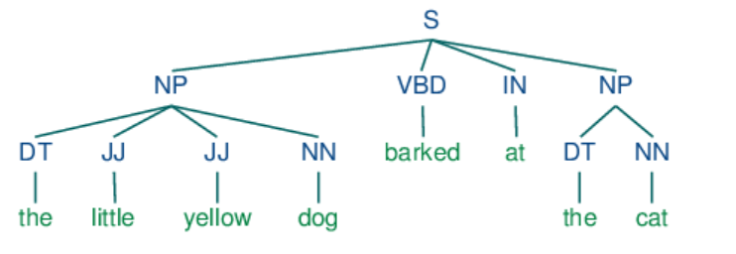
Eg: We saw the yellow dog
Segmentation and Labeling at both the Token and Chunk Levels
Eg: the little yellow dog barked at the cat
Example of a Simple Regular Expression Based NP Chunker.

Slide 11
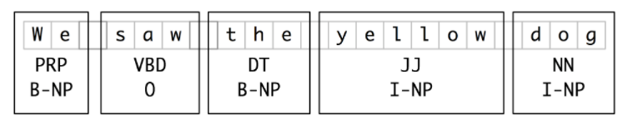
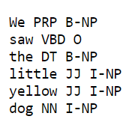
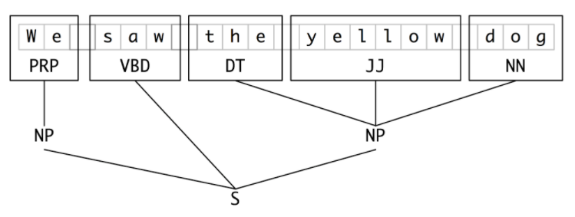
Representing Chunks: Tags vs Trees
The most widespread file representation uses IOB tags. In this scheme, each token is tagged with one of three special chunk tags, I (inside), O (outside), or B (begin). IOB tags have become the standard way to represent chunk structures in files.
Tag Representation of Chunk Structures
Tree representation of chunks have a benefit that each chunk is a constituent that can be manipulated directly.
NLTK uses trees for its internal representation of chunks, but provides methods for reading and writing such trees to the IOB format.
Tree Representation of Chunk Structures
Notes:
A token is tagged as B if it marks the beginning of a chunk. Subsequent tokens within the chunk are tagged I. All other tokens are tagged O. The B and I tags are suffixed with the chunk type, e.g. B-NP, I-NP. Of course, it is not necessary to specify a chunk type for tokens that appear outside a chunk, so these are just labeled O. An example of this scheme

Slide 12
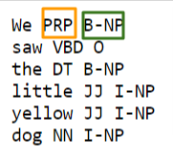
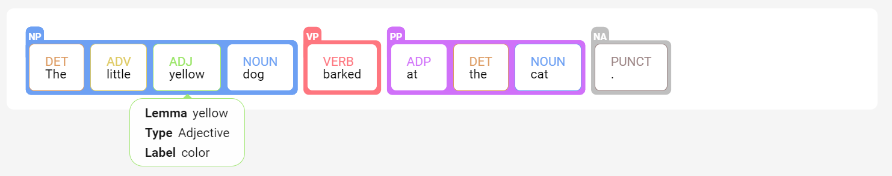
Tagger based Chunking
We can improve on Regex based Chunking, by adopting a more data-driven approach, where we use the training corpus to find the chunk tag (IOB) that is most likely for each part-of-speech tag.
We can build a chunker using a unigram or bigram tagger.
But rather than trying to determine the correct part-of-speech tag for each word, we are trying to determine the correct chunk tag, given each word's part-of-speech tag.

Slide 13
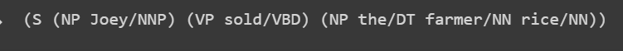
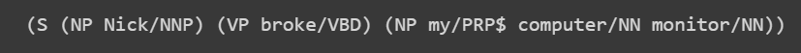
Classification based Chunking
Tagger based Chunking and Regex based Chunking give the same outputs for same tagged sentences.
We need to make use of information about the content of the words, in addition to just their part-of-speech tags.

Slide 14
Code Implementation
https://colab.research.google.com/drive/1ZZXdIj3cRjTiZ4VjlwJPaQXqg3HDueNv?usp=sharing

Slide 15
Thank You!

